Slide 1
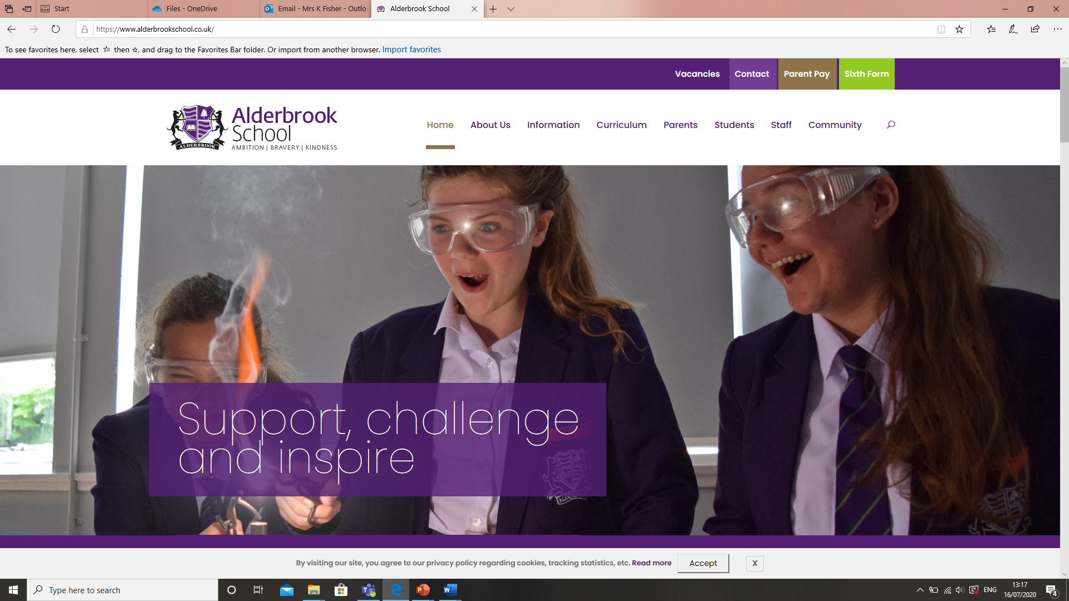
Step 1: Log onto the school website:
www.alderbrookschool.co.uk

Slide 2
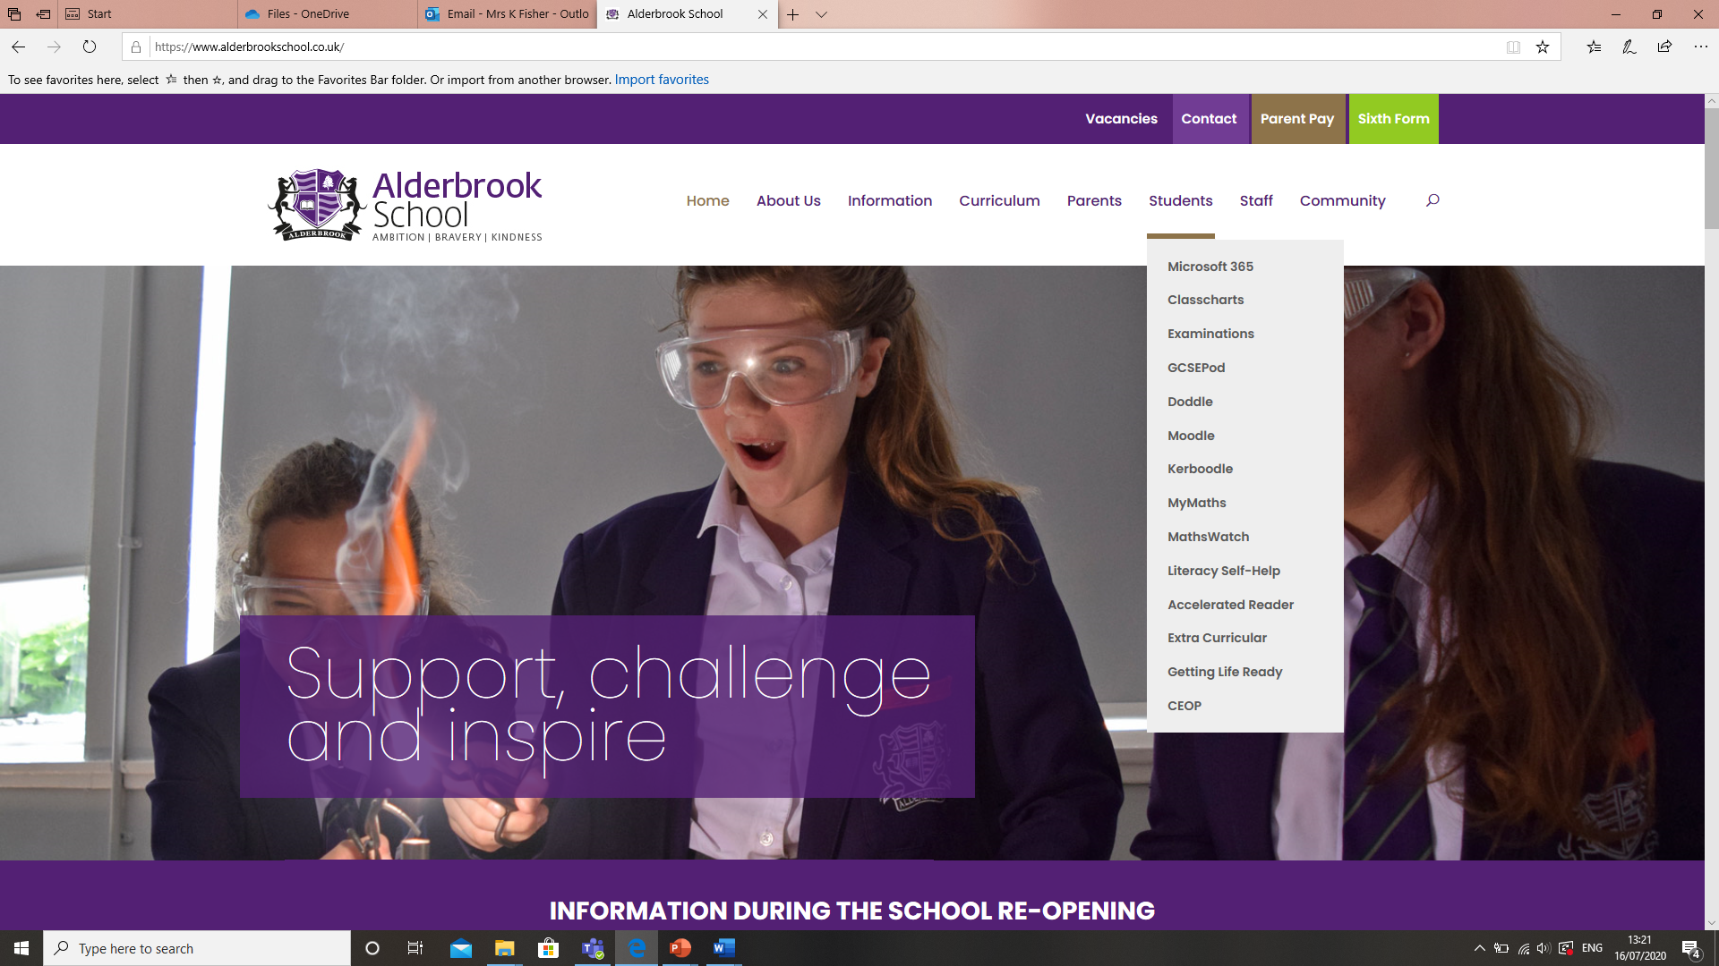
Step 2: On the menu hover over ‘Students’
Here you will find all the main tools you will be expected to use at home to support your learning.

Slide 3
Step 3: At the top of the ‘Students’ menu you will see Microsoft Office 365, click on this.
In the Office 365 login page enter your school provided email address and click ‘Next’, Enter your normal Network Password (the one you use to log in to a computer at Alderbrook) and click ‘Sign in’. If this is the first time you are accessing your Office 365 account you may be asked to select your Time zone – please ensure your select ‘(UTC +00:00) Dublin, Edinburgh, Lisbon, London’.
ALL users are entitled to install up to 5 instances of the complete Microsoft Office Suite on their personal devices at home (Windows PC, Laptop or Tablet or Apple Mac*) – This can be done by clicking on the ‘Install Office’ link.
It is recommended to use either Microsoft Edge or Google Chrome to access Office 365.

Slide 4
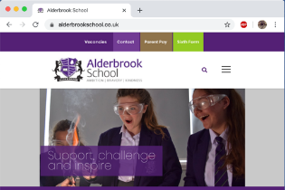
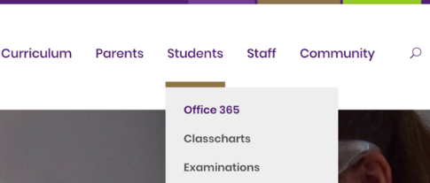
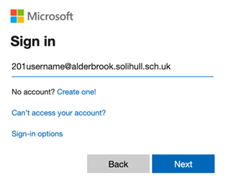
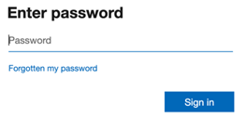
Accessing Microsoft
Load up the Alderbrook website by typing in: www.Alderbrook.co.uk
Hover your mouse over where it says “Students” then select “Office 365”
Then type in your email address using the format: 201username@alderbrook.solihull.sch.uk
You will then be asked to enter your password. This password is the same you use to log onto the school system.

Slide 5
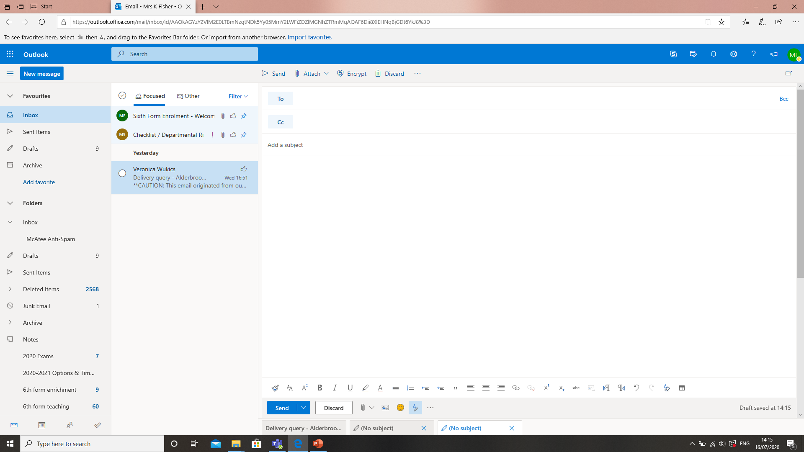
Microsoft Office 365: Outlook (sending an email)
You can send an email to ask teacher questions and attach work to send to your teachers
Step 1: Click on ‘New’
Step 2: Go to ‘To’ start to type on
the name of the person you
want to send the email and
their email address will appear.
Step 3: Give the email a title
Step 4: Type your message.

Slide 6
Microsoft Office 365: Outlook
Step 5: To attach your work. Click on ‘Attach’ with the paperclip next to it.
When you clicked on ‘Attach’ select the location you have saved your document.
When you click on your document, it will attach itself to your email.
Then click ‘Send’

Slide 7
Microsoft Office 365: OneDrive (where you can save your work)
This is a PERSONAL file storage area in Office 365. You can create Folders, upload documents and share these with a classmate or teacher for work purposes. This is monitored by our IT team.
Files can be uploaded in 2 ways:
Drag and drop files or folders into the area you want them
Click the ‘Upload’ button at the top of the Window and select the files or folders you want to upload
You can share a file or a folder with others (ALL files remain 100% private UNTIL you share them with someone else, like your teacher).
Select the item you want to share, click on ‘Share’ at the top of the Window, chose whether you want others to be able to Edit or just Read (untick ‘Allow editing’), select the person or people you want to share with then click ‘Send’ (Please note only valid Alderbrook emails can be used).
Note: If you share a file, then all you are giving access to is that individual file; if you share a folder you are giving access to everything within that folder – this includes anything you add to the folder in future.

Slide 8
Microsoft Office 365: SharePoint
Some departments already have SharePoint Sites set up (PE, D & T, EPQ and Health & Social Care).
These can be used for uploading tasks and assignments and staying in communication with your teachers.
Please make sure with your teacher if they are already using SharePoint, that you fully understand how and what your teacher will want you to be doing.

Slide 9
Microsoft Office 365: Teams
Once you click on Teams you will see all the teams you are a part of.
Click on a team.
If there are any live lessons you will need to join them if you can. When a live lesson is being conducted by your teacher, there will be a notification in the top right of your screen. This notification will inform you of which teacher & class is being streamed live and will ask you to click ‘join’. Once you click join, make sure your camera and microphone are disabled and you may enter your live lesson by clicking join for a second time. Your live lessons will take at the scheduled usual lesson time.

Slide 10
Microsoft Office 365: Teams
When in your team you will see a list of different channels where your teachers may have identified different units or topics you will cover.

Slide 11
Microsoft Office 365: Teams
If you click on ‘Files’ you will see any resources or documents your teacher has left, you to use.

Slide 12
Assignments
On the left hand row you have got a tab called “Assignments”
This is where you can access work set by members of staff and access the recommended resources.
It also allows you to upload your work for feedback.

Slide 13
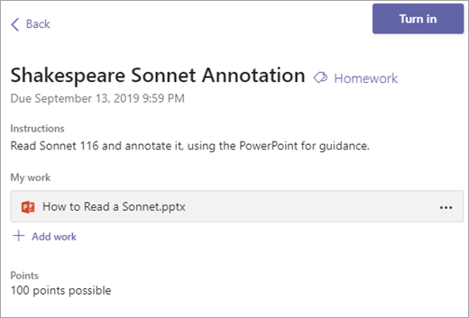
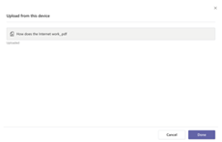
Uploading Assignments
To upload an assignment. Click on “add work”. This will then allow you to upload from different locations.
You should select upload from this device.
Once you have found the file you wish to upload, double click on it. Wait for the file to upload then press done.
Then select “Turn In” this will mean you have submitted your work meaning the teacher can provide feedback.

Slide 14
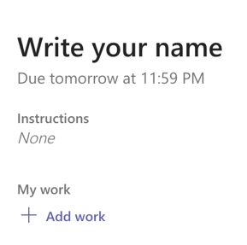
Microsoft Office 365: Teams - Assignments
Microsoft Office 365: Teams
When an assignment has been set. You can find it by clicking on the option “assignment”. Then clicking on the relevant class. The assignment will also be shown in the team page also.
Save the document (either to your device or one drive). Click “add work” on the assignment due.
If it’s saved to one drive, click one drive and click the document you want to upload. If it’s saved to your device, click “upload from this device” then click on the document you want to upload. Then click attach.
It will then upload. You then need to select ‘Done’. Once the file has been uploaded.
Then select ‘Turn it in’. This will allow the teacher to provide feedback on your work.

Slide 15
Important notes
When working on Microsoft Office documents in Office 365 you will get a much more enhanced experience by opening the document in the locally installed application: Right click the file > Click ‘Open’ > Click ‘Open in app’
The first time you do this on any device it will ask you to verify your login details (email and password).
When working on an Office document in the browser it will save automatically, but to ensure a final save and close the document just click on your name.
*You cannot install Microsoft Office suite onto an Android or Apple Smart phone or tablet. The individual apps (Word, Excel, OneDrive etc.) are available from the appropriate App Store free of charge.

Slide 16
How to use and access Classcharts
On the menu hover over ‘Students’
Then click on ‘classcharts’
This is where any work is set by your teachers.
To log into Classcharts you need to type in your code if logging in for the first time

Slide 17
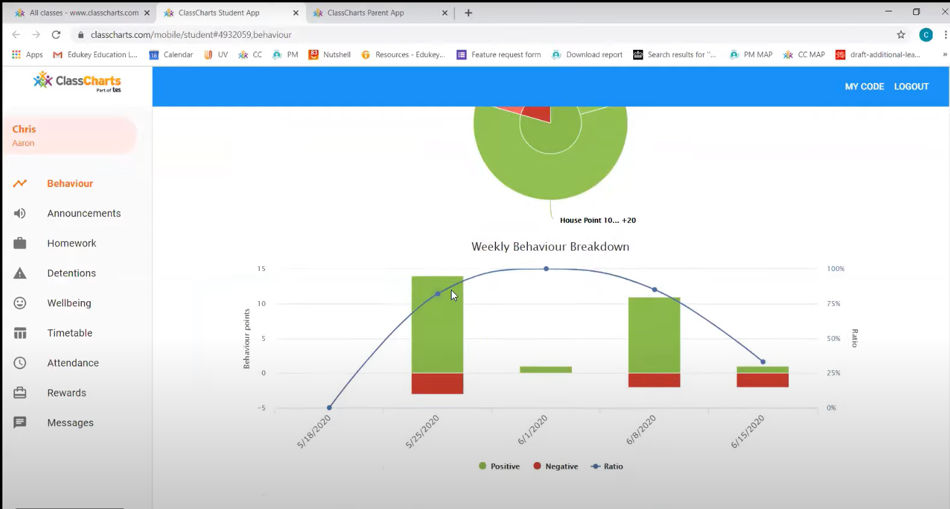
When you open up Classcharts this show all the different sections.

Slide 18
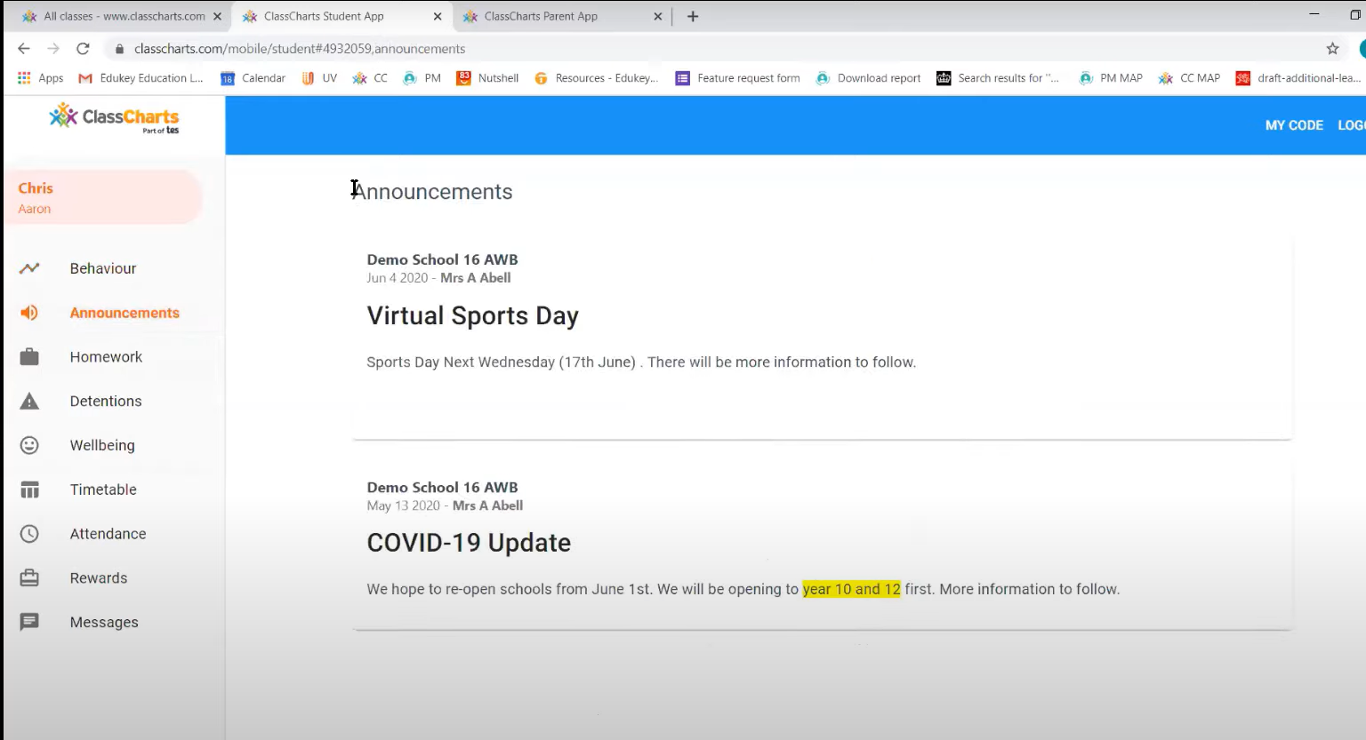
When you click on ‘Announcements’ this will show you any messages or reminders you need to know about.

Slide 19
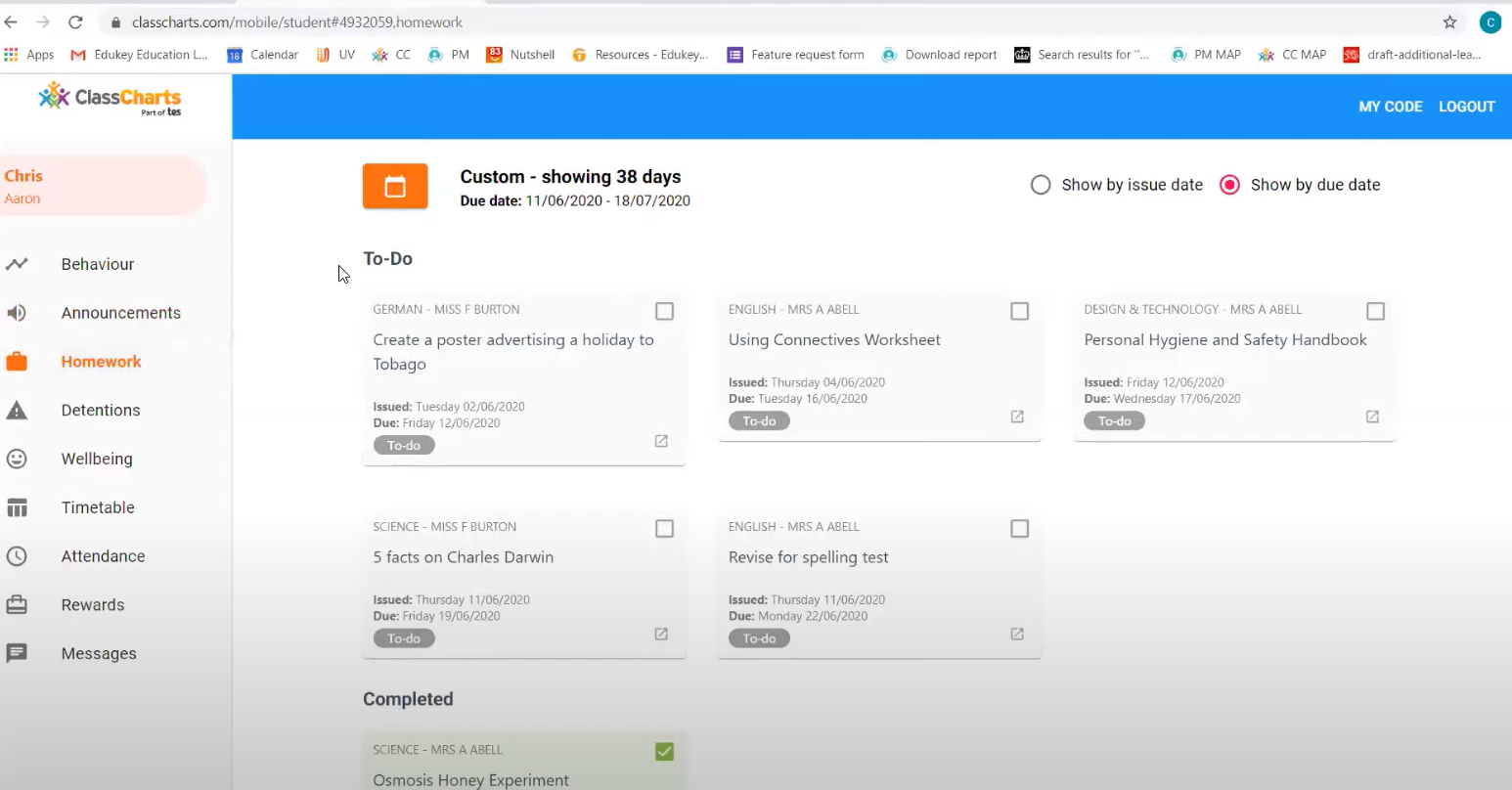
When you click on ‘Homework’ this will show you any what homework you have been set.
Click on the grey box and then you will see the homework details for that subject.

Slide 20
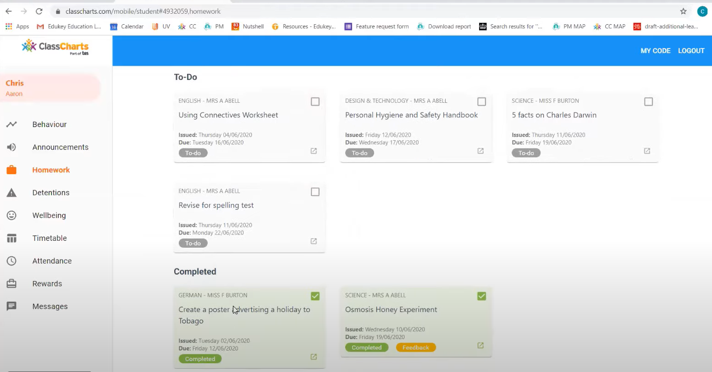
When you have completed your homework and want to see the feedback from you teacher you click on ‘Feedback’
Then you can see your teacher feedback.

Slide 21
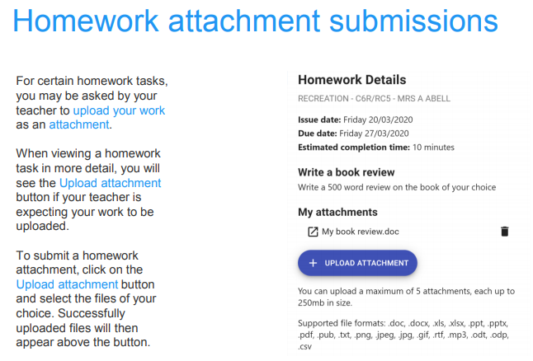
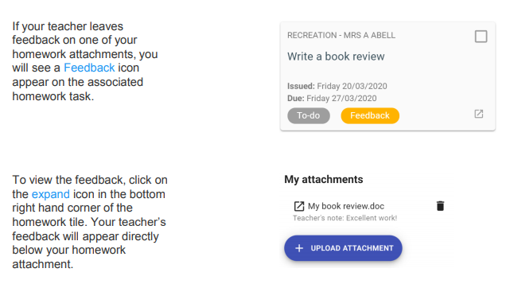

Slide 22
If you are unable to access any of the tools needed to complete your work or you need to reset your password use this email address:
itsupport@alderbrook.solihull.sch.uk

