Slide 2
What we provide to students
Unifrog is the one-stop-shop for destinations, allowing your children to explore every university course, apprenticeship and college course in the UK, plus other around the world opportunities such as European and US undergraduate courses.
Students finalise applications using Unifrog and receive feedback from teachers along the way. This includes creating their personal statement and CV, plus lots more!

Slide 3
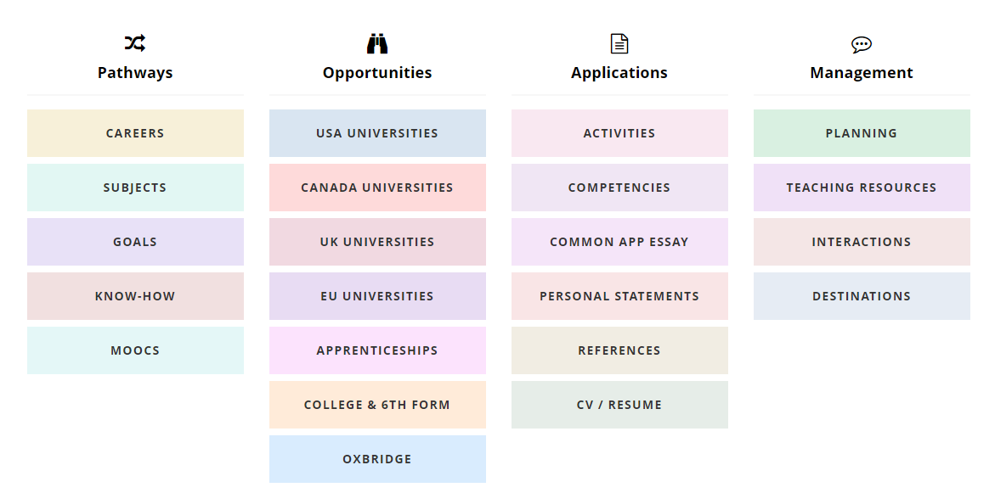
Unifrog is the one-stop-shop for destinations

Slide 4
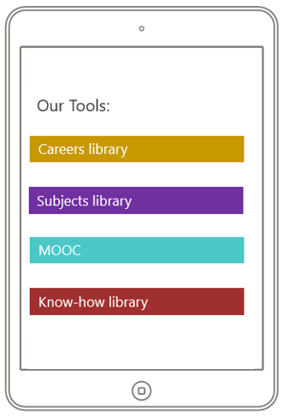
Students exploring pathways
Research future careers
Explore subject profiles
Make considered choices
De-mystify applications

Slide 5
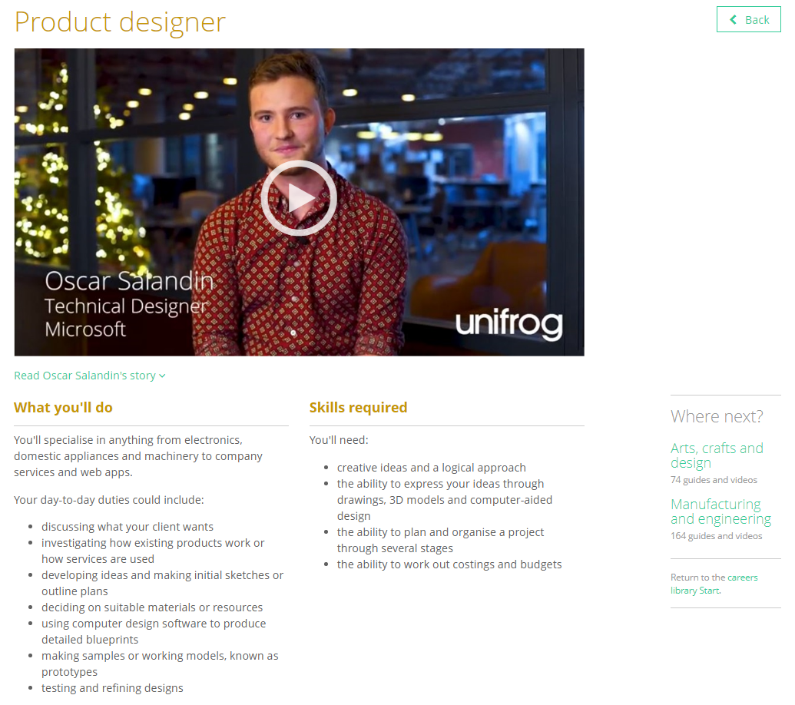
Read profiles on 900 different careers and learn how to get there

Slide 6
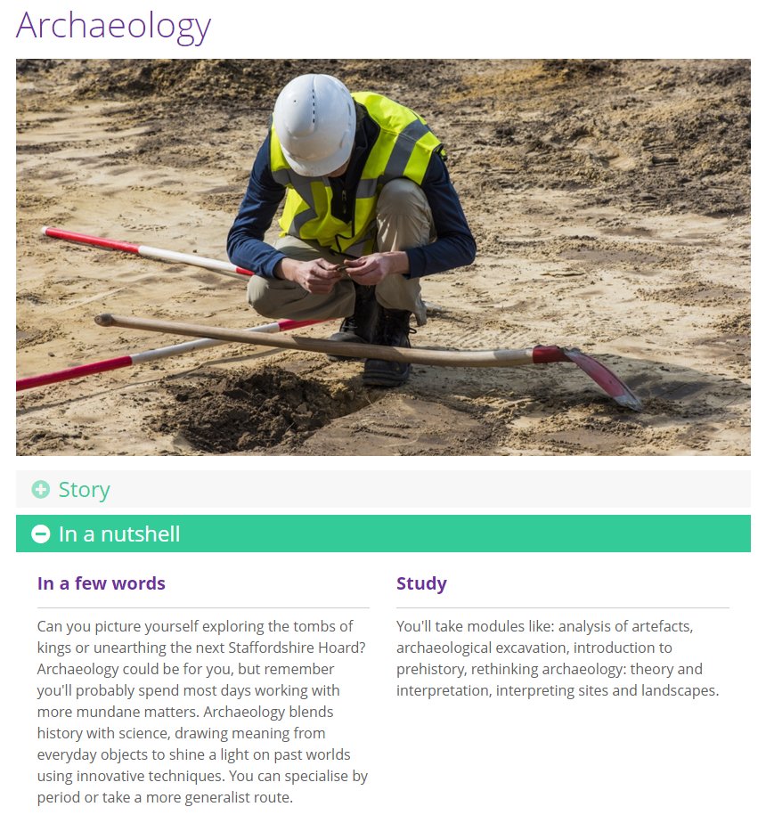
Explore potential university subjects suited to students’ interests and skills

Slide 7
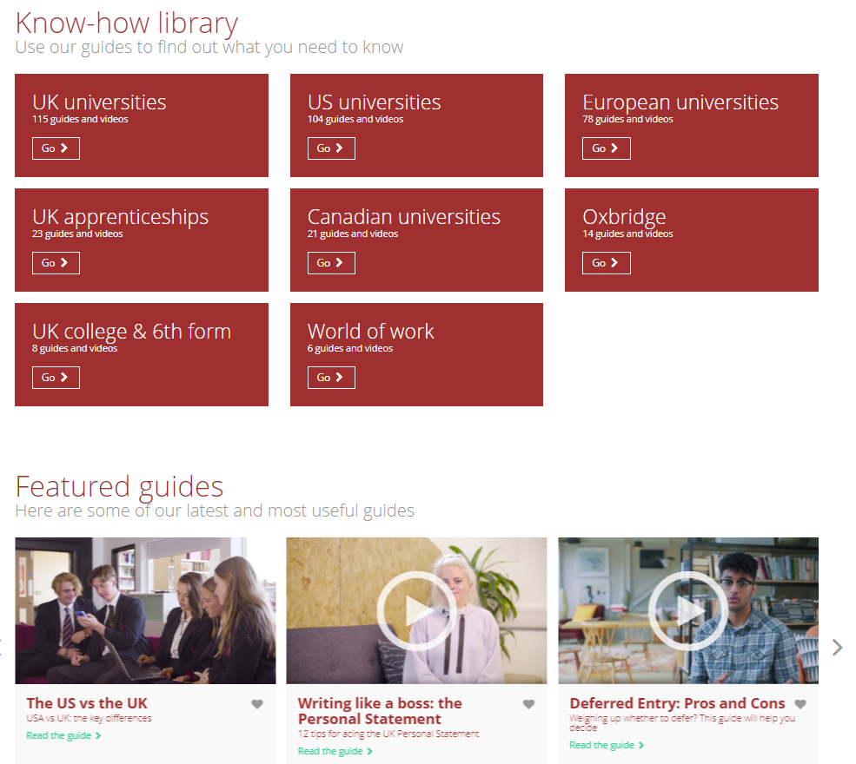
Search our database of guides to help students across multiple applications

Slide 8
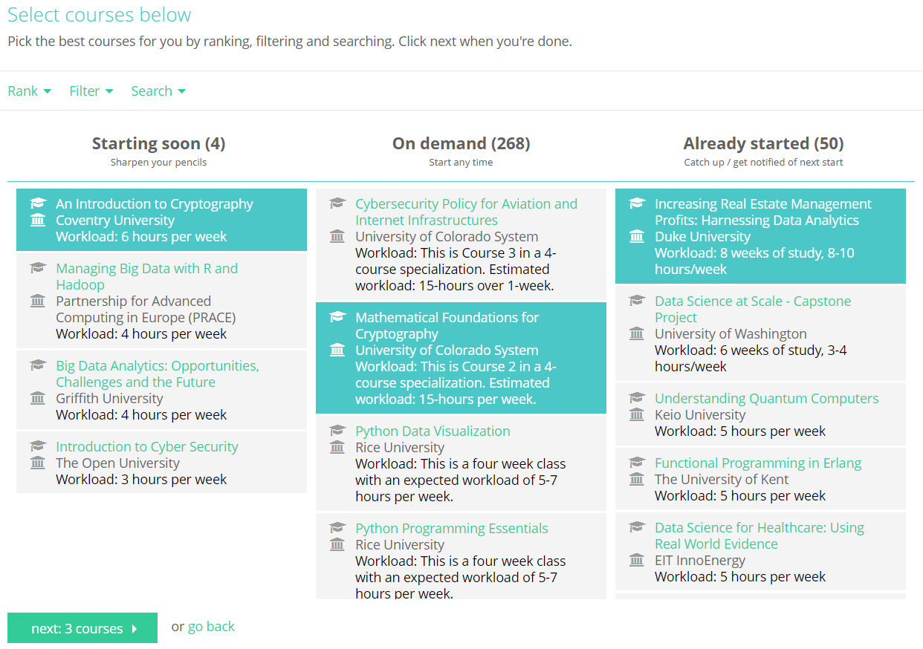
Students can complete a MOOC to develop interests and explore subjects in depth

Slide 9
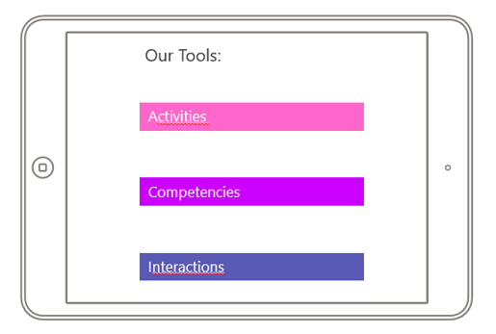
Recording what students have done
Add key activities
Add competencies
Input important interactions

Slide 10
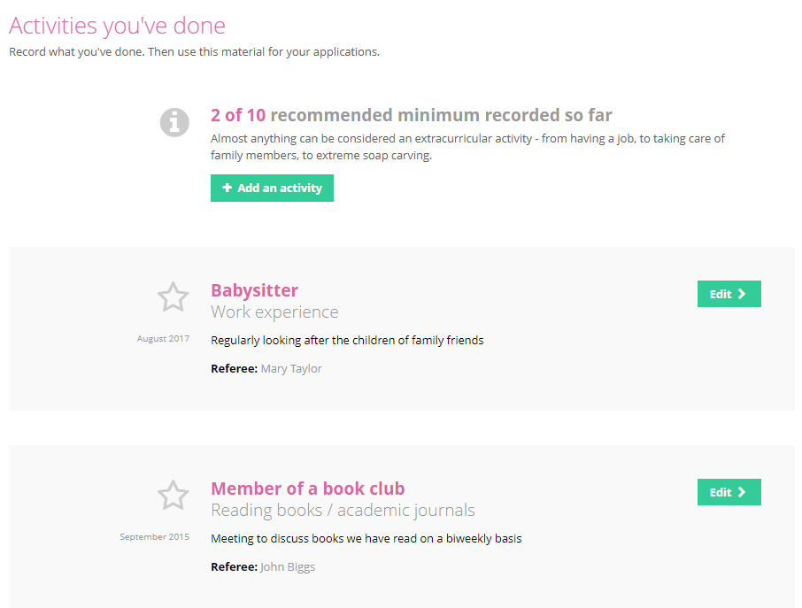
Students record extracurricular activities and experiences

Slide 11
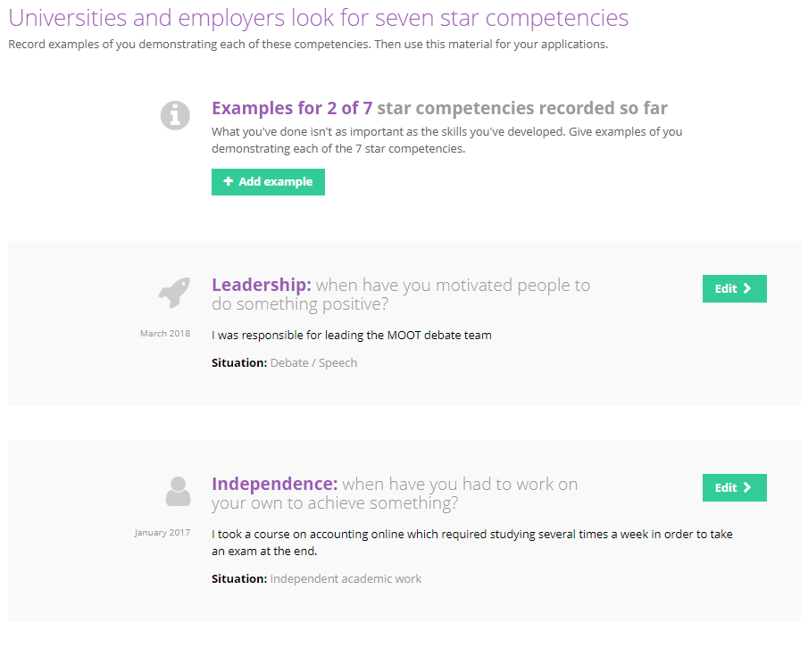
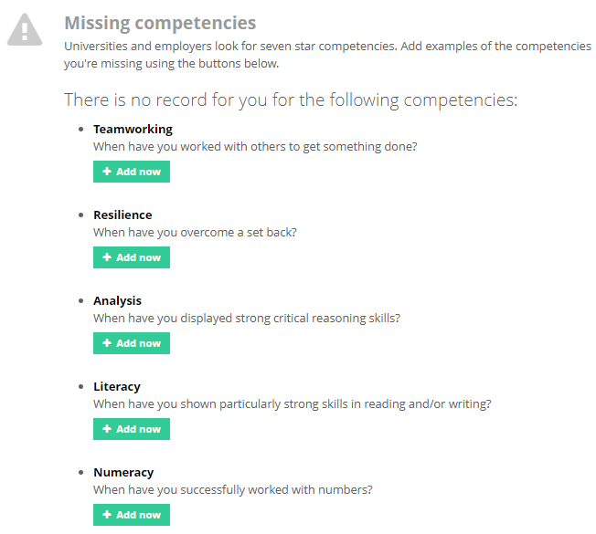
Students record competencies and skills they’ve developed

Slide 12
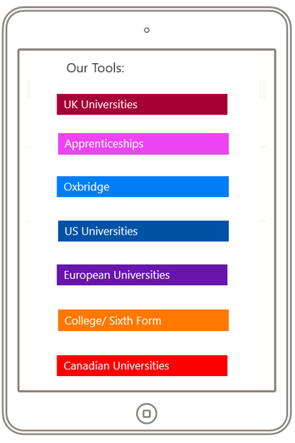
Opportunities to search for
Everything in one place
Intuitive process
Compare side by side
Make considered choices
Tailored to individual students

Slide 13
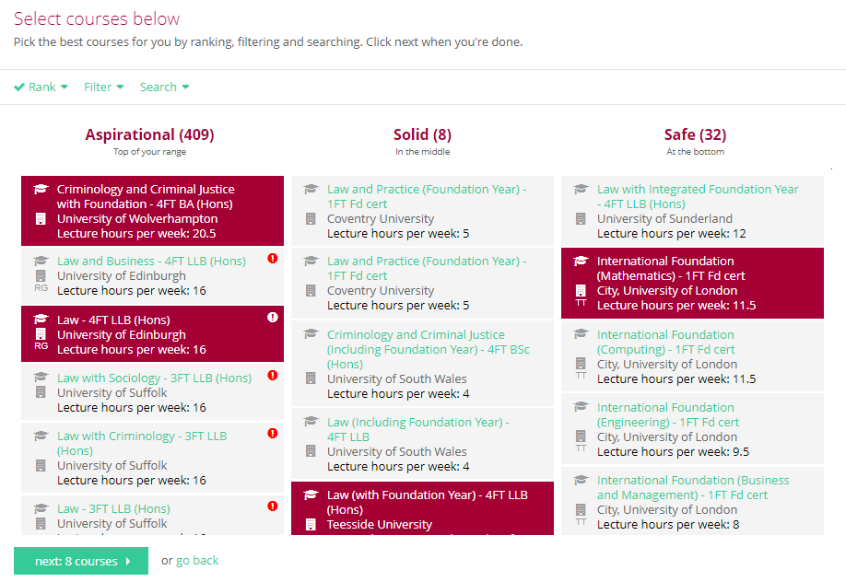
Search Unifrog to find best suited university courses

Slide 14
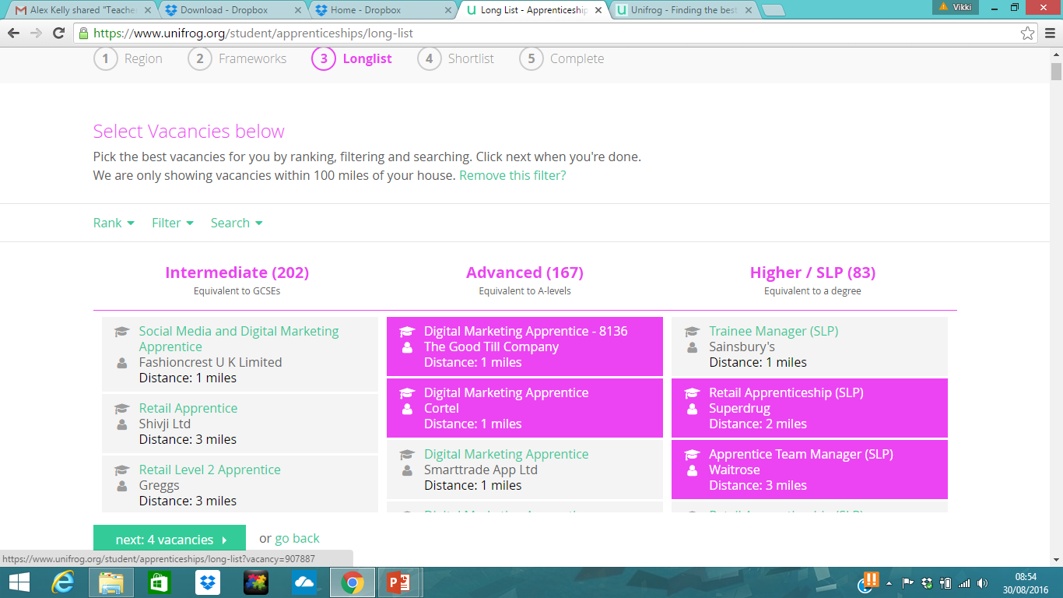
With new apprenticeship vacancies updated every 24hrs, students can find the best apprenticeships and school leaver programmes

Slide 15
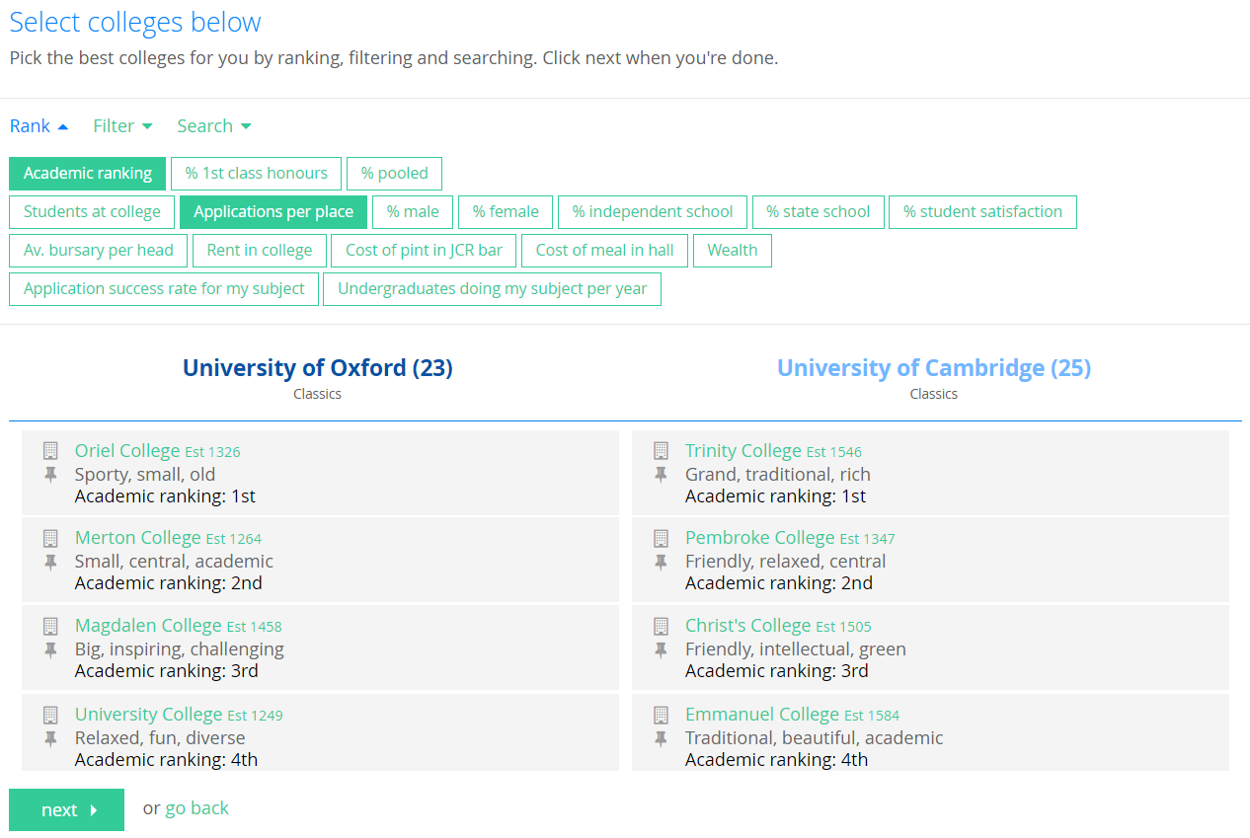
Unifrog’s Oxbridge tool de-mystifies the Oxbridge college application process

Slide 16
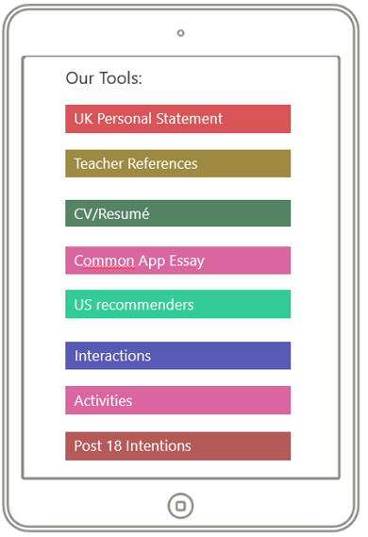
Creating applications
Manage everything from one dashboard
Guidance and examples
Nothing gets lost
Easy feedback on personal statements and references

Slide 17
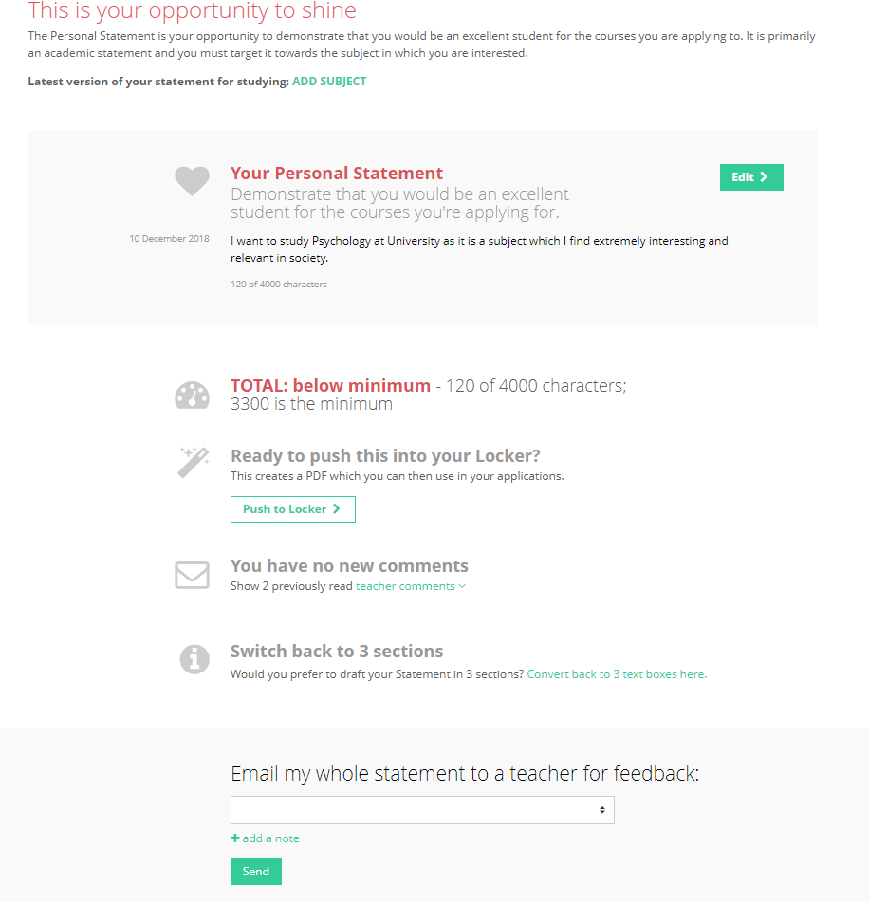
Students get in-depth support on their personal statements

Slide 18
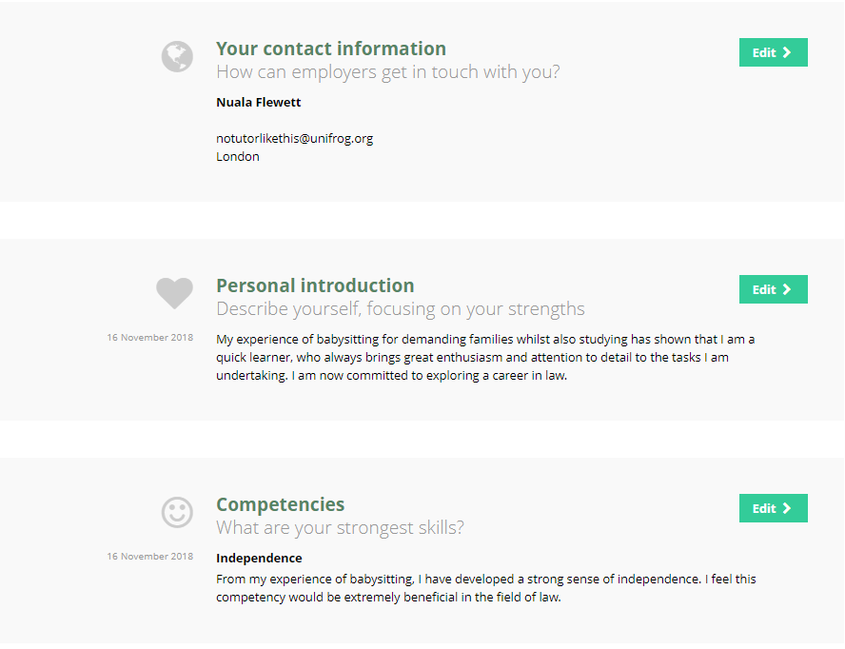
Students build effective applications with personal career goals and start to create their CV

Slide 19
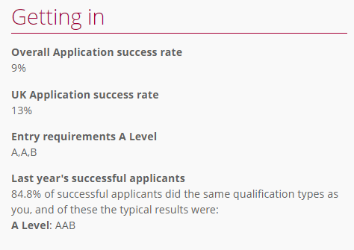
How Unifrog improves attainment
Students clearly see what grades they need to achieve at GCSE and A-level for certain courses. GCSEs are increasingly important with the new linear A-levels and no AS results.
It also helps ensure that students don’t restrict themselves early because they are aware of subject and grade requirements.

Slide 20
How Unifrog improves aspirations
Unifrog gets students thinking about universities, apprenticeships, degree apprenticeships and career paths early. It allows them to explore courses that they may never have heard of before in a way that is relevant for them and they can understand.
They will become familiar with Russell Group universities and Oxbridge colleges so that when they come to apply, the increased exposure will mean they are more likely to apply to the best universities for them.

Slide 21
Our reasons for using Unifrog
Why we chose Unifrog: (School to add text here)
How Unifrog will benefit our students: (School to add text here)
How we plan to use Unifrog with our students: (School to add text here)

Slide 22
You can have your own Unifrog account!
Stay up to date with the ever changing face of post-school destinations.
Help to support your child in their decision making.
Develop knowledge in order to support your child during the application process.

Slide 23
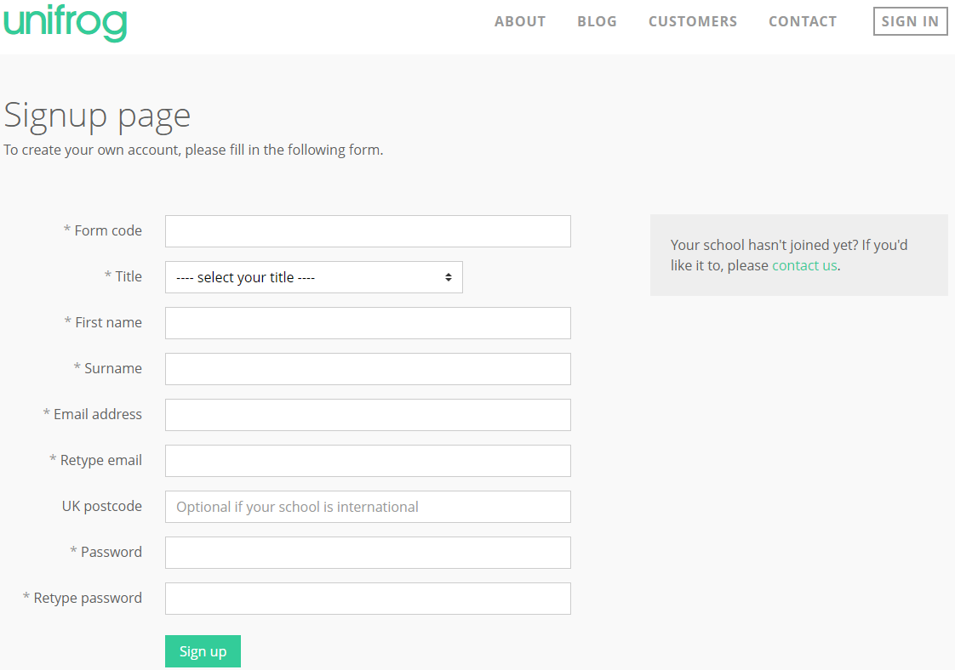
Sign in at www.unifrog.org/code
Enter this form code:
FORM CODE

