Slide 1
Degree apprenticeships cv writing virtual interviews
Mrs Matthews

Slide 2
What are apprenticeships?

Slide 3
The levels of apprenticeships

Slide 4
Degree apprenticeships available

Slide 5
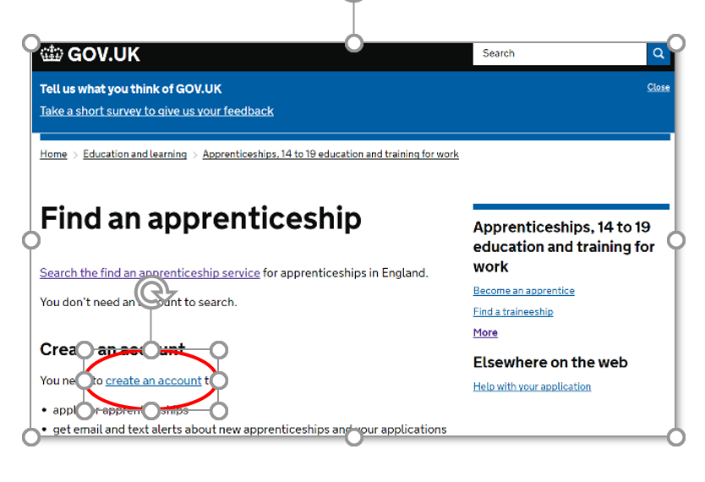
Find an apprenticeship

Slide 6
Where to look?

Slide 7
Cv writing
Layout
General content
Personal statement
Key skills, education and career history
Personal interests and references

Slide 8
CV - layout
Clear, sharp and professional with classic layout – white paper black text
Try to stick to two pages
Clearly state name, address and contact details at the top and centre of the page
Do not include date of birth or a photograph
Proof read and check spelling, punctuation and grammar

Slide 9
CV – General content
Avoid long paragraphs and large chunks of text
Avoid using slang or acronyms that may be unknown to the reader
Tailor your cv to the opportunity you are applying for
Read through Job description and highlighted qualities that the role requires – evidence these in your cv
Use positive language throughout and don’t be afraid to let your achievements shine through
Be confident in your abilities and show the reader how you can add value to their business

Slide 10
Cv – personal statement
This should be a short and snappy statement about you, which grabs the readers attention
Who you are, what you are looking for and why they should hire you – consider what you can offer their organisation
Avoid ‘power phrases’ that are very generic and lack meaning e.g. “A motivated hard working individual who works well in a team and also on own initiative ”
It needs to be personal to you drawing in on your qualities and experience.

Slide 11
Cv – key skills, education and career history
These can immediately follow the Personal Statement in any order, depending on which you feel is most suited to the application you are making. Be accurate with your dates and general information. Dates should detail month and year.
Key Skills – List any individual qualities you have that demonstrate your suitability for the role.
Education – list achievements include qualification, grade, dates and place of study (chronological order)
Career history -start with your most recent employer first and then work back. Have strong headings and ensure the company name is clear, along with your job title and dates of employment.
Use bullet points to highlight your key responsibilities
This Photo by Unknown Author is licensed under CC BY-SA-NC

Slide 12
Cv –personal interests and references
These should be at the end of the cv
Avoid using clichés such as ’reading and going to the gym’
Try to let your personality shine through, keep it simple and short 2 interests relating to what motivates you.
References – you will need 2 references and they should be at the end of the CV. They can be detailed or you can use “References available upon request” if you are struggling to keep to the two page rule
This Photo by Unknown Author is licensed under CC BY

Slide 13
Virtual interviews
A virtual interview is an interview that takes place remotely, sometimes over the phone, but often using technology like video conferencing and other online communication platforms.

Slide 14
Virtual interviews
Test your technology beforehand
Position yourself in a well lit, quiet and clean space
Wear professional attire
Prepare in advance
Limit distractions
Use professional body language
Build rapport – ask questions
Be authentic/be yourself
Follow up

Slide 15
Thank you for listening
Any questions ??
s201bmatthews@Alderbrook.Solihull.sch.uk
@ABKCareers

