Slide 1
Alderbrook School
Find the subjects for which you want to find out more.
It could be for further study or just for interest.
The Alderbrook Transition booklets will be given out after the 24th June.
Top tips on how students can succeed in the Sixth Form from a Head of Sixth Form
https://www.independentschoolparent.com/school/sixth-form/sixth-form-tips/

Slide 2
Subject specific links follow. Theses three links are just for interest:
There are so many really interesting people and things out there.
Here’s just a few that may capture your imagination…
https://blog.ed.ted.com/2017/03/16/9-ted-talks-recommended-by-students-for-students/
https://www.gresham.ac.uk/watch/
https://thecrashcourse.com/
Free high quality educational fast-paced courses – with videos only 10 mins long.
Ranging from the Humanities to the Sciences.

Slide 3
Art Matters podcasts (www.artuk.org) created by Ferren Gibson exploring the interesting ways art meets popular culture and non-traditional art topics. Recent podcasts include: Art and Tattoos. Art References in Recent Hip Hop, Hair Trends Throughout Art History.
Tate Galleries: Tate Modern, Tate Britain, Tate Liverpool, Tate St.Ives (www.tate.org.uk). The Yorkshire Sculpture Park (www.ysp.org.uk) and the Royal Academy of Arts (www.royalacademy.org.uk).

Slide 4
The Natural Selection podcast
Infinite Monkey Cage podcast
Horizon documentaries available on the BBC iPlayer
Oxford University Press transition pack
@AngePeahen booklet
PiXL booklet
Recommended CGP guide
Shelley Parry’s enrichment from Y11 to Y12.

Slide 5
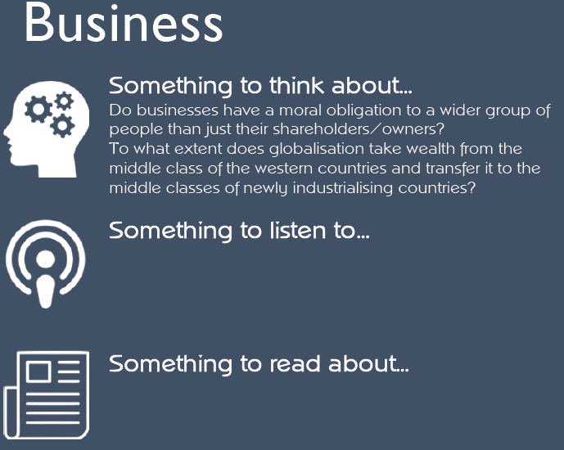
Making fashion sustainable
Is the UK up for sale?
Could Carbon offsetting save the world’s forests?
And of course DRAGON’S DEN and THE APPRENTICE (although both are more a TV show than a business really!).
www.bbc.co.uk/news/business constantly updates.
Pick any stories that interest you ,just read and do it often.
‘The Undercover Economist’ by Tim Harford is an easy read. The book (or audiobook) is broken into chapters and you don’t need to read the lot in one go.

Slide 6
Royal Society for Chemistry Podcast
Periodic table podcast
Entropy (Order and Disorder) Energy
Secrets of the Super Elements
Royal Society for Chemistry website
New Scientist magazine
SENECA Learning – enrol on the OCR A-level Chemistry course
A-level Chemistry Revision site

Slide 7
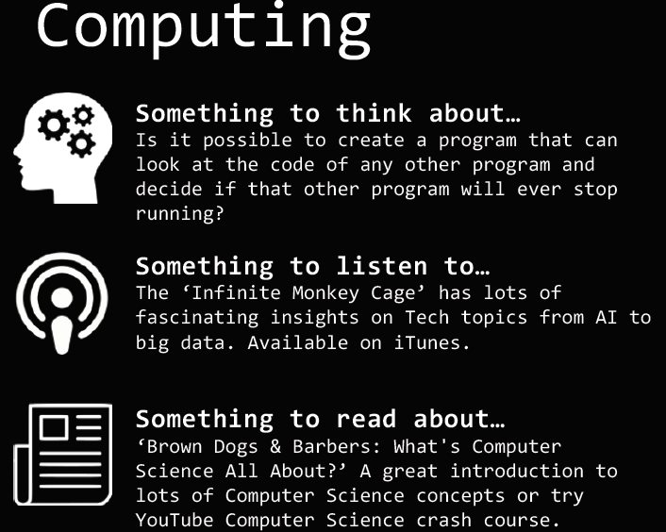

Slide 8
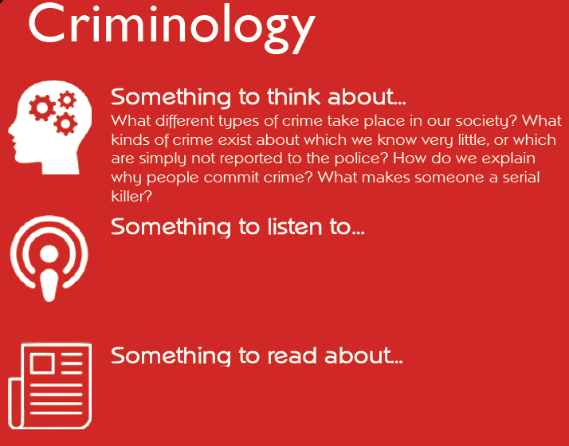
BBC Sounds have several podcasts that explore real-life crimes. This can be found on their crime page (click here).
Whether it’s learning more about how criminal evidence is collected or finding out how the legal system uses the information, this is a great place to start exploring forensics and how crimes are solved: www.exploreforensics.co.uk.

Slide 9
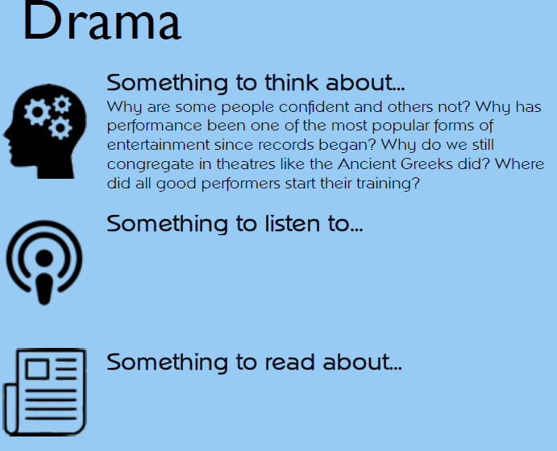
Frantic Assembly’s digital library: arguably the best theatre company in the world! Watch Shakespeare’s chilling Scottish tragedy Macbeth realized by Emmy-winning magician Teller (of Penn & Teller): a startling, supernatural show brimming with magic, mayhem, and madness.
Any play ever written! The more knowledge the better. Try to vary the styles/genres and playwrights that you explore. Some favourites are Simon Stephens, Mark Ravenhill, and Shelagh Stephenson (please be warned there is some very mature content in some of these plays). Oh, and of course Shakespeare!

Slide 10
‘Poems of the Decade: An Anthology of the Forward Books of Poetry’ is full of contemporary poets. It’s an exam text for a lot of sixth forms. For a full recommended reading list, please contact the sixth form you hope to attend next year.
A-level Chemistry Revision site

Slide 11
Follow the latest in the Francophone world on www.tv5monde.com and www.france24.com.
You will find some great articles for young adults in the magazine Phosphore. You can follow on Instagram #magphosphore or on Twitter @phosphoremag. Le Point also has some great content to develop to develop your vocabulary and knowledge of Francophone issues. You can also find those on social media: /lepointfr and @lepoint.

Slide 12
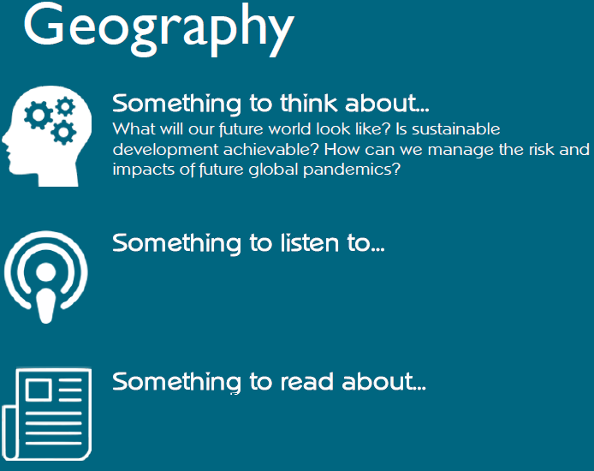
Royal Geographical Society: Ask the Experts podcast.
The Ignorance Project TED talk.
Climate Change TED talks.
Published in the UK since 1935, ‘Geographical’ is the official magazine of the Royal Geographical Society.
Wider reading in Geography (click here).

Slide 13
The National Elf Service and The Kings Fund podcasts
In Sickness and in Social Care podcast
Youtube: Department of Health and Social Care
World Health Organisation
Public Health England
The Health Foundation blog
The Care Quality Commission
Department of Health and Social Care
Health & Care Professionals
BTEC National Health and Social Care Student Book 1 and 2

Slide 14
A great starting point is History Today’s website. There are great articles on EVERYTHING historical.
Also check out www.historyextra.com for lots of interesting articles.

Slide 15
Simon Singh is an author, journalist and TV producer, specializing in Science and Mathematics. Visit his website www.simonsingh.net and read his blog covering everything from The Simpsons to moonwalking with Einstein.

Slide 16
BBC iPlayer has two excellent set of resources which explore different genres. The first is Inside Cinema: For Movie Fans: 35 short episodes, each focusing on a different code or convention. The second is Mark Kermode’s Secret of Cinema: a series of 5 episodes, each focusing on a different genre.
Read the news: what is going on in the world around us and how is the information being portrayed to the public? The Guardian media news page and blog are a great resource. You can also look at more subject specific content at the MediaKnowAll blog. Start with the GCSE pages and then work through to the AS pages.

Slide 17
A good starting point for all things music theory based is www.musictheory.net. Have a look at the following lessons: The Basics, Rhythm and Meter, Scales and Key Signatures, Intervals, the first two lessons from Chords, Diatonic Chords and the first from Chord Progressions would be a bonus!

Slide 18
Yougov is a Sports Research company with lots of interesting and thought-provoking articles. Also check out UK Sport for everything Team GB.
Good books: ‘How Bad Do You Want It?: Mastering the Psychology of Mind Over Muscle’ by Matt Fitzgerals and ‘Bounce: the Science of Success’ by Matthew Syed.

Slide 19
‘The Infinite Monkey Cage’ is a light-hearted podcast available on BBC Sounds covering all things Physics. ‘Sixty Symbols’ is a great series of (60!) videos on the symbols of Physics and Astronomy.
A great starting point is the Physics Review magazine. Lots of articles on the application of Physics from Mapping Earth’s Gravity to the Physics of Measurements and building film props. If you want to try out some of the challenges real physicists tackle using the physics you’ll learn in Y12 and Y13, look at the NASA pi day challenges.

Slide 20
Could things be better? How? In this funny, breezy Tedtalk, ‘Secret of Design’, the man behind the iPod shares some of his tips for noticing and driving change. Also, Philippe Starck in ‘Design and Destiny’ reaches for the very roots of the question “Why design?”
We rarely think about the design of the objects we use everyday. The fact is you’re not supposed to: these everyday objects have been meticulously designed to work so well that you never have to notice them – that’s what good design is all about. Take a look at ‘The 50 Most Iconic Designs of Everyday Objects’.

Slide 21
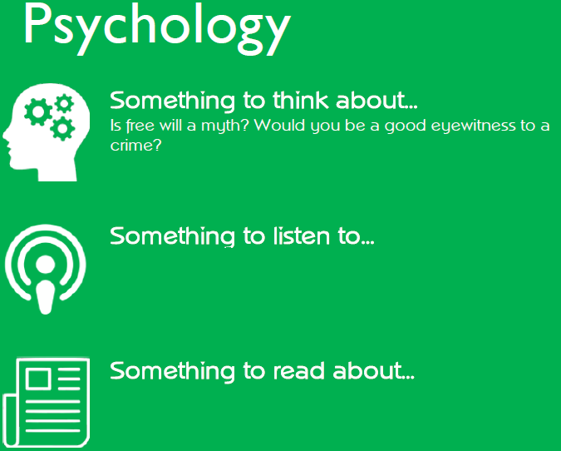
‘PsychCrunch’ The British Psychological Society research digest podcast.
Simply Psychology, Research digest and Psychology Review magazines available via Hodder Education.

Slide 22
‘Listen to a Spanish radio station Cadena Dial (https://play.cadenadial,com). This station plays only Spanish music with plenty of current pop songs.
To get up to date Spanish news and current affairs, take a look at the daily Spanish newspaper www.elpais.com online. Scan the headlines and pick out ONE article that grabs your attention. Or try looking at the www.bbc.com/mundo for BBC reporting in Spanish and click on videos for clips and reports in Spanish.

Slide 23
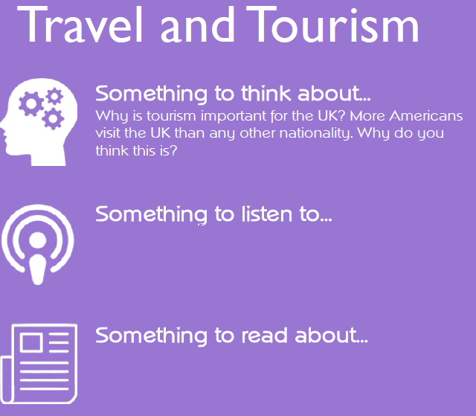
Listen to this YouTube clip explaining the impact of COVID-19 on global tourism.
A good place to read about tourism in the UK is the VisitBritain website. There are statistics, fact and figures to help give you interesting background information to the industry. Have a look at the following: www.visitbritain.org/britains-competitiveness and read through the articles.

