Slide 1





Lesson 1: Click here.
Lesson 2: Click here.
What should you do after getting your grades?
Click here.
Consider your strengths, weaknesses, opportunities and threats.
Explore where you are today, your barriers, where you could be and where to get help.
Understand how to take better care of your emotional wellbeing feel more confident in decision making and goal setting.
Exploration of the range of pathways available to you. Consider the differences between some of the options.
Explore how to make decisions about future options, good questions to ask and where to go for additional support and information.
Personality quizzes to help you decide what to do with your life.
Click here.
Thinking of building your own business?
Click here.

Slide 2
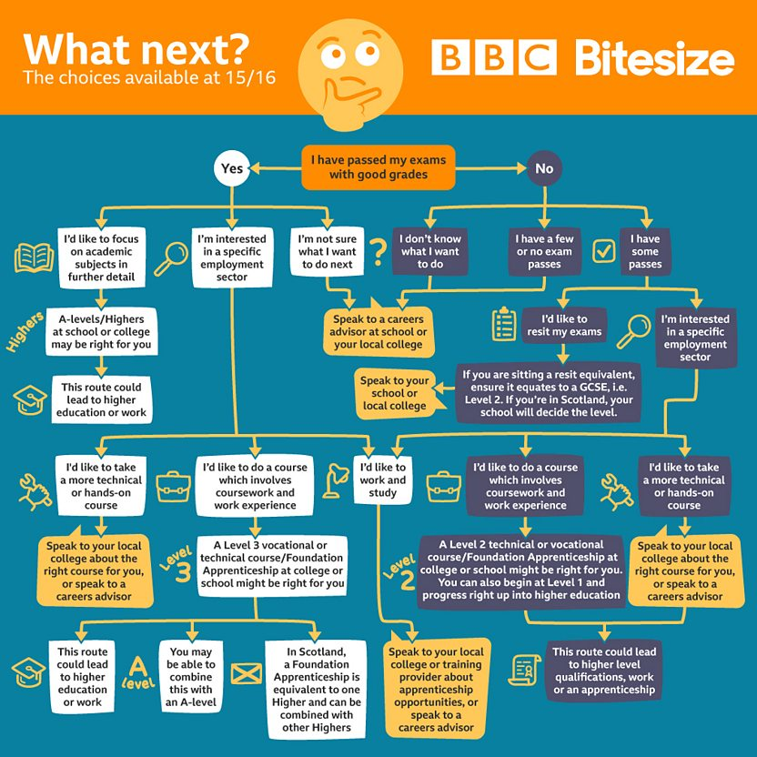

What should I do after getting my grades?
Your options at 15/16
Some things to remember:
As well as school or college careers advisers, there are lots of web-based resources you can consult to see what options are available in your area.
Some university courses, for example nursing, midwifery, police sciences, medicine, dentistry or teacher training, require a grade 4, 5 or 6 in Maths and English at GCSE. It’s worth considering resits if you don’t get these grades, as this may prevent you from choosing a specific university course in the future.
Download your own copy.

Slide 3
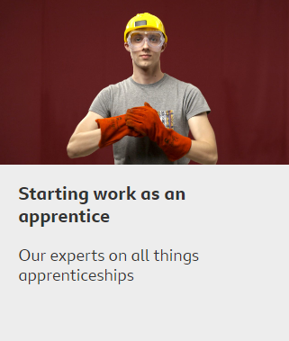
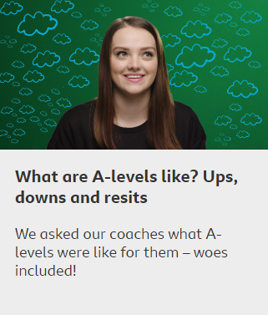
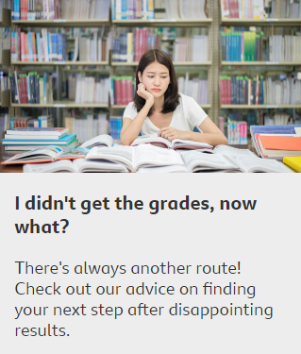
What should I do after getting my grades?
Your options at 15/16

Slide 4

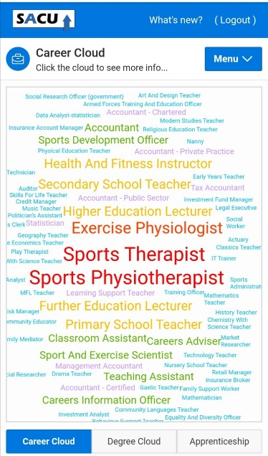



No idea what to do? Why not take these personality quizzes? Each has a different way of asking the questions. I recommend you do each of them to get a broad idea of where you could go. It’s also sometimes beneficial to take them more than once as the outcome can vary depending on your mood!
My favourite – this gives a detailed overview of your strengths and weaknesses and what careers may suit you.
Another that analyses your personality
A cool analysis of strengths and weaknesses but subscribes you to their newsletter.
As you can see
– take the quizzes with a pinch of salt.
But they ask good questions for you to reflect on your preferences.
Sacu – very visual – creates a word cloud. Here’s mine:
Click on the icons to go to the tests.
PERSONALITY QUIZZES

Slide 5


Alderbrook has joined up with two national organisations to help young people who are leaving education this summer to feel prepared for their next steps. Over the course of the next couple of weeks you can complete a range of online activities and following the social media campaign to make sure you’ve got the information and resources you need to get ahead. The activities that we will cover will not only provide you all with information about the range of pathways open to you, but will also provide you with support and information across a range of personal and professional development areas, including employability and life skills development, the opportunity to complete some virtual work experience and the opportunity to connect with Youth Friendly opportunities. All of this information and support is there to help you create the future you want, the more you put into these activities the more your future self will benefit.

Slide 6

The theme is You and Your Needs and you’ll take part in activities from Youth Employment UK’s online Young Professional programmes and explore extra resources and opportunities to build your knowledge and understanding.
The activities covered include:
Considering your strengths, weaknesses, opportunities and threats.
Exploring where you are today, your barriers, where you could be and where to get help.
Understanding how to take better care of your emotional wellbeing feel more confident in decision making and goal setting.
To get started, take a look here at Week 1 intro + activities list
Then have a go at Week 1 Young Professional Activity

Slide 7
Go to the link below, and create an account with Youth Employment UK
Young Professional: Preparing for your Future - You & Your Needs
You can save where you are and return to it to complete - see next step.

Slide 8


Alderbrook has joined up with two national organisations to help young people who are leaving education this summer to feel prepared for their next steps. Over the course of the next couple of weeks you can complete a range of online activities and following the social media campaign to make sure you’ve got the information and resources you need to get ahead. The activities that we will cover will not only provide you all with information about the range of pathways open to you, but will also provide you with support and information across a range of personal and professional development areas, including employability and life skills development, the opportunity to complete some virtual work experience and the opportunity to connect with Youth Friendly opportunities. All of this information and support is there to help you create the future you want, the more you put into these activities the more your future self will benefit.
NOTE:
You need to have completed Week one first.

Slide 9
This week’s theme is Knowing your Choices and you’ll take part in activities from Youth Employment UK’s online Young Professional programmes and explore extra resources and opportunities to build your knowledge and understanding.
The activities that we will cover this week include:
Exploration of the range of pathways available to you including: vocational and academic pathways, starting a business and finding employment.
Considering the differences between some of the options.
Exploring how to make decisions about future options, good questions to ask and where to go for additional support and information.
To get started, take a look here at Week 2 intro + activities list
Then have a go at Week 2 Young Professional Activity

Slide 10
Go to the link below, and create an account with Youth Employment UK
Young Professional: Preparing for your Future - You, Your Education And Training
You can save where you are and return to it to complete.
Once completed you get a certificate – useful for interviews.

Slide 11
Watch this video of a young entrepreneur with a bit of advice.

Slide 12
Opportunity | When is it happening? | What is it ? | Who is it aimed at? | Action
REBEL BUINESS SCHOOL | 5th – 16th July (Delivered via Zoom) | Rebel’s start-up programmes are both inspiring and practical, and will allow participants to learn the first steps to enterprise. The course shows a new way of thinking and practical ways to get your business idea off the ground and how to sustain and thrive as a business. | Any year 11 and 13 students who have an interest in starting a business. | Please email Mrs Reeve via the school office should you wish to take advantage of this.

