Slide 1
You can learn something completely new, brush up on skills from GCSE, or build on what you already know!
Click here!
Build your own essential skills with this online resource platform.
Click here!
Developing the key skills needed for life and work including key employability skills, such as communication, teamwork, problem solving, self-belief and self-employment.
Determining where you are on these skills and how to improve them.
Click here!

Slide 2
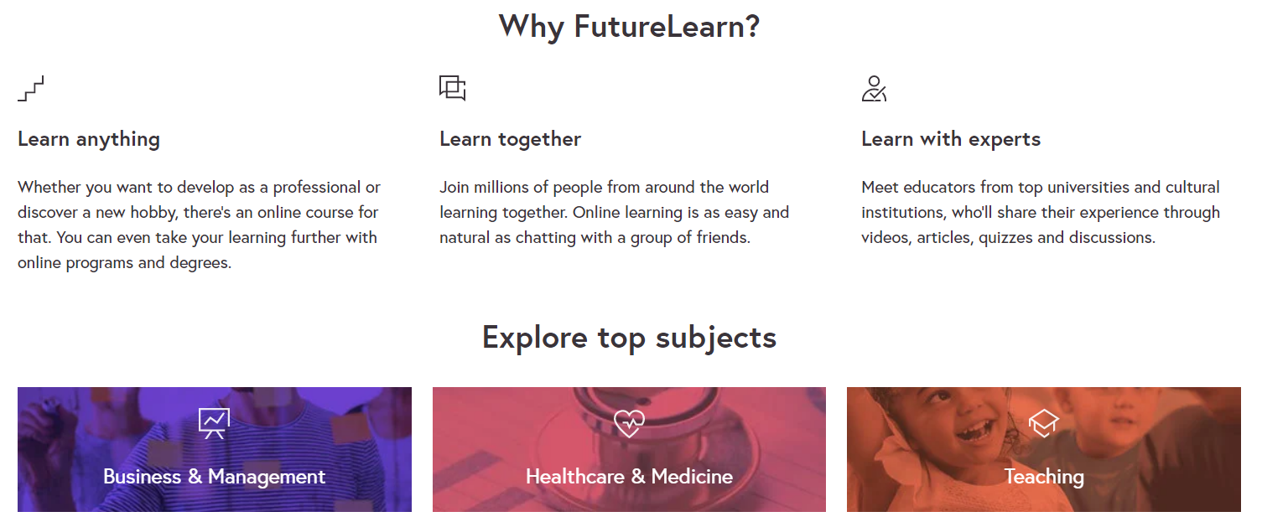
You can choose almost any course you can think of!!!!
Great for your CV.
You can learn something completely new, brush up on skills from GCSE, or build on what you already know!
Click here!

Slide 3
Alderbrook has joined up with two national organisations to help young people who are leaving education this summer to feel prepared for their next steps. Over the course of the next couple of weeks you can complete a range of online activities and following the social media campaign to make sure you’ve got the information and resources you need to get ahead. The activities that we will cover will not only provide you all with information about the range of pathways open to you, but will also provide you with support and information across a range of personal and professional development areas, including employability and life skills development, the opportunity to complete some virtual work experience and the opportunity to connect with Youth Friendly opportunities. All of this information and support is there to help you create the future you want, the more you put into these activities the more your future self will benefit.
NOTE:
You should ideally have completed Weeks one and two first (found in Careers).

Slide 4
This week’s theme is Building your Life Skills and you’ll take part in activities from Youth Employment UK’s online Young Professional programmes and explore extra resources and opportunities to build you knowledge and understanding.
The activities that we will cover this week include:
Developing the key skills needed for life and work including key employability skills, such as communication, teamwork, problem solving, self-belief and self-employment.
Determining where you are on these skills and how to improve them.
To get started, take a look here at Week 3 intro + activities list
Then have a go at Week 3 Young Professional activity

Slide 5
Go to the link below, and create an account with Youth Employment UK
Young Professional: Preparing for your Future - You And Your Life Skills
You can save where you are and return to it to complete.
Once completed you get a certificate – useful for interviews.

Slide 6
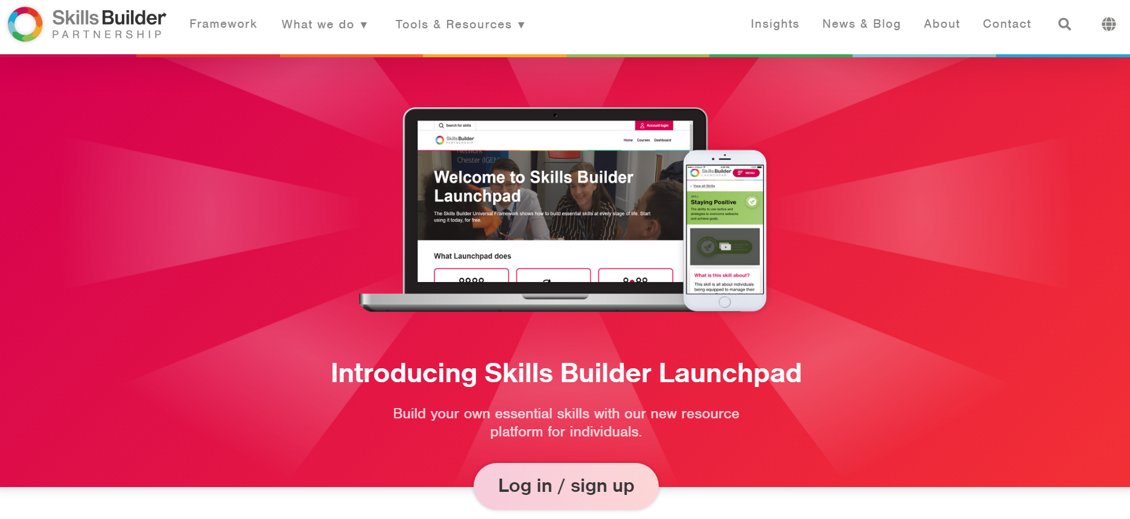
Use this superb website to build your skills!

