Slide 1

Paper 1- The Living World
GEOG YOUR MEMORY

Slide 2
Ecosystems- 5.1 + 5.2
Q1) What is an ecosystem?
Q2) What is a producer?
Q3) What is a consumer?
Q4) What is the role of a decomposer in an ecosystem?
Q5) How can change such as deforestation affect an ecosystem?

Slide 3
ANSWERS
Q1) What is an ecosystem?
Q2) What is a producer?
Q3) What is a consumer?
Q4) What is the role of a decomposer in an ecosystem?
Q5) How can change such as deforestation affect an ecosystem?
A community of plants and animals that interact with each other and their physical environment
An organism or plant that is able to absorb energy from the sun from photosynthesis (makes its own energy)
A creature that eats animals and/or plants
A decomposer such as bacteria or fungi breaks down dead plant and animal material adding nutrients to the soil (it is part of the nutrient cycle)
Changes in ecosystems can upset the balance of them for example:
Deforestation would destroy habitats for animals, it would also affect the nutrient cycle
Draining ponds for farming will result in aquatic plants and animals dying
Adding fertiliser to water sources such as ponds can lead to eutrophication, this will reduce the amount of oxygen in the water so plant and animal life will die

Slide 4
Global Ecosystems- 5.3
Q1) What is the geographical term for a large scale ecosystem?
Q2) Where are hot deserts located in the world? And give an example of one
Q3) Where are tropical forests located in the world? And give an example of one
Q4) Why are tropical forests located in this part of the world?
Q5) Why do polar regions have low temperatures throughout the year?

Slide 5
ANSWERS
Q1) What is the geographical term for a large scale ecosystem?
Q2) Where are hot deserts located in the world? And give an example of one
Q3) Where are tropical forests located in the world? And give an example of one
Q4) Why are tropical forests located in this part of the world?
Q5) Why do polar regions have low temperatures throughout the year?
A biome
Generally hot deserts are found on the tropics/ tropic of cancer (30°N) and tropic of Capricorn (30°S). An example is the Sahara desert in North Africa
Generally tropical forests are found on/near to the equator (0°), An example is the Amazon Rainforest in South America. One exception however is the tropical forest found in east Australia
Tropical forests are found in this area as it is an area of low pressure, meaning it rains a lot, It is also directly on the equator meaning lots of sunlight this allows there to be lots of plant growth
The reason is because the sun hits the polar regions at a very low angle so they receive a small fraction of the energy that the equator receives, resulting in lower temperatures.
The tilt of the earth means that the suns rays are dispersed unevenly meaning the polar regions get the least energy and therefore the lowest temperatures

Slide 6
Global Ecosystems- 6.1
Q1) What is the climate of a tropical rainforest like?
Q2) Define the term biodiversity
Q3) What are the 4 layers of the rainforest? (and put them in the correct order of height)
Q4) Identify one plant from a tropical rainforest and explain how it has adapted to survive there
Q5) Identify one animal from a tropical rainforest and explain how it has adapted to survive there

Slide 7
ANSWERS
Q1) What is the climate of a tropical rainforest like?
Q2) Define the term biodiversity
Q3) What are the 4 layers of the rainforest?
Q4) Identify one plant from a tropical rainforest and explain how it has adapted to survive there
Very high temperatures throughout the year and variable but high rainfall. There are no clear seasons
The variety of life in the world or a particular habitat e.g. in a tropical rainforest
Shrub/ground layer, Lower canopy, Middle canopy, Top canopy/emergent layer
Drip tip leaf- this has a conical shape and drip tip at the end of the leaf to allow excess water to be removed, this prevents the leaf from growing mould/bacteria
Buttress roots- Large exposed roots used to support the tallest emergent trees, they are able to absorb nutrients to support plant growth
Lianas/strangler figs- these are woody creepers which wrap themselves around other trees to support them, they are epiphytes absorb nutrients from other plants to help them grow
*add in any other specific ones you may have taught

Slide 8
ANSWERS
Q5) Identify one animal from a tropical rainforest and explain how it has adapted to survive there
Howler Monkey- has a tail to help it move/swing through the trees, it also has hands to allow it to grip onto branches
Sloth- moves very slowly to conserve energy, overtime the sloth turns green as it doesn’t wash, this allows it to camouflage, long claws to grip onto the trees when climbing
*add in any other specific ones you may have taught

Slide 9
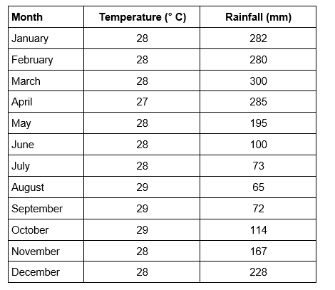
Global Ecosystems- 6.1
Q1) Using figure 1 calculate the temperature range for a tropical forest
Q2) Using figure 1, what is the total annual rainfall in a tropical forest
Q3) Using figure 1, what is the maximum temperature in a tropical rainforest?
Q4) Using figure 1, what is the minimum amount of rainfall in a tropical forest
Q5) Using figure 1 describe what the climate of a tropical forest is like
Figure 1

Slide 10
ANSWERS
Q1) Using figure 1 calculate the temperature range for a tropical forest
Q2) Using figure 1, what is the total annual rainfall in a tropical forest
Q3) Using figure 1, what is the maximum temperature in a tropical rainforest?
Q4) Using figure 1, what is the minimum amount of rainfall in a tropical forest
Q5) Using figure 1 describe what the climate of a tropical forest is like
= 2 (Highest (29) – LOWEST (27)
=2161mm (add all the rainfall values together)
=29°C
= 65 mm
Hot and humid, high but variable rainfall. There are no distinct seasons in tropical forests
Figure 1

Slide 11
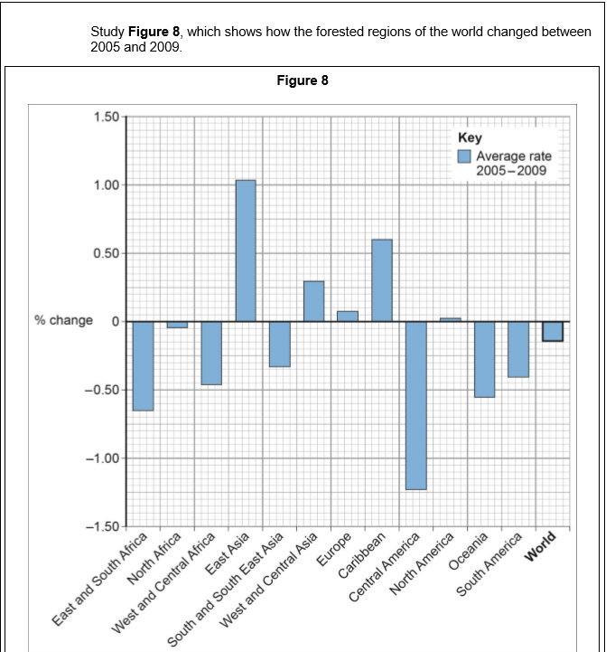
Causes of deforestation 6.2
Q1) What is deforestation?
Q2) What is your case-study for tropical forests?
Q3) Using figure 8, which region of the world had the greatest rate of deforestation?
Q4)Why do some countries deforest more than others?
Q5) Explain one cause of deforestation

Slide 12
ANSWERS
Q1) What is deforestation?
Q2) What is your case-study for tropical forests?
Q3) Using figure 8, which region of the world had the greatest rate of deforestation?
Q4)Why do some countries deforest more than others?
Q5) Explain one cause of deforestation
The chopping down and removal of trees to clear an area of forest
Malaysia
Central America
They have more tropical forests, their main income (primary industry in LICS/NEEs), land needed
Logging, Road building, Mineral extraction/mining, energy/HEP, commercial farming/subsistence farming

Slide 13
Impacts of deforestation 6.3
Q1) What is selective logging?
Q2) What is commercial farming?
Q3) Outline one impact of deforestation?
Q4) How does deforestation create economic advantages but at a cost to the environment?

Slide 14
ANSWERS
Q1) What is selective logging?
Q2) What is commercial farming?
Q3) Outline one impact of deforestation?
Q4) How does deforestation create economic advantages but at a cost to the environment?
The cutting down of trees which are mature or inferior to encourage the growth of the remaining trees in the forest
Farming to sell produce for a profit to retailers or food processing companies
Climate change- Tropical forests are carbon stores, if trees are chopped down carbon is released into the atmosphere, as it is a greenhouse gas it increases global warming
Loss of biodiversity- As trees are chopped down, animals habitats are lost, this may result in extinctions
Soil erosion- Tree roots hold soil together, if the trees are removed the soil is loose and exposed, the rain washes the soil and nutrients away- this is called leaching
Economic advantages- it generates an income from logging/mining and selling the products, through employment
Cost to the environment- Soil erosion, water pollution, forest fires, plant and animal extinctions

Slide 15
Managing tropical forests 6.4
Q1) Why do we need to protect tropical forests?
Q2) What is selective logging?
Q3) What is sustainability?
Q4) What is debt reduction?
Q5) Outline one way we can manage tropical forests sustainably

Slide 16
ANSWERS-
Q1) Why do we need to protect tropical forests?
Q2) What is selective logging?
Q3) What is sustainability?
Q4) What is debt reduction?
Biodiversity- Tropical forests contain more than 50% of the worlds plant and animal species
Medicine- 25% of medicines are from tropical forests, also new possible cures yet to be discovered
Climate change- Tropical forests store carbon dioxide (carbon store) so less in the atmosphere
Indigenous Tribes- people who are living in the forests
The cutting down of trees which are mature or inferior to encourage the growth of the remaining trees in the forest
Actions and progress that meets the needs of the present without reducing the ability of future generation to meet their needs
Countries are relieved of their debt in return for protecting their tropical forests

Slide 17
ANSWERS-
Q5) Outline one way we can manage tropical forests sustainably
Selective logging and replanting- selecting the trees 1-2 years prior to be chopped down, then chopping them down, then replanting afterwards
Conservation and education- encourages the preservation of forest through nature reserves and research.
Ecotourism- holidays which introduce people to the natural world and how to protect it, people would stay in eco-lodges etc..
International agreements- e.g. debt reduction- agreeing to reduce a countries debt and in return they reduce their rate of deforestation.

Slide 18
Cold environments 8.1
Q1) Where are polar environments located in the world?
Q2) Where are tundra environments located in the world?
Q3) What is permafrost?
Q4) Identify one difference between a polar and tundra environment
Generally polar environments are located in the very north of the northern hemisphere and south of the southern hemisphere. For example Antarctica
Tundra environments are slightly below polar environments on the line of latitude, they are found in the northern part of the northern hemisphere. For example North Canada.
Permanently frozen ground found in polar and tundra regions
Temperature- tundra is slightly warmer than polar as it a few degrees lower in latitude
Soil- Permafrost in polar, in tundra the permafrost melts during the summer/warmer months
Plants- few plants in the polar region, more found in tundra such as the bearberry
Animals- well adapted animals in polar e.g the polar bear, more variety in tundra e.g. the arctic fox, birds, insects

Slide 19
Geog your memory
Q1) How have plants (such as the bearberry) adapted to living in a cold environment?
Grows low to the ground, so it is protected from strong winds
Hairy stems insulate the plant from cold temperatures/snow
Bright red berries attract birds and help spread the seeds
Q2) Outline one way we can manage tropical forests sustainably
Selective logging and replanting- selecting the trees 1-2 years prior to be chopped down, then chopping them down, then replanting afterwards
Conservation and education- encourages the preservation of forest through nature reserves and research.
Ecotourism- holidays which introduce people to the natural world and how to protect it, people would stay in eco-lodges etc..
International agreements- e.g. debt reduction- agreeing to reduce a countries debt and in return they reduce their rate of deforestation.

Slide 20
Opportunities and challenges in cold environments 8.2-8.3
Q1) What is your cold environment case-study?
Q2) Where is this located in the world?
Q3) How many people are employed in coal mining here?
Q4) How many species are fish are found in the Barent Sea?
Q5) Outline one opportunity for development in this cold environment

Slide 21
Opportunities and challenges in cold environments 8.2-8.3
Q1) What is your cold environment case-study?
Q2) Where is this located in the world?
Q3) How many people are employed in coal mining here?
Q4) How many species are fish are found in the Barent Sea?
Svalbard
Svalbard is an island in the most northerly part of the world, (80°N), it is the territory of Norway, located in the north Atlantic Ocean
300 people
150 species

Slide 22
Opportunities and challenges in cold environments 8.2-8.3
Q5) Outline one opportunity for development in this cold environment
Coal Mining/Mineral extraction- employs 300 people, provides and income through trade, however it is controversial environmentally
Geothermal energy/energy developments- Svalbard utilises its natural geothermal energy for power stations which serve all of Svalbard- this is a likely source of energy for the future
Fishing- Barent sea is rich with 150 species of fish, this can be traded and sold to bring in an income, however it is monitored to prevent overfishing
Tourism- provides 300 jobs (as many as mining), popular attractions include the northern lights, glaciers and the wildlife, 70,000 tourists visited Longyearbyen in 2011

Slide 23
Opportunities and challenges in cold environments 8.2-8.3
Q1) What is meant by the term infrastructure?
Q2) Why is construction (building things) so difficult in Svalbard?
Q3) Outline one challenge to development in cold environments?

Slide 24
ANSWERS
Q1) What is meant by the term infrastructure?
Q2) Why is construction (building things) so difficult in Svalbard?
Q3) Outline one challenge to development in cold environments?
Thiings that help humans to live somewhere, water, electricity, roads and paths, hospitals , schools.
Extreme temperatures of -30°C makes manual labour difficult/risk of frostbite
Most construction work has to be done in the summer due to the temperature and hours of sunlight
Permafrost/frozen ground makes laying pipes more difficult
Extreme temperatures- winter temperatures can fall below -30°C, this brings a risk of frostbite and hyperthermia, lots of layers of clothing have to be worn- this can slow down work and make it more difficult.
Construction- most construction work takes place in the summer due to the temperatures and day light hours, the permafrost has to be protected from melting and damaging the ground underneath
Services- Pipes for water, power, sewage/sanitation have to be raised above the ground to prevent them from damaging the permafrost layer
Accessibility- Svalbard is not very accessible, it has one port, one air port and only 50km of road in Longyearbyen, most people travel by snow mobile

Slide 25
Cold environments under threat and management 8.4-8-5
Q1) What is meant by a ‘fragile environment’
Q2) How are cold environments being damaged?
Q3) What is meant by a wilderness area?
Q4) How can technology help protect cold environments?
Q5) How can governments help protect cold environments?

Slide 26
ANSWERS-
Q1) What is meant by a ‘fragile environment’
Q2) How are cold environments being damaged?
Q3) What is meant by a wilderness area?
Q4) How can technology help protect cold environments?
Q5) How can governments help protect cold environments?
An environment which is both easily disturbed and hard to restore if damaged
Drilling for oil can result in oil spills which damage the environment and the things living in it, off roading by tourists damages the permafrost and the ground underneath
A natural area which has not been significantly modified by human activity. These are the most intact, undisturbed places left on earth
Pipelines (like the trans-Alaskan pipeline) raised above the ground transport oil across countries, they are raised to reduce the damage to the permafrost and allow the caribou to migrate, automatic shut off systems if there is a leak to prevent oil spills damaging the environment
Laws and policies can be made to protect wilderness areas, for example the Antarctic treaty. This was put in place to prevent any economic development, promote scientific research.

