Slide 1
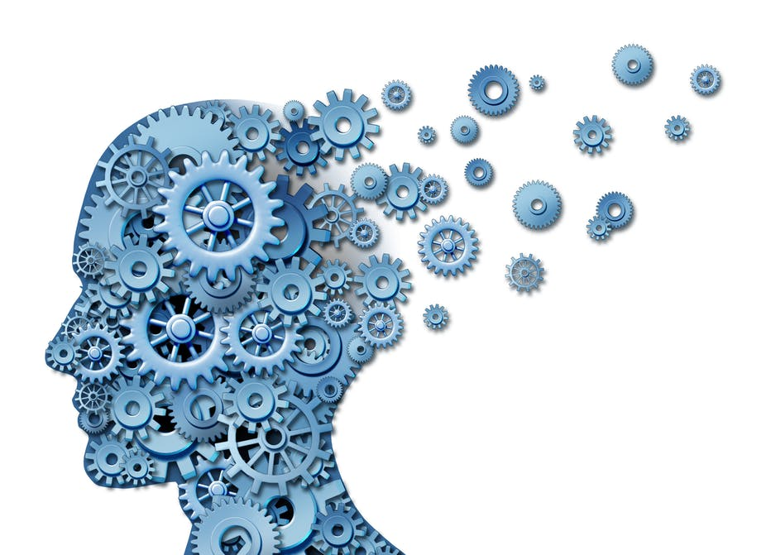
GEOG YOUR MEMORY Resource management

Slide 2
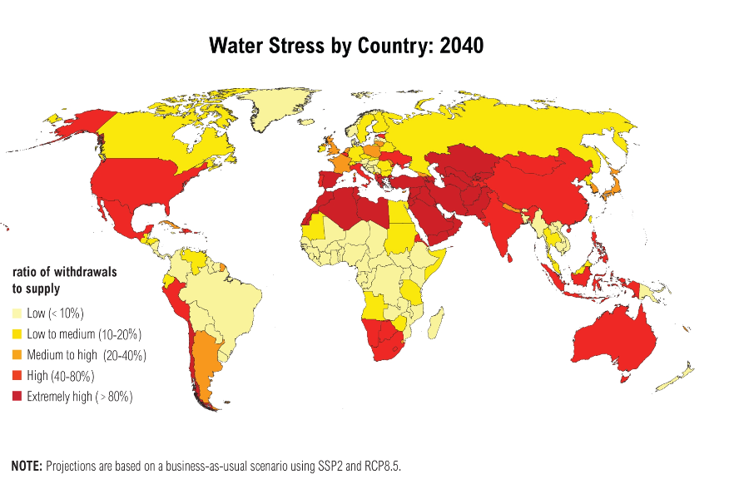
1.Describe future trends of water stress?
North Africa and the middle East and Chile will experience the highest levels of water stress, sub-Saharan Africa, Greenland and Brazil
2.Give possible reasons for why some areas suffer water deficit and some water surplus.
Surplus – Greenland because population is low.
Brazil has the largest rainforest in the world so has plenty of resources.
Sub-Saharan Africa, consumption is low and population around the Sahara is low.
Deficit –
North Africa – Increasing desertification and lack of economic funds to invest in expensive water transfer schemes.
Middle-East – Very little access to water resources. Increasing population and reliance on desalination.
Chilli – Patagonian desert

Slide 3
1.Name the three resources needed for social and economic well-being
Food, Water, Energy
2.The economic effects of undernourishment are…
Illness and disease which stops people from working and being productive to contribute to the economy.
3 .What does economic well-being mean?
Feeling like you have enough money to access food, water and energy
4.Food production uses how much of the global water supply? 35%, 50%, 70 %
70 %

Slide 4
Describe patterns in undernourishment 2011-13
Eastern and southern Asia and sub-Saharan Africa account for over three-quarters of global undernourishment.
Developed countries just 6-7 % of undernourishment.
A clear poor/rich divide
Give possible reasons for why there are food inequalities in the world.
Rich countries have the money to invest in machinery – buy food from other countries.
Poor countries grow high value crops for export so they are not growing enough food for themselves – they cannot afford the food they export.
Populations may be high is some Asian countries so it is difficult to feed them.

Slide 5
1.Energy conservation means….
Using less energy
2.Water security means….
Access to enough water of high quality.
3. How does poverty affect water availability?
Lack mains water supply in poorer countries, ability for large water transfer schemes. Lack of ability for large water treatment plants, lax environmental laws leads to agricultural and industrial pollution
4.Why might fracking be good for the UK?
Adds to future energy needs.
5.What are the economic and environmental impacts of wind farms?
Economic – high costs, reduces tourist numbers so negative on local economy, some wind farms attract visitors so increase it. Reduces energy bills locally.
Environmental – visual on the landscape is negative, no CO2 emissions, noise, access roads have to be built so negative on the environment.

Slide 6
Describe how energy demand is changing
Poor countries will demand more energy than they do now.
India, Africa and other Asia will double their demand.
China will continue to demand the most.
All rich countries will only demand slightly more, with Japan and Russia not increasing at all.
Explain how this demand can be managed sustainably
Countries need to move towards more renewable sources and reduce CO2 emissions.
Develop nuclear energy due to no CO2 emissions.
Encourage people to use less

Slide 7
1.Food production uses how much of the global water supply? 35%, 50%, 70 %
70 %
2.Carbon footprint means….
Emission of Co2 into the atmosphere from producing and transporting food
3.Seasonal food is….
Eating food that grows at certain times of the year in the UK
4.Explain what organic produce is
Food grown and animals raised without the use of chemicals. High labour costs, lower yields and more expensive. Often associated with buying local and seasonally

Slide 8
How is the UK’s demand for food changing?
Demand for high value food all year around. Importing food is increasing; currently at 40%
Explain what organic produce is.
Food grown and animals raised without the use of chemicals. High labour costs, lower yields and more expensive. Often associated with buying local and seasonally
If this is the answer, what is the question? It creates mini earthquakes so may harm buildings, The use of high pressured water with chemicals may pollute underground water resources. There is a high cost to extract it.
Explain why fracking is a concern to people
Describe what an agribusiness is.
Intensive farming aimed at maximising the amount of food produced. They often share big expensive machinery with other large farms. They have large fields and use lots of chemicals fertilisers and pesticides.

Slide 9
1.Obesity means..
Being overweight
3.An example of seasonal food is…
Broccoli in May, Strawberries in summer, Brussel sprouts in winter, apples in autumn
4. What does social well-being mean?
Feeling like you have enough food, water and energy to be happy.
5. Water deficit means…
Demand exceeds supply
6. Highest undernourishment occurs in….
Africa, followed by SE Asia
7. The economic effects of undernourishment are…
Illness and disease which stops people from working and being productive to contribute to the economy.

Slide 10
Use both maps to give reasons why water transfer schemes may be needed in the UK
The high populations around London, Leeds and Sheffield, have the least Rainfall.
The sparse populated area in north Scotland has the most rainfall.
Tip: when given to resources in a question, link data between them

Slide 11
Explain what organic produce is not
Food grown using chemical pesticides and fertilisers and animals that have hormones injected.
Name an environmental impact of nuclear power production
Processing and storing the toxic waste is a problem, warm waste water can harm local ecosystems, risk of radioactive leaks – Chernobyl.
Name an economic impact of building a nuclear power plants
High costs to build and decommission, creates job opportunities, cheap reliable energy.

Slide 12
1.What is the difference between water quality and water quantity?
Water quantity is the amount of water and water quality refers to whether it is polluted/contaminated or not.
2.An example of seasonal food is…
Broccoli in May, Strawberries in summer, Brussel sprouts in winter, apples in autumn
3.Name two ways water supplies can be increased. And give an example for each
Pumping water down to replenish underground aquifers (reservoirs)Eg. London and Los Angeles. Storing water in reservoirs by damming rivers, Eg. Elan Valley. Water transfer schemes Eg. China’s south-north. Desalination. Eg. UAE
4.Water quality can deteriorate because…..
Industrial waste and chemicals leak into rivers, fertilisers and pesticides from agriculture runs off into rivers, water used for cooling nuclear power stations are released back into rivers. Sewerage is released directly into rivers.

Slide 13
1.What is water transfer?
The movement of water from an area of surplus to an area of deficit
2.How does pollution affect water availability?
In LICs and NEEs chemicals in farming and open sewers contaminate water and lead to waterborne diseases
3.Energy consumption in the UK has decreased in recent years because….
Decline of heavy industries and improved energy conservation. The use of energy-efficient appliances, better building insulation and fuel-efficient cars.
4.What is the question if this is the answer? It uses a third less coal and the use of renewables has quadrupled.
How has the UK energy mix changed over the years?

Slide 14
How does geology affect water availability?
rock is permeable then water will seep through and create reserves underground in aquifers
Why might fracking be good for the UK?
Adds to future energy needs. And creates jobs
Explain why fracking is a concern to people.
It creates mini earthquakes so may harm buildings
The use of high pressured water with chemicals may pollute underground water resources.
There is a high cost to extract it.
How is water conflict leading to water insecurity. Use an example in your response.
Turkey’s dams stopped the Euphrates and Tigris flowing into Syria and Iraq who threatened war if not resolved. India and Bangladesh - Ganges, Egypt and neighbouring countries – Nile.

Slide 15
How does climate affect water availability?
Some areas have low and some high rainfall.
How does over-abstraction affect water availability?
Some areas pump water out of aquifers (underground reservoirs) faster than it can be replaced.
How does limited infrastructure affect water availability?
Poorer countries cannot afford to transport water from surplus areas to where it is needed.
If this is the answer, then what is the question?
There is an effect on the environments and habitats so species could decline.
There is high costs involved so there is high cost to the government and people through taxes
CO2 gasses are released when pumping water over long distances , adding to global warming.
People are displaced in it’s building, Eg. South to north scheme, so communities and families are broken.
Evaluate the issue of large-scale water transfers.

Slide 16
1.Grey water is…
Waste water from people’s homes that can be put to good use. EG. Water plants
2.How is the UK’s demand for food changing?
Demand for high value food all year around. Importing food is increasing; currently at 40%
3.Name two ways water supplies can be increased. And give an example for each
Pumping water down to replenish underground aquifers (reservoirs)Eg. London and Los Angeles. Storing water in reservoirs by damming rivers, Eg. Elan Valley. Water transfer schemes Eg. China’s south-north. Desalination. Eg. UAE
4.Name two things that can cause water insecurity
Water pollution, food production, growing industry taking more water, other countries taking more water of a shared river resource Eg. Turkey taking water out of the TIGIRIS and Euphrates, upsetting Iraq and Syria

Slide 17
Explain how water supplies can be made more sustainable
Water conservation – reducing leakages, improving public awareness and water metres so people change their habits. Eg. Collect rainwater to use in the garden
Groundwater management – maintain the quantity and quality.
Recycling - through using treating water used in industry, Sunlight helps algae use to photosynthesise sewage.
Using grey water – taken from bath, showers and washing machines is used water plants and crops

