Slide 1
Distinction Exemplar
Learning Outcome 1: Be able to plan for a live performance

Slide 2
1.1 Describe personal aims in relation to the live performance including own image, repertoire and audience expectation
My aims are to communicate my character by using a wide range of body language, facial expressions and gestures to show what my character is about. This will help communicate the background of my character to the audience. We want the audience to react with positive comments and feedback to the group. I am to be a committed group member and I need to work as a team, throw in any ideas I may have and be more confident in myself and with my group. I need to make sure our stage setting is perfect when acting it out and make it links with the performance and theme.
To increase my confidence I need to enable myself to show my character clearly, act like there’s no one there and give it my best show in order to make this entertaining. Our lines need to have a bit of laughter to them but we’re telling a serious story and addressing war and conflict issues. We need to make our target audience think our performance is believable and realistic and appropriate for a younger audience.
I aim to find a motherly character because I am good at playing these roles. Mothers are kind and caring towards their children. My character also needs to use a variety of drama and acting techniques and I will use facial expression and body language to communicate different moods. Our script is called Archie Dobson’s War and I think that this fits really well with the theme and the characters that we are playing suit us. It will be important to carry out research into our characters and the historical context of the script. This is particularly helpful because of props and costuming so, I know what to wear. The script is in a very war time's style because of the language and content in it. It is based on a family, and a boy whose cousin is in war and write letters home about it and his aunt who watches him going to fight in the war. we could use flashbacks of us reflecting when he comes home from the war this links to the theme of peace and conflict because we see him going off to war and see him come back home. Even though it Is set in an olden day based play we could improvise it and add scenes and make it our own and suitable for our modern day audience, but we also want to get the message across about how awful the war was which people will understand. So we can set it in a more clear way and use modern words, going off the script for an idea but also improvise out own version and use modern language, so the script just gives us a platform to work with. When if comes to the audience I think they will be expecting a wide range of scenery and to see clear statuses of character and they will want to get to know what the characters are about. They are also going to want to observe how we perform as a group and see how our team work comes across. It is important that we get this to pay off and they can see that we have put in 100% effort when working together. I think they will be watching the performance and wanting to see a good quality piece of work that is rehearsed and in role and believable at the s

Slide 3
1.2 Propose ideas for the performance that incorporates your chosen discipline: Acting or dance
This play is about a boy named Archie Dobson his cousin goes off to war to fight and his family at home don’t like the fact that he wasn't going to be home for a long time. They get letters and the drama cuts to the trenches and we see how the war is like. This will be a group performance with four of us students included in the group. I am playing Archie’s mam and a teacher and a soldier. The mam and nephew were extremely close, she knew that he going to war was very beneficial for him because he could make good money for himself and do the country proud and his family and he always grew up liking the idea of war. When I'm collaborating in my group I will need to input ideas and show my group that I'm part of it, contributing ideas can also get me high marks and show more accuracy.
When I'm onstage it is important for me to show that I get along with the other actors on stage and show the rapport with the characters and that I am a mam and Archie is my son with the way we stand near each other. Also being committed to acting is going to have a big impact on the group. I play Archie Dobson's mother in the play, a teacher and the English solider. I will communicate my characters by showing who my character is in the costume and showing their background they came from. For example, I can use accents to show were they're from. To play my mother character I'm going to use a range of facial expressions so when I get mad, raise one eyebrow, raise my shoulders back, show my children that I mean business and the other side of me is to become a friendly, motherly character e.g. Put my arms around the children to show that I love them and I also need to show close proxemics to show relationships. When I'm the teacher I will move further away from the children and stand fall over them, I'm less of a motherly character. I will use more of a stern voice and angry facial expression I have a further distance away to show I am stern.
The performance links with conflict and peace because it shows Archie's cousin going off to war and his family back home and him reflecting back on it when he comes home. The family say there thoughts and what they felt when he was in the war and how happy they were to get him back. I also play the teacher, who has three students in her class room played by Racheal, Leanne and Callum. In this scene I explain to class 4 that a boy called Thomas Metcalf is missing, and point out the empty chair and that he isn't in the class because his brother Fredrick has been killed fighting in the war, and he was a pupil at this school just 6 years ago. Now this is a good link to peace and conflict because it is showing the good and bad sides of going into the war and fighting. We present this in a different way so the audience can understand it even if it is a bad message, our group is trying to make it come across, in a positive way. My ideas for the sound effects are having music on in the background that's almost like a sudden drop of death but we also need some light relief music because when he's finished and over the war, it's like sudden sighs of relief, this music is meant to be like a roller coaster for the atmosphere.
Props and costuming is a very important part of the play because what we wear needs to be shown back in the last century so wearing old grandad hats, black long skirts with white high neck tops, walking sticks - so this will fit in with the time period of the play. For the class room set we will need a table with chairs and we also need it for the living room scene and props to show a family home like a teapot and newspaper. When I'm working with others it is important that I'm going to give ideas and use rehearsal time as best as I can and split up the jobs between us so we can share the work.

Slide 4
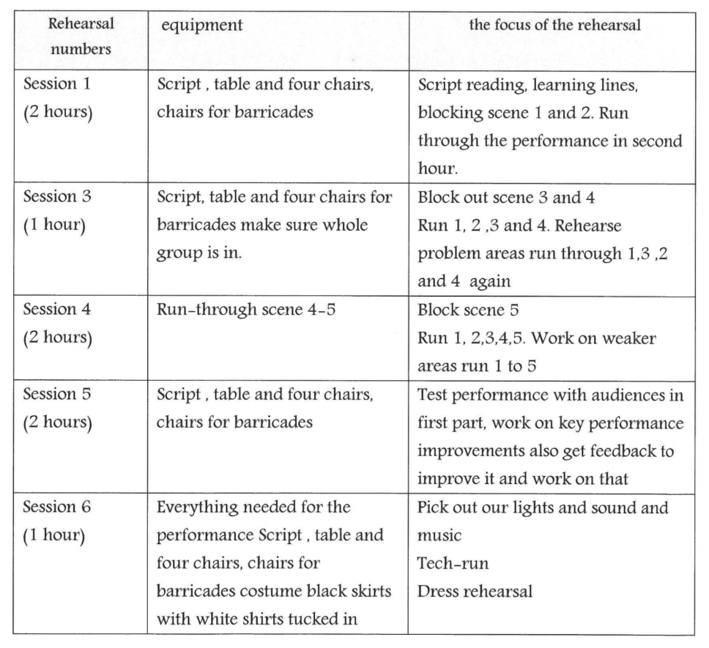
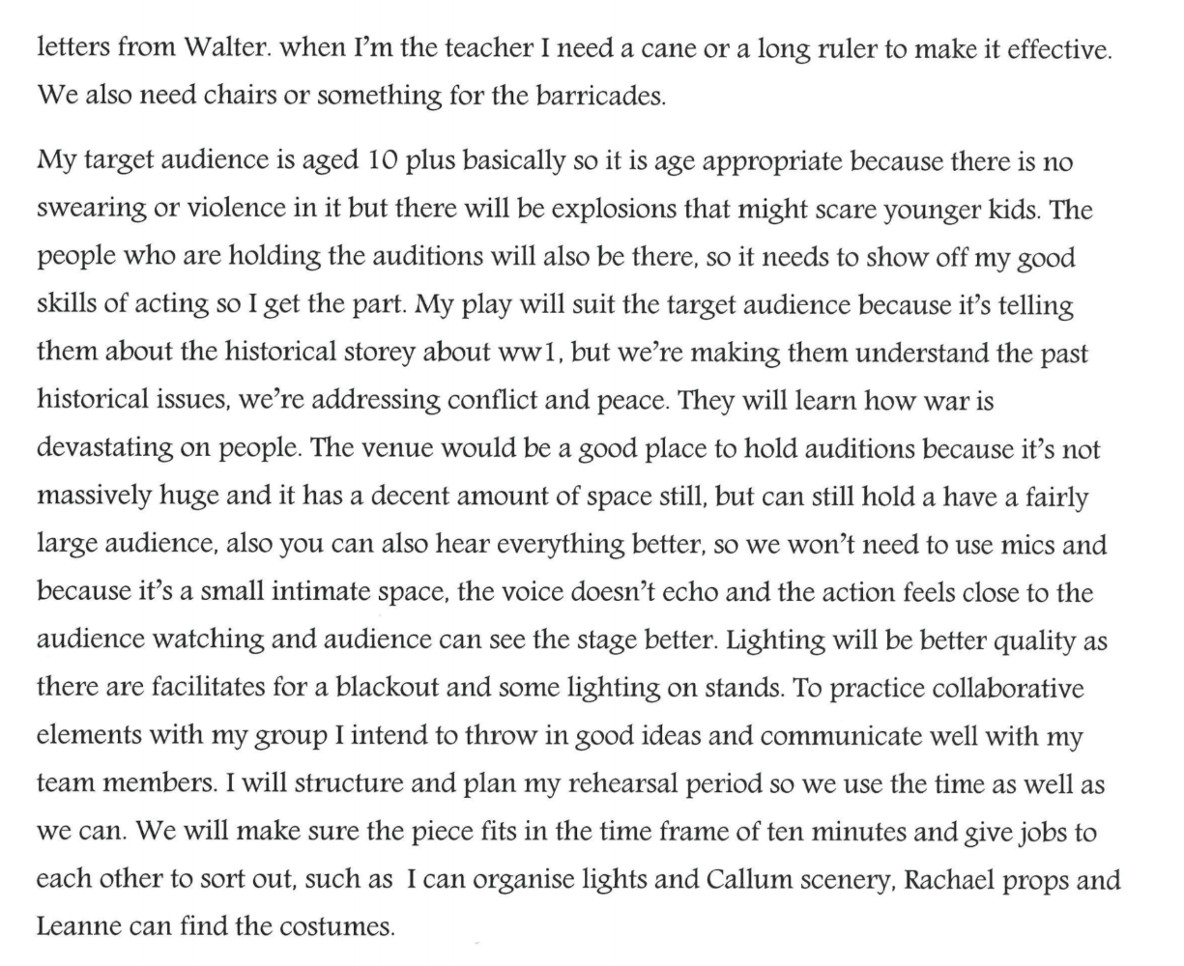
1.3 Produce a production plan to meet the needs of an agreed brief

Slide 5
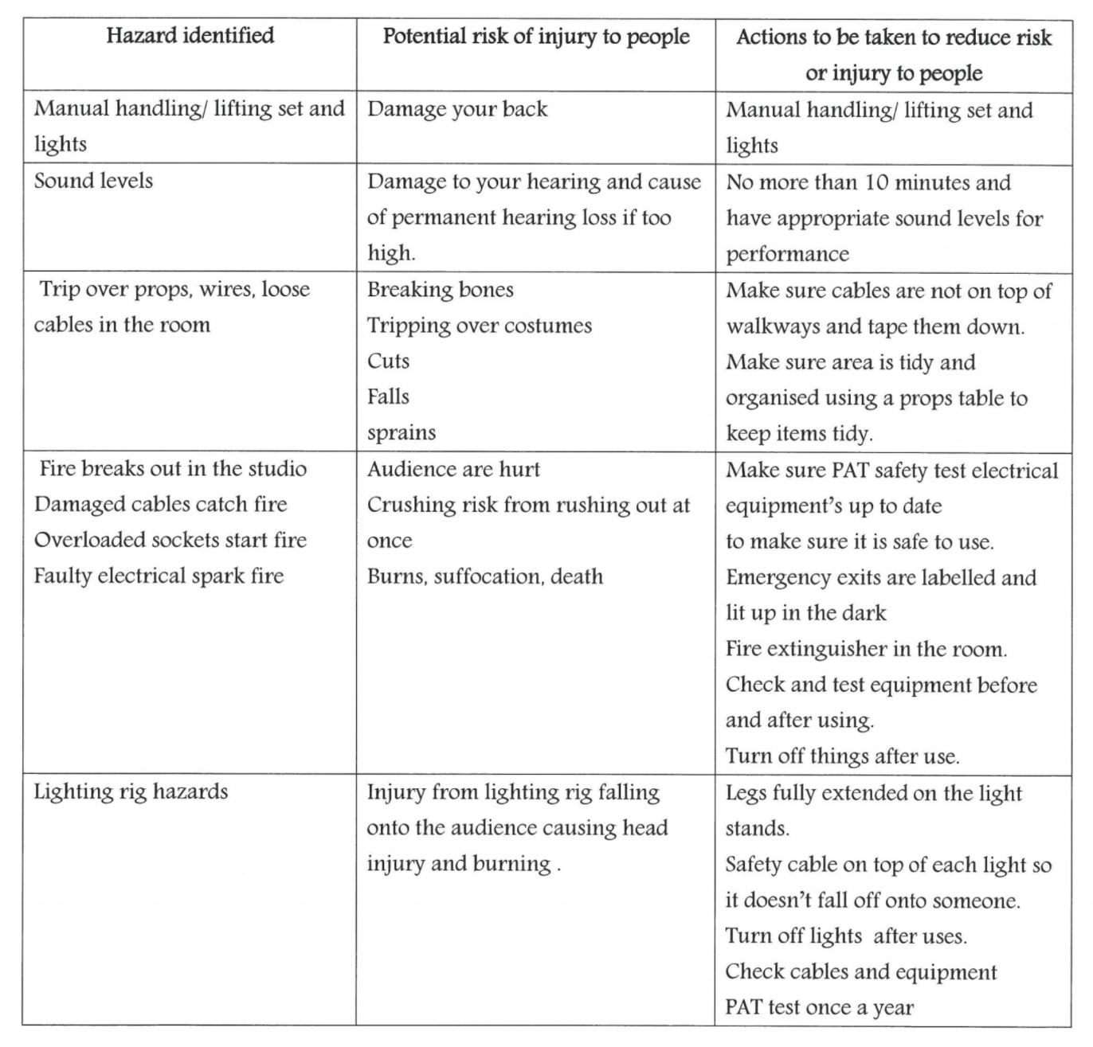
1.4 Analyse Health and Safety issues in the context of a live performance

