Slide 1
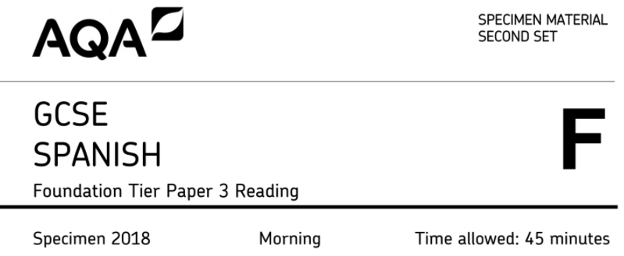
Strategies for success in the foundation reading paper

Slide 2
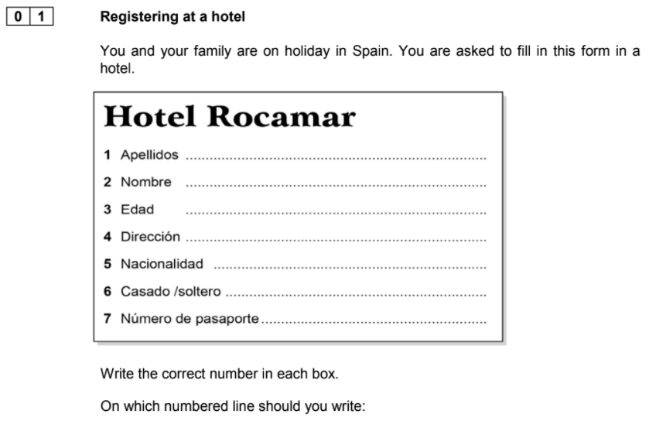
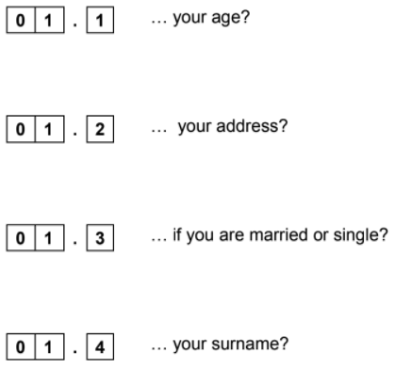
Advice: here you are looking for the correct Spanish nouns which translate the English nouns. There are some cognates here (e.g. ‘número de pasaporte’), but others like ‘dirección’ will require some out-of-the-box thinking skills!
3
4
6
1

Slide 3
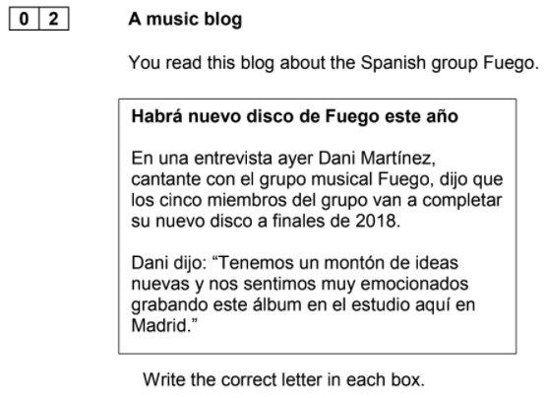
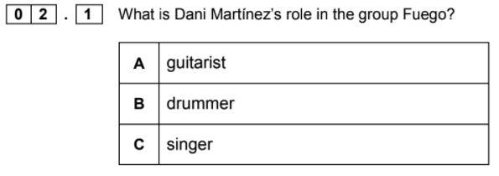
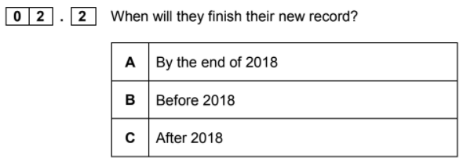
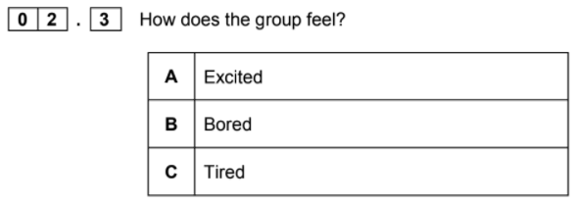
Advice: there are no exact cognates in the phrases containing the answers, so…
Q2.1 - do you know the verb ‘cantar’ which links to the noun ‘cantante’?
Q2.2 - do you think ‘a finales de’ means ‘by the end of’, ‘before’ or ‘after’?
Q2.3 - what is ‘emocionados’ likely to mean?
C
A
A

Slide 4
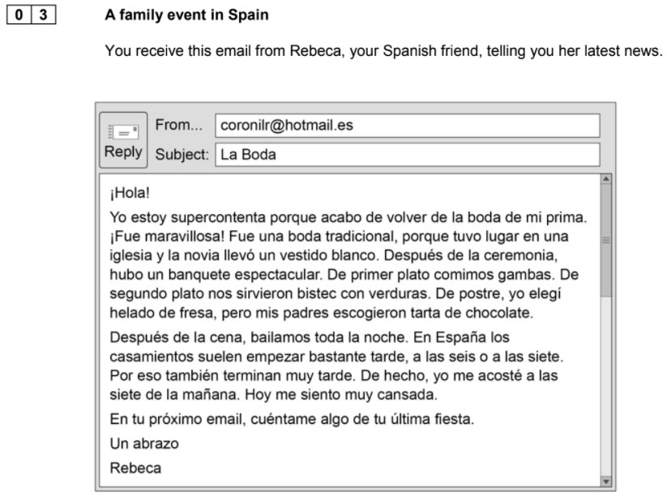
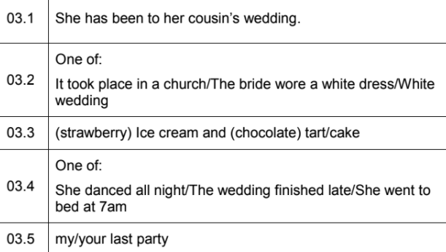
Advice: for these questions use your cultural knowledge about weddings (see the subject of the email). For example, if you don’t know ‘vestido’, what is likely to be white on a wedding day?

Slide 5
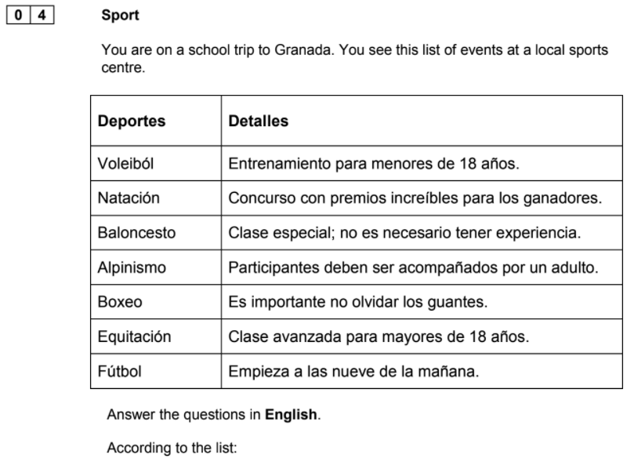
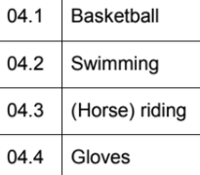
Advice: for these questions use your cultural knowledge about weddings (see the subject of the email). For example, if you don’t know ‘vestido’, what is likely to be white on a wedding day?

Slide 6
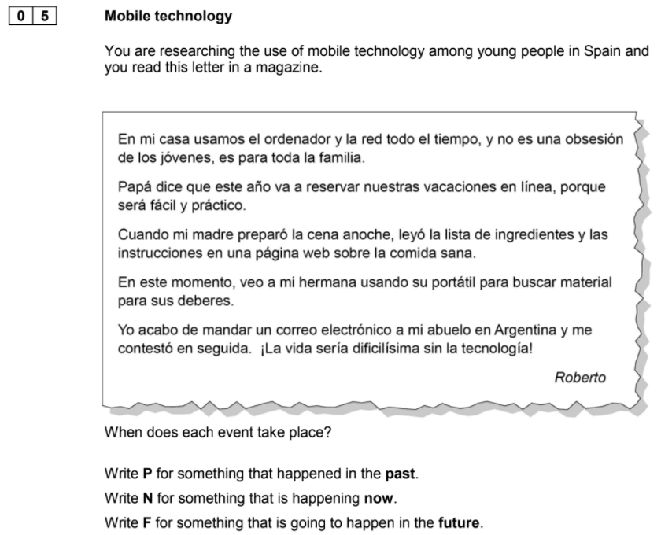
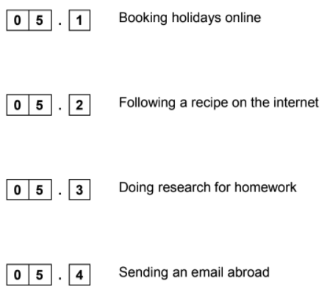
Advice: once you have found a key word which links to the four ideas in the questions, look very carefully at the time phrases and verbs in those sentences.
Q5.4 - ‘acabar de’ means ‘to have just’; does that imply past, present or future?
F
P
N
P

Slide 7
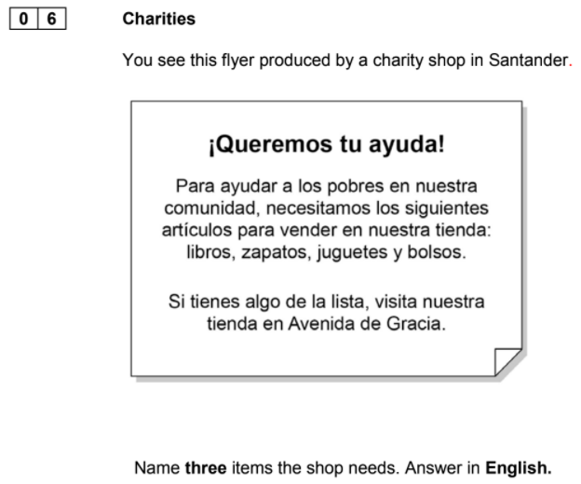
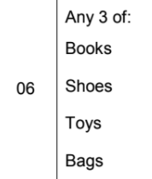
Advice: when a number of words are required in an answer, they are likely to appear as a list (the punctuation in the text will assist you here). If you don’t understand all the words, make an intelligent guess thinking about what charity shops would often require.

Slide 8
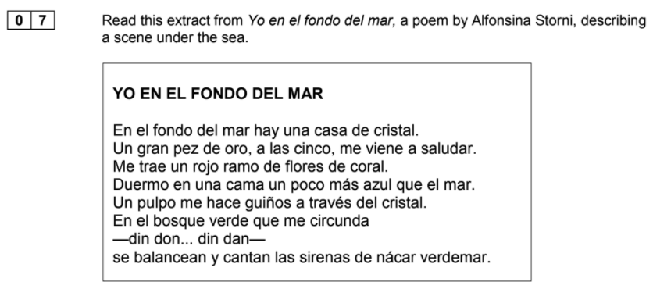
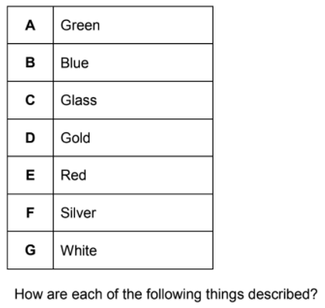
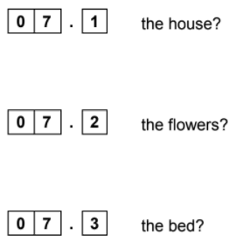
Advice: first you need to find the three nouns within the text: house, flowers and bed. Then you can highlight the adjectives describing these nouns. If you don’t know the meaning of ‘cristal’, look for the most likely option in the list.
C
E
B

Slide 9
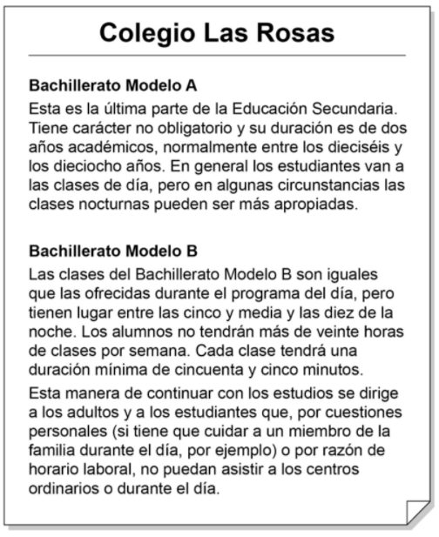
Advice: multiple choice questions are all about process of elimination! Remember the options are worded deliberately to catch you out..
B
C
A
Notes:
Q1 on Higher

Slide 10
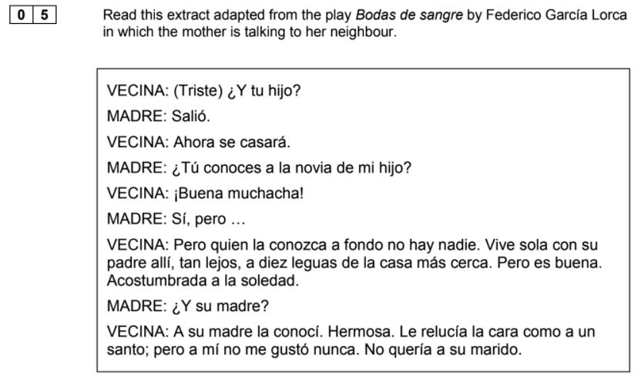
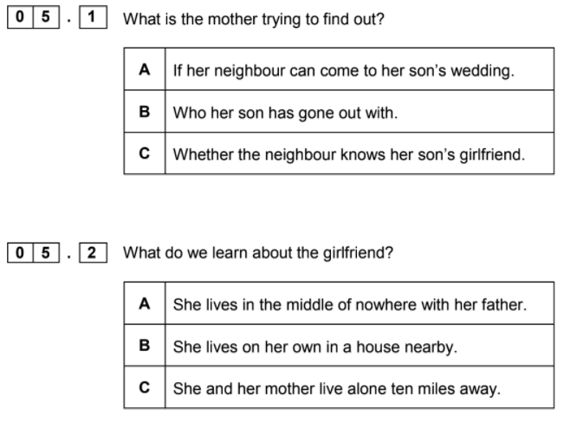
Advice: when reading authentic texts don’t worry about understand absolutely everything; look out for any clues or key words that you can.
C
A
C
B
Notes:
Q5 on Higher

Slide 11
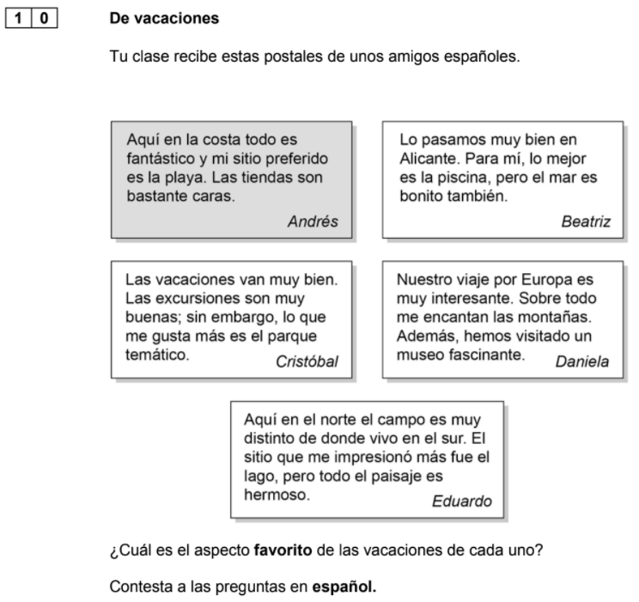
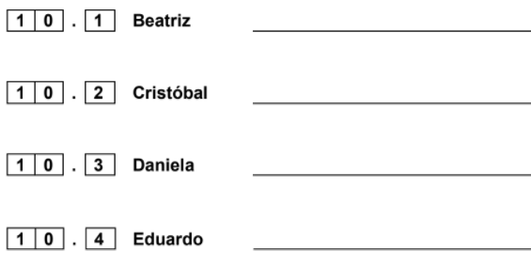
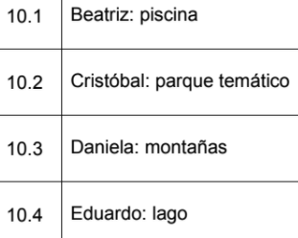
Advice: in the question you can see the word ‘favorito’ in bold and you must answer in Spanish. You need to look for phrases about each person’s favourite aspect of holidays and only copy out the nouns directly from the text.

Slide 12
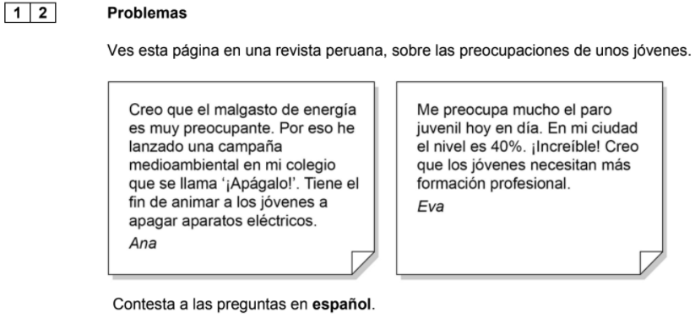
Advice: as with the previous questions you can LIFT a phrase directly from the text (as long as you don’t use verbs in the ‘yo’ form).
Q12.1 Can you find a noun and adjective in the sentence which tells you what ‘Apágalo’ is called?
Q12.2 Can you find an infinitive phrase in the sentence which mentions ‘los jóvenes’?
Q12.3 What is worrying Eva (i.e. the problem)?
Q12.4 What does Eva think about young people?
Notes:
Q12 on Higher

Slide 13
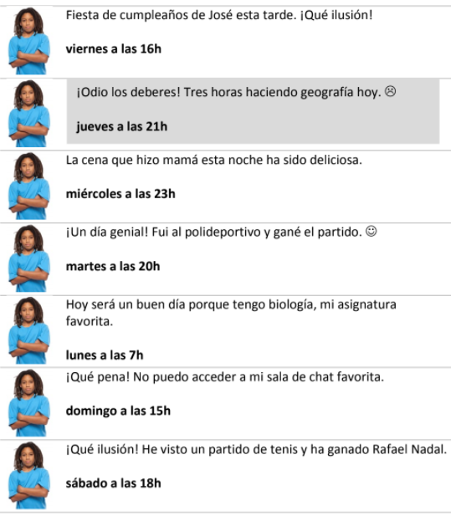
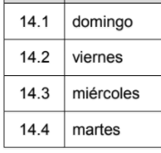
Advice: first make sure you know what is required by the questions (here you need to write the day in Spanish).
Q14.4 Two sentences mention sport (martes and sábado); which one mentions participating in sport?
Notes:
Q14 on Higher

Slide 14
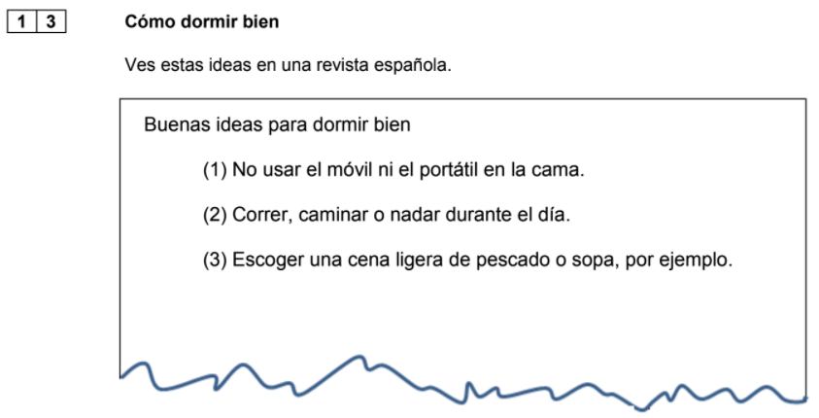
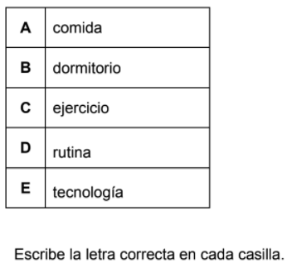
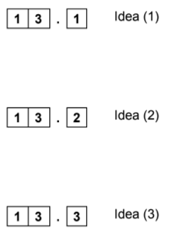
Advice: here you must look for words related to the options provided and make an intelligent guess if you don’t know the words in the text.
E
C
A

Slide 15
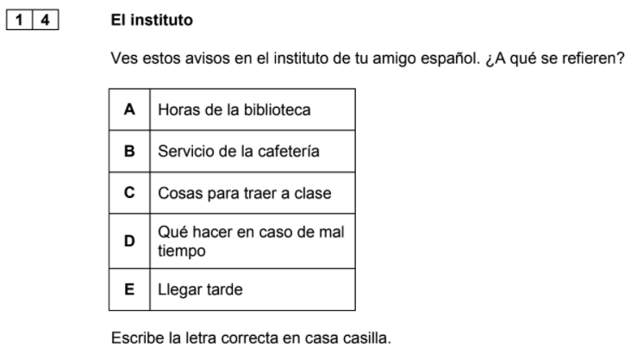
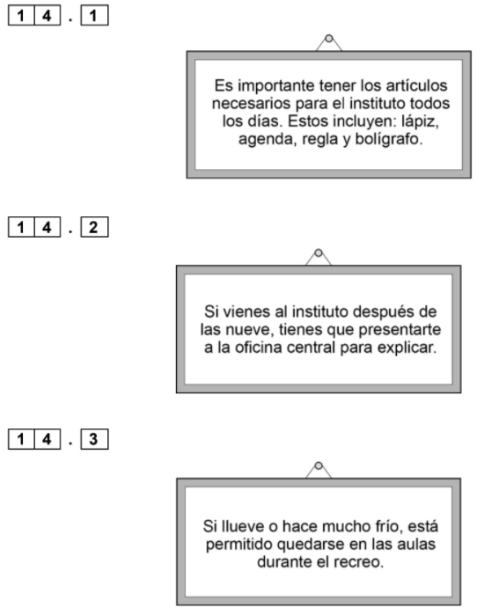
Advice: here you must look for words related to the options provided and make an intelligent guess if you don’t know the words in the text.
C
E
D

Slide 16
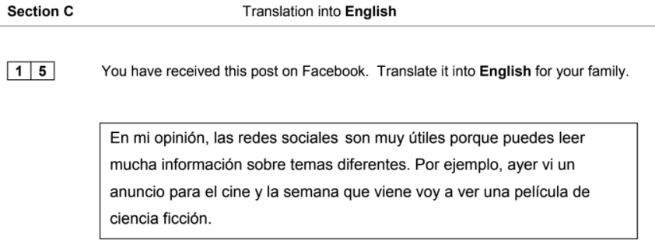
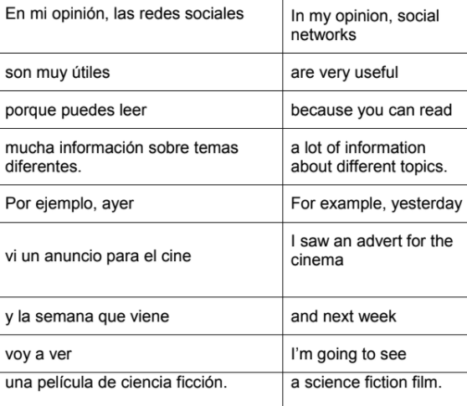
Hints: make intelligent guesses using what you know about the context if you don’t know the exact meaning.
‘puedes’ - this is a present-tense verb in the ‘you’ (singular) form
‘información sobre temas diferentes’ - can you work out the meanings of the two words in the middle?
‘ayer’ - this is a time phrase
‘vi’ - this is past tense
‘un anuncio’ - this is a false friend and does not mean ‘announcement’!
‘la semana que viene voy a ver’ - this is a time phrase and a verb referring to the future

Slide 17
Quizlet
password: ilovespanish
Notes:
https://quizlet.com/285388102/aqa-9-1-new-gcse-spanish-second-specimen-foundation-reading-paper-trickyuseful-vocabulary-flash-cards/

