Slide 1
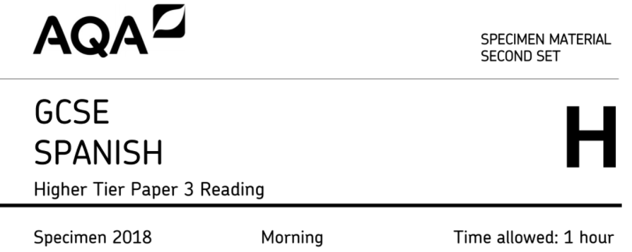
Strategies for success in the higher reading paper

Slide 2
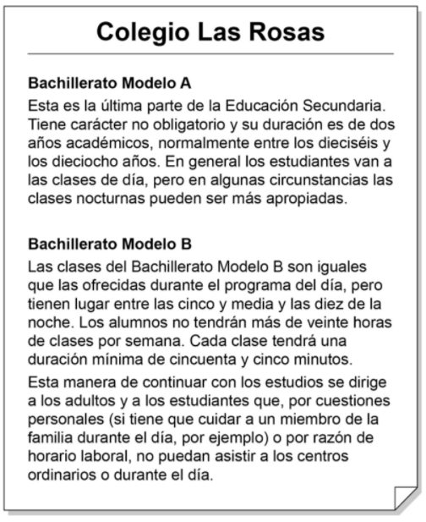
Advice: multiple choice questions are all about process of elimination! Remember the options are worded deliberately to catch you out..
B
C
A

Slide 3
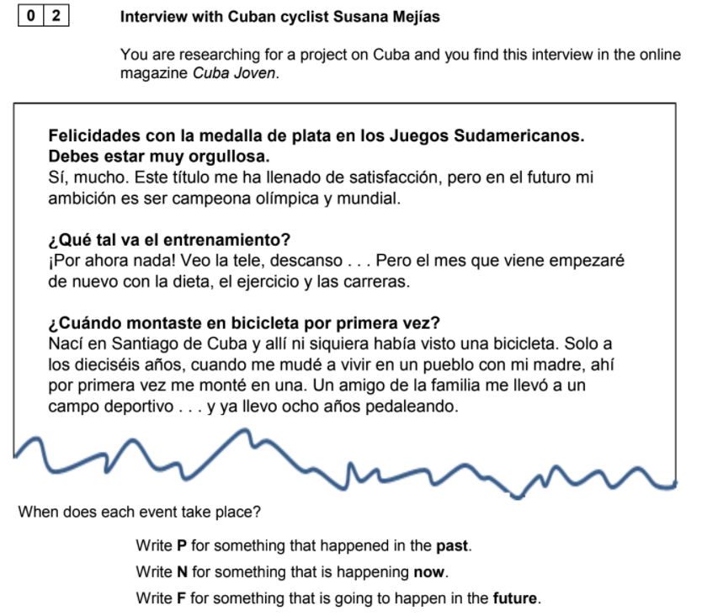
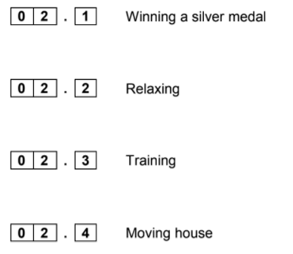
Advice: use a highlighter to highlight the verbs and look very carefully at the verb tense.
Q2.1 - they have tried to catch you out by adding a distracting time phrase!
P
N
F
P

Slide 4
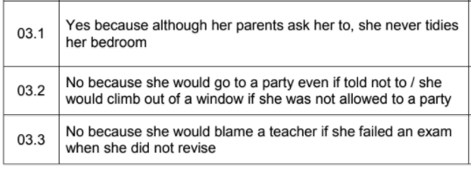
Advice: translate the whole answer into English in the ‘she’ form. When you see the mark scheme you will notice you must include all the information from the survey answer to get the mark.

Slide 5
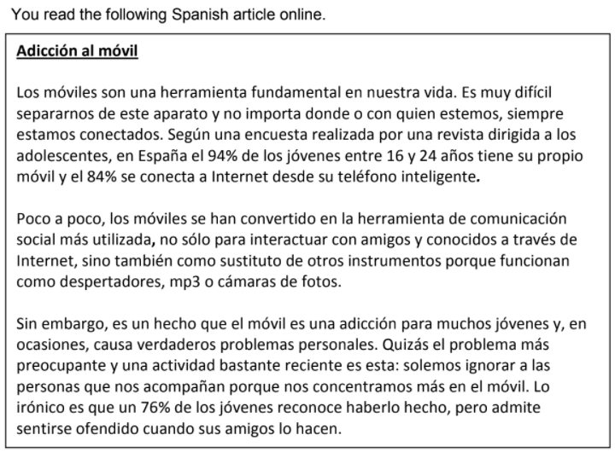
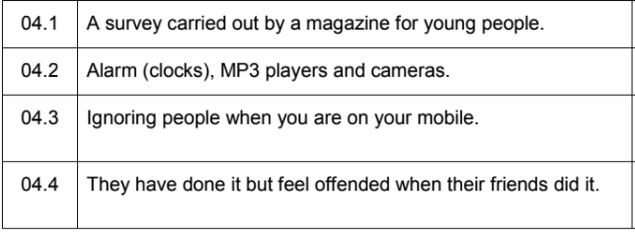
Advice: try to give all the information required rather than just one word.
Q4.2 - what else can a phone be used for? Are there any cognates or verbs (e.g. despertarse) which give clues?
Q4.4 - even if you don’t understand the penultimate line, the last line gives many clues.

Slide 6
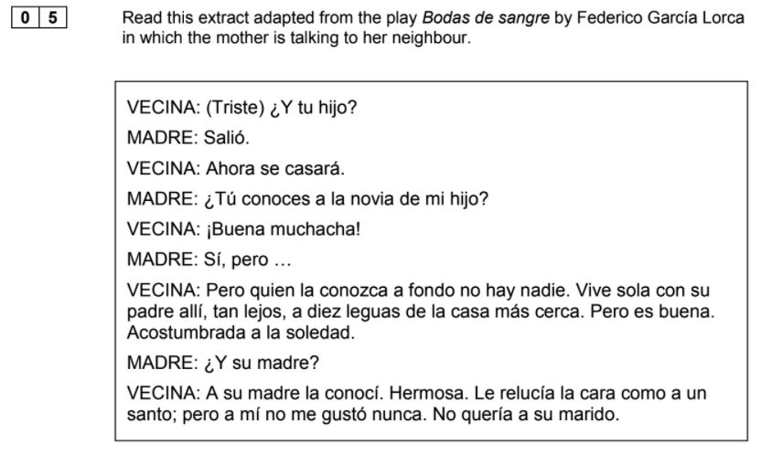
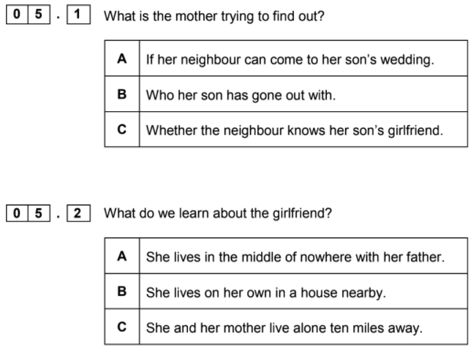
Advice: when reading authentic texts don’t worry about understand absolutely everything; look out for any clues or key words that you can.
C
A
C
B

Slide 7
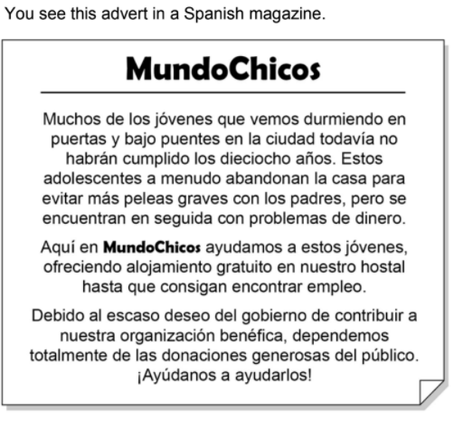
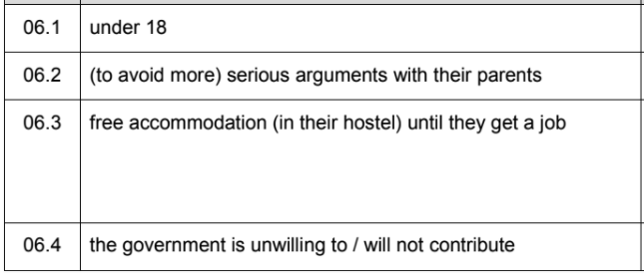
Advice: try to give all the information required rather than just one word.
Q6.3 - You must have written the word ‘free’ (what good is accommodation to the homeless if they have to pay?!)

Slide 8
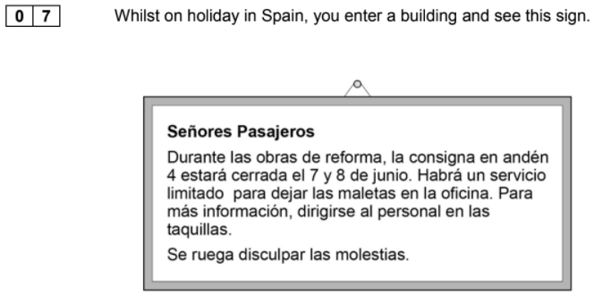
Advice: highlight any words which give you clues to the location of this sign (e.g. pasajeros, la consigna, el andén, las maletas, las taquillas).
Q7.2 - saying ‘limited service’ is not enough to get the mark here!

Slide 9
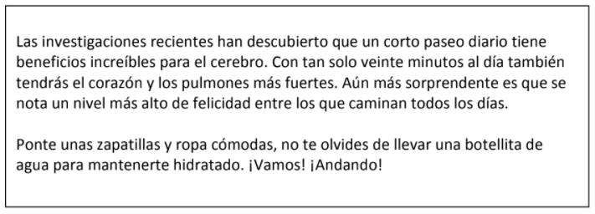
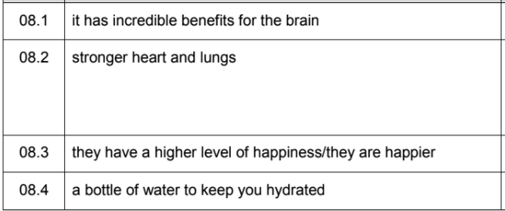
Advice: are there any words you know from Biology which will help you work out the body parts (i.e. cerebral cortex and pulmonary arteries)?
Q8.4 - make sure you give the reason or you won’t get the mark!

Slide 10
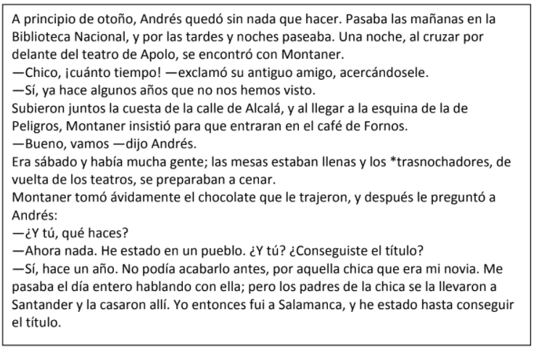
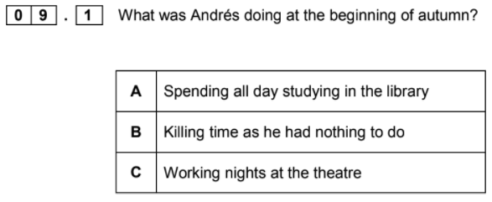
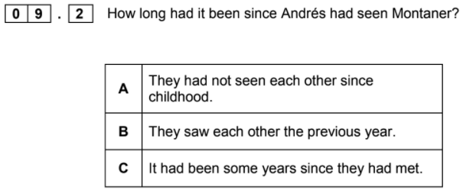
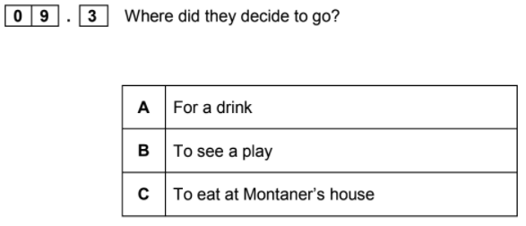
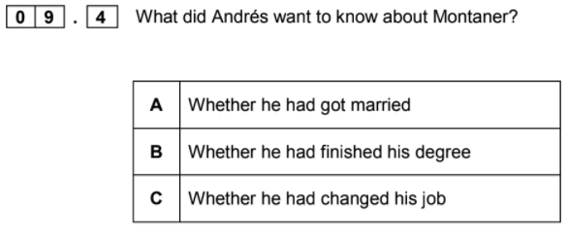
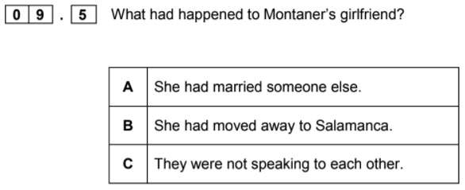
Advice: when reading authentic texts don’t worry about understand absolutely everything; look out for any clues or key words that you can.
B
C
A
B
A

Slide 11
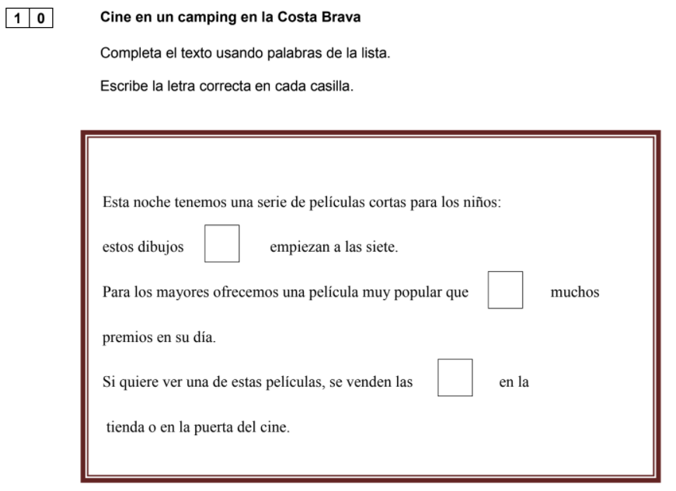
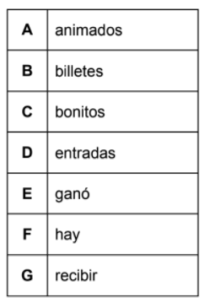
Advice: read the whole sentence in your head. Then see if you can categorise the possible words into adjectives (gender? number?), verbs (tense? person?), nouns (gender? number?), intensifiers (muy, bastante…) etc. Finally look for any clues in the words before and after the box.
A
E
D
You have learnt the word ‘dibujos ???’ at KS3 in TV programmes
...a very popular film that (VERB) many...
‘las’ means ‘the’ (feminine plural) so you need a feminine plural noun...

Slide 12
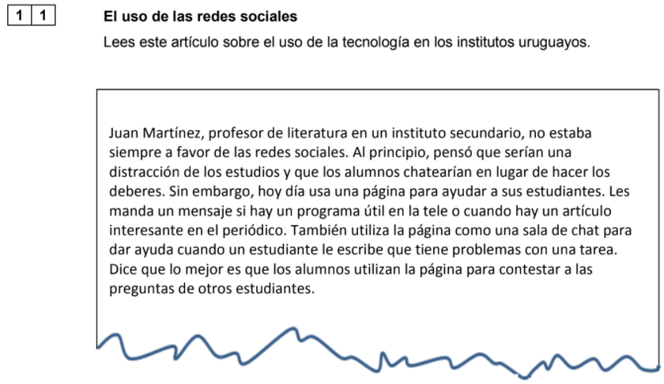
Advice: look very carefully at the questions! You should know what ‘¿Por qué?’ and ‘¿Cuál?’ mean and if you pick out key words like ‘no...a favor’ and ‘en contacto con…’ and ‘la ventaja’ to at least get the gist of what the question requires.
Remember with questions which require an answer in Spanish you can often LIFT a phrase directly from the text (as long as you don’t use verbs in the ‘yo’ form).
For Q11.2 you may have lifted: ‘hoy día usa una página web para ayudar a sus estudiantes’ but this doesn’t answer the question ‘Why…?’!

Slide 13
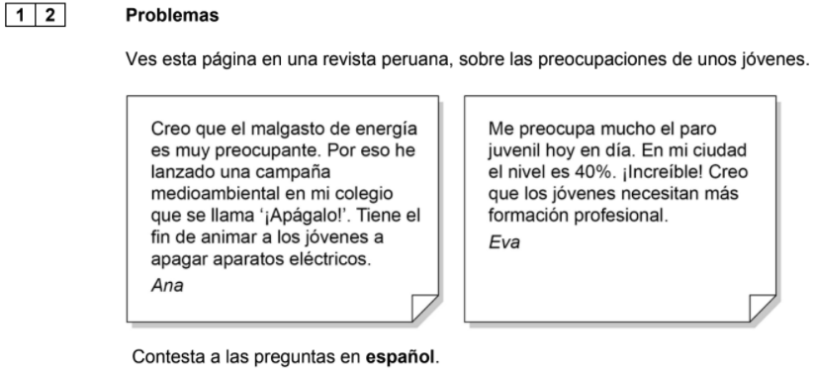
Advice: as with the previous questions you can LIFT a phrase directly from the text (as long as you don’t use verbs in the ‘yo’ form).
Q12.1 Can you find a noun and adjective in the sentence which tells you what ‘Apágalo’ is called?
Q12.2 Can you find an infinitive phrase in the sentence which mentions ‘los jóvenes’?
Q12.3 What is worrying Eva (i.e. the problem)?
Q12.4 What does Eva think about young people?

Slide 14
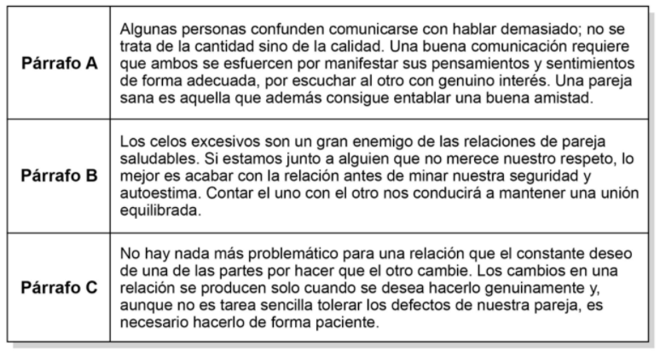
Advice: questions like this require you to find synonyms and or words which are linked to the statement
B
A
C
A

Slide 15
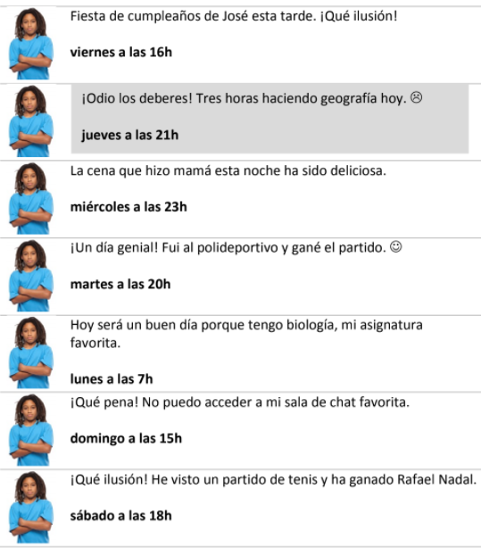
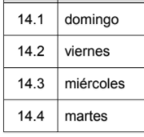
Advice: first make sure you know what is required by the questions (here you need to write the day in Spanish).
Q14.4 Two sentences mention sport (martes and sábado); which one mentions participating in sport?

Slide 16
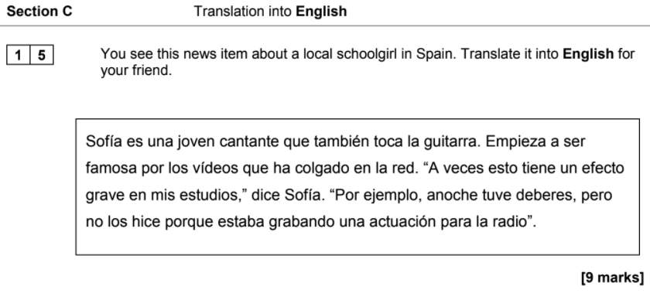
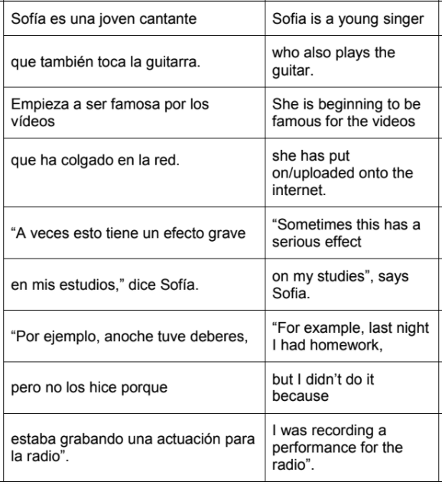
Hints: make intelligent guesses using what you know about the context if you don’t know the exact meaning.
‘Empieza’ - this is present tense from ‘empezar’
‘ha colgado en la red’ - this is not the same as ‘la red social’
‘un efecto grave’ - ‘grave’ does not mean ‘serious’
‘dice’ - this is not past tense!
‘anoche’ - does not mean ‘one night’
‘tuve...hice’ - these are irregular verbs from which tense?
‘estaba grabando una actuación’ - she is a young singer/guitarist; what might she be doing for the radio?

Slide 17
Quizlet
password: ilovespanish
Notes:
https://quizlet.com/283818729/aqa-9-1-new-gcse-spanish-second-specimen-higher-reading-paper-trickyuseful-vocabulary-flash-cards/?new

