Slide 1
AQA English Language Paper 2 Question 5
“Parents and teachers expect children to work far too hard at school and at home. Young people should still be able to have fun whilst they can.” Write a broadsheet newspaper article explaining your point of view on this statement.
Think + Write:
What do AQA mean when they say ‘explain your point of view’?
L.O: To be able to write a newspaper article explaining your point of view upon a statement

Slide 2
“…explaining your point of view”
This is not argumentative writing. It’s explanatory.
This means you can agree, disagree or be mutual towards the statement – as long as you explain why you feel the way you do.
Explaining means giving your view with justification and valid points of argument.
Writing to explain techniques include: hyperbole, similes, metaphors, personification, anaphora, hypophora, alliteration, emotive language, rule of three, statistics/facts, opinions, imagery, rhetorical questions and anecdotes.

Slide 3
What does a newspaper article need by AQA standards?
A headline
Some subheadings (if you think necessary)
Clear organised paragraphs with flowing ideas
Alliteration: Exasperated Earth – Our Final Chance
Repetition/Anaphora: Change Our Ways, Change Our Planet
Making a huge statement: How Can We Save Our Planet?
Asking a rhetorical question: What Can We Do To Help Our Planet?
Using Pronouns to engage the reader: Our Planet is a Responsibility for us all
Emotive language: Our last chance to salvage the planet

Slide 4
“Parents and teachers expect children to work far too hard at school and at home. Young people should still be able to have fun whilst they can.” Write a broadsheet newspaper article explaining your point of view on this statement.
Create a list of ideas about this statement:
Below your chart, select the 4 ideas from either column of your chart that best sum up your views.
For – reasons for adopting a ‘less work, more play’ ethic | Against – reasons against adopting a ‘more work, less play’ ethic

Slide 5
“Parents and teachers expect children to work far too hard at school and at home. Young people should still be able to have fun whilst they can.” Write a broadsheet newspaper article explaining your point of view on this statement.
Feedback?
For – reasons for adopting a ‘less work, more play’ ethic | Against – reasons against adopting a ‘less work, more play’ ethic
Let kids be kids – why suck the life out of them at such a young age? Let them enjoy rather than suffer. | Students lives rest on their academic ability at school – no study, no grades, no college, no uni and no job.
Allows more creativity to bloom and more life lessons to be had | Prepares students for their life and teaches them the importance of hard work, endurance and perseverance.

Slide 6
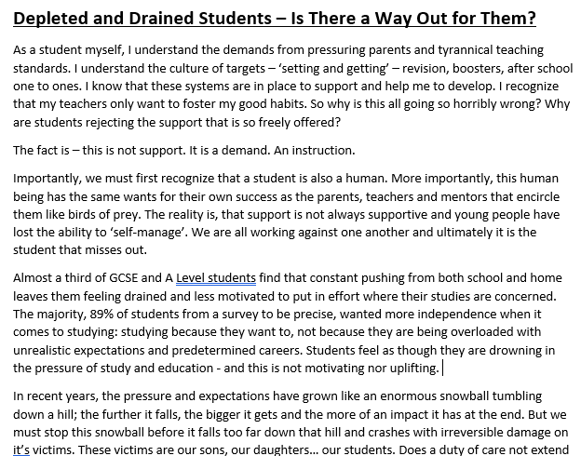
“Parents and teachers expect children to work far too hard at school and at home. Young people should still be able to have fun whilst they can.” Write a broadsheet newspaper article explaining your point of view on this statement.
Exemplar scored full marks on both AO5 and AO6.
As we read the exemplar, I want you to annotate the following:
What each paragraph is about – it’s thesis, if you will. Write a small note next to each paragraph.
Clear use of discourse markers and/or declarative sentences that summarises the point at the opening to each paragraph
Use of: hyperbole, similes, metaphors, personification, anaphora, hypophora, alliteration, emotive language, rule of three, statistics/facts, opinions, imagery, rhetorical questions and anecdotes.
The cyclical structure – how is it added in?

Slide 7
Create a flow-chart plan:
Intro – what type of opening? Anecdotal? Anaphora? Hypophora?
First idea/argument?
How are you going to organise your work so that each idea/paragraph flows into the next?
Second idea/argument?
Third idea/argument?
5 mins timer
Summarising of ideas – cyclical structure?

Slide 8
Writing Time.
Writing Time.
As you are writing, I want your sentences to be CRAFTED with linguistic devices as much as the exemplar is.
You can see the extent to which that has a device embedded and interwoven into almost all sentences – and yours should be the same.
As you are writing, I want your sentences to be CRAFTED with linguistic devices as much as the exemplar is.
You can see the extent to which that has a device embedded and interwoven into almost all sentences – and yours should be the same.
First two opening paragraphs at minimum

