Slide 1
Link to the PDF copy of the text I Use (this is for chapter 1 but you can download all of them as a pdf). I also annotated the text myself before running off pupil copies- boxing off key sections, etc to make it easier for them to find the sections we were looking at
https://etc.usf.edu/lit2go/160/a-christmas-carol/2824/stave-i/

Slide 2
ENGLISH LITERATURE PAPER 1 EXAM
(1hr 45 min, worth 64 marks- 30 for each question and 4 for SPAG)
Section A: Shakespeare
Close reading of an extract,
then extended writing on set text.
We will be reading A Romeo and Juliet
Section B: THE 19th CENTURY NOVEL
Close reading of an extract,
then extended writing on set text.
We will be reading A Christmas Carol

Slide 3
Think-Pair-Share
Lesson 1
What makes an effective opening? What can a writer do to make the reader want to read on?

Slide 4
OBJECTIVES
READ and DESCRIBE the opening of the novel.
DISCUSS how the beginning of the story hooks in the reader.
SELECT relevant quotations.
EVALUATE how effective the opening of the story is.
LITERACY FOCUS: selecting relevant quotes, capital letters and full stops.

Slide 5
Task
Read the opening of the novel again (Marley was dead...it was all the same to him.)
Highlight any quotations that hook you into the story and make you want to read on. Look for what information is REPEATED again and again to the reader.
3. Write next to the quote how it hooks you in.
Lire à nouveau l’ouverture du roman (Marley était mort… c’était pareil pour lui.)
Mettez en évidence toutes les citations qui vous attirent dans l'histoire et vous donner envie de continuer à lire.
Ecrivez à côté de la citation comment cela vous branche.

Slide 6
PA: The opening of the novel
How does Dickens engage the reader in the opening of the novel?

Slide 7
Writing frame
P: The writer hooks me into the novel when he says,
E: Copy your chosen quote.
E: This makes the reader interested because...
P: Another way the writer interests me is when it says,
E: Copy your next quote.
E: This makes me want to read on because.
CHALLENGE TASK: CAN YOU WRITE AN EXTRA PEE PARAGRAPH ON THE SIMILE DICKENS USES IN THE OPENING OF THE NOVEL?

Slide 8
WAGOLL
P:The writer hooks me into the novel when he says,
E: ‘Marley was dead...to begin with’.
E: This makes the reader interested because it tells us that Marley was dead ‘to begin with’. This suggests to me that Marley is dead at the beginning of the story but is going to come back to life. This makes me want to read on because I want to see if he comes back to life.

Slide 9
Peer assessment- green pen
Give your partner a STRENGTH, what they have done well.
S-
Give your partner a DEVELOPMENT, what they need to do better next time.
D-

Slide 10
Green pen work
P:The writer hooks me into the novel when he says,
E: ‘Marley was dead...to begin with’.
E: This makes the reader interested because it tells us that Marley was dead ‘to begin with’. This suggests to me that Marley is dead at the beginning of the story but is going to come back to life. This makes me want to read on because I want to see if he comes back to life.

Slide 11
On your post-it note
Write down how Charles Dickens makes us want to read on at the beginning of the story.
Notez comment Charles Dickens nous donne envie de lire au début de l'histoire.

Slide 12
Bell work: think of some adjectives to describe this man
Lesson 2
CHALLENGE TASK: CAN YOU COME UP WITH SOME SIMILES TO DESCRIBE HIM?

Slide 13
OBJECTIVES
RECALL what adjectives and similes are.
DISCUSS what Scrooge is like.
SELECT relevant quotations.
LITERACY FOCUS: selecting relevant quotes.

Slide 14
Scrooge PAGES 2-8
His environment (office).
The way they treat others.
Adjectives.
Similes.
Notes:
Guided reading. Pupils look at these pages about Scrooge and design a key for the above. They then highlight the quotes about him, using the appropriate colour code.

Slide 15
Scrooge’s character in Chapter 1 x/9/18
Notes:
Glue into books. Label everything you know about him.

Slide 16
On your post-it note
Write down a list of words to describe what Scrooge is like.
Ecrivez une liste de mots pour décrire comment est Scrooge.

Slide 17
OBJECTIVES
Lesson 3
DESCRIBE what Scrooge’s home is like.
SELECT and highlight relevant quotations.
DISCUSS how Scrooge’s home and office reflect his character.
LITERACY FOCUS: selecting relevant quotes, reading for meaning and understanding.

Slide 18
Setting= a PLACE in a novel
Scrooge’s house creates atmosphere. It is dark and starts to make the story scarier!
Scrooge’s house shows what his personality is like. It helps remind us that he is greedy and lonely.

Slide 19
Scrooge’s House
Look at pages 10-12.
Highlight quotes about what Scrooge’s house is like and how it fits in with his personality.

Slide 20
EXTENSION TASK
Make your own knowledge organiser about Scrooge.

Slide 21
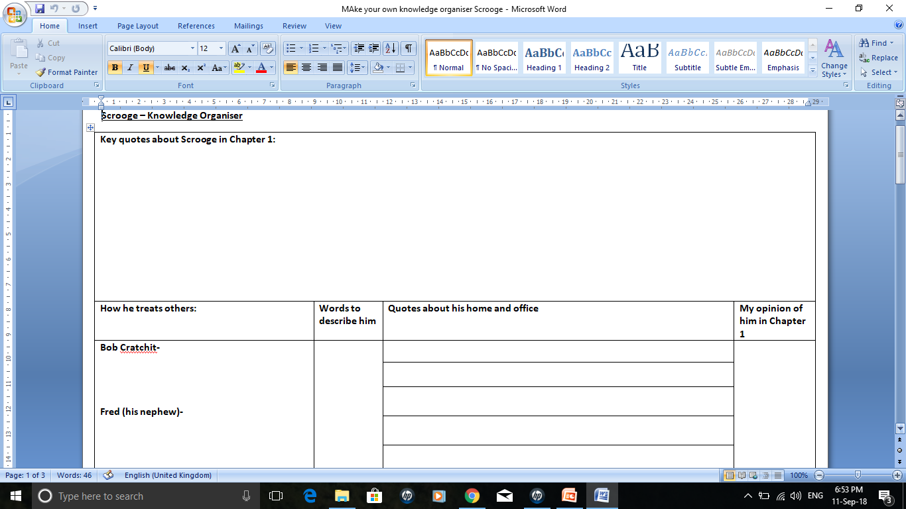

Slide 22
Plenary: The A-Z of Scrooge so far

Slide 23
Homework
Take your knowledge organiser home and learn the information about Scrooge.
TIP- try to memorise some of the quotes about him.

Slide 24
OBJECTIVES
Lesson 4
RECALL what Scrooge is like in Chapter 1.
PLAN a response to an exam question.
EXAMINE what a good exam should look like.
LITERACY FOCUS: use of the PEE chain; planning your work, FULL STOPS AND CAPITAL LETTERS.

Slide 25
Essay Question
Starting with this extract, how does Dickens present Scrooge here?
How does Dickens present Scrooge in the novel as a whole?

Slide 26
An outstanding answer will contain:
Headings for the two sections of the question.
3 PEE paragraphs about the extract.
3 paragraphs on the whole story (the second part of the exam question).
Terminology if possible.
Zoom in on power words.
Repeat key words from the question.
Now find and label these features in the example essay.

Slide 27
Now plan your own response
Highlight 3 quotations that you will then turn into 3 PEE paragraphs.
Think about what Scrooge is like later on in the story (though we haven’t read it, you will know the story already!)

Slide 28
Homework
Terminology.
Learn the key terms on the sheet- their meaning and their spelling.

Slide 29
Write your answer
Exam conditions.
Use of PEE.
Capital letters and full stops.
Legible handwriting.
Think back to the example essay.

Slide 30
Quick Fire Five!
LIST 5 THINGS THAT WE ALREADY KNOW ABOUT JACOB MARLEY.

Slide 31
OBJECTIVES
Lesson 5
RECALL who Marley is and what we already know about him.
IDENTIFY key quotes about Marley.
SUMMARISE what we learn about Marley in Chapter 1.
LITERACY FOCUS: capital letters and full stops, using quotation marks.

Slide 32
Marley p 14, 17, 19,20.
Read the description of Marley’s ghost on pages 14.
What is he wearing?
Why? What might these objects tell us about his character when he was alive?
Notes:
Then discuss the remaining pages, what he says and why it is important.

Slide 33
Marley’s Ghost
Glue the picture into your book.
Around it, write everything you know about Marley. Include some quotations from your booklet.

Slide 34
LITERACY FOCUS: capital letters and full stops, using quotation marks.
Proofread your work.
When do we use a full stop?
When do we use a capital letter?
When do we use quotation marks?

Slide 35
Plenary: The A-Z of Marley

Slide 36
Then read chapter 2

Slide 37
Quick Fire Five!
LIST 5 THINGS THAT YOU REMEMBER ABOUT WHAT HAPPENS IN CHAPTER 2.

Slide 38
OBJECTIVES
Lesson 6
RECALL the Ghost of Christmas Past and Chapter 2.
IDENTIFY key quotes about Marley.
SUMMARISE what we learn about Marley in Chapter 1.
LITERACY FOCUS: capital letters and full stops, using quotation marks.

Slide 39
The Ghost of Christmas Past- highlight and label:
1. What the Ghost of Christmas Past looks like.
2. What his glowing head represents.
3. What tells you he is a friendly ghost?

Slide 40
It was a strange figure -- like a child: yet not so like a child as like an old man, viewed through some supernatural medium, which gave him the appearance of having receded from the view, and being diminished to a child's proportions. Its hair, which hung about its neck and down its back, was white as if with age; and yet the face had not a wrinkle in it, and the tenderest bloom was on the skin. The arms were very long and muscular; the hands the same, as if its hold were of uncommon strength. Its legs and feet, most delicately formed, were, like those upper members, bare. It wore a tunic of the purest white, and round its waist was bound a lustrous belt, the sheen of which was beautiful. It held a branch of fresh green holly in its hand; and, in singular contradiction of that wintry emblem, had its dress trimmed with summer flowers. But the strangest thing about it was, that from the crown of its head there sprung a bright clear jet of light, by which all this was visible; and which was doubtless the occasion of its using, in its duller moments, a great extinguisher for a cap, which it now held under its arm.

Slide 41
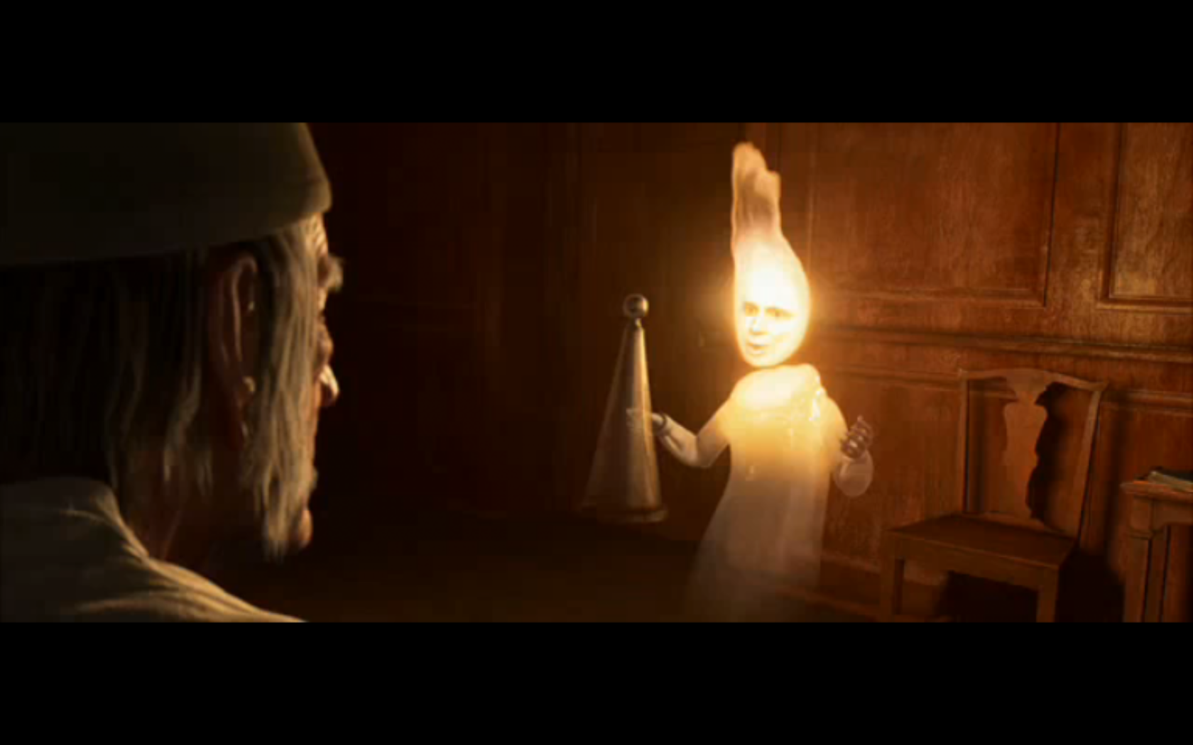
The Ghost of Christmas Past has a glowing head symbolize memory.
The light it brings into Scrooge’s dark room could represent the light the spirit will bring to Scrooge’s dark and miserable life.

Slide 42
Questions to answer
What memories are shown to Scrooge? Why is Scrooge shown these things?
How was he treated by his father?
Why does seeing his sister make Scrooge sad?
What does Fezziwig’s party tell us about how Christmas should be celebrated?
Why is Scrooge’s relationship with Belle destroyed? What did he love more?

Slide 43
On your post-it note
Write down what you have learned about The Ghost of Christmas Past.

Slide 44
Watch and read chapter 3- go back to pre-reading PP

Slide 45
Class Charts
Complete the worksheet by filling in the gaps for Chapter 3 (stave 3).
Notes:
This was a cloze website I downloaded from Tes. It isn’t my own so has not been included in my scheme of work.

Slide 46
Do it now task
Write down on the paper what Christmas means to you.
Forget about the idea that it is a Christian festival about the birth of Christ, think about what Christmas means to you personally.

Slide 47
OBJECTIVES
Lesson 7
RECALL the Ghost of Christmas Present and Chapter 2.
IDENTIFY key quotes about the ghost.
SUMMARISE what we learn about the Ghost of Christmas Present.
LITERACY FOCUS: capital letters and full stops, using quotation marks.

Slide 48
What were Dickens’ thoughts and feelings about Christmas?
In Dickens’ mind, Christmas wasn’t a time for religion and the birth of Christ.
He felt it was instead a time for sharing, spending your money on enjoyment, a time of gathering, love and celebration.

Slide 49
The Ghost of Christmas Present feels the same way
This ghost wants Scrooge to see how Christmas is celebrated.
He has transformed Scrooge’s house into a treasure trove, containing piles of Christmas goods and food to show what a wonderful celebration it is.

Slide 50
The spirit’s torch
The spirit’s torch has been likened to a cornucopia, a large, horn shaped container overflowing with produce: flowers, nuts, edibles, or wealth in another form.
It is a symbol of plenty and abundance.

Slide 51
Task
Complete the annotation tasks worksheet to annotate the information about the Ghost of Christmas Present.

Slide 52
Planners out please
LEARNING HWK
Read the knowledge organiser on The Ghost of Christmas Present and begin to learn the information about him.
You will be tested at a later date!

Slide 53
Title- The Ghost of Christmas Present
Lesson 8
Write 2 pages of PEE paragraphs about how Dickens presents the Ghost of Christmas Present.
You can do it!

Slide 54
Some points to start your paragraphs.
The Ghost of Christmas Present transforms Scrooge’s home,
Another example of how the ghost has changed Scrooge’s room is,
The Ghost is described as,
The Ghost carries a cornucopia,
The ghost looks like it is friendly,
Further evidence of the ghost being friendly is,
The ghost is wearing...

Slide 55
WAGOLL
The Ghost of Christmas Present transforms Scrooge’s home, for example, ‘Heaped up on the floor, to form a kind of throne, were turkeys, geese, game, poultry, brawn, great joints of meat,’
The ghost has brought lots of festive things to Scrooge’s house. The adjective ‘heaped’ and the long list of things Charles Dickens writes about tells us there is a lot of food. This helps to make the reader think about what a good time Christmas is, when we can enjoy lots of different things and in large amounts because that is what Christmas is all about. The ghost has made Scrooge’s room different because it is filled with lots of luxurious food which is better compared to the gruel Scrooge was eating in chapter 1 of the story.

Slide 56
WAGOLL
Another way the Ghost of Christmas Present has changed Scrooge’s home is, ‘a mighty blaze went roaring up the chimney,’
This quote tells us....This is effective because...

Slide 57
DIRT TIME
Make your green pen corrections.
Private reading of your Accelerated Reader book.

Slide 58
Do it now task
Write down on the paper what Christmas morning is like.
What’s going on? Is it busy or quiet? What is the atmosphere like?

Slide 59
OBJECTIVES
Lesson 9
READ Dickens’ description of Christmas morning.
IDENTIFY key quotes that describe the scene.
DISCUSS what atmosphere is created.
TRANSFORM your knowledge into an image.
LITERACY FOCUS: capital letters and full stops, using quotation marks.

Slide 60
Shared reading
As we read the description of Christmas morning, highlight any details about:
What people are up to
The weather
The mood
The atmosphere
Sights, sounds.

Slide 61
Analysing and exploring quotations
‘For, the people who were shovelling away on the housetops were jovial and full of glee; calling out to one another from the parapets, and now and then exchanging a facetious snowball – better-natured missile far than many a wordy jest – laughing heartily if it went right and not less heartily if it went wrong..’

Slide 62
Analysing and exploring quotations
‘the customers were all so hurried and so eager in the hopeful promise of the day, that they tumbled up against each other at the door, clashing their wicker baskets wildly, and left their purchases upon the counter, and came running back to fetch them, and committed hundreds of the like mistakes, in the best humour possible.’

Slide 63
Analysing and exploring quotations
‘There were great, round, pot-bellied baskets of chestnuts, shaped like the waistcoats of jolly old gentlemen, lolling at the doors, and tumbling out into the street’

Slide 64
TRANSFORM your knowledge into an image.
Using the information you have just read, draw a picture which matches the scene that Dickens has described.

Slide 65
Plenary
Thinking back to Dickens’ description of Christmas morning, what atmosphere has he created?
Be ready to justify your answer.

Slide 66
Do it now task- list 5 things you already know about this family
LITERACY FOCUS: capital letters and full stops,

Slide 67
OBJECTIVES
Lesson 10
READ Dickens’ description of the Cratchit family and their Christmas.
IDENTIFY key quotes that describe the scene.
DISCUSS how the Cratchits are presented to the reader.
EVALUATE how and why they are important to the story.
LITERACY FOCUS: capital letters and full stops, using quotation marks.

Slide 68
Meet the Cratchits!
On pages 8-14, the Ghost of Christmas Present shows Scrooge how the Cratchit family celebrate their Christmas.
This allows Scrooge to see how the poor live and how we can be content without riches. It allows Scrooge to feel sympathy with the lower class and to see his worker, Bob, in a different light.

Slide 69
Meet the Cratchits!
Remember that many of the upper classes were unfeeling to the poor- like Scrooge, some were angry that their taxes went towards housing the poor in work houses.
Dickens presents the Cratchits in a positive light as he wanted to undermine the prove that the poor are good people too. Dickens shows the Cratchits are family orientated, clean, tidy and take pride in their appearance/ the dinner that has been made.
Dickens also uses the Cratchits to highlight the problems faced by the poor.

Slide 70
Meet the Cratchits!
In your exercise books, using your notes and your own knowledge, summarise what you know about the Cratchits and why they are important in the story.

Slide 71
Extension
Now write some PEE paragraphs about what the Cratchits are like and how they celebrate Christmas.

Slide 72
Starter Sentences
The Cratchits are a very loving family...
We know they are a poor family because...
The family all help out with the preparation of the Christmas dinner...
The Cratchits keep themselves tidy and presentable...
The family are grateful for what they have...

Slide 73
WAGOLL
The Cratchits are a very loving family, ‘Why, bless your heart alive, my dear, how late you are!” said Mrs Cratchit, kissing her a dozen times, and taking off her shawl and bonnet for her.’
This proves they are loving because Mrs Cratchit is pleased to see her daughter. She calls her daughter, ‘my dear’ which is a loving word to use and kisses her ‘a dozen times’ meaning that she is pleased Martha is home for Christmas and loves her dearly.

Slide 74
Plenary: The A-Z of the Cratchits

Slide 75
Class Charts
LEARNING HWK
Learn the key quotes about the Cratchit family.
You will be tested at a later date!

Slide 76
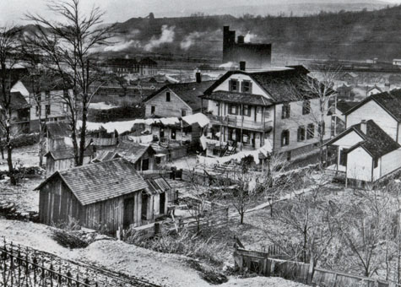
DO NOW TASK (THINKING TASK):What’s the connection between these places and the Ghost of Christmas Present?

Slide 77
OBJECTIVES
Lesson 11
READ Dickens’ description of the other Christmases we see.
IDENTIFY key quotes that describe the scenes.
DISCUSS what the Ghost of Christmas past wants Scrooge to learn from these scenes.
TRANSFORM the scenes into images.
LITERACY FOCUS: capital letters and full stops, using quotation marks.

Slide 78
The other places, p 15-16
What locations does the spirit take Scrooge to before Fred’s house?
How are the settings outside different to the atmosphere inside?
Why does the spirit show these dismal places to Scrooge? What does he want Scrooge to learn from seeing them?

Slide 79
TRANSFORM your knowledge into an image.
Using the information you have just read, draw a picture which matches the scene that Dickens has described.

Slide 80
Plenary
What lesson does Scrooge learn from seeing these bleak and miserable places?
How is Christmas celebrated in these miserable places?

Slide 81
Do it now task- Fred’s House (17-22)
What is going on in Fred’s house for Christmas?
What is the mood and atmosphere?

Slide 82
OBJECTIVES
Lesson 12
READ Dickens’ description of Christmas at Fred’s house.
IDENTIFY key information about Fred’s Christmas.
DISCUSS what lesson Scrooge learns from seeing Fred’s Christmas.
LITERACY FOCUS: capital letters and full stops, using quotation marks.

Slide 83
Title: Christmas at Fred’s house (pg 17-22)
How does Fred feel about his uncle Scrooge? What does he say about him on pages 18?
What do the characters do to celebrate Christmas? What are some of the activities they enjoy? (P19-21)
What happens when they play the Yes and No game on p21-22?
How has Scrooge changed on p21? What does he beg the spirit to allow him to do?

Slide 84
Plenary
What lesson does Scrooge learn from seeing Fred’s Christmas?
How is Christmas celebrated in Fred’s home?

Slide 85
Do it now task: Read pages 23-24 and describe what happens to your partner

Slide 86
OBJECTIVES
Lesson 13
READ Dickens’ description of Ignorance and Want.
IDENTIFY key quotes.
ANALYSE the language used to present the children.
LITERACY FOCUS: capital letters and full stops, using quotation marks.

Slide 87
Analysing the children
TASK:
Begin analysing the quotations about the children.

Slide 88
What do we now know about the children?
What do the children look like? What does their appearance suggest about their characters?
Who do they belong to?
What are their names?
If they are allegorical, what do they represent?
Which one should Scrooge be most wary of? Why?
What is Scrooge ‘Ignorant’ to?
How does ‘Want’ fit in with his character?

Slide 89
Written task
Now write some PEE paragraphs about the children.
The appearance of the children is described as…
Another quote about the appearance of the children is…
The names of the children are important…

Slide 90
What do you now know about this image? What have you learned today?

Slide 91
Exam question (extract)
Lesson 14

Slide 92
Read Chapter 4 and watch

Slide 93
Class Charts
Complete the worksheet on Stave 4.
Notes:
Again, this was a cloze exercise I downloaded from another teaching site.

Slide 94
DO IT NOW TASK- discuss what you remember about this ghost and stave 4

Slide 95
The Ghost of Christmas Yet to come
The Ghost of Christmas Yet to Come represents the fear of death and moral reckoning (a religious belief that we are judged before we die and sent to Heaven or Hell). Where might Scrooge go?
It is a silent, ‘Grim Reaper’-like figure and is the final part of Scrooge’s lessons.

Slide 96
OBJECTIVES
Lesson 15
READ Dickens’ description of the Ghost of Christmas Yet to Come.
IDENTIFY key quotes.
ANALYSE the language used to present the ghost.
LITERACY FOCUS: capital letters and full stops, using quotation marks, using PEE.

Slide 97
The Ghost of Christmas Yet to come pg’s 1 and 2
Highlight any quotes about the ghost’s appearance and how it behaves.
Challenge-can you label any verbs, adverbs or adjectives?

Slide 100
Title- The Ghost of Christmas Yet to Come
Write 1 page of PEE paragraphs about how Dickens presents the Ghost of Christmas Yet to come.
You can do it!

Slide 101
Some points to start your paragraphs.
The Ghost of Christmas yet to come is a frightening spirit...
The Ghost of Christmas Yet to Come creates a bleak atmosphere...
The Ghost is described as wearing...
The Ghost does not speak...
This ghost, for Scrooge, is the one he is most frightened of...

Slide 102
WAGOLL
The Ghost of Christmas Yet to Come creates a bleak atmosphere, ‘the very air through which this spirit moved seemed to scatter gloom and mystery,’
The ghost has brought a miserable atmosphere with it because instead of bringing joy, it brings misery. The word ‘gloom’ tells us that the ghost brings a sad atmosphere with it.

Slide 103
DIRT TIME
Make your green pen corrections.
Private reading of your Accelerated Reader book.

Slide 104
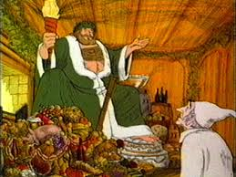
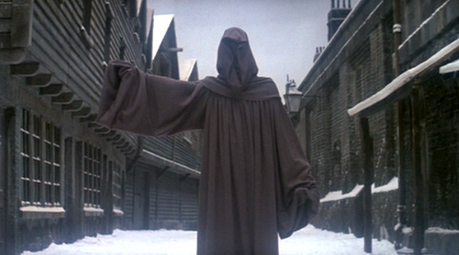
PLENARY: In your opinion, which ghost has the most influence on Scrooge? Be prepared to explain your ideas.

Slide 105
On pages 2-12, the spirit shows Scrooge conversations and gossip between the locals about a man who has just died. How do people react to the news of his death?

Slide 106
OBJECTIVES
Lesson 16
DESCRIBE people’s reactions to Scrooge’s death.
IDENTIFY key quotes.
LITERACY FOCUS: capital letters and full stops, using quotation marks.

Slide 107
Different responses to Scrooge’s death
The businessmen.
The thieves.
The husband and wife who owed Scrooge money.
Notes:
Fill in worksheet.

Slide 109
On your post-it note
Write down in your own words how people react to the news of Scrooge’s death.

Slide 110
What was life like in the Cratchits’ house in Chapter 3 when Scrooge visited with the Ghost of Christmas Present?
Notes:
Silhouette activity.

Slide 111
OBJECTIVES
Lesson 17
READ Dickens’ description of the Cratchit house in Chapter 4.
IDENTIFY key quotes.
ANALYSE the language used to present the house.
EXPLORE how the household is different from chapter 3.
LITERACY FOCUS: capital letters and full stops, using quotation marks, using PEE.

Slide 112
Shared reading
How is the Cratchit house different?

Slide 113
The Cratchits in Chapter 3 | The Cratchits in Chapter 4, pages 13-14.
‘two smaller Cratchits, boy and girl, came tearing in screaming.’ ‘these young Cratchits danced around the table.’ ‘Such a bustle ensued’ | ‘Quiet. Very quiet. The noisy little Cratchits were as still as statues.’

Slide 114
Check
How is life different at the Crachit house? Compare and contrast to Chapter 3.
What is the mood and atmosphere like?
Why?

Slide 115
Pages 17-18: Scrooge’s promise
What does Scrooge promise to do?
What do you think he means?

Slide 116
"I will honour Christmas in my heart, and try to keep it all the year. I will live in the Past, the Present, and the Future. The Spirits of all Three shall strive within me. I will not shut out the lessons that they teach. Oh, tell me I may sponge away the writing on this stone!"

Slide 117
Class Charts
Learn the knowledge organiser on Stave 4.
Watch the videos set for you on GCSE Pod.

Slide 118
Read and watch stave 5

Slide 119
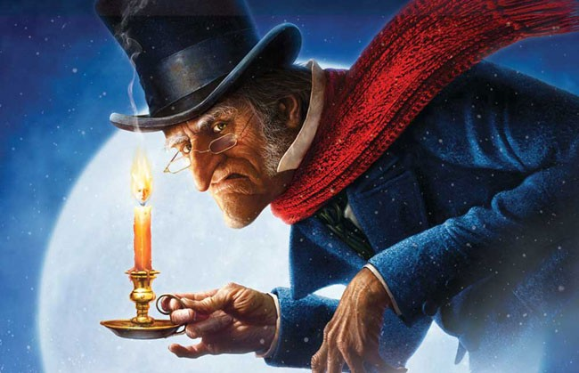
DO IT NOW TASK
List how Scrooge is different at the end of the story compared to what he was like at the beginning.

Slide 120
OBJECTIVES
Lesson 18
DESCRIBE how Scrooge is different.
IDENTIFY key quotes.
INVESTIGATE how Scrooge makes amends for his bad deeds in Chapter 1.
LITERACY FOCUS: capital letters and full stops, using quotation marks.

Slide 121
Create your Scrooge
Group 1- Scrooge at the start of the story.
Group 2- Scrooge at the end of the story.

Slide 122
How his personality has changed
Complete the worksheet and glue it into your book.

Slide 124
Title- Scrooge’s tansformation
Write some PEE paragraphs about how Dickens presents the Scrooge has changed in Chapter 5.
You can do it!

Slide 125
Some points to start your paragraphs.
In Chapter 5, Scrooge is happy and joyful...
Another quote that proves Scrooge is happy and joyful is...
Scrooge describes himself using similes...
Another simile Scrooge uses to describe himself is...

Slide 126
DIRT time

Slide 127
DO IT NOW TASK- Discuss what this phrase means
‘Make amends.’
To make amends with someone.

Slide 128
Low Scrooge makes amends
What are some of the bad things he did in Chapter 1?
Mean to Bob- no coal for the fire.
Refuses money to the charity workers.
Refuses Fred’s invitation to Christmas dinner the next day.
How does he put things right or make amends in Chapter 5?

Slide 130
Plenary
What do you personally think is the best change in Scrooge and why?

Slide 131
Exam question- Scrooge in Chapter 5
Assessment opportunity to chart Scrooge’s developments over the course of the novel? Use ch 5 opening as the extract?

Slide 132
Themes Revision

Slide 133
Themes
Charity and greed
Rich v’s poor
Time
Redemption and change (regret, Free will)
The Christmas Spirit

