Slide 1
So far this week:
In your writing you need to:
Use complex sentences
Write using personal pronouns for effect
Use superlatives and comparatives
Use exaggeration – opinions into facts
Today we will use a few more techniques to help us write an argument!

Slide 2
Difference of opinion:
Everyone has a different opinion
In your argument you must show you understand both sides of an argument. Even if you don’t agree with one!
If you do this you can win an argument!

Slide 3
Counter Arguments
While you might think that a hippopotamus is a difficult animal to keep as a pet, actually, it’s not too bad.
Although you say that it won’t like living in our two bedroom flat, in fact, hippos love living somewhere cosy.
Despite the fact that it’s dangerous to come between a hippo and water, this needn’t be a problem because we can keep it in the bath.
Some people worry that hippos need to eat a lot of food, but they don’t realise that hippos eat grass.
Pick your own animal – maybe a crocodile, elephant or anteater - and argue that you should be allowed to keep it as a pet.
While people say that………
Although you think that…………
Despite the fact that………….

Slide 4
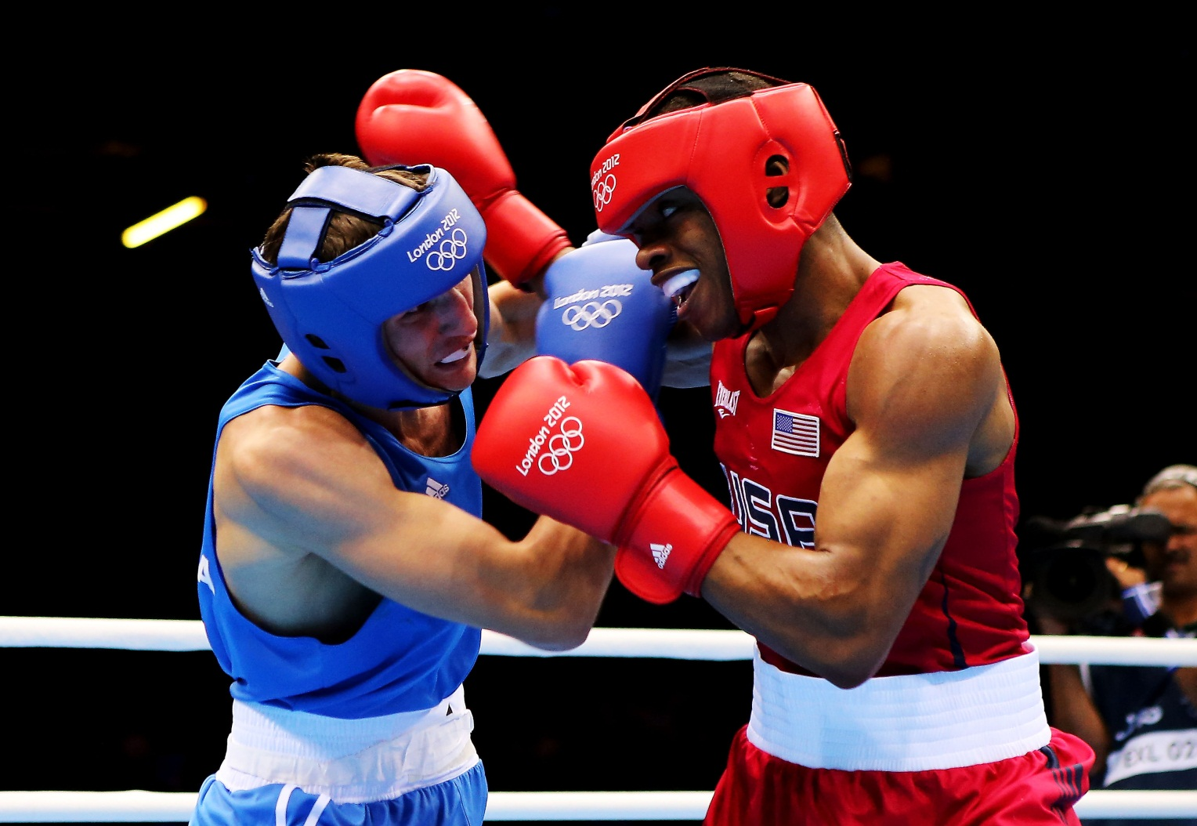
Let’s get ready to RUMBLE!
http://www.youtube.com/watch?v=yjXZmtg7GwI

Slide 5
Let’s get ready to… RUMBLE!
Their Opinion DUCK! AKA ‘Weaving’ | SQUASH IT ‘Counter Punch’ | YOUR OPINION JAB/Right Hook/Uppercut etc.
I understand why some people believe… | However, | I believe that…
Some people may think… | But, | On the other hand,
I know how some people feel about… | Although this might be the case, | Have they considered…?
Some people think this is a good idea because… | Never the less, | I feel strongly that…
 | In contrast to this, | I would argue that…

Slide 6
Exam Question:
‘Another referendum is within our basic right. Labour are correct in forcing another vote through. The first time around the general public had no clue what they were voting for.’
Argue for or against this statement.
*Ideas
*Skills – devices
*SPAG – sentence structures
Notes:
http://www.youtube.com/watch?v=yjXZmtg7GwI

Slide 7
Use your rumble paragraph sheet to write a paragraph that squashes an opposing argument
Firstly, think about at least one opposing argument to your topic. What might someone who disagrees with you think?
Secondly, choose a sentence opener to ‘duck’ their argument.
Thirdly, SQUASH their argument using your point and any other argumentative techniques.
Lastly, complete your paragraph with your final opinion.

Slide 8
TRAPPERS OR DAFOREST
Three – the power of three! Use three ideas, words or examples.
Repetition – Repeat single words or ideas.
Alliteration – where words next to each other start with the same letter. Eg. ‘taunting teachers’
Paragraphs – Have at least three different arguments and use a range of connectives to make the speech flow.
Punctuation – Use and vary punctuation in writing your writing. Use pauses for effect.
Evidence – Use facts/stats and opinions to make audience feel you have knowledge to back up your view.
Rhetorical Questions – A question not needing a response.
Sentence Structure – Vary this. When arguing short sentences can be just as effective as a complex sentence.
Notes:
Work through identifying, explaining and writing using these techniques in the next few weeks.

Slide 9
Swap paragraphs
Give a tick for:
An introductory sentence
A squash it sentence
An opinion sentence
1 point for any other TRAPPERS techniques
1 point for starting a sentence with a personal pronoun.
Public Critique: Kind, Specific and a Helpful comment at the bottom of their work!

Slide 10
How to plan a whole argument!
Using the fight plan you are going to plan a whole argument.
First of all brainstorm some ideas of things you feel strongly about!
Think of the counter-arguments before you plan.

Slide 11
Using the sheet
Plan an introduction to your argument – use bullet points.
How many paragraphs can you plan – what would the counterargument be and your argument back?
What would your knockout blow be?!

Slide 12
Write a rumble paragraph using:
Rhetorical question
Complex and simple sentences
Alliteration
Personal pronouns
The RUMBLE structure!

