Slide 1
Writing to Persuade - Trolls
We all hear or see the word ‘troll’ a lot recently, but what is a troll and why are they so controversial?
What is an online troll?
Why is it that online trolls have become more of a problem in recent years?
What strategies can we use to stop trolls and help people who suffer because of them?

Slide 2
The term ‘online troll’ is a relatively new one
It became popular on the Internet in the late 1990s and the rise of social media has seen a huge increase in the amount of ‘trolling’.
The original use of the word comes from Scandinavian folklore, where little, ugly creatures would live under bridges and often be anti-social, slow-witted and argumentative.
In more recent times, the term has been used as a metaphor to describe the act of targeting someone on the Internet, with abusive or hateful messages.
As social medias like Facebook, Instagram and Twitter have grown, more and more people have acted as ‘trolls’ in an attempt to create anger, division and get a negative reaction from others.

Slide 3
Learning outcomes
To describe persuasive techniques and how they can persuade an audience
To explain how we can use persuasive techniques to engage an audience
To evaluate how a writer uses specific techniques in an article and why

Slide 4
What are the differences between persuading and arguing?
We’ve spent the last week analysing articles and writing our own, but with a focus on writing to argue.
Now, we will look at writing to persuade.
Discuss: What are the differences between these two purposes? How are they shown in the style of writing?

Slide 5
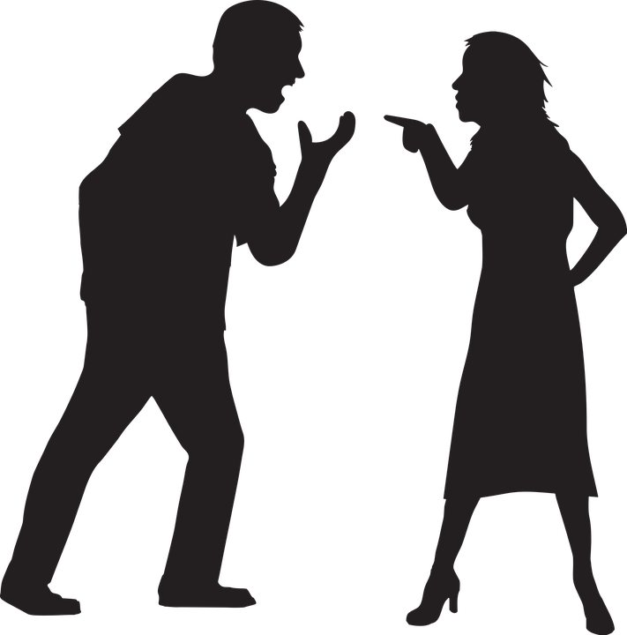
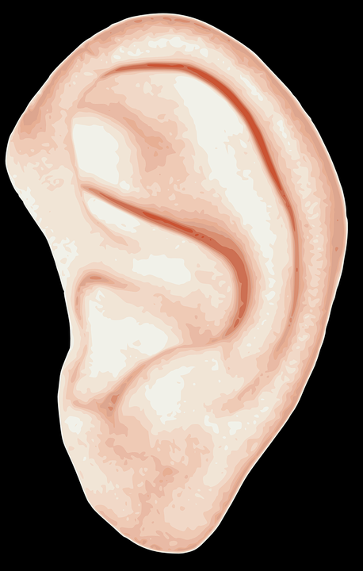
 | WRITING TO ARGUE | WRITING TO PERSUADE
What is it? | Giving the case for one side of a debate | Convincing someone that your opinion is right
What does it involve? | Being aware of the other side of a debate | Using your language to convince your leader.
What key features do you often find in this type of writing? | Includes counter-arguments, rhetorical questions, facts, statistics, emotive language | Includes triplets, repetition, emotive language, rhetorical questions, direct address and more…
There are similarities between these two purposes, but generally writing to argue is about putting forward your own ideas AND showing an awareness of other perspectives, whilst writing to persuade focuses on your own perspective and convincing the audience you are right.
Writing to argue often involves more facts and statistics to support ideas, whereas writing to persuade focuses on use of language to change a reader’s mind.

Slide 6
Persuasive techniques
Today we’re going to focus on persuasive writing. Did you know there are many techniques you can use to help you to persuade someone to think or do something? An easy way to remember some of these is the acronym DAFORREST.
Direct address (“you”) A
F
O
R
R
E S T
Complete the ‘DAFORREST’ acronym which lists many of the persuasive techniques you can use when writing to persuade.
Extension: What are the best techniques to use when writing to persuade? Why?

Slide 7
Persuasive techniques
Direct address (“you”) Alliteration / Adjectives
Facts
Opinions
Rhetorical questions
Repetition
Exaggeration / Emotive language Statistics Tone / Triplets
Complete the ‘DAFORREST’ acronym which lists many of the persuasive techniques you can use when writing to persuade.
Extension: What are the best techniques to use when writing to persuade? Why?

Slide 8
Read the ‘Trolls’ article with the person nearest to you
Direct address (“you”) Alliteration / Adjectives
Facts
Opinions
Rhetorical questions
Repetition
Exaggeration / Emotive language Statistics Tone / Triplets
Work together to annotate any DAFORREST techniques you can see being used.
For each one, explain how the writer has used them and why.
Evaluate how the writer is able to use DAFORREST techniques to engage the audience. Provide specific examples.

Slide 9
They used to be ugly creatures that lived under bridges in fairy tales. In the 1990s, they were the florescent-haired toys that nobody could get enough of. In the 21st century, trolls are now lurking online, waiting to spoil your fun, and worse.
Since the rise of the internet, we’ve used the word ‘trolls’ to refer to people who deliberately try to annoy or upset people online. They often post insults, spam, deliberately argumentative comments or other material designed to get a negative reaction from the original poster. You’ll find trolls pretty much anywhere there’s a comments section. You might even have been a troll yourself at some point. You might be one still, priding yourself on your ability to upset people you’ve never met with a carefully-chosen nonsensical argument, off-topic post or pathetic personal insult.
But I hope you’re not.
The opening paragraph of the article hooks the reader in by explaining what trolls are and what the word ‘troll’ means without using it. It intrigues us as readers before we go on to discover what the article is actually about.
Next, the writer uses a number of facts to explain what trolls are and what they do. They use hyperbole to suggest trolls are in every comments section, and a lot of direct address to speak directly to the reader and make them feel this article is relevant to them.

Slide 10
You see, trolls are just another type of bully. They’re nothing new in themselves; as a species, we’ve been subjected to meanness, spite and ignorance since we figured out we could talk. It’s unfortunately part of the rich tapestry of human experience, along with other nicer things like kindness, empathy and understanding. But the problem with trolls is that, because they are often protected by the anonymity of a username, they feel that they can vent their bilious rants wherever they like and to whomever they like, without fear of actually having to be responsible for their words.
Thankfully, the law is changing to try and remedy the situation. The Crown Prosecution Service are now making it easier to prosecute trolls who abuse and harass people online. Comments which threaten violence, which are obscene or grossly offensive, could cause their author to be prosecuted.
In this section of the article, the writer conveys their opinions about trolls and how much they dislike them, but also how frustrating it is that trolls can often be protected by anonymity online.
However, in the next paragraph they explain using facts that the CPS is going to be able to prosecute types of trolling in the future.

Slide 11
‘Oh, but what about free speech?’ I hear you ask. ‘Isn’t it my right to deliberately be an idiot somewhere I’m not wanted?’. Well no, it isn’t, actually. But there is an important distinction to make between disagreeing with people and subjecting them to abuse. If your opinion differs from other people, fine. You might not be welcome to express it in certain contexts, but it’s your opinion and you are entitled to it. If you are deliberately using your words (or pictures) to offend and upset somebody, then you’re trolling, and that’s not okay. Take the example of female MPs online, who are exposed to rape and death threats on a depressingly frequent basis, merely for doing their jobs. Nobody deserves to be subjected to that kind of trolling.
Most trolls wouldn’t dream of saying the things they type online out loud in real life, to real-life people. If they did, they’d be kicked out of places faster than they could say ‘loser’. So be sure to steer clear of trolls, and don’t be afraid to use the ‘report’ button if you need to flag up some abusive comments. The internet has given us so many wonderful things; let’s put those trolls back under the bridge where they belong.
In the last paragraphs of the article, the writer continues to provide their own opinions about trolls and tries to persuade the reader that there is no defence for trolling. They claim having a different opinion is fine, but if you trying to hurt others or abuse them then that’s trolling. They provide the example of female MPs who are often subjected to atrocious abuse; this helps to support the writer’s viewpoint.
In the final paragraph, the writer continues to provide their opinions, but they also continue to address the reader. At the end of the article, they link back to the very start, using the original meaning of ‘troll’ to criticise ‘online trolls’ and suggest they should be put back ‘under the bridge’.

Slide 12
The writer uses a lot of direct address in this article
Moreover, much of the focus of the article is in providing their opinions to the reader.
Discuss: Why do you think they did this?
Bonus Challenge: How is this article different to the others we have studied this term so far?

Slide 13
Plenary: Three Ideas
Write down three ideas you will take away from today’s lesson to better prepare you for…
To describe persuasive techniques and how they can persuade an audience
To explain how we can use persuasive techniques to engage an audience
To evaluate how a writer uses specific techniques in an article and why

