Slide 1
EXAM STRESS

Slide 2
Who are we?
Solar is a partnership between Birmingham and Solihull Mental Health NHS Foundation Trust (BSMHFT), Barnardo’s and Autism West Midlands.
The Mental Health Support Team (MHST) within Solar provides Emotional Wellbeing and Mental Health Services to Children, Young People and Families in Solihull.
Solar supports young people (0-19 years old with some aspects going up to 25 years old) who are experiencing emotional wellbeing and/or mental health concerns.

Slide 3
The 3 core functions of the MHST
Deliver evidence-based interventions for mild to moderate mental health issues.
2. Supporting the senior mental health lead in each school or college to introduce or develop their whole school or college approach.
Giving timely advice to school and college staff, and liaising with external specialist services, to help children and young people to get the right support and stay in education

Slide 4
The support that we offer…
1:1 low intensity intervention support
Whole school approach (working with schools)
Advice and support
Workshops
Support for carers
Support for young people
Support for staff

Slide 5
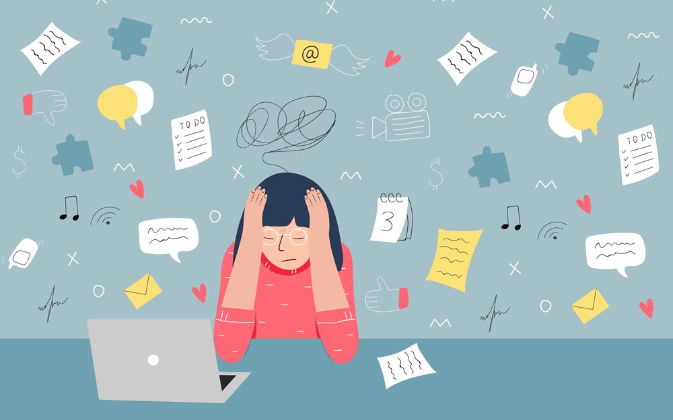
Exam Stress

Slide 6
Why are we talking about exam stress?
Stress has a massive impact on our Emotional Health and Mental Wellbeing
It can cause us to feel low in mood or anxious, and can lead to changes in behaviour and thoughts
There are ways to manage feelings of stress, therefore helping our children and young people cope through such stressful times

Slide 7
What is stress?
“ Stress is the adverse reaction people have to excessive pressure or other types of demand placed on them”
Stress is a normal emotion that everyone feels
It can sometimes be useful to enhance our performance but it can become a problem when it interferes with everyday life

Slide 8
Where does stress come from?
Notes:
Anxiety = a persons specific reaction to stress.

Slide 9
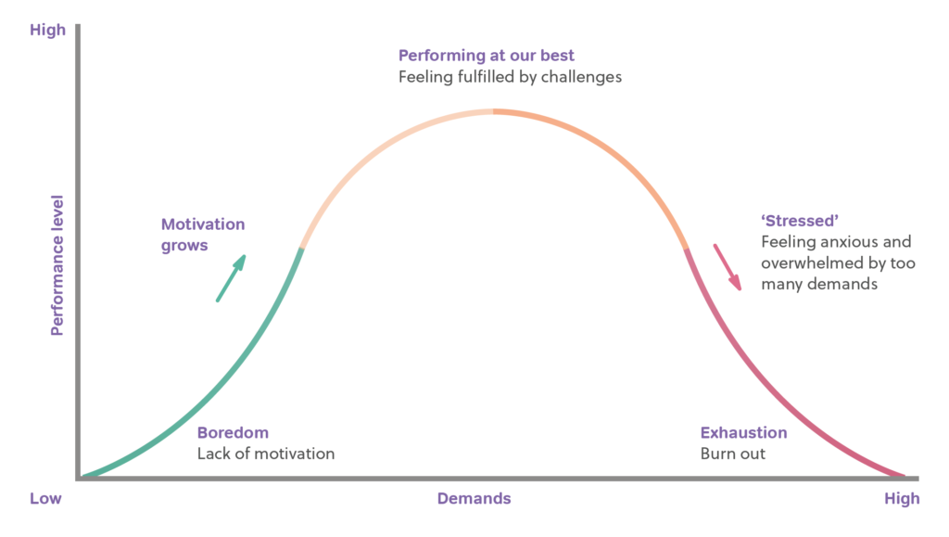
The benefits of stress..
Notes:
Improved alertness
Improved performance and concentration

Slide 10
Identifying stress
Stress can affect us in four main ways….
Physical
Emotional
Behavioural
Thoughts

Slide 11
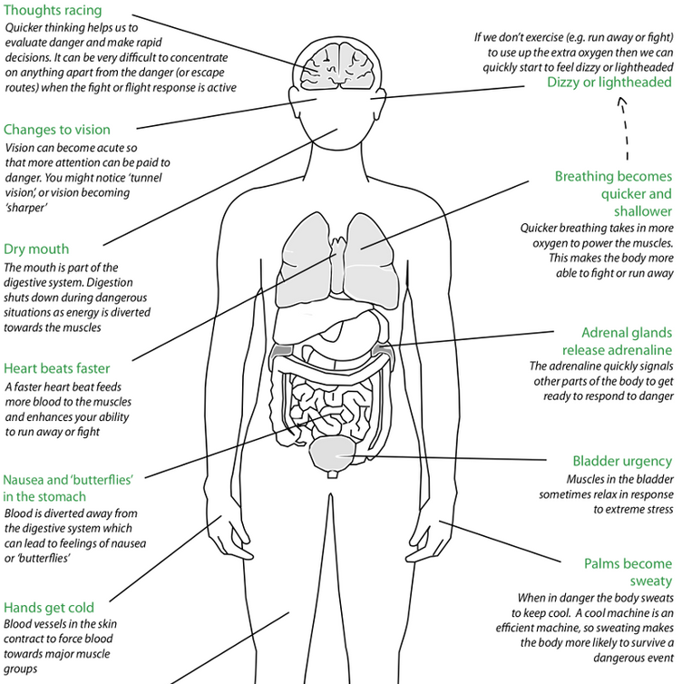
Physical…

Slide 12
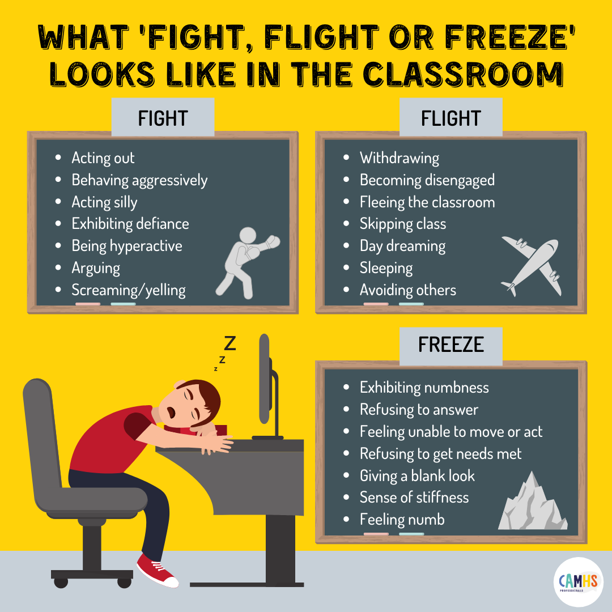
Behavioral…
Notes:
Angry or aggressive outburst
Indecisive
Changes in eating (over eating/over eating)
Substance misuse
Social withdrawal
Less active
Mood swings
Compulsive behaviours
Lack of sleep/insomnia
Restlesness
Accident prone

Slide 13
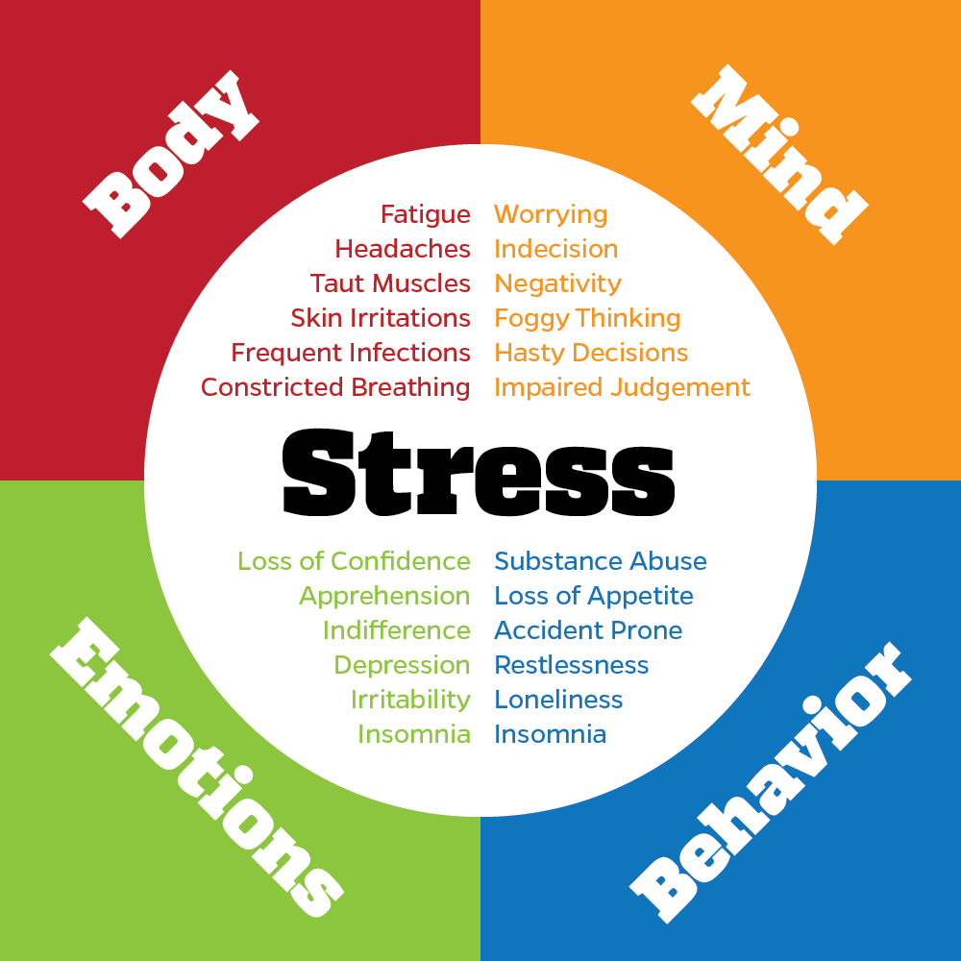
Emotional…
Notes:
More fussy
Anxiety
Low mood
Alienation or loneliness
Apathy
Lack of confidence or self esteem
Apprehension
Easily angered
Lack of interest

Slide 14
Thoughts…
Notes:
Worrying
Overthinking
Impaired judgement
Negativity
Muddled thinking
Indecisiveness
Hasty decisions
Foggy thinking

Slide 15
Creating a wellbeing bucket…
Notes:
A wellbeing or stress bucket helps us to see the ways in which stress builds and how we can manage such stress.
The bucket represents the mind.
The top of the bucket and water going in = stressors
Bottom of bucket = stress release + helpful coping strategies
All these different things in everyday life start to fill up our stress bucket – e,g lack of sleep, finance, child care etc. Our bucket starts to fill quite quickly. We need to find ways to reduce the amount of worries that we have, like putting a few taps on the bucket so that we can filter or reduce the amount of water going in.
We can help to reduce the effects of stress by being more conscious of the things that cause It and what we can do to help get through them.
For us this might look like this….

Slide 16
What might my child's stress bucket look like?
Notes:
Excellent resource
https://weheartcbt.com/
Complete together collaboratively

Slide 17
Helpful vs unhelpful coping strategies
Sports/being active
Interests /Hobbies
Having routine/structure
Getting enough sleep
Asking for help
Establishing healthy boundaries
Creating to do lists
Managing time
Breathing and grounding
Setting SMART goals
Avoidance
Procrastinating
Negative self talk
Eating too much or too little
Aggression
Notes:
Think about what is going to help your child when they are feeling stressed.

Slide 18
Setting S.M.A.R.T goals
Goals are really hard to stick to, especially when it takes a lot of motivation to do it (like revising for an exam). Setting S.M.A.R.T goals are a really good way to provide clarity, focus and motivation to achieve goals. It also helps to encourage us to achieve goals due to making them measurable and time bound.
S.M.A.R.T = Acronym
Specific
Measurable
Achievable
Realistic
Time bound.
“I want to get my science and maths revision done by the last day of this month …………”
“I want to get all my revision done so that I can pass my exams”

Slide 19
Creating a timetable and structure
Again, timetables go really well alongside S.M.A.R.T goals to help provide structure and help us to manage our time.
Timetables = essential for helping us to feel in control. A lot of anxiety around exam stress is from feeling overwhelmed. Reduce this by creating structure and a sense of control/ownership.
TOP TIPS:
Create your child's timetable collaboratively, or prompt your child to ask a teacher or trusted friend for some help. Sometimes we do have unrealistic expectations for ourselves and this is hard to notice sometimes.
Before adding in revision into the timetable, prioritise self care and helpful coping strategies (from the stress bucket that will help to reduce negative feelings). Mental health underpins educational attainment so ensure your child is getting their self care time in!!
20 minute chunks of work!! Research shows that studying in smaller chunks is optimal for revision.

Slide 20
Breathing and grounding
Breathing is arguably one of the best strategies to reduce stress and anxiety.
Controlled breathing = direct affect on heart rate, slowing it down. It also helps to reduce the amount of stress hormones in our body as a calmer body produces more serotonin (happy hormone)
Grounding = re-connecting and bringing you back to the here-and-now. Helpful when you're having a lot of ‘what if’ thoughts about past/future events

Slide 22
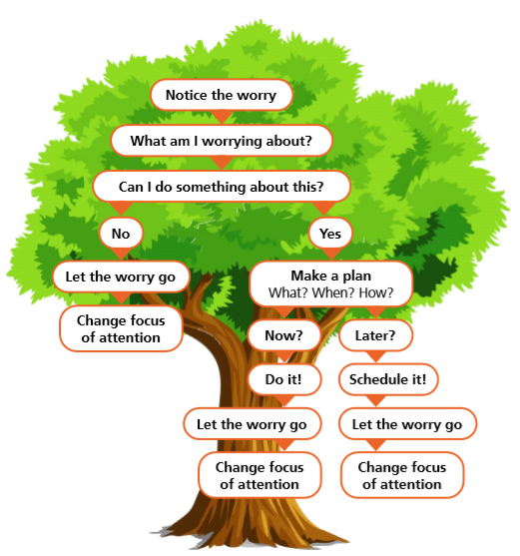
The worry tree – a way to problem solve
Worry trees are fantastic for problem solving.
https://www.nhs.uk/every-mind-matters/mental-wellbeing-tips/youth-mental-health/
Notes:
Can also write down all worries on a piece of paper if there are multiple worries

Slide 23
Being mindful of perfectionism
Perfectionism is a personality trait characterised by a person striving for flawlessness and setting excessively high performance standards, accompanies by over critical self-evaluations and concerns regarding others’ evaluations.
Helpful tips:
Normalise that everyone is imperfect
Normalise that people make mistakes
Setting S.M.A.R.T goals
Don't forget the positives that are/have been achieved
Highlight that if we were perfect at everything, we would never learn!

Slide 24
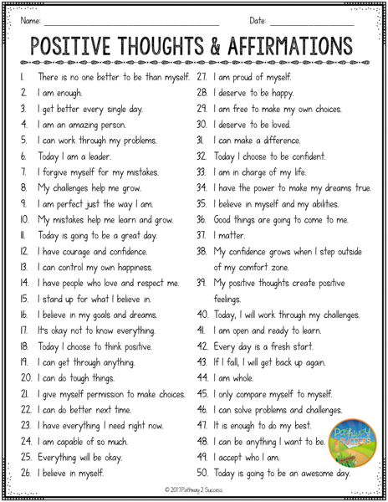
Positive affirmations
These are positive phrases and statements that repeatedly help us to challenge negative thoughts
Based on psychological theory (Self affirmation Theory – Steele 1998) and has been evidenced in research.
https://www.youtube.com/shorts/fWsLds0oO1c

Slide 25
Creating a safety plan/wellbeing plan

Slide 26
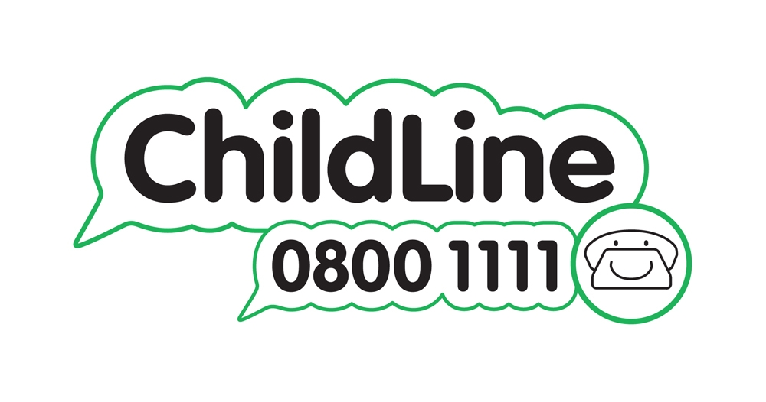
Where to get further support
Schools – we work closely with schools to provide signposting, resources, help and advice. Contact your school for more information on our support options
KOOTH – this is an online platform for children and young people (aged 11-25). They can access this anonymously, and use chat forums or access 1-2-1 support
Childline – Free confidential helpline for children under 19 years old. Call 0800 1111 for 24/7 support or visit the website for a online 1-2-1 chat with a counsellor.
Shout – this is a free text service offering 24/7 support. You can contact them if you are struggling or need immediate help. Text 85258

Slide 27
If you feel like your child needs additional support for their mental wellbeing… https://www.bsmhft.nhs.uk/our-services/solar-youth-services/
Notes:
https://www.bsmhft.nhs.uk/our-services/solar-youth-services/

Slide 28
Crisis support
Birmingham Mind – crisis support available for urgent mental health help. Ring 0121 262 3555 for 24/7 hour support.
NHS – call 999 if someone's life is at risk, or if you feel you can not keep yourself or someone else safe.
Young minds – They have a crisis messenger service across the UK – text ‘YM’ to 85258
Papyrus – charity for young people experiencing thoughts of suicide under 35 years – text 07860 039 967or call 0800 068 4141 (9am-12am midnight).

Slide 29
Q+A and Open Discussion

