Slide 1
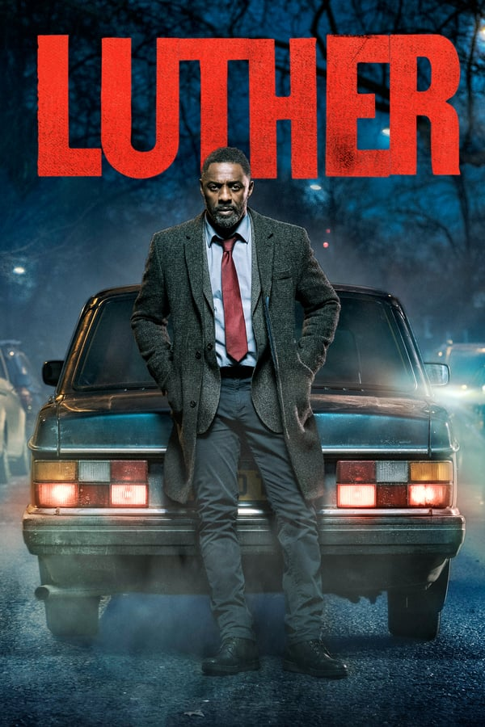
DIN- The Sweeney re-cap
When is The Sweeney set?
How are men represented in The Sweeney?
How are women represented?
How are the Police represented?
What commonalities does The Sweeney have with Luther?
What differences are there between Luther and The Sweeney?
A hybrid of crime detective/ psychological thriller
A hybrid of crime detective/ action
Q- How do these hybrids reflect a change in society?

Slide 2
Exam questions on Luther/The Sweeney
Explain the effect of social and cultural contexts on crime dramas. Refer to Luther or The Sweeney to support your points. [10]
Why might audience responses to crime dramas change over time? Refer to the crime dramas you have studied to support your points. [10]

Slide 3
Explain the effect of social and cultural contexts on crime dramas. Refer to Luther or The Sweeney to support your points. [10]
Luther reflects the social and cultural context of being made in 2010. This is shown through the fact that …….
The Sweeney also reflects the 1974 context in which is was made because ……..

Slide 4
Why might audience responses to crime dramas change over time? Refer to the crime dramas you have studied to support your points. [10]
Modern audiences would be highly engaged with Luther because ……..
An audience in 1974 would also be engaged with The Sweeney because ………

