Slide 1
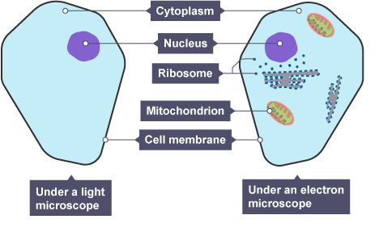
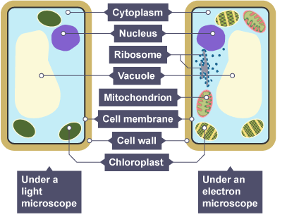
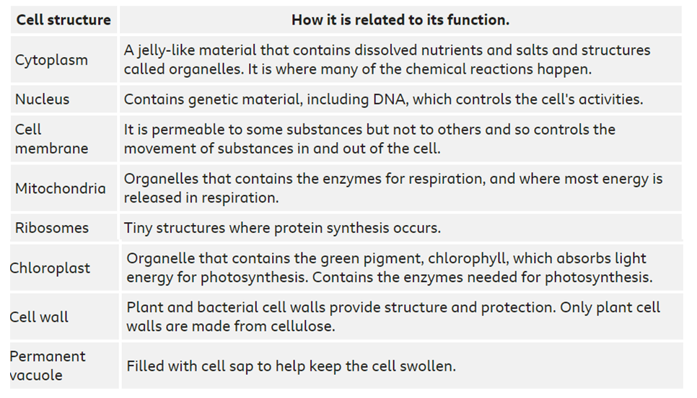
B1 Cells
Found in plants and animals
Animal and plant cells are eukaryotic!!!
Found in plants only

Slide 2
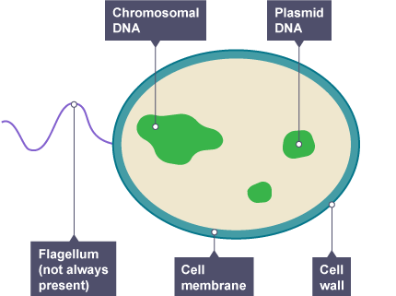
Bacteria cells are prokaryotic!!!
Prokaryotic vs eukaryotic
Prokaryotic cells have a cell wall
Plant cells have a cell wall
But
Animal cells do not
Feature | prokaryote | eukaryote
Nucleus | No | Yes
Where DNA found? | Free floating in cytoplasm | In nucleus
size | Smaller than eukaryote | Larger than eukaryote
Organelles e.g. mitochondria | No | Yes
Ribosomes | Yes - smaller | Yes - Larger
Cell membrane | yes | yes
Cytoplasm | yes | yes

Slide 3
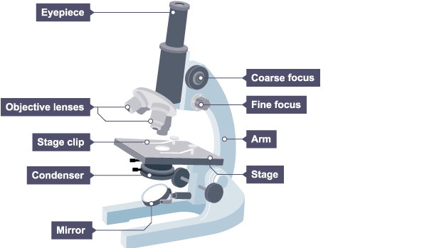
Change objective lens changes magnification
Focusing knobs makes the image clear and in focus
Do not write zoom!!!
Order of magnitude
10 x bigger – order of magnitude 10¹
100 x bigger – order of magnitude 10²
Changing mm to µm x1000
Changing mm to µm ÷1000
Low resolution
Low magnification
Living things can be viewed
High resolution
high magnification
Dead things only can be viewed

Slide 4
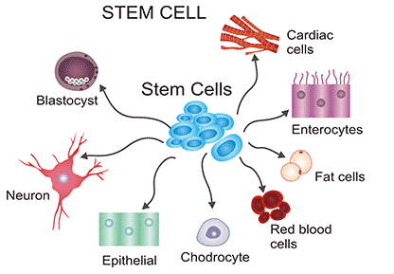
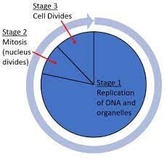
Stem cell – undifferentiated cell
Specialised cell – cell with a specific function
Embryonic stem cells
Differentiate into any type of cell
Adult stem cells
From bone marrow
Can only differentiate into limited cells
Painful process
Plant stem cells
* Found in meristem
Cell cycle – use divide not split!!!
Cell | Adaptation
Muscle | Many mitochondria
Nerve | Myelin sheath
Root hair | Large surface area
Red blood | No nucleus and haemoglobin
Stage 1: DNA and organelles replicate
State 2: Each set of chromosomes move to opposite poles
Stage 3: Cytoplasm and membrane divides

Slide 5
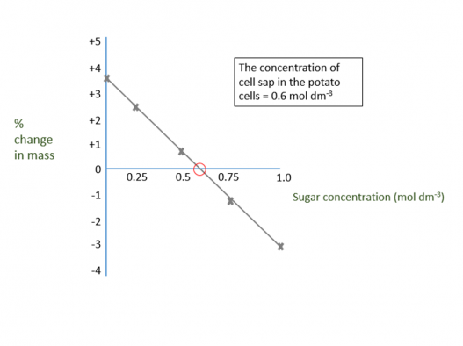
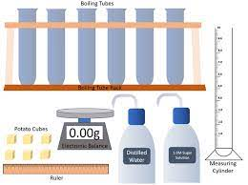
Substance moves against the concentration gradient- energy is needed!!!
Substance moves down the concentration gradient- from a high to a low concentration
Water moves down the water concentration gradient-from a high water to a low water concentration through a selectively permeable membrane
RP - osmosis
https://www.bbc.co.uk/bitesize/guides/zs63tv4/revision/5
Water moves into the plant by osmosis and the mass increases
Where line crosses x axis is the concentration of sucrose in plant tissues
Independent: concentration of sugar solution
Dependent: % change in mass
Control: length and width of potato, volume of solution
Water moves out of the plant by osmosis and the mass decreases
% change in mass used as different starting masses

