Slide 1
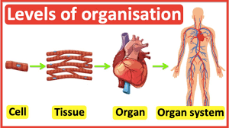
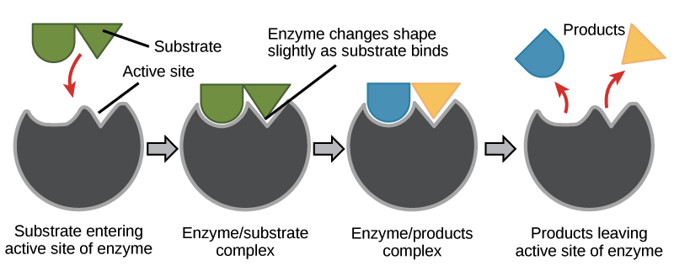
B2 Organisation
Cell – building block of life
Tissue – made up of similar cells
Organ – made up of different tissues
Organ system – made up of different organs
Enzyme has an active site
The active site is complementary to one substrate
Substrate binds to the active site
Enzyme-substrate complex forms and a reaction occurs
The new products are released from the active site

Slide 2
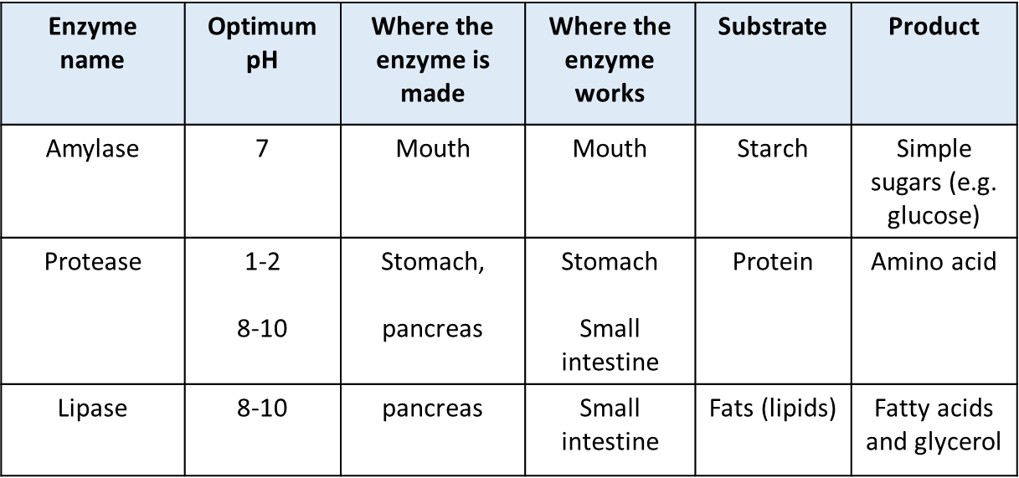
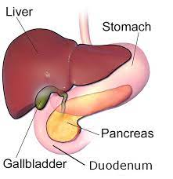
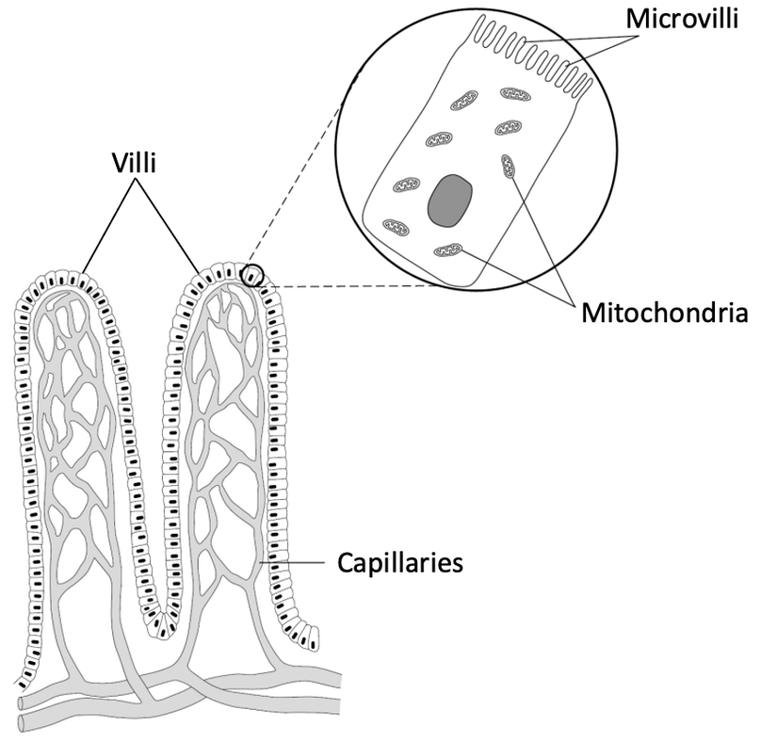
Liver makes bile
Gall bladder store bile
Role of bile
Emulsifies fat to increase surface area for lipase
Neutralises stomach acid
Adaptations of small intestine
Villi and microvilli – large surface area for absorption
Villi made of a single layer of cells – short diffusion pathways
Villi cells have many mitochondria – for active transport of glucose

Slide 3
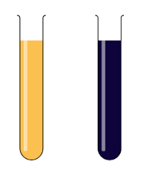
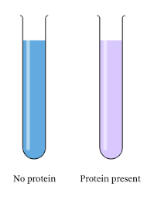
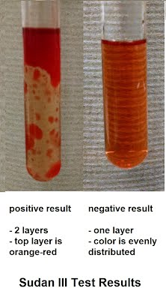
Food Tests RP
Iodine – turns blue black with starch
Benedict’s – turns purple with protein
Sudan III test – test for fats (lipids)
Benedict’s –turns brick red with glucose
Heat is needed!!!

Slide 4
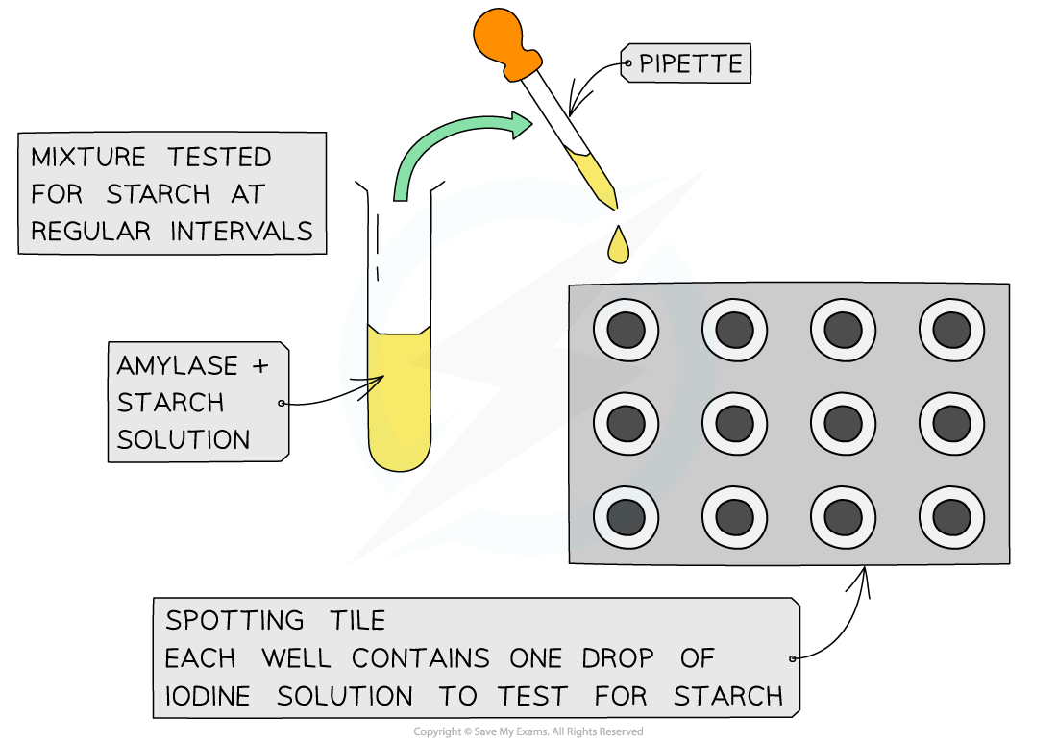
A sample is removed from the test tubes every 10 seconds to test for the presence of starch.
Iodine solution will turn a blue/black colour when starch is present, so when all the starch is broken down, a blue-black colour is no longer produced. The iodine solution will remain orange-brown.
Amylase RP
Investigate | Independent | Dependent | Control
The effects of temperature on amylase | Temperature – place starch amylase mixture in different water baths | Time taken for the iodine to stay orange | Same pH Same concentration of starch / amylase Same volume of mixture / iodine
The effects of pH on amylase | pH – add different pH buffer solutions to starch – amylase mixture | Time taken for the iodine to stay orange | Same temperature Same concentration of starch / amylase Same volume of mixture / iodine

Slide 5
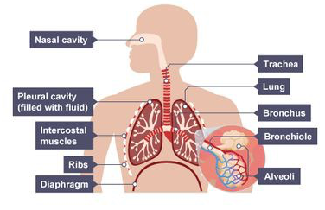
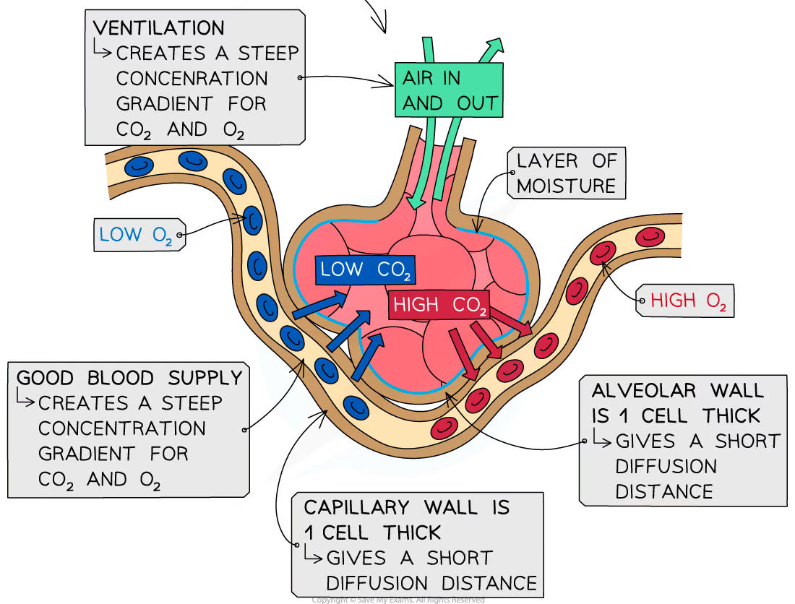
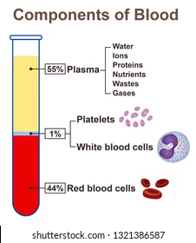
Know the adaptations!!
Blood component | Role
Red blood cell | Carries oxygen (no nucleus so more can be carried)
White blood cells | Engulf and digest pathogens Antitoxins antibodies
Plasma | Carries hormones, ions etc.
Platelets | Clot blood

Slide 6
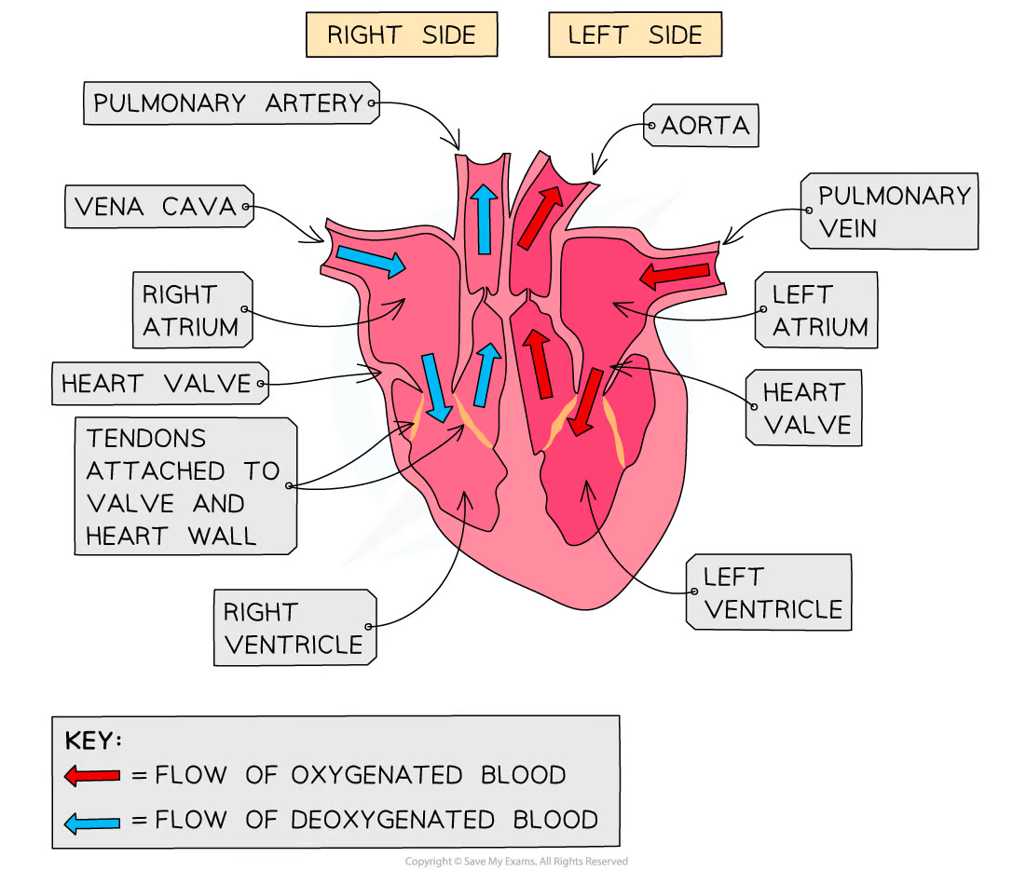
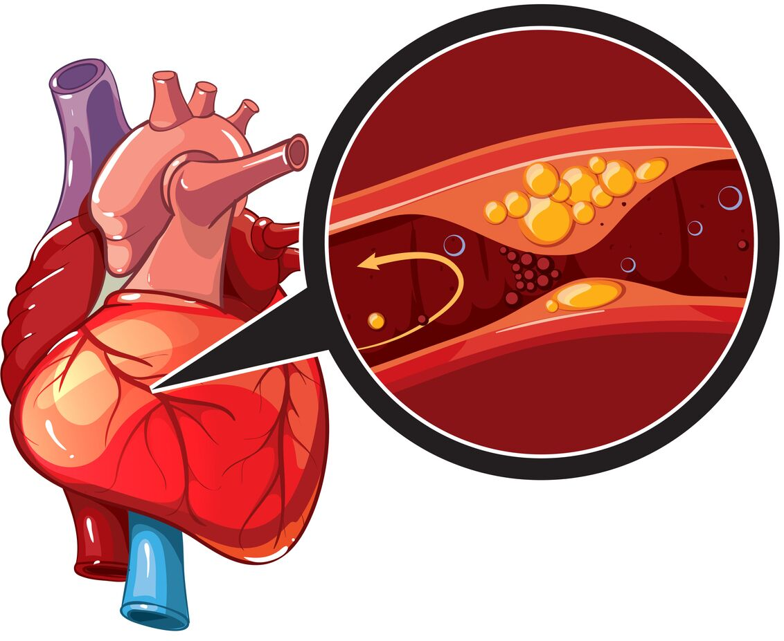
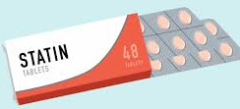
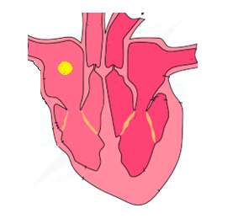
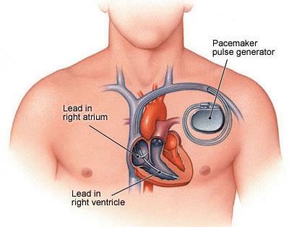
Be able to label the heart
Coronary artery – supplies heart muscle with oxygen
CHD – coronary arteries are blocked by plaque (fatty deposits) reducing blood flow
Stents – open arteries but need surgery
Artificial pacemaker used for irregular heart rhythm
Statin – reduces cholesterol but need to take every day
Natural pacemaker is found in the right atrium
Valve replacement
Biological – needs replacing
Mechanical – long lasting but can cause blood clots

Slide 7
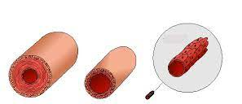
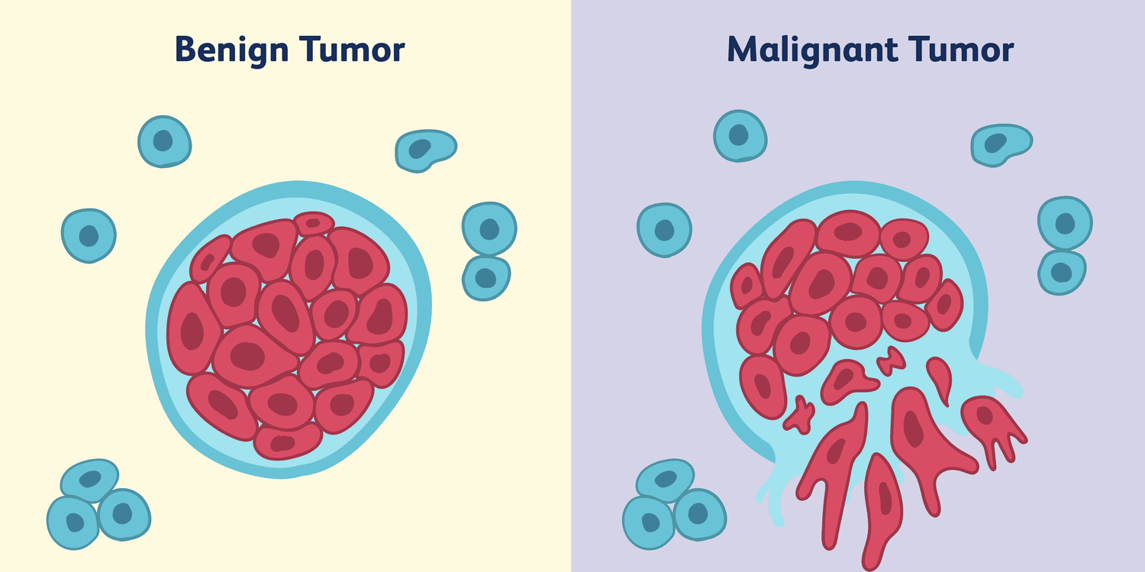
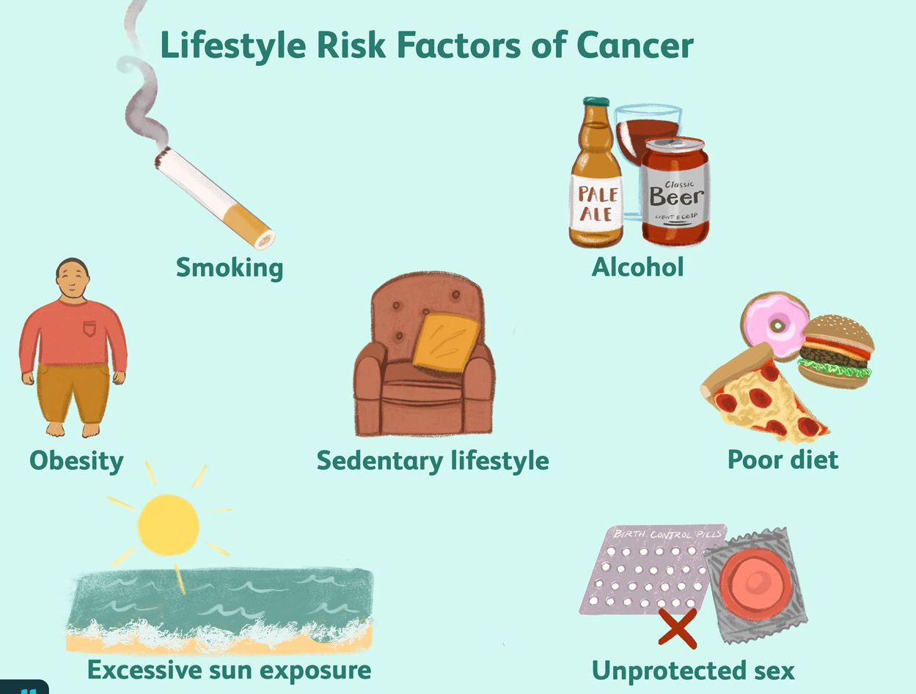
Artery
Thick wall to withstand pressure
Small lumen
No valves
Takes blood away from heart
Vein
Thin walls
Large lumen
Valves to stop backflow
Takes blood to the heart
Capillary
Walls 1 cell this – short diffusion pathway
artery
vein
capillary
A risk factor is a factor that increases your chance of getting a non communicable disease
Benign
Caused from uncontrolled cell division
Form a lump of abnormal cells
Do not spread and stay in one place
Malignant
Caused from uncontrolled cell division
Form a lump of abnormal cells
Spread into neighbouring tissues
Faster growing
Risk Factors
Obesity – diabetes
Obesity, smoking, high salt – CHD
Obesity, high salt - stroke

Slide 8
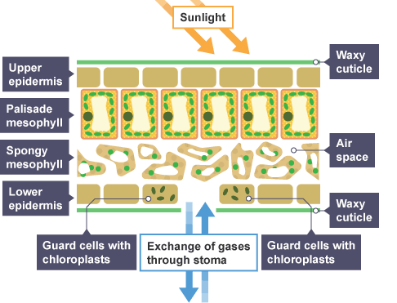
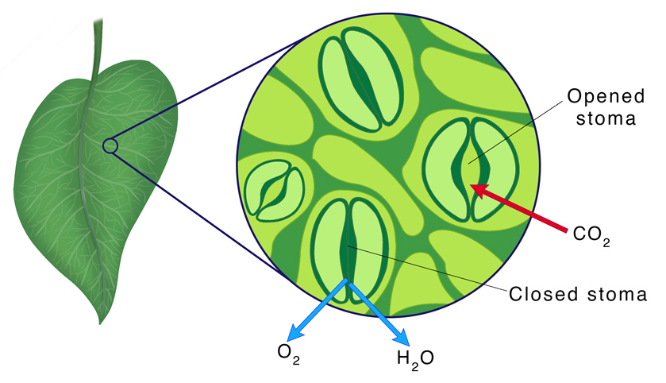
Gases diffuse in and out of the leaf
Water moves out of the leaf by evaporation
Guard cells open and close stomata
When closed prevent water loss
More stomata on the underside of leaf as cooler which reduces evaporation

Slide 9
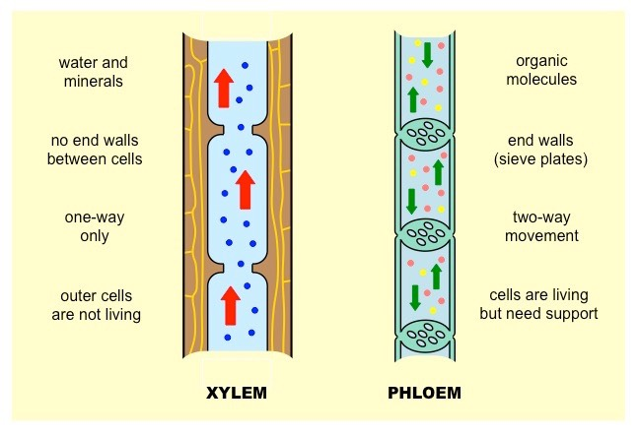
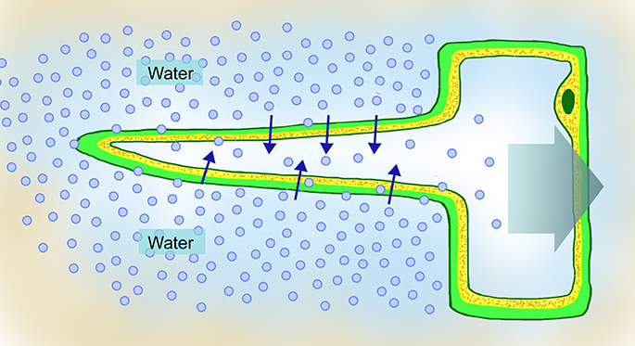
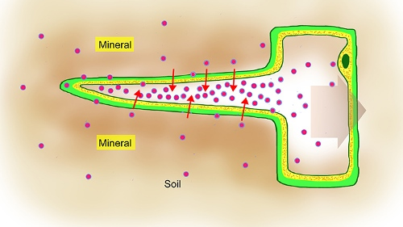
Translocation
Phloem (living has sieve tubes and companion cells)
Transport of sugars (sucrose)
In both directions
Transpiration
Xylem
Transport of water
Upward (from roots to leaves)
Root hair cells have a large surface area for absorption
Water moves into the root hair cell by osmosis
Ions move into the root by active transport against the concentration gradient and need energy
Water moves into the root hair cell by osmosis

