Slide 1
B3 Disease and Response
Disease | Type of pathogens | Symptoms | Transmission / prevention
Salmonella | bacteria | Diarrhoea, sever stomach cramps vomiting | Transmission – contaminated food Prevent: cook food correctly
Gonorrhoea | Bacteria | Yellow / green discharge from penis / vagina Pain on urination | Transmission – sexual contact Prevent: Condoms / abstinence
measles | virus | Red rash, fever | Transmission – air droplets Prevent: vaccination
HIV | virus | Flu like symptoms at first, then eventually immune system fails which results in AIDS | Transmission – sexual contact, sharing needles Prevent: Condoms / abstinence
TMV | virus | Yellow mottled leaves, growth reduced | Transmission – contact Prevent – do not allow plants to touch
Rose black spot | fungi | Black spots on leaves, growth reduced | Transmission – contact Prevent – do not allow plants to touch
Malaria | protist | Fever, diarrhoea, vomiting | Transmission – by mosquito (vector) Prevent – kill mosquito at breeding ground
Communicable disease – spread between organisms
Non - communicable disease – does not spread between organisms

Slide 2
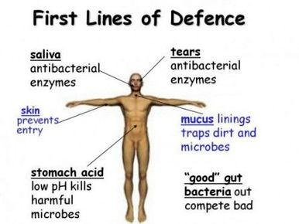
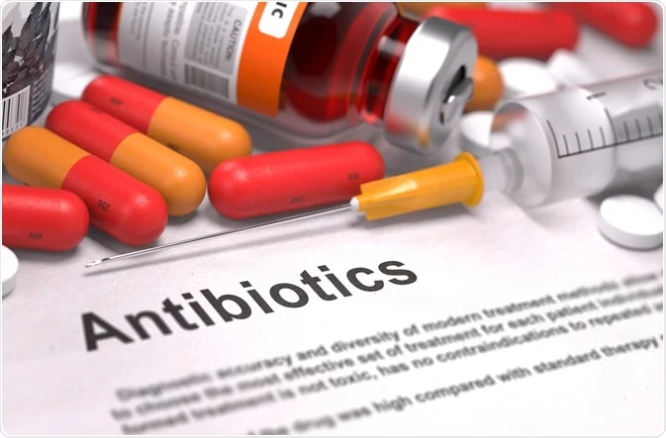
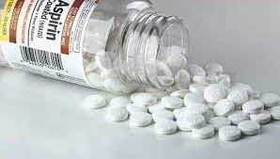
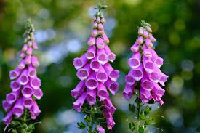
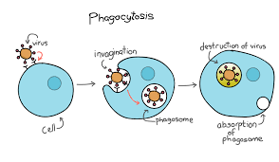
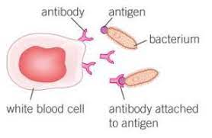
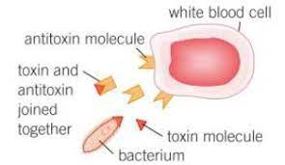
Antibiotics kill bacterial cells but you can get antibiotic resistance if not taken properly
No effect on virus as viruses invade cells
Aspirin is from willow
Digitalis from fox glove
Second Line of Defence
White blood cells engulf and digest pathogens
2. White blood cells produce antibodies
3. White blood cells produce antitoxins

Slide 3
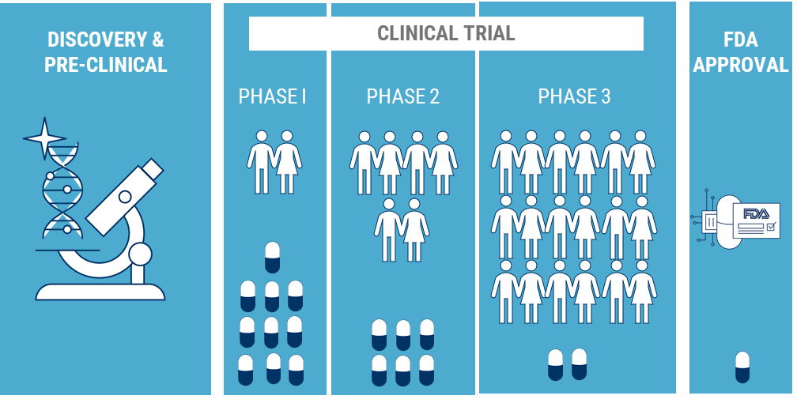
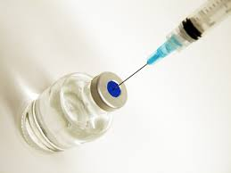
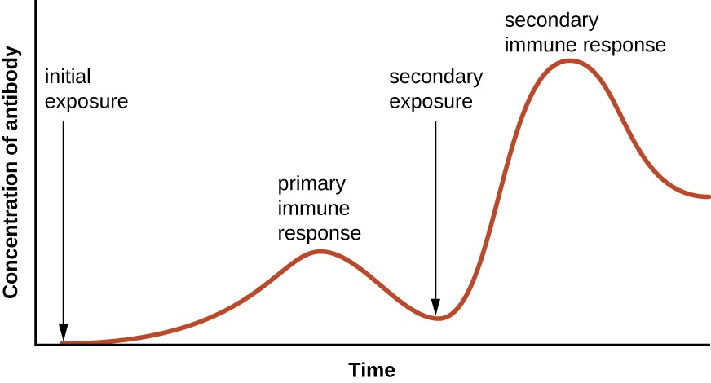
Vaccine
Inactive / dead form of the pathogen
Primary response
Secondary response
Preclinical trials
Use cells in laboratory
Tests for effectiveness (efficacy) and side effects
2. Preclinical trials (animals)
Tested on animals
Test for side effects
3. Clinical Trial 1
Tested on healthy volunteers to check safety
Primary response
Infection or vaccination
Little antibodies made
Takes time for
Secondary response
Infected again with same pathogen
Lots of antibodies produced quickly
4. Clinical Trial 2
Tested on people with illness to check for safety, effectiveness.
Start on low dosage then increase until optimum dose identified

