Slide 1
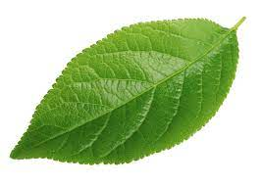
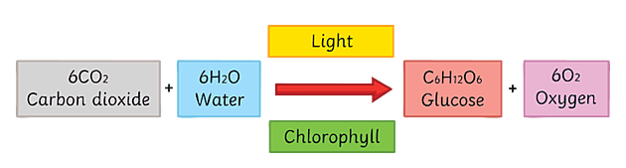
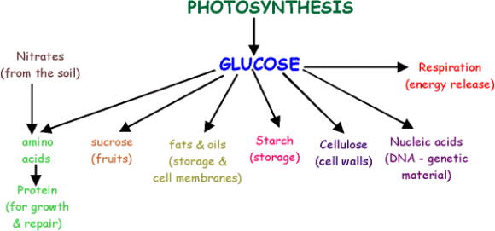
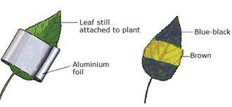
B4 Bioenergetics
photosynthesis
Leaf has a large surface area to absorb lots of light
Test a leaf for starch using iodine – starch turns blue-black

Slide 2
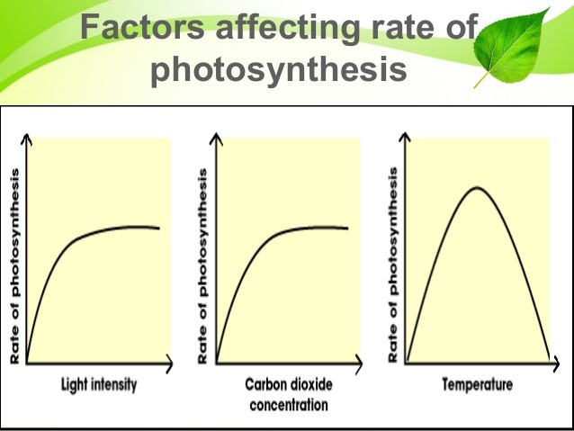
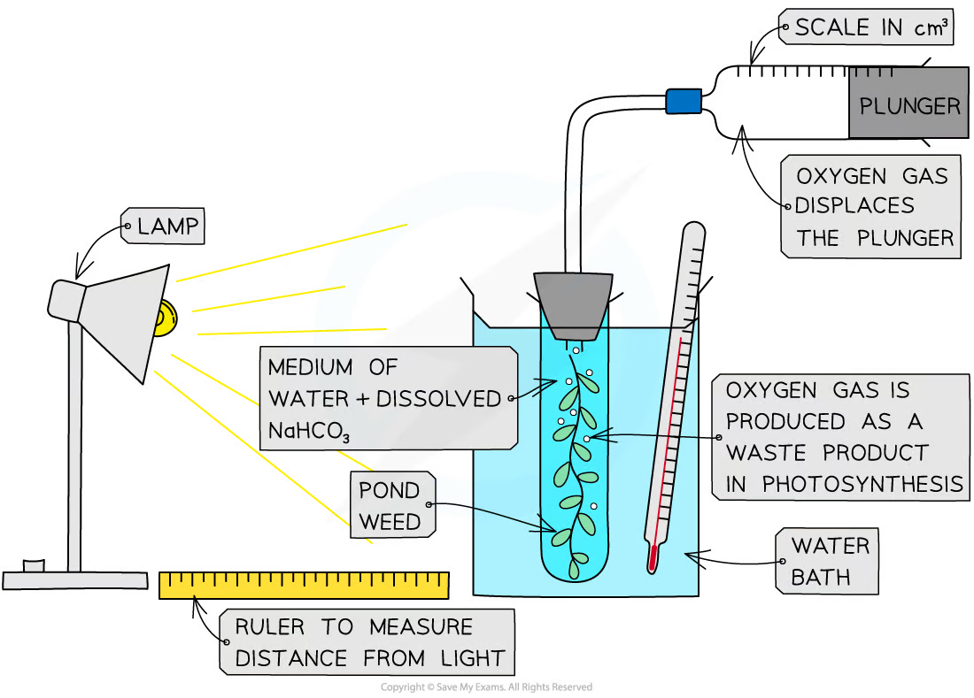
Learn these graphs!!!
Another factor: CO₂, temperature
Another factor: light, temperature
Optimum temperature
Light is the limiting factor
CO₂ is the limiting factor
Learn this equation!!
Light intensity = 1/distance²
Independent variable – light intensity
Dependent – volume of gas in 1 minute
Control
Length of pondweed
Type of pondweed
volume of solution
You can count the number of bubbles produced in 1 minute, but using a gas syringe is more accurate

Slide 3

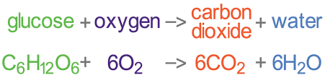
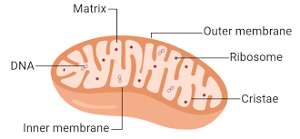

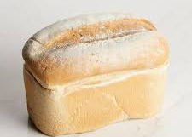

Respiration
Energy is released
Anaerobic (Animal)
No oxygen!!!
Lactic acid causes muscle fatigue
Aerobic (Animal, plant and yeast)
Oxygen debt – amount of oxygen required to break down lactic acid
Anaerobic (Plant and Yeast)
This process is called fermentation and is used to make bread and wine
No oxygen!!!
*Need oxygen
* Occurs in mitochondria
Releases a lot of energy

Slide 4
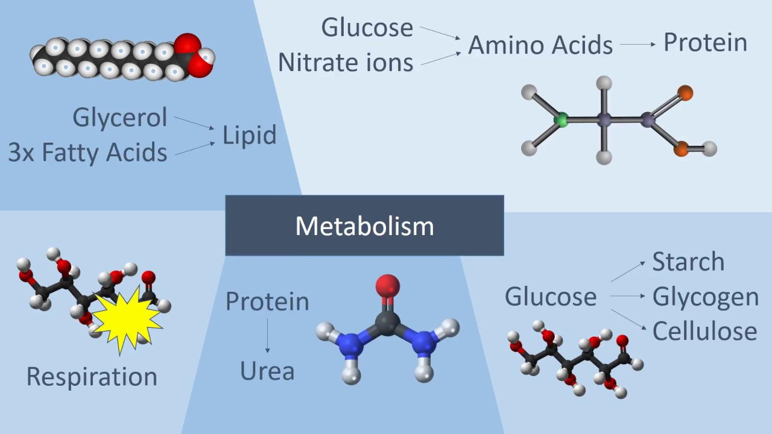

Effects of exercise
Metabolism
All the reactions in the organism
At rest:
Respiration occurs
Glucose and oxygen still required
Exercise:
More respiration occurs – rate of respiration increases
More glucose and oxygen required
Heart rate increases – to transport more oxygen and glucose to muscles
Breathing rate increases – take in more oxygen
More energy to muscles
Anaerobic respiration will occur and build up of lactic acid
Building up
Making of starch from sugars
Making proteins from amino acids
Making fats from fatty acids and glycerol
Breaking down
Breaking down starch into glucose
Breaking down proteins into amino acids
Breaking down fats into fatty acids and glycerol
Breaking down lactic acid
respiration

