Slide 1
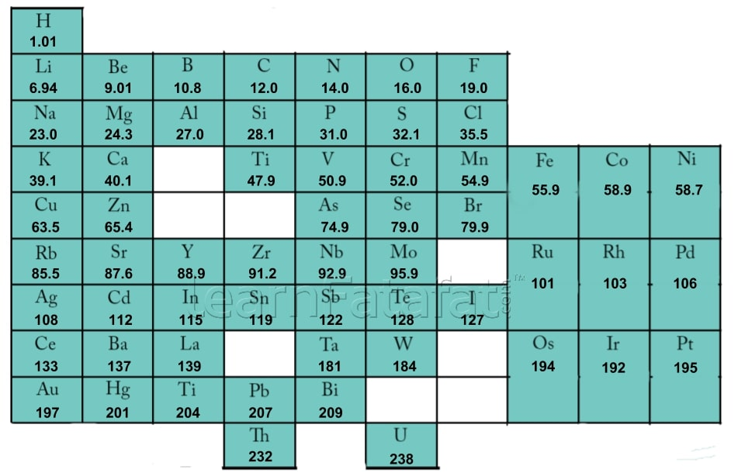
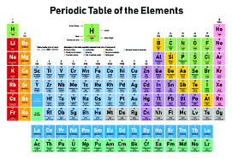
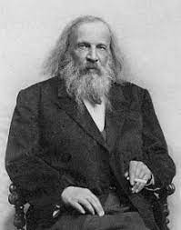
The Periodic Table
Similarities: Mendeleev and Today’s Periodic Table
Both organised into groups
Both organised by properties
Group – column
Period - row
Mendeleev’s periodic table – grouped by
Atomic weight (atomic number had not been discovered)
Properties (how different elements behaved)
Left gaps for undiscovered elements and made predictions
No group 0!!!
Differences: Mendeleev and Today’s Periodic Table
Todays arranged by atomic number, whereas Mendeleev is by atomic weight
Todays have no gaps, Mendeleev left gaps
Today’s have group 0, these were not discovered and included in Mendeleev

Slide 2
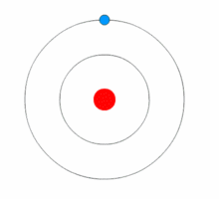
History of Atom
Gold leaf was bombarded by alpha particles – proved, atom mostly empty space and positive charge in the centre called the nucleus
Discovered the neuron
Solid spheres
Can bond together to form compounds
Plum pudding
Sphere of positive charge with scattering of negative charge
Discovered electrons
Nucleus not discovered yet!!!
Nuclear model
Most of atom empty space
Positive charge in nucleus
Electrons orbiting atom
Electrons orbiting in energy levels / energy shells
Electrons can gain energy and move to different energy level. When energy is lost the electron moves and gives out energy

Slide 3
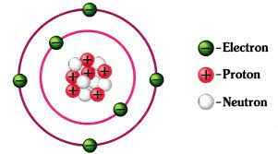
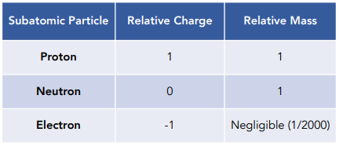
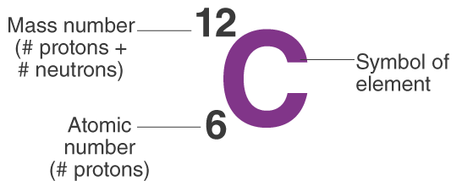
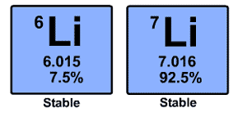
These are the subatomic particles
Ar short hand electron configuration
2.8.8
First shell: 2e⁻
2^{nd & 3rd} shell: 8e⁻
Be able to calculate the number of each subatomic particle
3 shells – 3rd period
8 electrons in outer shell – group 0
Relative atomic mass
Relative to carbon-12
Average mass
These are isotopes
Isotopes have the
Same atomic number (protons)
Different masses (neutrons)
A_{r} = (6.015 x 0.075) + (7.016 x 0.925)
= 6.9
The relative atomic mass of these isotopes = 6.9

Slide 4
Alkali Metals
1 electron in outer shell – similar properties
React with water
2Li + 2H₂O → 2LiOH + H₂
2Na + 2H₂O → 2NaOH + H₂
More fizzing
Orange flame
2K + 2H₂O → 2KOH + H₂
More fizzing
Lilac flame
More reactive down the group
More shells
Outer electron easier to be lost
The electrostatic force of attraction between nucleus and outer electron weaker down the group
OH⁻ is the hydroxide ion which causes the solution to become alkaline
More reactive up the group
Less shells
Easier to gain outer electron since the electrostatic force of attraction between nucleus and outer electron stronger
Become darker down the group
A more reactive halogen will take the place of a less reactive halogen
F₂ + 2NaCl → Cl₂ + 2NaF
Cl₂ + 2NaF → no reaction
7 electrons in outer shell – similar properties
All halogens are diatomic

Slide 5
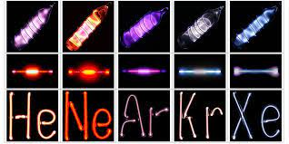
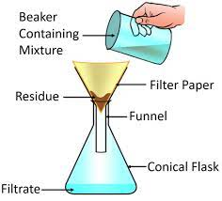
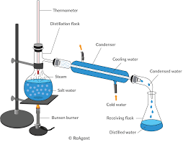
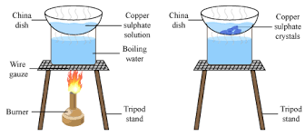
Full outer shell of electrons
Unreactive
Down group
More dense
Used for lighting as unreactive
Chromatography
Separate by different solubility
See C9 chemical analysis
Evaporation and crystallisation
Heat the salt solution and the water evaporates
Salt crystals remain – if heat slowly crystals are bigger.
Filtration
Separate an insoluble solid from a soluble solution
e.g. sand from salt solution
Distillation
Separate by different boiling points
Heat the mixture – evaporates the solution with lower boiling point.
Condenser cools the vapour into a liquid

