Slide 1
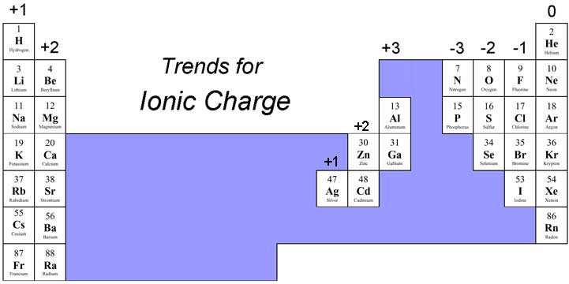
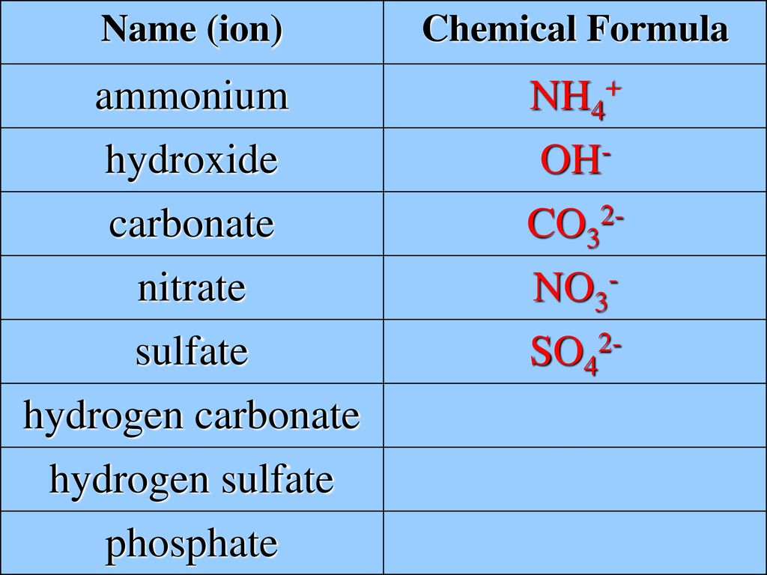
1. Ionic Bond
C2 Bonding, Structures and Matter
Group | Transfer | ion
1 | 1 e⁻ lost | 1+
2 | 2 e⁻ lost | 2+
3 | 3 e⁻ lost | 3+
5 | 3 e⁻ gained | 3-
6 | 2 e⁻ gaine1 | 2-
7 | 3 e⁻ gained | 1-
Know the complex ions
2+
Formula are balanced
Easy: Calcium chloride Ca²⁺ and Cl⁻
Need 2 chloride ions to balance the Ca²⁺
Formula: CaCl₂
Medium: Potassium sulfate K⁺ SO₄²⁻
Need 2 potassium ions to balance the SO₄²⁻
Formula: K₂SO₄
1-
1-
1+
1+
2-
3+
3+
2-
2-
2-
Hard: aluminium carbonate Al³⁺ CO₃²⁻
Need 2 aluminium ions to balance 3 CO₃²⁻
Formula: Al₂(CO₃)₃
Use brackets!!!

Slide 2
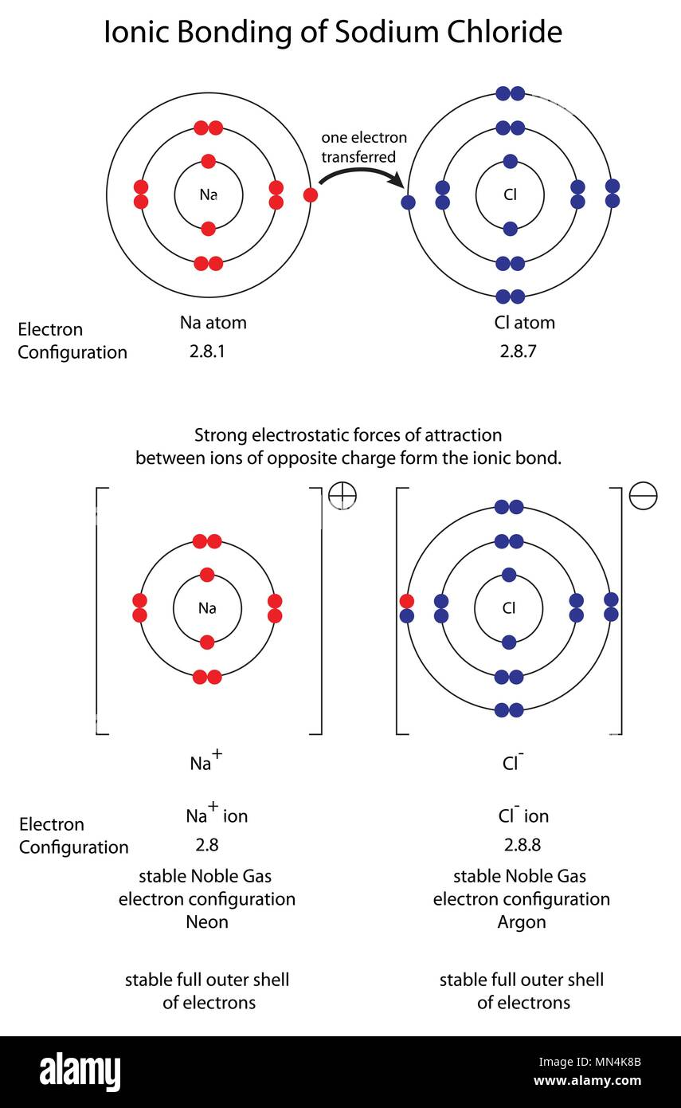
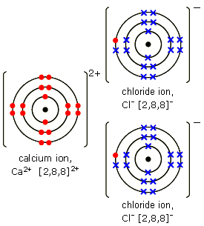
Ionic bond of calcium chloride
Step 1
Draw the electron configuration
Step 2
Draw the electron transfer
Step 3
Draw a new diagram of the ions – remember brackets and charge!!!
Ensure you can explain these as a set of double bonds

Slide 3
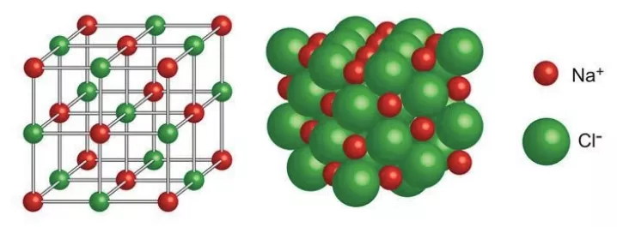
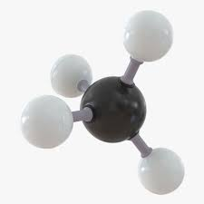
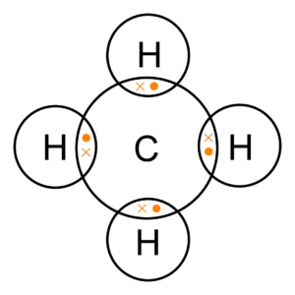
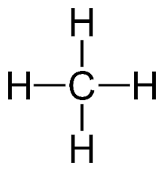
Structure:
Ions are arranged in a giant lattice
Ions are closely packed in a regular lattice
Strong electrostatic forces of attraction between opposite charged ions
Properties:
High melting point due to strong electrostatic forces of attraction
Conductions as liquid and aqueous
Ions move
2. Covalent Bond
Share pairs of electrons
The covalent bond is very strong
Between non-metals
3D model
Shows how the atoms are arranged next to each other
Do not show the electrons
Display formula
Shows the covalent bonds as the lines
don’t show 3D structure
Dot and cross
Show electrons
But don’t show relative sizes of atoms or 3D structure

Slide 4
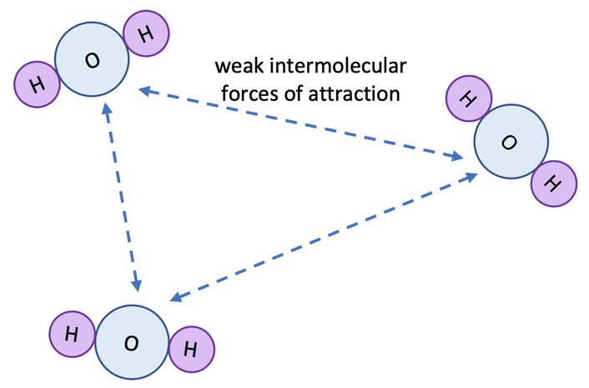
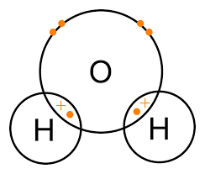
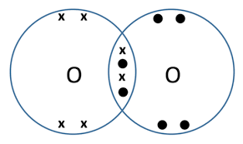
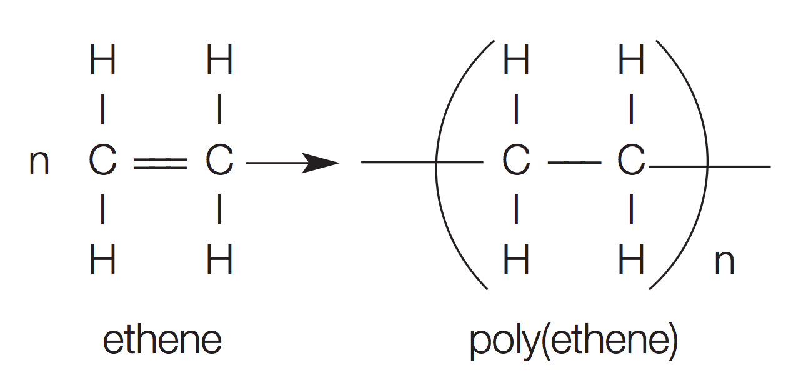
Simple covalent
Properties:
Low melting point due to weak intermolecular forces – found as gases / liquids
Does not conduct as no delocalised electrons
Molecules
Polymers
Bit in bracket is repeating unit
Long chains of repeating units
Covalent compounds
Larger the polymer, the more energy needed to break them down
Bond through the bracket joins to the next repeating unit
“n” is a large number and tells the number of repeated units

Slide 5
Giant covalent
Silicon dioxide (silica). What each grain of sand is made of.
All atoms are bonded to each other by strong covalent bonds
Diamond
Each carbon bonded (covalent) to four other carbons (4 covalent bonds)
Many covalent bonds – strong and hard – used for cutting tools
Many strong covalent bonds – high melting point
No free electrons – do not conduct
Graphite
Each carbon bonded (covalent) to three other carbons (3 covalent bonds)
Carbons arranged in hexagons
Layers can slide - lubricant
Many strong covalent bonds – high melting point
Delocalised electrons –conduct heat and electricity – used as electrodes
Graphene
Single layer of graphite – one atom thick (2D)
Very strong (due to covalent bonds) but light
Added to composite materials to make stronger
Delocalised electrons – used in electronics
Fullerenes
Made of carbon – tubes or hollow balls
used to cage other molecules e.g. to deliver a drug
Have a high surface area so can be used with catalysts
Used as nano-tubes –for electronics or strengthen material

Slide 6
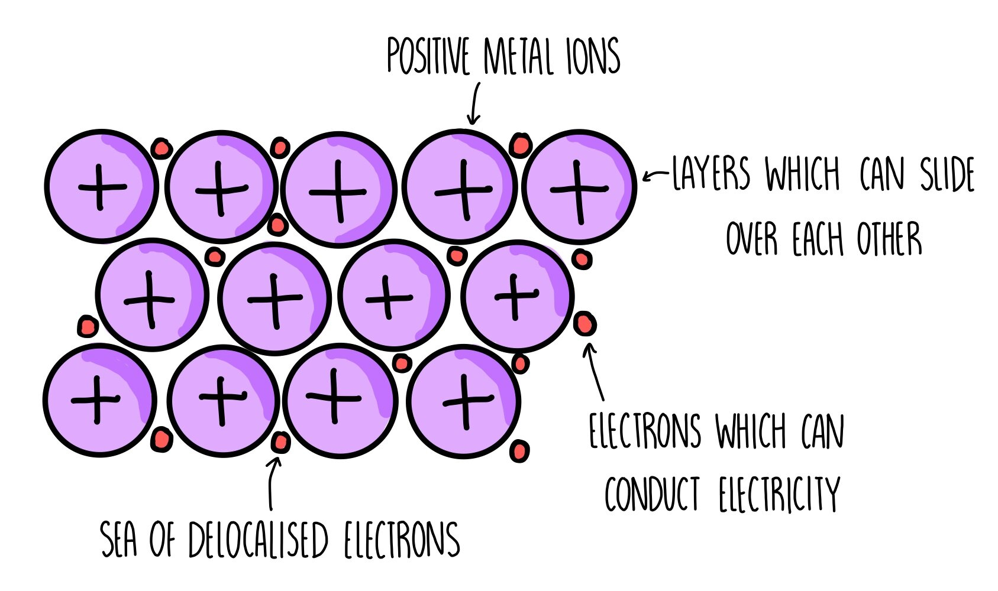
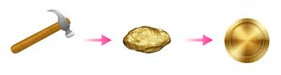
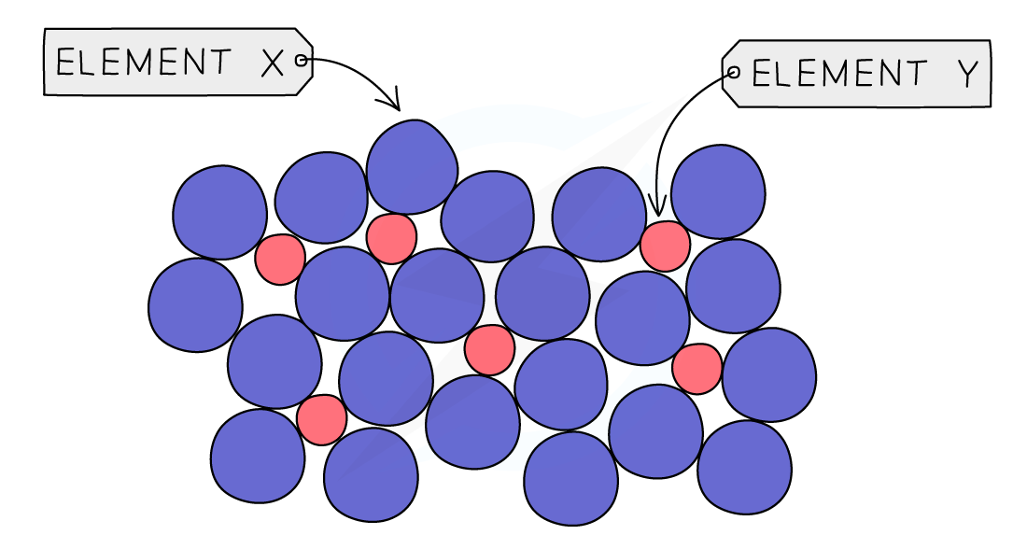
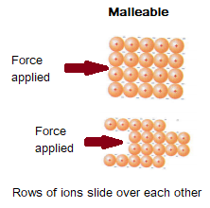
Metallic
Structure:
Outer electrons are delocalised
Regular structure
Properties
Very high melting point - due to strong electrostatic forces between positive metal ions and the negative electrons
Delocalised electrons – conduct heat and electricity
Layers of atoms slide over each other
Alloy – metal mixed with another element (no longer pure)
Different sized atoms – layers cannot slide
Alloy harder

Slide 7
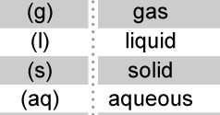
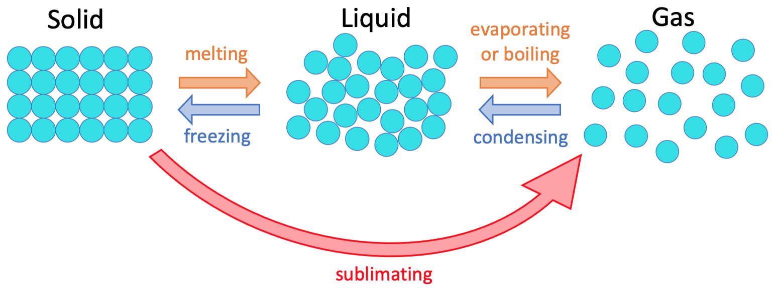
States of Matter and State Symbols
Weak forces between particles
Particles move past each other but do stick to each other
Constantly moving with random motion
Very weak forces between particles
Particles are free to move and far apart
Constantly moving with random motion
Strong bonds
Regular lattice structure – particles close together
Particles vibrate
Meting point – particles gain enough energy to break free from their fixed positions
Boiling point – particles gain even more energy to break bonds holding the liquid together
Condensing point – Particles cool, bonds form between the gas particles
Freezing point – particles lose even more energy, more bonds form and cause particles to be in fixed positions

