Slide 1
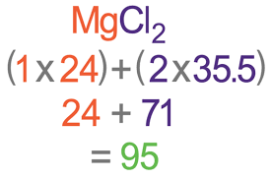
Quantitative Chemistry
Relative Formula Mass (M_{r})
A_{r} x number of atoms of that element
M_{r} of the compound
% mass of an element in compound
=
x100
e.g. % by mass of chloring in MgCl₂
Ar of Mg is 24, there are 2 atoms 2 x 24 = 48
Mr of compound (see opposite) – MgCl₂ = 95
Calculation = (48/95) x 100 = 50.1%
Total of all the relative atomic masses of all the atoms in the compound
1 Mole
= 6.02 x 10²³ particles
(atoms, molecules, ions)
= A_{r} or M_{r} in grams
e.g. A_{r} Mg is 24 and 1 mole Mg is 24g
M_{r} MgCl2 is 95 and 1 mole is 95g
Mass may seem to increase if oxygen from the air reacts
Mass may seem to decrease if a gas escapes into atmosphere
Total mass of reactants
=
Total mass of products
H2O would therefore be 36g

Slide 2
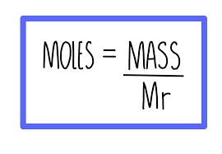
Working out the balanced symbol equations from the masses
Calculate number of moles by mass/A_{r}
Divide number of moles of each substance by the smallest number of moles
If any are not whole numbers – multiply all by the same amount to become whole
Write the balanced equation
Learn and rearrange
1. Calculate the number of moles in 34g of LiOH. (Li – 7 O – 16 H – 1)
M_{r} LiOH = (1 x7) + (1 x 16) + (1 x 1)
= 7 + 16 + 1 = 24
Number of moles = 34/24 = 1.4 mol
2. Calculate the mass of water in 4.5mol (H – 1, O – 16)
Mr water H₂O = (2 x 1) + (1 x 16) = 18
4.5 = mass / 18
4.5 x 18 = mass
= 81g
8.1g ZnO reacts completely with 0.6g of carbon to form 2.2g of carbon dioxide and 6.5g zinc
M_{r} ZnO = (65 +16) = 81 M_{r} C = 12
M_{r} CO₂= 12 +(2 x 16) = 44 M_{r} Zn 65
ZnO = 8.1 / 81 = 0.1mol C =0.6 / 12 = 0.05mol
CO2 = 2.2 / 44 = 0.05 mol Zn = 6.5 / 65 = 0.1mol
2. Divide by the smallest 0.05
ZnO = 0.1/0.05 = 2 C = 0.05/0.05 = 1
CO₂ = 0.05/0.05 = 1 Zn = 0.1 / 0.05 = 2
3. Equation 2 ZnO + C → CO2 + 2 Zn

Slide 3
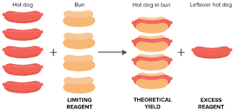
Limiting Reactants
In a reaction to produce sodium sulfide, Na₂S, 9.2 g of sodium is reacted with 8.0 g of sulfur. Which reactant is in excess and which is limiting?
Step 1: Write a balanced equation: 2Na + S → Na₂S (2 : 1 mols of Na react with S)
Step 2: Calculate the relative formula masses (M_{r}): Na = 23, S=32 Na₂S = (2 x 23) + 32 = 78
Step 3: Calculate the number of moles
Na = 9.2/23 = 0.4 mols S = 8.0/32 = 0.25 mols but 1.6 : 1 mols of Na reacted with S
Step 4: Identify the reactant in excess / limiting
Na must be limited because there is less than 2mols (needs to be double of S but it is not
S is in excess because it is more than half the number of moles of Na
Look at p127 for an example to show how to calculate the mass of a reactant

Slide 4
Concentrations of solution
6 mark calculation questions
How many moles of NaOH are in a 25cm³ solution with a concentration of 56 g/dm³?
Make sure you can do this!
=
Mass of solutes (g)
Volume of solvent (dm³)
Concentration
(g/dm³)
Exam tip!
Change volumes to dm³
1dm³ = 1000cm³
Step 1 and 2 use this equation
Change volume to dm³
25/1000 = 0.025dm³
2. Calculate mass 56 = mass / 0.025
56 x 0.025 = mass
= 1.4
Use the moles, mass and M_{r} equation
3. Calculate M_{r} NaOH = (1x23)+(1x16)+ (1x1)
= 23 + 16 + 1 = 40
4. Number of moles = mass / M_{r}
= 1.4 / 40
Number of moles = 0.035 mols
What mass of sodium chloride would be needed to form a 3.2g/dm³ in a 45cm³ solution
Change volume to dm³
45/1000 = 0.045dm³
2. Calculate mass
3.2 = mass / 0.045
3.2 x 0.045 = mass
= 0.144g
Step 3 and 4 use this equation

