Slide 1
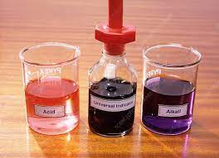
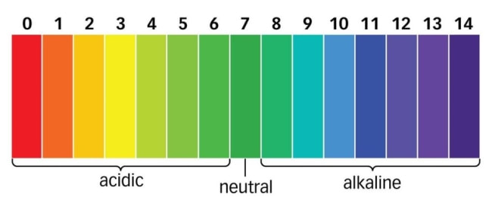
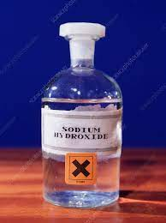
pH scale 0-14
Quantitative Chemistry
Universal indicator: colour change but subjective
pH meter and probe are used to provide an accurate pH value
Acids
Base
Soluble forms OH⁻ ions
Sulfuric (H₂SO₄)
Hydrochloric (HCl)
Nitric (HNO₃)
Metal hydroxide
Metal oxide
Metal carbonate
insoluble
Acids form solutions with a pH less than 7
Form H⁺ ions in water
Neutralisation (acid + base)
H⁺_{(aq)} + OH⁻_{(aq)} → H₂O _{(l)}

Slide 2
Strong acids
Fully dissociate
(completely ionises)
Weak acids
Partially dissociate
(some ionises)
Strength vs Concentration
Strength refers to how much ionisation occurs i.e. how many H⁺ ions form
Concentration refers to how much acid there is in a certain volume of water
No HCl particles all have formed H⁺ and Cl⁻ ions
Some particles exist and some ions
HCl → H⁺ + Cl⁻
Every HCl particle dissociates to form a H⁺ ion
CH₃COOH H⁺ + CH₃COO⁻
Some ionisation occurs
Reaction is reversible
HCl → H⁺ + Cl⁻
Every HCl particle dissociates to form a H⁺ ion
pH – A measure of the concentrations of H⁺ ions
For every decrease in 1 of the pH scale, the concentration of H ions increase by a factor of 10 (becomes more acidic)
X is the difference in pH e.g. if the pH dropped from pH8 to 4, difference is -4
* H⁺ ion concentration increased by 10⁻⁽⁻⁴⁾ = 10⁴
Factor H+ ion concentration changes by =10^{-x} (x is the difference in pH)

Slide 3
Neutralisation Reactions
Acid
+
Base
Salt
+
Water
Metal oxide
Metal hydroxide
Naming Salts
Sulfuric acid forms a metal sulphate salt
Hydrochloric forms a metal chloride salt
Nitric acid forms a metal nitrate salt
Examples
Hydrochloric acid + sodium hydroxide → Sodium chloride + water
Sulphuric acid + Lithium oxide → Lithium sulphate + water
Acid
+
Base
Metal carbonate
Salt
+
Water
+
Carbon dioxide
Extra product for metal carbonates
Examples
Hydrochloric acid + sodium carbonate → Sodium chloride + water
+ carbon dioxide
Sulphuric acid + Lithium carbonate → Lithium sulphate + water + carbon dioxide

Slide 4
RP Making a soluble salt from an insoluble base
Filter to remove excess base, to obtain salt solution
Heat slowly to gain large crystals
Excess base is used to ensure all the acid reacts
Warm acid will increase reaction rate
Insoluble base – metal oxide or metal carbonate
(metal hydroxide cannot be used as soluble)
Exam Tip: Look at the salt name to determine the metal base and acid needed
How to identify the acid and base
e.g.
Salt: copper sulphate – need copper oxide or copper carbonate + sulfuric acid
Salt: calcium chloride – need calcium oxide or calcium carbonate + hydrochloric acid
Salt: Zinc nitrate – need zinc oxide or zinc carbonate + nitric acid

Slide 5
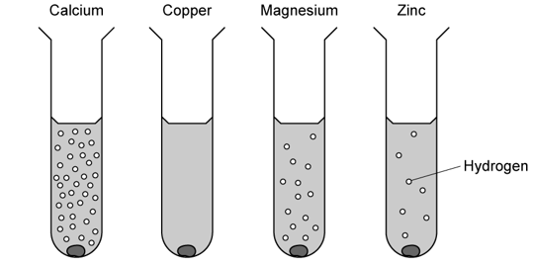
Metal + Acid
Reacting Metals with acid
More reactive metal produces more bubbles of hydrogen
Copper is less reactive than hydrogen so does not react with acid
React with acids
Displace hydrogen from the acid
More reactive than hydrogen
Does not react with acids as less reactive than hydrogen
+
Displacement reaction – hydrogen released!!!
Metal
+
Acid
Salt
hydrogen
Examples
Sodium + hydrochloric acid → Sodium chloride + hydrogen
Iron + sulfuric acid → Iron sulfate + hydrogen
Tin + nitric acid → tin nitrate + hydrogen
Remember a salt is formed!!

Slide 6
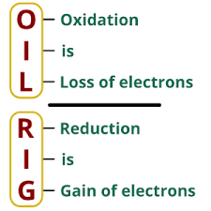
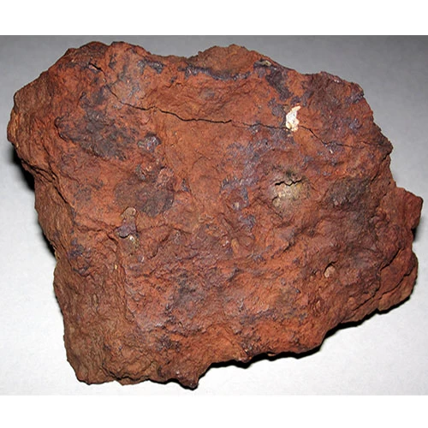
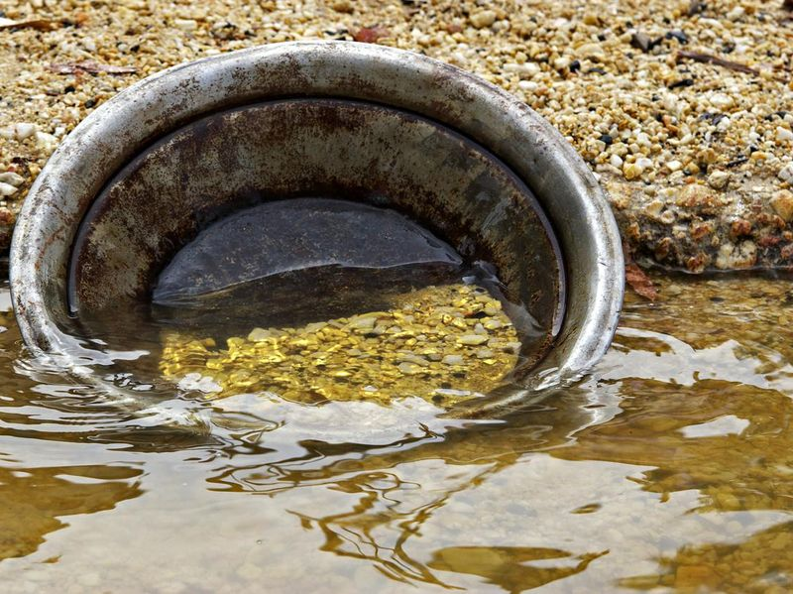
Extraction of Metals
The method of extraction depends on its reactivity!
An ore is a rock containing a metal compound
Electrolysis
Metals above carbon
End in –ium (cannot be displaced by carbon!!!)
Very strong bonds
Electricity break bonds
Very expensive!!!!
Reduction by gain of electrons
Na⁺ + e- → Na
electrolysis
sodium oxide → sodium + oxygen
Oxidation by loss of electrons
2O²⁻ -4e- → 2O₂
Displacement reaction
Metals below carbon
Weak bonds
Heat can break bonds and carbon can displace the metal
Reduction by gain of electrons
Zn²⁺ + 2e- → Zn
Displacement heat and carbon
Zinc oxide + carbon → Zinc + carbon dioxide
Metals below hydrogen
Very unreactive and found naturally
Gold and platinum least reactive and found naturally
Panning for gold

Slide 7
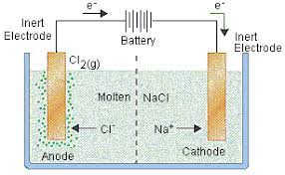
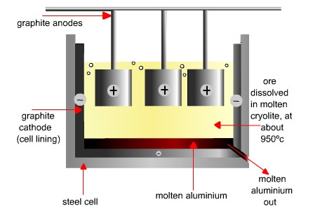
Electrolysis - Molten
Molten contains just the 2 ions
Na⁺ - attracted to negative electrode (anode) – silver coating
Cl⁻ attracted to positive electrode (cathode) – bubbles seen
Breaking down of an ionic compound using electricity
Ions must move
Ionic compound has to be molten or aqueous
electrolyte
Ion half equation
Na⁺ + 1e- → Na (reduction – gain an electron)
2Cl⁻ - 2e- → Cl₂ (oxidation – loses electrons)
H
I
Cl
Br
O
F
Chlorine is diatomic! This needs to be shown in the ion half equation
Diatomic
Aluminium is extracted from aluminium oxide
Cryolite is used to reduce the melting point (less energy)
Al³⁺ +3e- → Al
(Al³⁺ moves to the negative electrode and becomes reduced (gains electrons)
2O²⁻ -2e- → 4O₂
(O²⁻ moves to the positive electrode and becomes oxidised (loses electrons)
The oxygen reacts with the graphite electrode forming carbon dioxide – needs to be replaced
Oxygen is diatomic

Slide 8
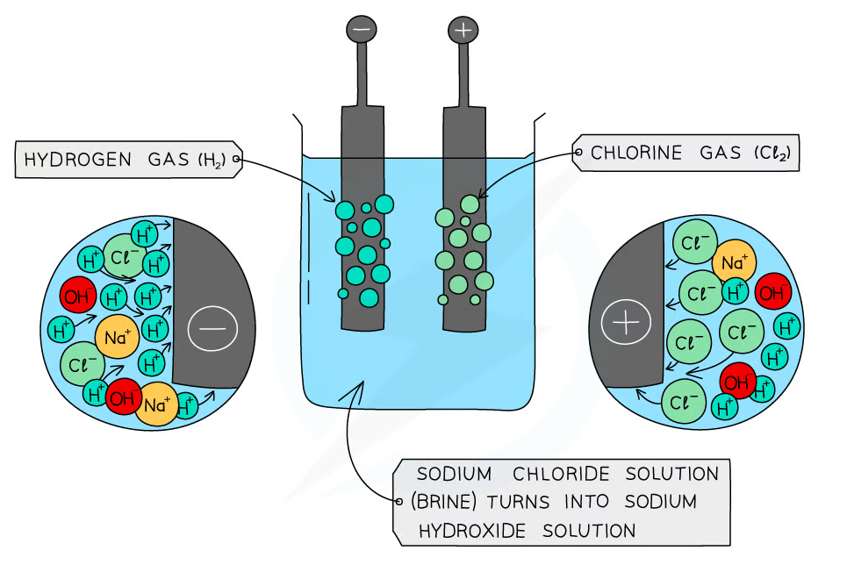
Electrolysis - Aqueous
Water dissociates H₂O → H⁺ + OH⁻
Sodium chloride (aq)
Na⁺
Cl⁻
H⁺
OH⁻
From the solution
From the water
4 ions are involved!!!
How do I know what is formed?
If a halide is present that comes out
If not
oxygen and water form
The least reactive comes out of solution
All metals will remain in except copper as less reactive than hydrogen!
Na⁺
H⁺
Cl⁻
OH⁻
Bleaches litmus paper
A halide is present (Cl-)
2Cl⁻ -2e- → Cl₂ (oxidation)
Observe bubbles
The solution becomes alkaline since OH⁻ stays in solution
hydrogen is diatomic
2H⁺ +2e- → H₂ (reduction)
Observe bubbles
Sodium remains in solution
Lit splint squeaky pop

Slide 9
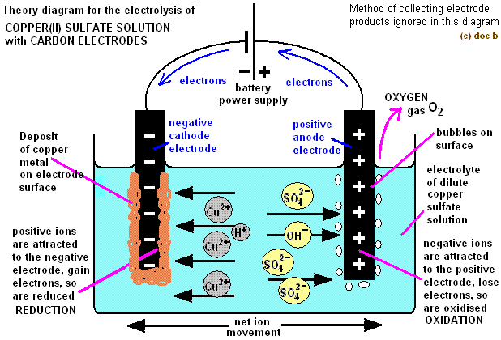
Electrolysis - Aqueous
Copper less reactive than hydrogen
Copper is formed
Cu²⁺
H⁺
SO₄²⁻
OH⁻
No halide, so oxygen and water is formed
Cathode
Cu²⁺ + 2e- → Cu
Gain of electrons (reduction)
A brown layer forms over the electrode
Anode
4OH⁻ - 4e- → 2H₂O + O₂
Loss of electrons (oxidation)
A brown layer forms over the electrode

