Slide 1
Energy Changes
Respiration
Hand warmers
Combustion
Neutralisation
f
Break old bonds
Heat energy taken in
Exothermic
More energy given out in making new bonds than taken in breaking old bonds
Products have less energy than reactants
Surroundings get hotter
Making new bonds
Heat energy given out
Endothermic
More energy taken in breaking old bonds than given out making new bonds
Products have more energy than reactants
Surroundings get colder
Thermal decomposition
Sports injury packs

Slide 2
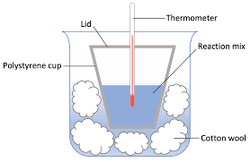
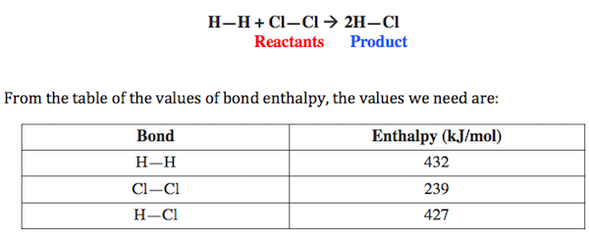
RP Energy Transfer
Insulators
polystyrene cup
Cotton wool
lid
Controls:
Volume of acid
Length / mass of magnesium
Time of reaction
To investigate the effects on energy between magnesium and different concentrations of acid
Independent:
Concentration of acid
Dependent:
Temperature change after 1 minute
You can also do this for neutralisation of sodium hydroxide with different acid concentrations!!
Energy break reactant bonds
(1 x H-H) + (1 x Cl-Cl) = 432 + 239
= 671J (energy needed)
Bond energy
Energy form product bonds
(2 x H-Cl) = 2 x 427
= 854J (energy released)
Energy change = reactant - product
=671-854
= -183J (More energy released!!!)

