Slide 1
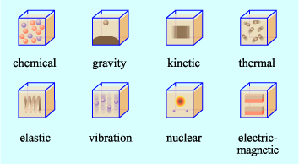
P1 Energy
GPE – gravitational potential energy
e.g. batteries and food
e.g. objects that can fall
e.g. objects are moving
e.g. objects that give of heat
Energy Stores
Energy can be transferred from one object to another or to the surroundings
chemical
GPE
Kinetic
Thermal
Elastic potential
Magnetic
Nuclear
electrostatic
e.g. energy stored in a magnetic field
e.g. energy stored in an atom e.g. Uranium used in a nuclear power station
e.g. when like charges moved closer together or unlike charges further apart
e.g. objects that have been stretched or compressed

Slide 2
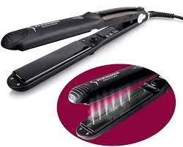
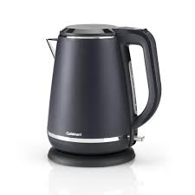
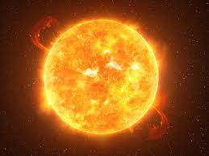
4 ways energy transferred
Chemical energy in coal used to generate electricity
Chemical energy in person arm
2. Electrical work – charges moving due to potential difference
1. Mechanical work – force moving an object through a distance
Mechanical work
Electrical work
Kinetic energy of the ball
Thermal energy in the heating element
throwing a tennis ball
Turning on straighteners
3. Heating – due to temperature difference caused electrically or by chemically
Thermal energy of heating element
4. Radiation – energy transferred as a wave e.g. light
Chemical energy in the sun
Heating
Radiation e.g. light
Heating water in a kettle
Thermal energy of the water

Slide 3
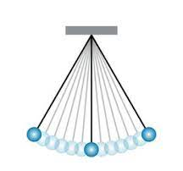
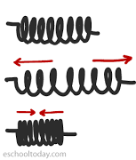
GPE can transfer to kinetic energy and vice versa.
Maximum gravitational potential energy
No kinetic energy
Maximum gravitational potential energy
No kinetic energy
In a vacuum a pendulum will continue to swing
In air, due to friction from the air particles thermal energy is transferred to the surroundings
No gravitational potential energy
Maximum kinetic energy
Gravitational Potential energy
Kinetic energy
Know your units and be able to convert!!!
Stretching and compressing a spring increases the elastic potential energy
Elastic Potential Energy
Big spring constant – stiffer spring

Slide 4
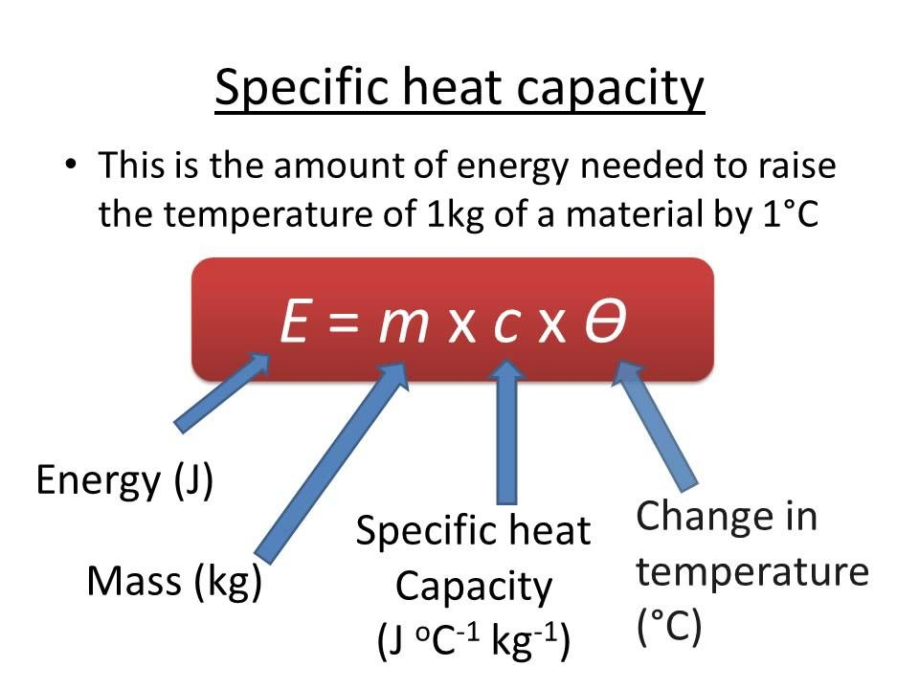
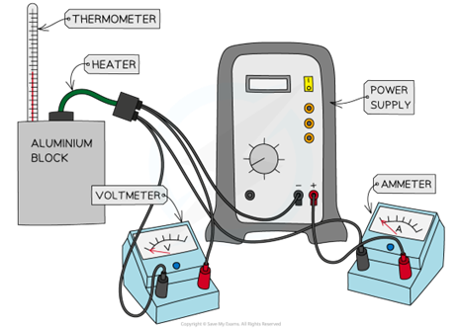
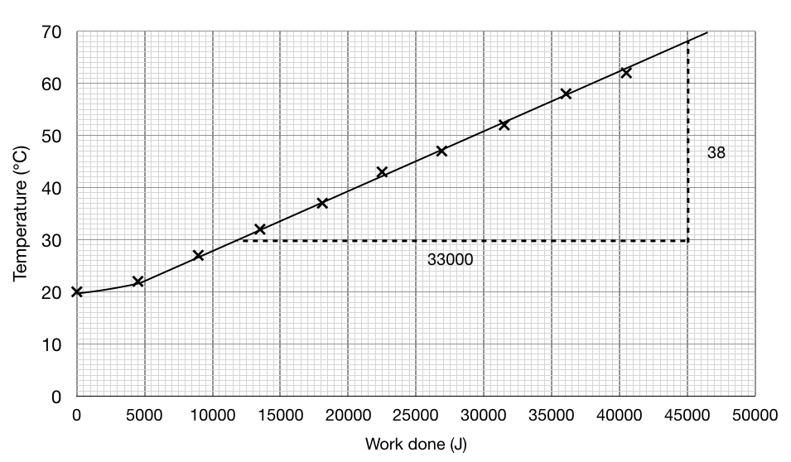
Measure the mass of the block
Wrap the block in insulator layer to reduce heat loss
Measure initial temperature of the block
Turn on the power pack measure the current, voltage and temperature every minute for 10 minutes
Use P=IV to calculate power for every minute
Use E=Pt to calculate energy transferred at the time for each temperature reading
7. Calculate the gradient of the line
8. Calculate 1/(gradient x mass of block) for specific heat capacity
9. Repeat for different material blocks

Slide 5
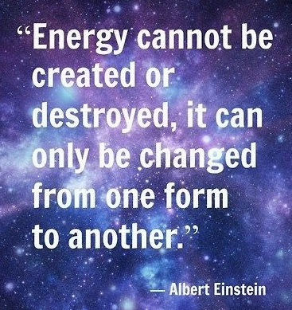
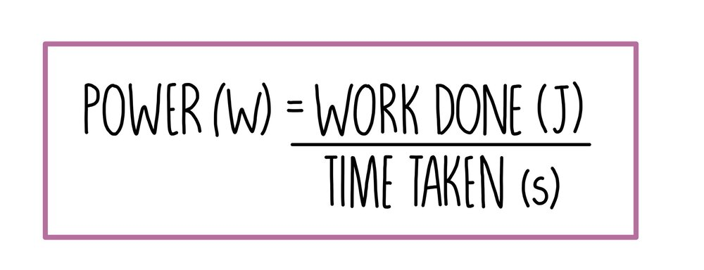
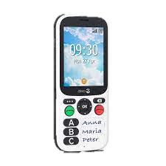
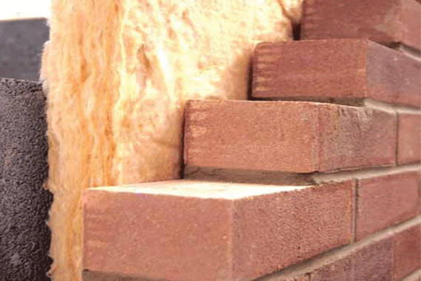
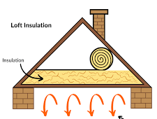
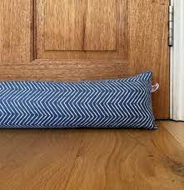
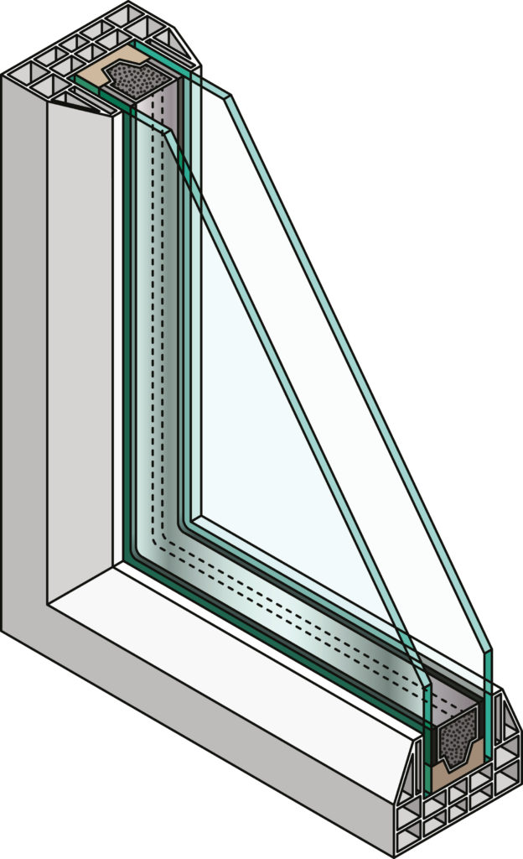
Conservation of energy and reducing waste
An efficient device is transfers a lot of energy in a small about of time
Energy can be transferred, stored or dissipated
When a mobile phone is used, it gets warm. Thermal energy transfers (dissipated) to the surroundings
Convert kW to W
Reduce Friction
Use lubrication on moving parts
Reduces thermal energy dissipated to surroundings
Conduction – pass energy from particle to particle (solids best)
Convection (liquids and gases), particles gain energy, spread out and become less dense and rise, when lose energy, particles move closer and become more dense and fall
Cavity wall insulation:
Reduces conduction & convection
Loft insulation & draft excluders:
Reduces convection
Double glazing:
Reduces conduction

Slide 6
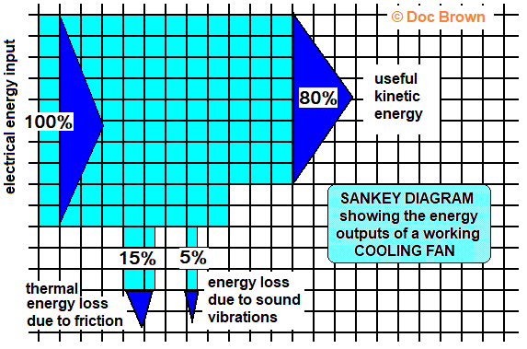
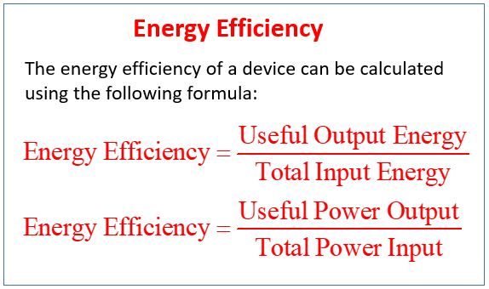
Width of arrow allows you to calculate the energy
Each square = 10%
Sanky Diagram and efficiency
Useful energy
Waste energy

Slide 7
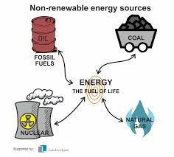
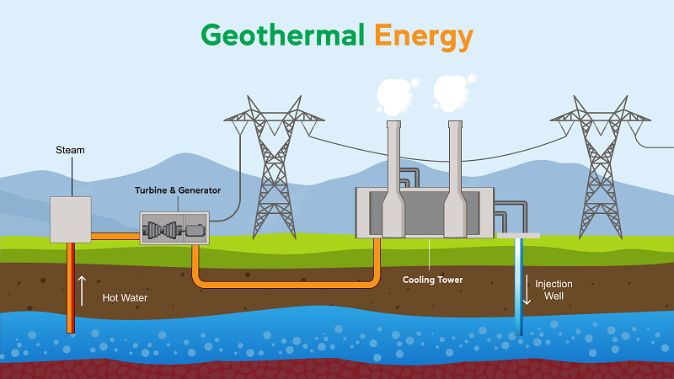
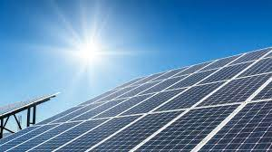
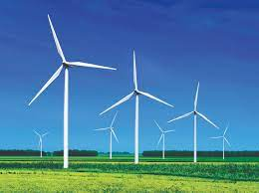
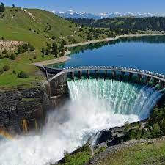
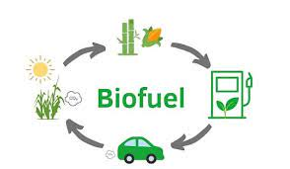
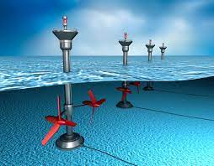
Energy resources
Solar
Renewable
No CO₂ emissions
Cannot increase output
High initial costs
Limited energy output
Wind
Renewable
No CO₂ emissions
Need a lot of turbines as little energy output
Spoils view
Initial costs high
Geothermal
Renewable
No CO₂ emissions
Located near hot rocks
Initial costs high
Solar cells
Non – Renewable energy resources will run out!!
More reliable than renewable
Fossil fuels
Made millions of years ago
Coal, oil and gas
Burning produced carbon dioxide – global warming
Nuclear
* Produces nuclear waste
Hydro-electric
Renewable
No CO₂ emissions
Immediate response and use when demand high
Flood habitats
Very high initial cost
Wave & Tidal
Renewable
No CO₂ emissions
Prevent access for boats
Waves dependent on wind – unreliable
Tidal – reliable as due to moon
Biofuel
Renewable
Short time to grow crops
Carbon neutral
Need large areas of land to grow crops
Loss of habitats

