Slide 1
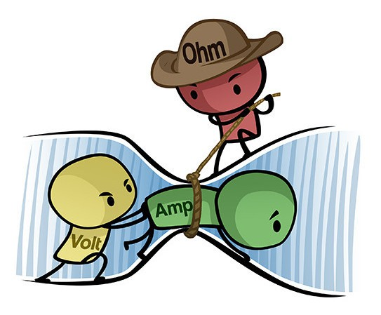
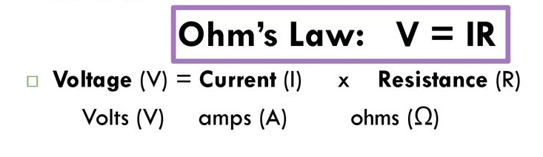
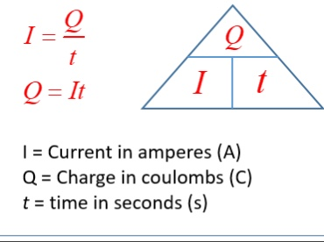
Resistance reduces the current
High resistance = low current
Units
Current - A
Potential difference - V
Resistance - Ω
Charge - C
Time - s
Length - m
P2 Electricity
Current is the flow of charge
Wire – electrons
Solutions - ions
Take care – convert units!!!
1A = 1000mA
1V = 1000V
Potential difference is the driving force that pushes the charge round
Increase voltage = high current
Uses these equations!!!

Slide 2
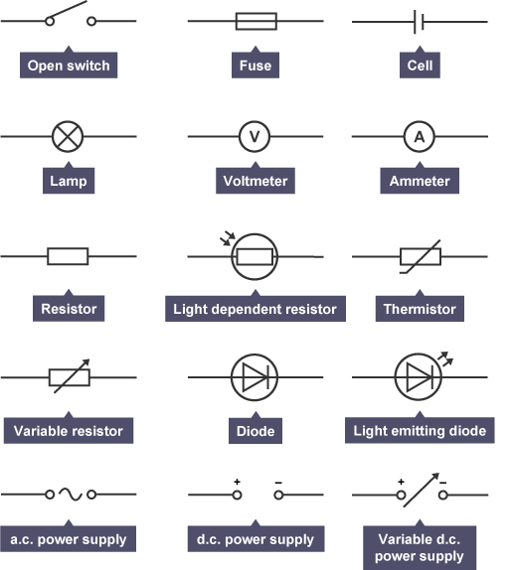
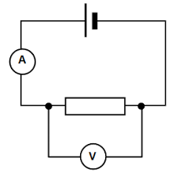
A resistor reduces the current
All resistor symbols have a box
  Fixed resistor
  Fuse
  LDR
  Thermistor
  Variable resistor
A Diode only allows the current to flow in one direction – look for the “play” symbol
Diode
LED
Ammeter is placed in series
Voltmeter is placed in parallel
A fuse contains a metal wire – this melts when the current is too high

Slide 3
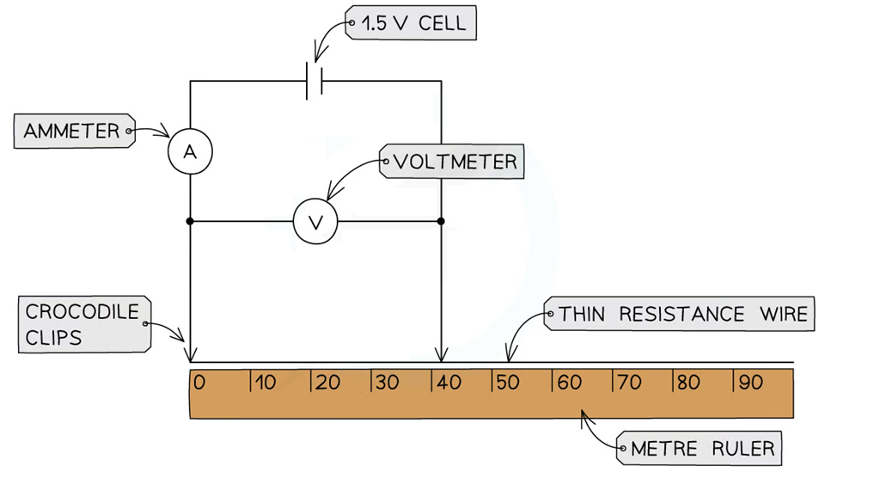
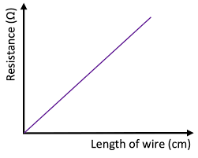
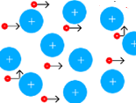
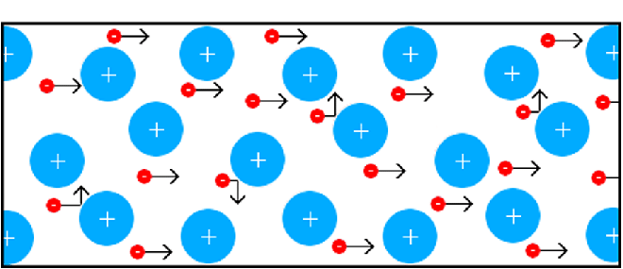
Effects of length of wire and resistance
Measure the potential difference and current for each length and calculate the resistance
Graph:
length of wire against resistance
Directly proportional must go through (0,0)
Keep one crocodile clip at 0m and move the other at different distances
A shorter length wire
Less collisions results in less resistance
Current increases
A high current causes the wire to get hot and could go on fire!!!
A longer length wire
Has more metal ions
Therefore more collisions occur between the electrons and metal ions
More collisions = more resistance which reduces the current

Slide 4
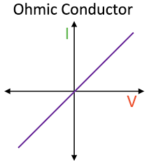
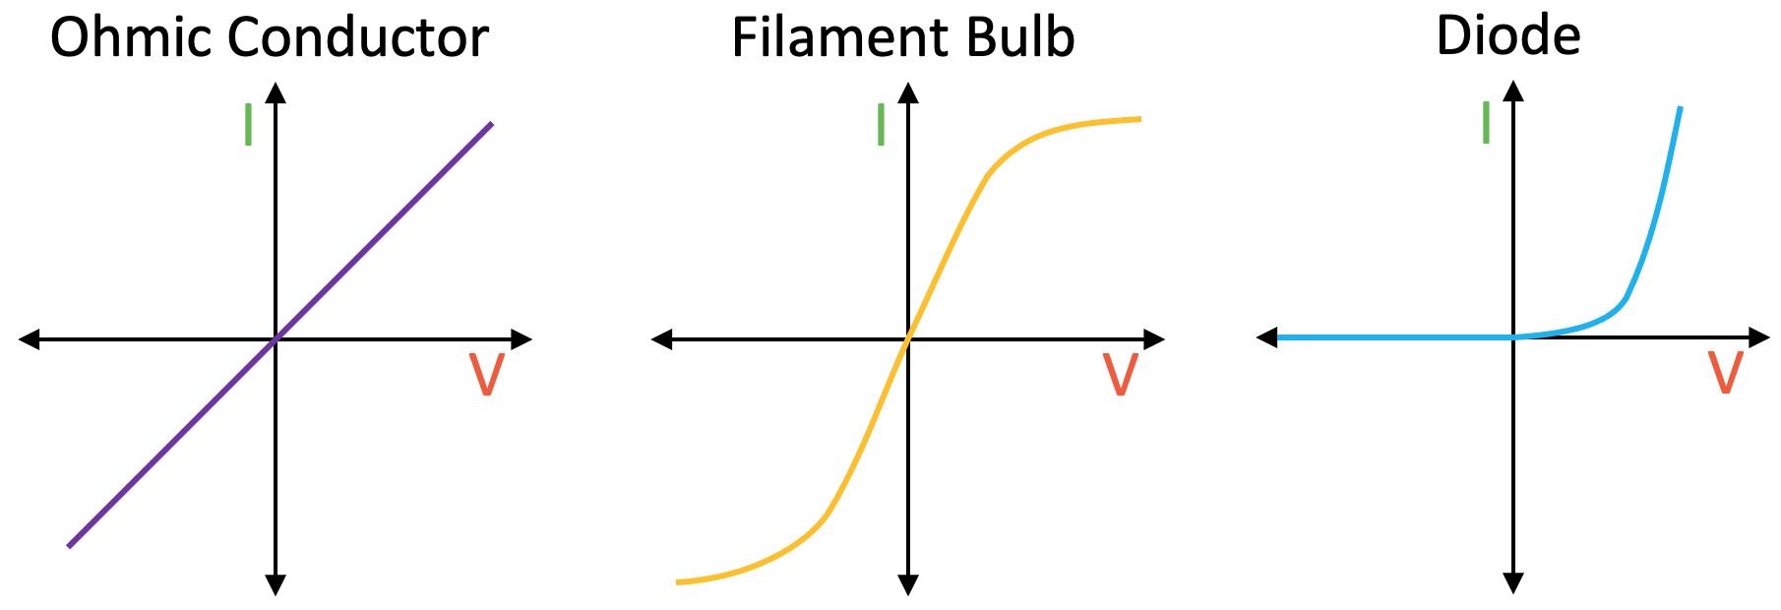
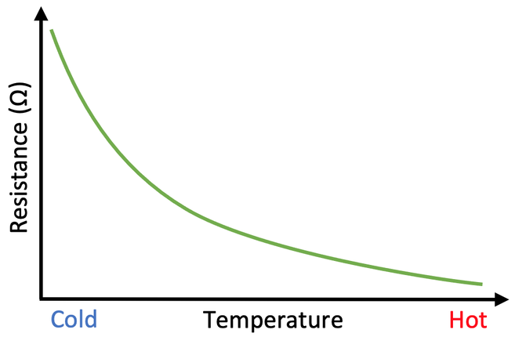
A – wire cold, few collisions between ions and electrons
Little resistance so high current
B
Directly proportional
A
B – wire hot, ions vibrating more, so more electrons collide with ions
* More resistance less current
Non – ohmic conductor
e.g. fixed resistor
Temperature remains constant
A – if the potential difference is in the opposite direction, there is a high resistance and current does not flow
Thermistor and LDR work in the same way
thermistor’s resistance changes with temperature
LDR changes resistance with light
B
A
Temperature / light
B – if the potential difference is in the correct direction, then current flows through the diode in one direction
High temperature / light = low resistance = high current
Low temperature / light = high resistance = low current
Non – ohmic conductor

Slide 5
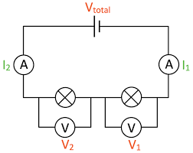
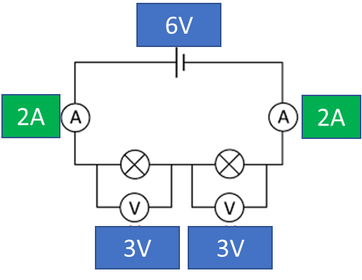
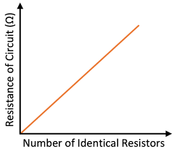
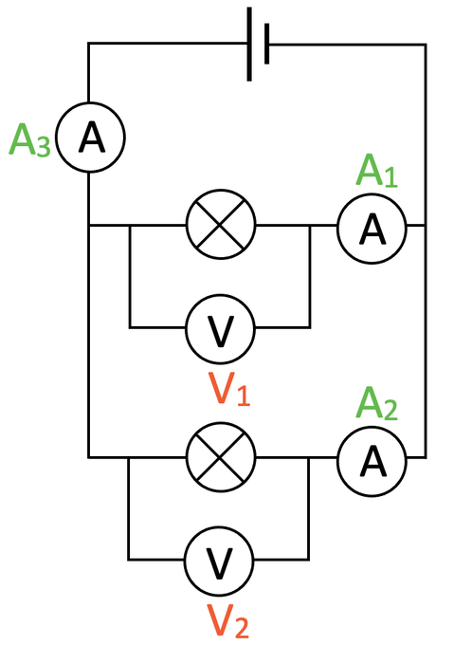
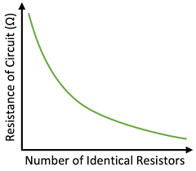
Series Circuit
example
V=IR
Resistance bulb 1 = 3/2
= 1.5Ω
Resistance bulb 2 = 3/2
= 1.5Ω
Total resistance = 1.5+1.5
=3Ω
Potential difference shared
V_{total} = V₁+V₂ +…
Current same
I1 = I2=…
In series add up the resistance R_{total} = R₁ + R₂
2
1
Parallel Circuit
More than one loop
series
More resistors = increase resistance
Take care – things are different for a parallel circuit
Voltage the same across all components V₁=V₂=…
Current is shared between branches
A_{3 (total)} = A₂+A₁
* Total resistance is less than the resistance of the smallest resistor
parallel
More resistors = decrease resistance

Slide 6
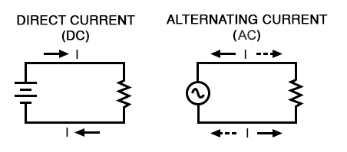
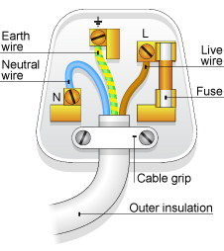
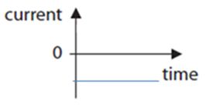
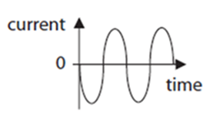
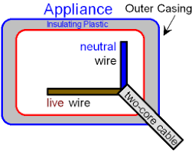
Electricity in the home
Earth – safety
0V
Live – 230V
Alternating current, changes direction 50 times every second.
Frequency 50Hz
230V
Neutral –0V
Direct current – current flows in one direction
Fuse – safety, metal wire melts to break the circuit – high current
Double insulated provides an extra layer of insulation to prevent electric shock
Current is either always positive or negative
Current alternates between positive and negative

Slide 7
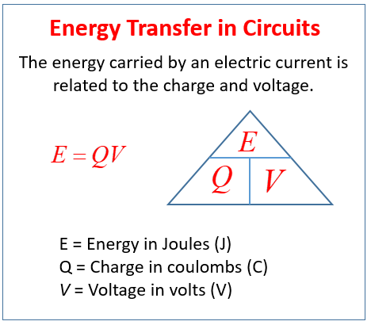
Power
Transferring energy to an appliance
Energy is transferred to an appliance to make it work
The more energy transferred in a given time, the higher the power.
The power of an appliance can also be calculated
P=VI
P=I²R
Be able to use all equations and convert
E=Pt
E energy (J)
P power (W)
t time (s)
Be able to convert units
1kW = 1000W

Slide 8
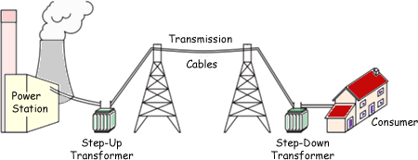
National grid
Giant system of cables and transformers that covers the UK
Transfers electrical energy from power stations to consumers
National Grid
Energy is lost through powerlines
More energy lost if current is high!!!
Voltage is decreased for safety
Power station generates electricity
Step up transformer
Increases potential difference
To keep power the same P=VI
Current is reduced
Low current reduces heat loss as electrical energy is transferred along power lines
Step down transformer
Decreases potential difference
To keep power the same P=VI
Current is increased

