Slide 1
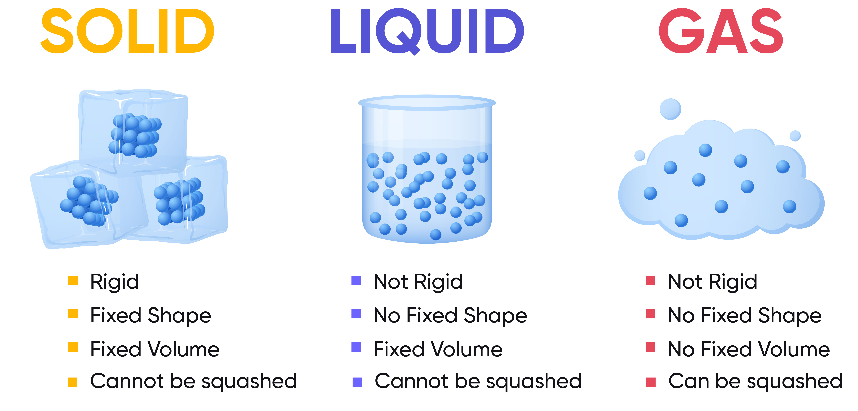
P3 Particle Model and Matter
Weak forces between particles
Particles move past each other but do stick to each other
Constantly moving with random motion
More energy than solids
Very weak forces between particles
Particles are free to move and far apart
Constantly moving with random motion
More energy than liquids and solids
Strong bonds
Regular lattice structure – particles close together
Particles vibrate – little energy
Solids most dense
Gases least dense

Slide 2
Gas pressure
Reduce volume
The particles are more squashed together
More collisions with the container
Increased pressure
Pressure = force ÷ area
N/m² N m²
Gas pressure
Gas particles
Increase temperature
The volume is the same
The particles gain more kinetic energy and move faster
More collisions with the container
Increased pressure
Gas particles freely move around colliding with the container
They exert a force on a specific area of the container
Resulting in pressure

Slide 3
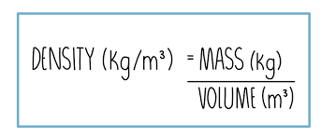
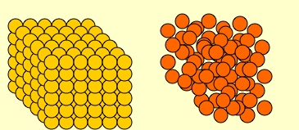
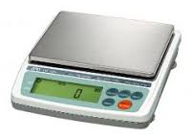
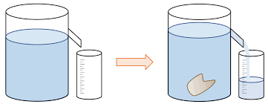
Density - RP
Density: how compacted a substance is
Density of solid object
Regular shape
Measure mass – top pan balance
Volume - use ruler measure length, width and height
Use the equation
Irregular
Mass – top pan balance
Fill eureka (displacement) can with water
Add irregular object and collect displaced water in measuring cylinder
Record volume of displaced water
Use the equation
High density Low density
Particles tightly packed
Particles loosely packed
Density of a liquid
Place measuring cylinder on balance and zero balance
Add 10ml liquid and measure mass
Add another 10ml and measure mass
Repeat until cylinder full
For each 10ml calculate the density using equation
Take an average of all the densities – the average is density of volume

Slide 4
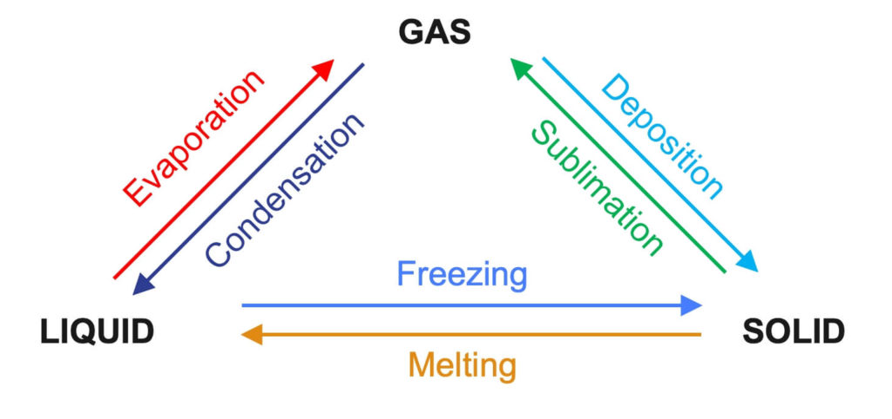
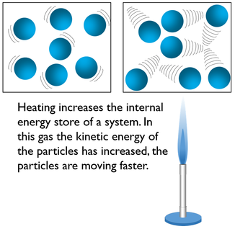
Internal Energy
Internal energy = kinetic energy + potential energy
Internal energies change depending on whether the particles gain or lose energy
Heating
Increases kinetic energy
Particles move faster
So total internal energy increases
When changes of state occurs, the mass does not change!!!

Slide 5
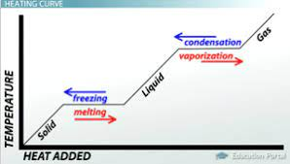
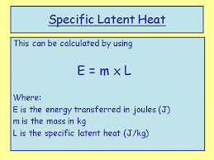
Specific Latent Heat
Change of state – flat horizontal line
States of matter – diagonal line
Melting and Boiling
Energy is still added
But temperature does not rise!!!
Energy used to break bonds
Internal energy increases
Change of state - the energy remains constant as bonds are either breaking or forming
Condensing and Freezing
Energy is released
But temperature does not fall!!!
Energy released- new bonds form
Internal energy decreases
Energy needed to change the state of 1kg mass
Specific latent heat of vaporisation
change between liquid and gas
Evaporating, boiling or condensing
Specific latent heat of fusion
change between solid and liquid
Melting or freezing

