Slide 1
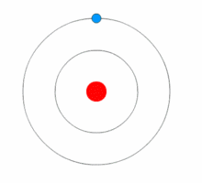
History of Atom
Gold leaf was bombarded by alpha particles – proved, atom mostly empty space and positive charge in the centre called the nucleus
P4 Atomic Structure
Solid spheres
Can bond together to form compounds
Plum pudding
Sphere of positive charge with scattering of negative charge
Discovered electrons
Nucleus not discovered yet!!!
Nuclear model
Most of atom empty space
Positive charge in nucleus
Electrons orbiting atom
Electrons orbiting in energy levels / energy shells
Electrons can gain energy and move to different energy level. When energy is lost the electron moves and gives out energy
Discovered the neuron

Slide 2
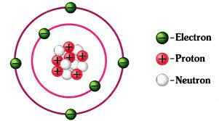
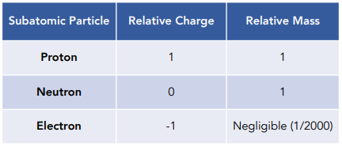
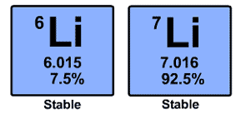
These are the subatomic particles
Current atomic model
Most of mass in nucleus
Atoms have a neutral charge
Radius of an atom = 1 x 10⁻¹⁰m
Electrons can gain and lose energy
Electrons can be transferred forming ions
Ar short hand electron configuration
2.8.8
First shell: 2e⁻
2^{nd & 3rd} shell: 8e⁻
3 shells – 3rd period
8 electrons in outer shell – group 0
Relative atomic mass
Relative to carbon-12
Average mass
These are isotopes
Isotopes have the
Same atomic number (protons)
Different masses (neutrons)
A_{r} = (6.015 x 0.075) + (7.016 x 0.925)
= 6.9
The relative atomic mass of these isotopes = 6.9

Slide 3
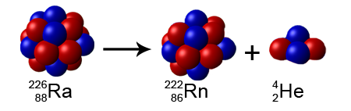
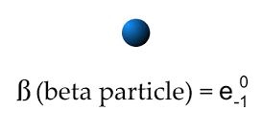
Nuclear decay
Some isotopes are stable
proton = neutron
Some isotopes are unstable
More neutrons
nucleus decays
Gives out radiation
Radium – 226 unstable
Alpha particle released
Radon – 222 formed
 | Alpha | Beta | Gamma
What is it | Helium nuclei 2 neutrons 2 protons Mass = 4 | Fast moving electron Mass = 0 | Electromagnetic wave No mass
Particle / wave | Large particle | Small particle | wave
Ionising | very | Less than alpha | Less than beta
penetration | poor | good | Very good
What stops it? | Air, skin, paper etc | Aluminium, tin | Lead and concrete

Slide 4
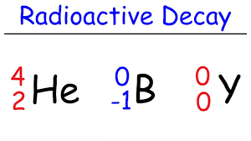
Nuclear equations – shows radioactive decay
Alpha is released
Mass =4
Protons =2
Alpha decay
Due to losing mass 4 from alpha Radon must have 222-4 = 218
Due to losing 2 protons, the atomic number is 88-2=86
Radium-222 is unstable
Ra
No mass is lost hence N has a mass of 14
Due to beta having -1 proton, nitrogen needs to have 1 extra proton to carbon i.e. 7
Beta decay
Carbon-14 unstable
Beta has 0 mass and -1 proton
Gamma decay
Gamma has no mass or protons since it is a wave, so the same atom is released

Slide 5
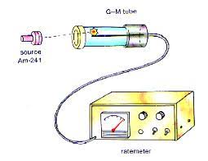
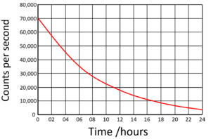
Radioactive Decay and Half life
Detects number of radiation counts per second
Radioactive decay
Random
Releases radiation (alpha, beta or gamma) – detected by Geiger-Muller tube and counter
Some radioactive isotopes have a short half life (seconds), others have a long half life (millions of years)
After every half life number drops by half but never reaches zero
Half life:
time taken for the number of radioactive nuclei in an isotope to half
Draw a line from 35,000 to the curve then down
At 0 hours there was 70,000 radioactive nuclei
After 6 hours (half-life)
35,000 radioactive nuclei (number has halved)
After another 6 hours, 17,500 radioactive nuclei remain
This will continue – but will never reach zero!!!
Note it starts at 70,000 not 80,000
Activity (Bq)
Half of 70,000 is 35,000
Half life is 6 days

Slide 6
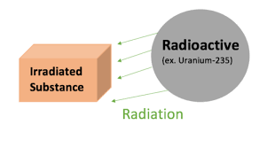
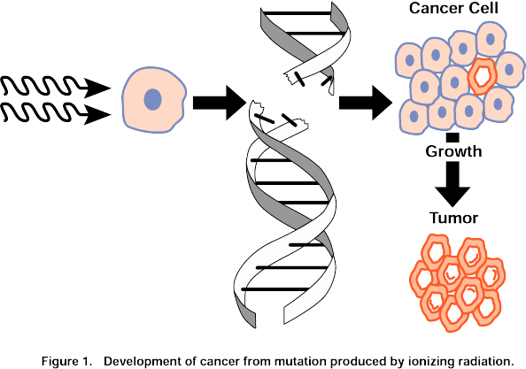
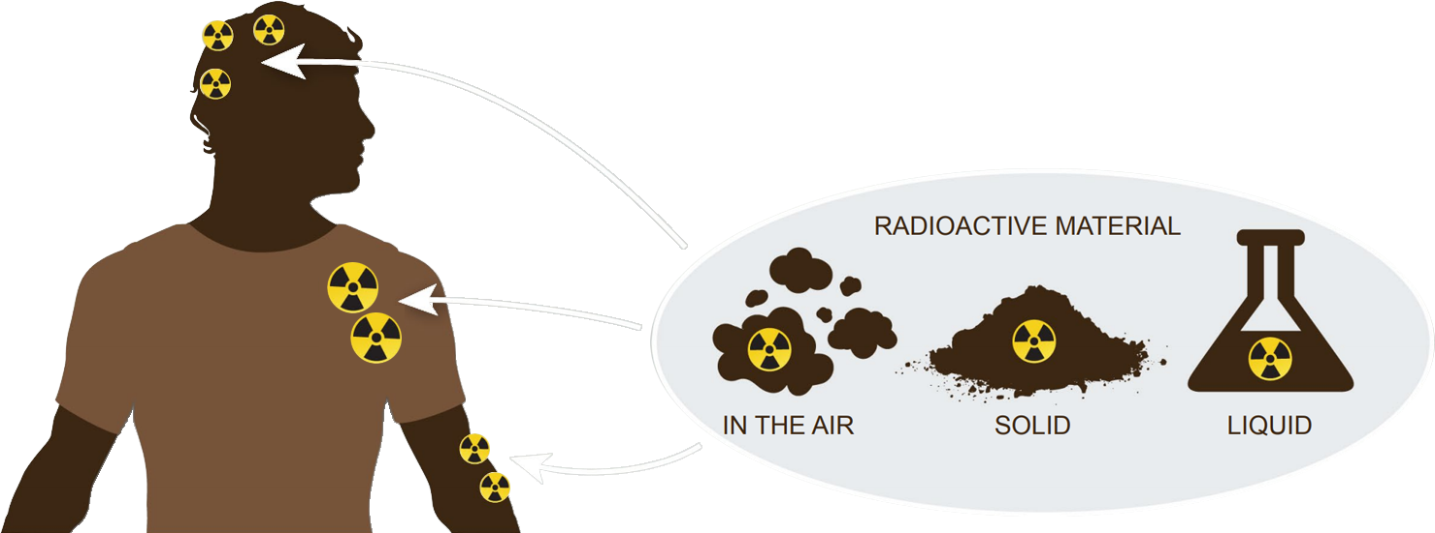
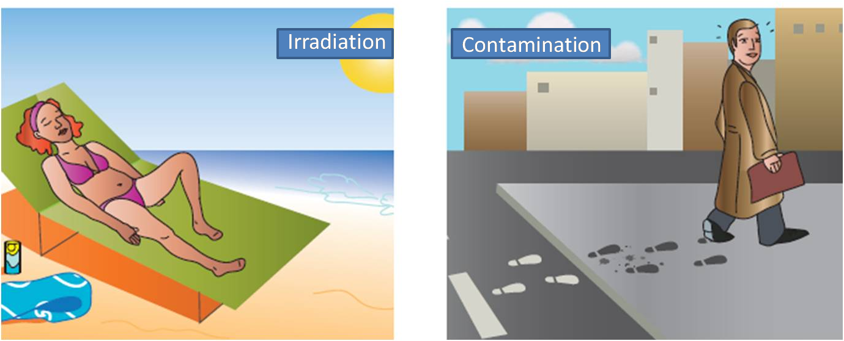
Irradiation and Contamination
Ionising radiation can enter cells
Cause cancer or
Cell death
An irradiated substance is something that has been exposed to radiation
It does not become radioactive!!!
A radioactive substance gives out radiation
Radioactive contamination – when unwanted radioactive atoms get onto an object
* Use gloves / tongs / masks
Gamma and beta most dangerous as irradiation source
Alpha is the most dangerous if consumed in the body as most ionising!
The woman has been irradiated by the sun’s radiation
The man has been contaminated as picked up radioactive atoms on his shoes

