Slide 1
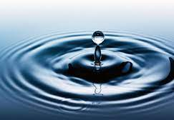
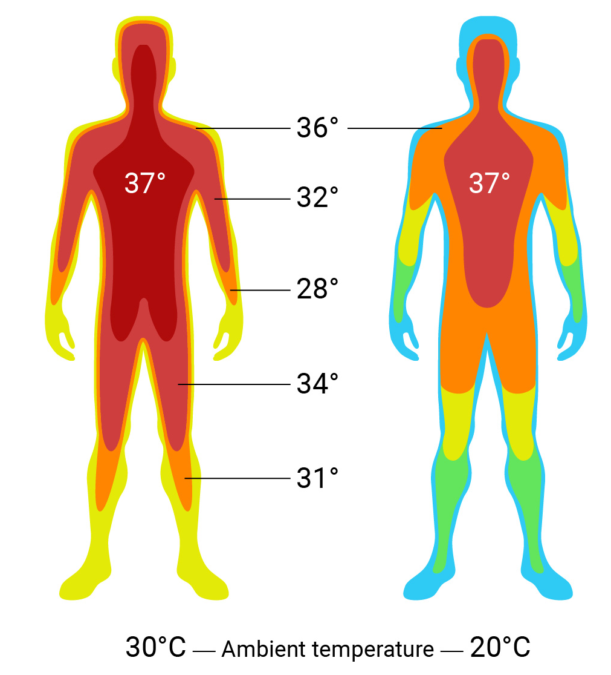
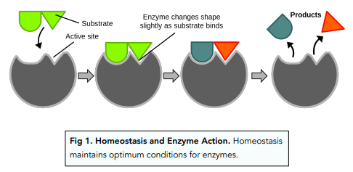
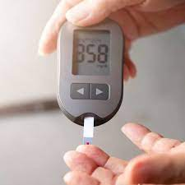
B5 Homeostasis
Higher
What is controlled by homeostasis?
Body temperature (thermoregulation) 37ºC
Definition:
Maintaining a constant internal environment
Blood concentration (osmoregulation: water content)
Blood sugar concentration
Why is homeostasis important?
Enzymes speed up reactions in the body
Optimum conditions need to be maintained so enzymes can work effectively
An environmental change that causes a response
Receptor
Specific cells that detect a stimuli
Central nervous system (brain and spinal cord – CNS)
Any changes to the internal and external environment are detected and the body responses to maintain homeostasis
Coordination centre
Effector
Muscle or gland

Slide 2
Nervous System Vs Endocrine system
To respond to stimuli, information needs to be sent around the body by
The nervous system
hormones
Nervous system
Use electrical impulses
Fast response
Act for a short time
Endocrine system
Use hormones (chemical messengers)
slower response
Act for a long time
Negative feedback regulation
Vs
Control centre (CNS)
Negative feedback – counteracts a change
e.g. if you get too hot, the body produces sweat (glands) to cool you down back to 37ºC
If too cold, body shivers (muscles) to increase temperature back to 37ºC
Receptors: cells that detect a stimuli
Effector:
Muscle or gland

Slide 3
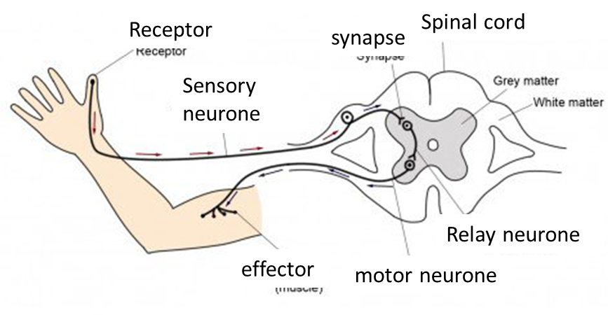
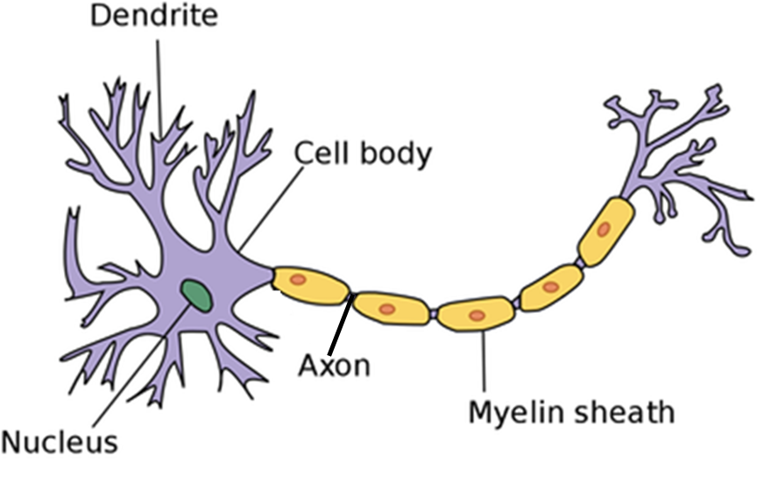
Nervous system
Reflex Arc – Involuntary response
Label this in an exam!!!
Voluntary response
(chose to do)
Stimuli
Receptor
Sensory neurone – carries electrical impulses
Brain (part of CNS)
Motor neurone – carries electrical impulses
Effector (muscle or gland)
Involuntary response (reflex)
Stimuli
Receptor
Sensory neurone – carries electrical impulses
Relay neurone in spine
Motor neurone – carries electrical impulses
Effector (muscle or gland)
Reflex is quicker than voluntary
Reflex uses spinal cord not the brain
Reflex uses relay neurones, voluntary does not
Reflex help prevent injury

Slide 4
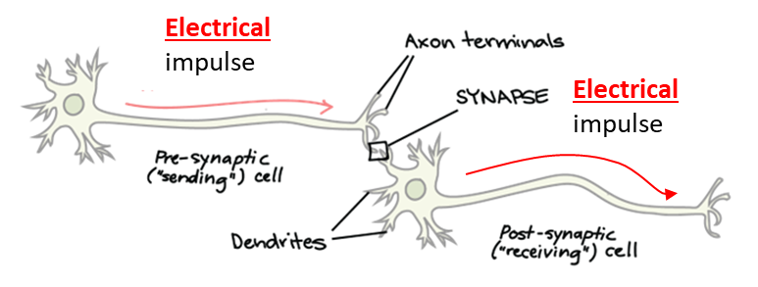
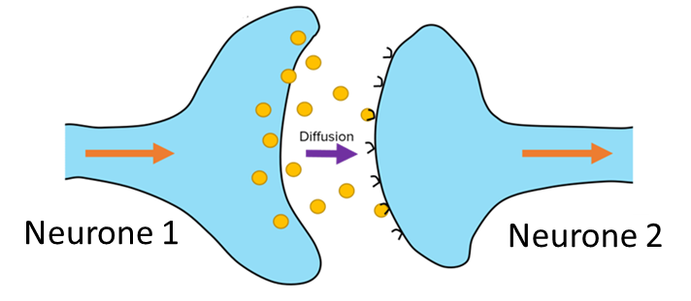
Synapse
Synapse:
Gap between 2 neurones
Electrical impulse arrives at the end of the axon on the first neurone
Neurone 1 releases neurotransmitters (chemical messengers into synapse
Neurotransmitters diffuse across the synapse
Neurotransmitters bind to receptors on neurone 2
Electrical impulse generated in neurone2

Slide 5
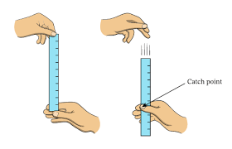
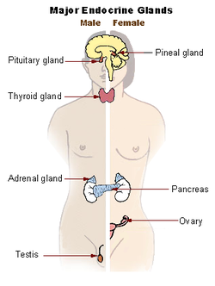
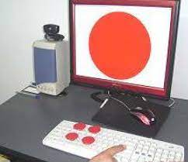
RP Reaction Time
Master gland
Hold ruler between thumb and fore finger and that zero is level with the thumb and finger
Measure the distance caught from the top of the thumb
Repeat and take a mean
Variables:
Independent: Number of cups of caffeine (speeds up reaction time)
Dependent: distance on ruler at catch
Control: Same person, drop height, hand, type of caffeine used
Gland | Hormones
Pituitary | FSH, LH, TSH
Thyroid | Thyroxin (metabolism)
Adrenal | Adrenalin (flight or fight)
Pancreas | Insulin and glucagon (blood sugar regulation)
Ovary | Progesterone and oestrogen (uterus lining)
testes | Testosterone (male features)
Computers more precise – remove human error
Computers more accurate as record in milliseconds

Slide 6
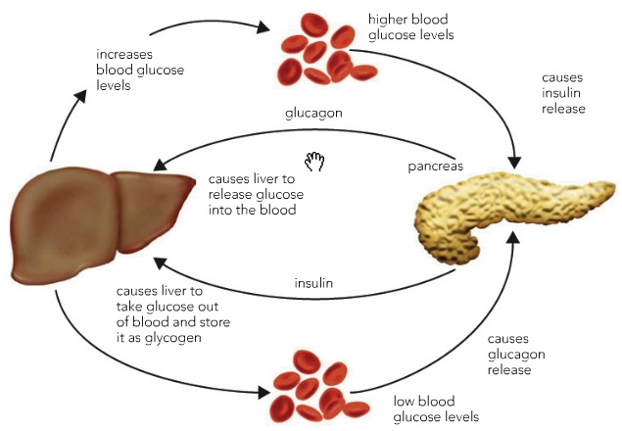
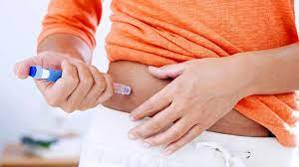
Blood Sugar
Blood glucose concentration too high (eating)
Pancreas detects high blood glucose concentration
Releases insulin
Insulin travels to the liver in blood
Insulin causes liver cells to take up glucose and store it as glycogen
Blood glucose concentration returns back to normal
Learn these answers!!!
Blood glucose concentration too low (exercise)
Pancreas detects low blood glucose concentration
Releases glucagon
Glucagon travels to the liver in blood
Glucagon causes liver cells to break down glycogen and release glucose
Blood glucose concentration returns back to normal
Diabetes
Type I
Does not make insulin
Need insulin injections (low sugar diet + exercise)
Type II
Cells become less responsive to insulin
Still make insulin
Low sugar diet and exercise

Slide 7
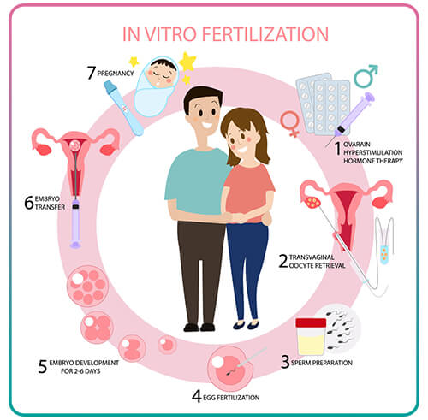
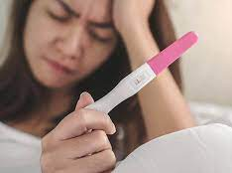
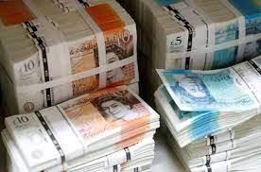
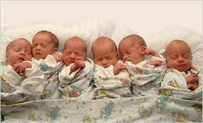
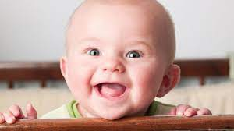
IVF
Stage 7
Woman given hormones
FSH – mature egg
LH – release egg
Several eggs are matured and released
Eggs extracted
Sperm and egg collected
Sperm injected into the egg
Fertilised egg divides to form an embryo
Embryo transferred to the uterus
Woman becomes pregnant
Stage 1
Stage 6
Stage 2
Stage 5
Stage 3
Stage 4
benefit
Cons
unethical
Multiple births
Emotional and physical stress
Expensive
Low success rate

Slide 8
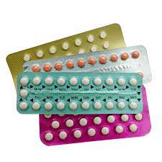
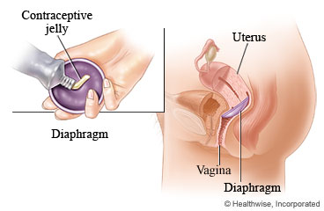
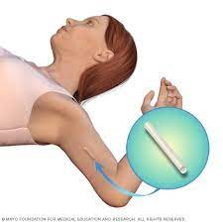
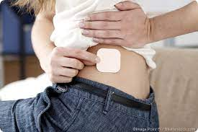
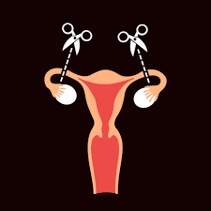
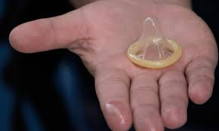
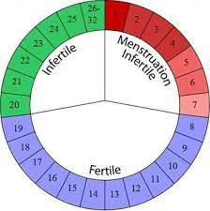
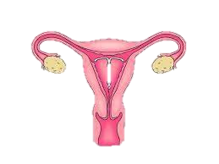
Contraception
Diaphragm
Placed over cervix.
Used with spermicide that kill sperm
Prevents pregnancy:
Prevents STI:
Pill / Patch / Implant
Oestrogen – stops egg being released
Progesterone – produces this mucus preventing sperm reaching egg
Prevents pregnancy:
Prevents STI:
Sterilisation
Cutting fallopian tubes / sperm duct - permanent
Prevents pregnancy:
Prevents STI:
Natural
Avoid having sex when ovulating
Prevents pregnancy:
Prevents STI:
Intrauterine device (IUD)
Planted in uterus – kills sperms and stops fertilised egg to implant
Prevents pregnancy:
Prevents STI:
Condom
Stops sperm reaching egg
Prevents pregnancy:
Prevents STI:
Abstinence
Not having sex
Prevents pregnancy:
Prevents STI:

Slide 9
menstruation
Stage 1
Menstruation
Uterus lining breaks down
Stage 2
Uterus lining build up again
Stage 3
Egg matured and released
Stage 4
Wall maintained
Pituitary gland releases FSH
FSH matures the egg in ovary
2. FSH simulates oestrogen to be produced by ovaries
3. Oestrogen
Oestrogen thickens lining of the uterus
stimulates LH production from pituitary gland
Inhibits FSH production
LH releases the egg
(this is ovulation)
4. LH
LH releases the egg
(this is ovulation)
Stimulates production of progesterone
Inhibits production of oestrogen
5. Progesterone is released by ovaries
Maintains uterus lining

Slide 10
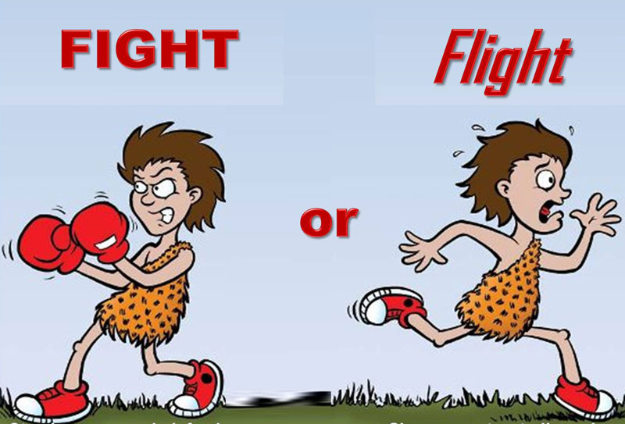
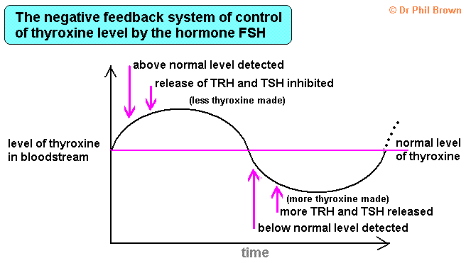
Adrenaline
Adrenaline released from Adrenal glands
Breathing rate increases – take in more oxygen
Heart rate increases to deliver more oxygen and glucose to the muscles
Increase rate of respiration so muscles can contract
Thyroxine
The hormone thyroxine needs to be kept at normal level
If thyroxine hormone higher than normal
Pituitary stops thyroid stimulating hormone (TSH) from being released
No TSH causes no thyroxine to be released
Thyroxine lowers back to normal
5. If thyroxine is too low, pituitary gland releases TSH, which causes more thyroxine to be released

