Slide 1
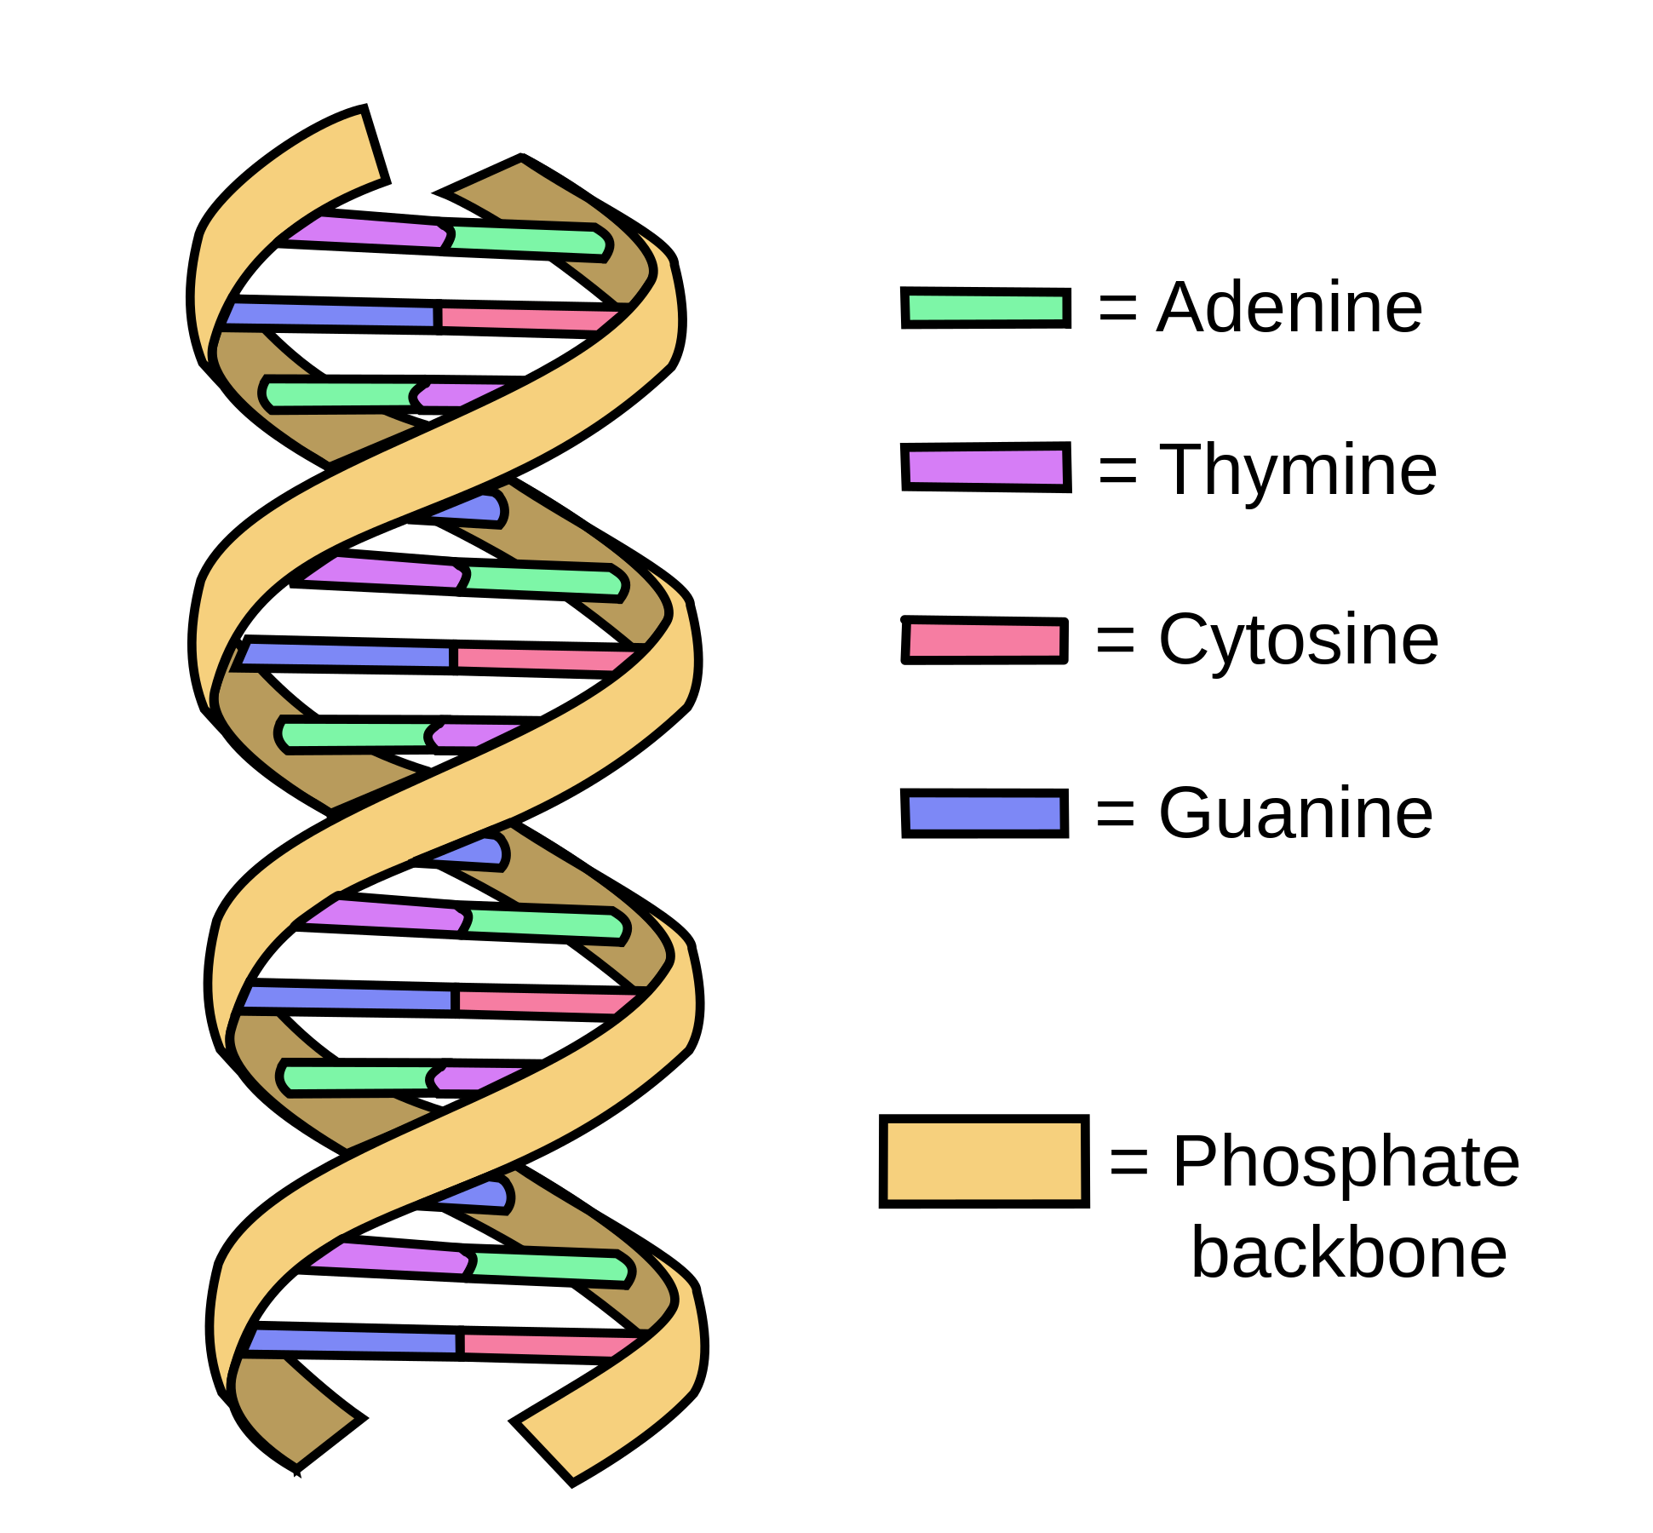
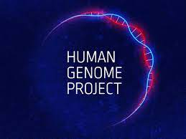
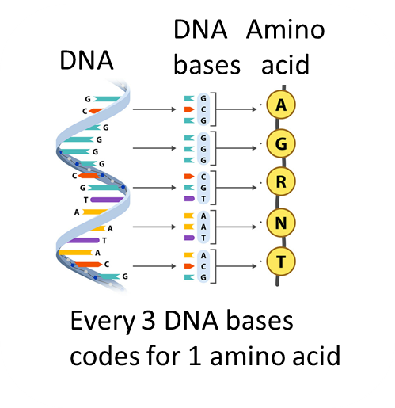
B6 Inheritance, Variation and Evolution - Higher
DNA
Polymer
Double stranded helix
Contains 4 bases
Sugar-phosphate backbone
Nucleus Contains genetic information (DNA)
Chromosomes Contain DNA
Haploid cells (gametes) 23
Diploid cells (all cells but gamete) 46
Gene
Small section of DNA that codes for a protein
Human Genome project
Genome (entire set of genetic material)
Allows identification of genes linked to different diseases
Allows identification of genes that cause genetic diseases and new treatments
Allows identification of human migration patterns

Slide 2
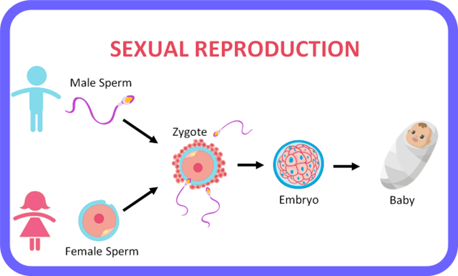
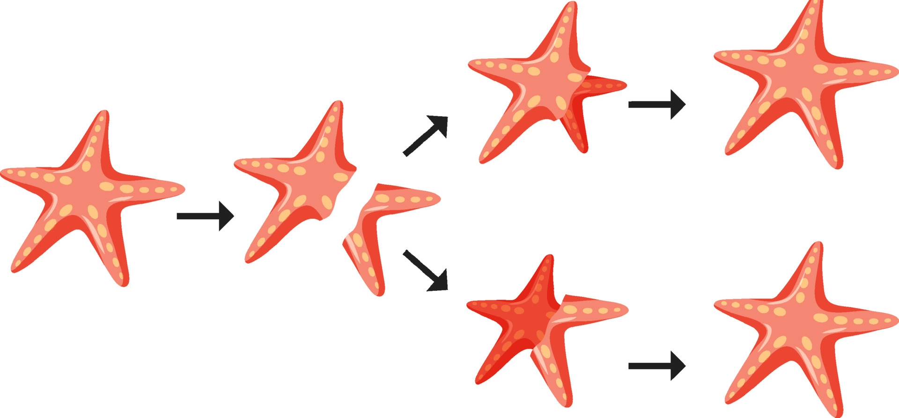
Sexual Reproduction
Genetically different
Asexual –
Genetically identical
1 parents
Forms clones (genetically identical)
Uses mitosis
No gametes involved
2 parents
Use gametes (haploid cells)
Sperm / pollen (23 chromosomes)
Egg (23 chromosomes)
Gametes formed by meiosis
Nucleus of sperm / pollen and egg fuse to form a diploid zygote (46 chromosomes)
Causes variation
Reproduction

Slide 3
Mitosis vs Meiosis
 | Mitosis | Meiosis
DNA replicated | ✓ | ✓
Use spindle fibres | ✓ | ✓
Number of cells produced | 2 | 4
Haploid / diploid cells produced | diploid | haploid
Genetically identical / different cells produced | Genetically identical daughter cells | Genetically different daughter cells
Number of divisions | 1 | 2
Variation occurs | x | ✓
use | Growth & repair | Make gametes

Slide 4
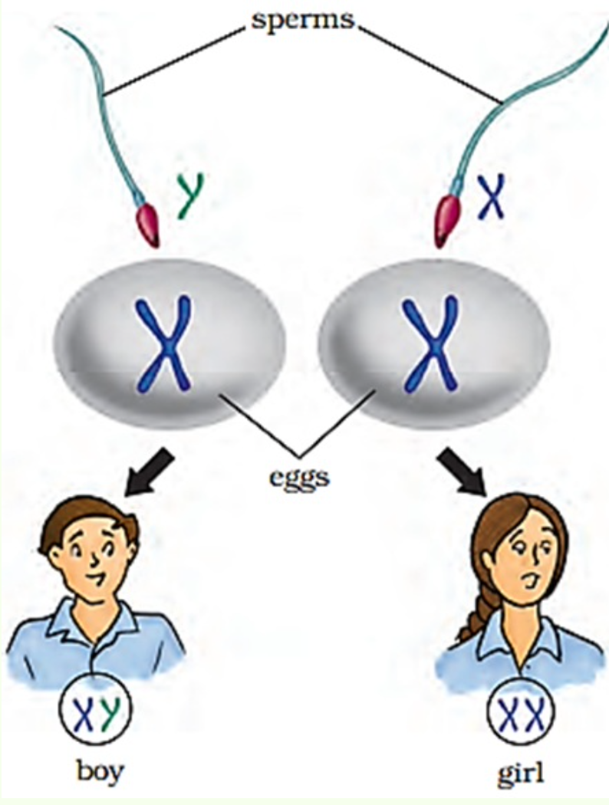
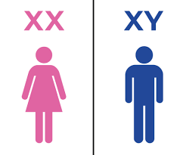
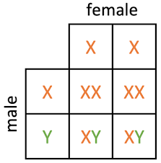
Sex determining chromosomes
Rules for genetic diagram
Identify the gametes
Complete the genetic diagram
Circle the different characteristics
Calculate percentages
Learn definitions
Gene – small section of DNA that codes for a protein
Allele – form of a gene (can be dominant or recessive)
Homozygous – two of the same alleles
Heterozygous – two different alleles (one dominant and one recessive)
Dominant – only need 1 allele for the characteristic to be expressed
Recessive – both alleles required for the characteristic to be expressed
Phenotype – expressed characteristic
Genotype – alleles
Gamete female
X and X
50% females
50% males
Gamete male
X and Y

Slide 5
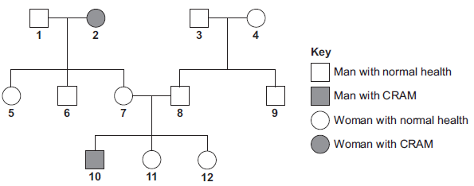
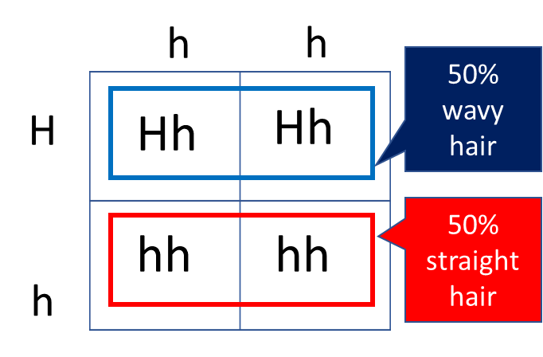
Worked example
H – wavy hair
h – Straight hair
A heterozygous mother has a baby with a straight haired father. What percentage of the offspring has straight hair?
Family tree
How does the diagram so CRAM is recessive?
Rules for genetic diagram
Identify the gametes:
Mother Hh (heterozygous)
Father hh (straight hair is recessive so need 2 alleles
Look for parents that do not have the characteristic but have offspring with the characteristic
10 has CRAM – if CRAM is recessive must have two recessive alleles
1 recessive allele from 7 and one from 8
7 and 8 do not have CRAM, but pass on the gene so must be heterozygous
7 and 8 are carriers
2. Complete the genetic diagram
3. Circle the different characteristics
4. Calculate percentages

Slide 6
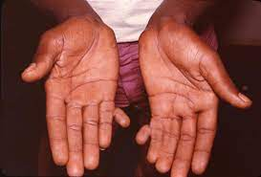
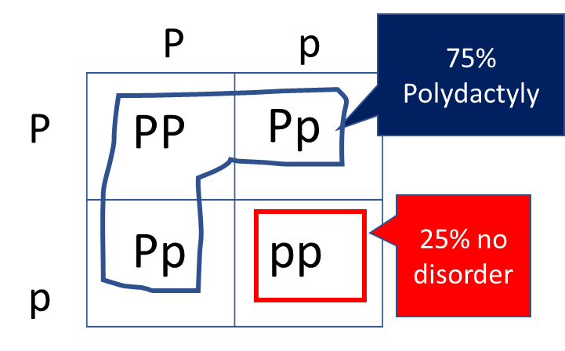
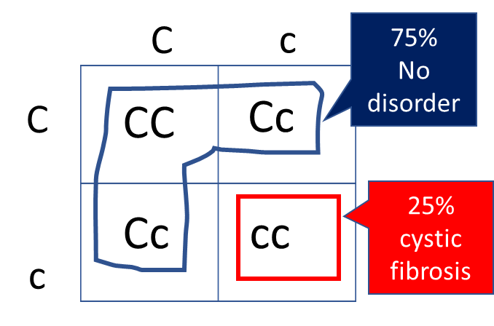
Cystic Fibrosis – Genetic disorder
Polydactyly– Genetic disorder
Produces lots of mucus
Extra fingers or toes
Dominant Disease
(need only 1 allele)
Recessive Disease
(need 2 alleles to have disorder)
PP – Polydactyly
Pp – Polydactyly
pp – no disorder
CC – no disorder
Cc – carrier (heterozygous)
cc – has cystic fibrosis
For a child to have the disorder the parents need to be either carriers or have the disorder
Embryonic screening:
To test for genetic disorders
Pre-implantation genetic disorder – analyse cells from embryo
Ethical issues about designer babies
2. Chorionic villus sampling – takes cells from placenta
* could cause miscarriage

Slide 7
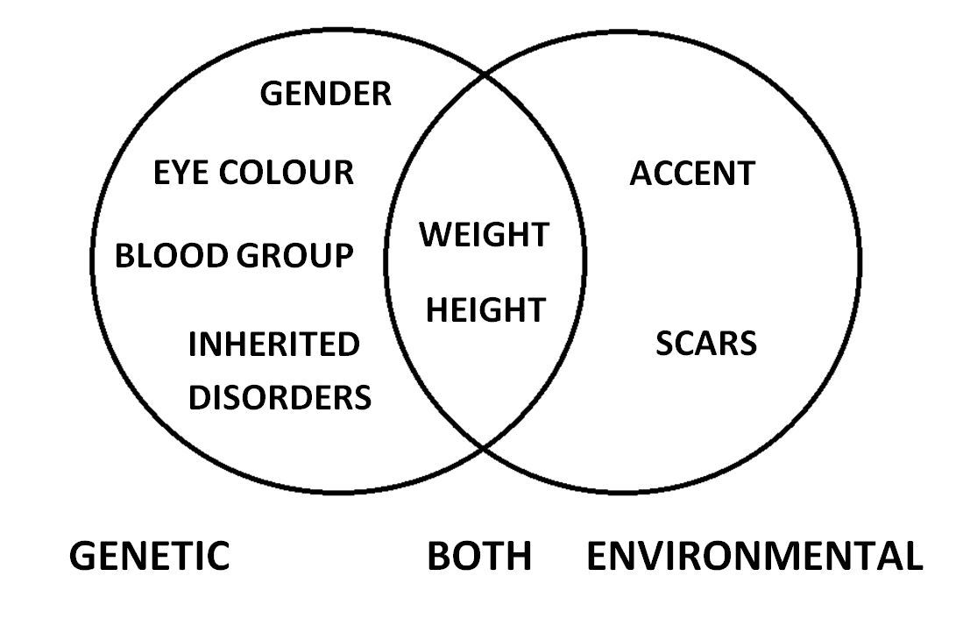
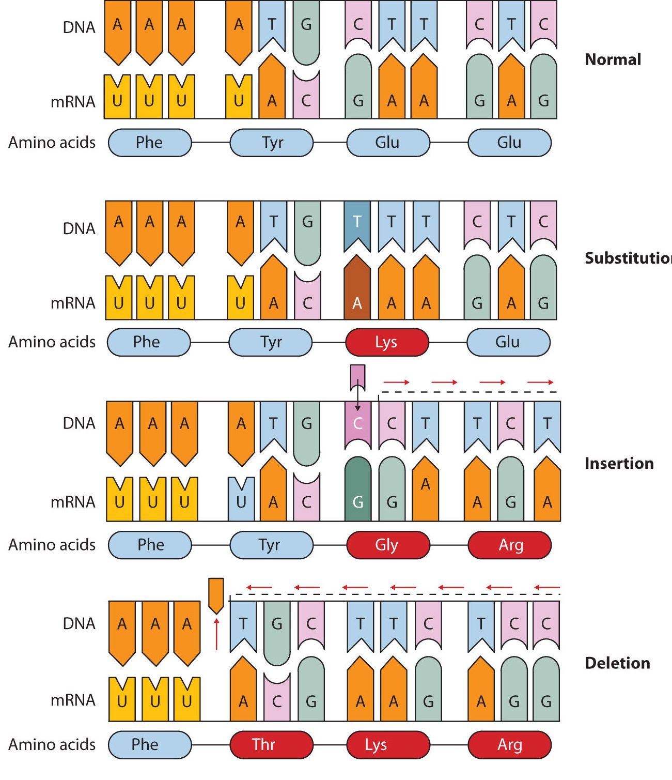
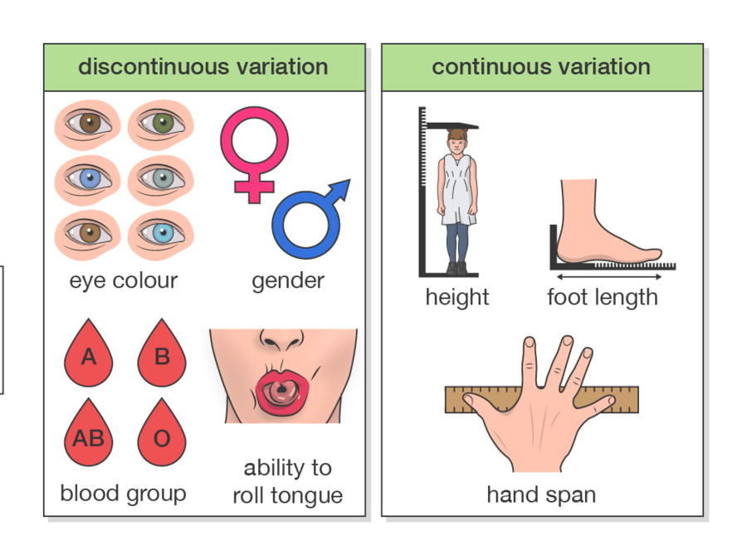
Variation – differences between organisms
Caused by
Inheritance (genes)
Environment
Variation and mutation
Mutations causes changes to the genome (change base sequence of DNA)
Rare and random
Inherited only (examples) - Discrete
Eye colour
Blood group
Roll tongue or not
Environment only (examples) Discrete data
Scar
Sun burn
Both(examples)
Continuous data
Height
Weight
Discontinuous is discrete data
Some mutations harmful
Genetic disease
Some mutations have no effect
Some mutations are beneficial
Mutation causing long neck giraffes

Slide 8
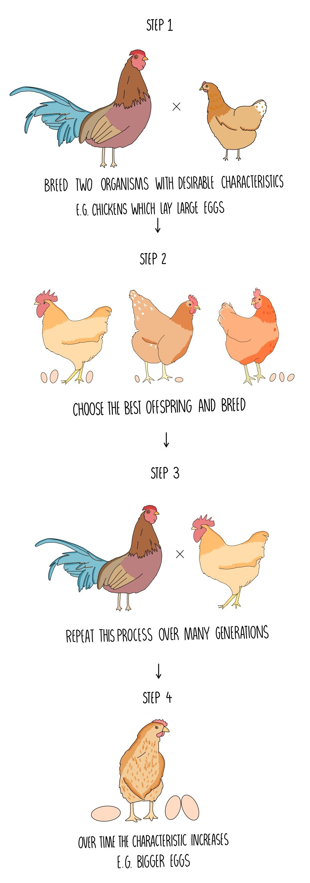
Selective breeding
Cut out gene using restrictive “cutting” enzymes
Genetic Engineering
Insert gene using “sticking enzymes”
Pros
Improve meat and crop yields
Choose and breed 2 organisms with desirable characteristics e.g. chickens that lay large eggs
Cons
Reduction in gene pool
Health problems e.g. genetic diseases
Cannot evolve or become resistant to new diseases
Takes a long time
Choose and breed the best offspring with the desirable characteristics
Plasmid is the vector
Genetic engineering – transfer of a gene for a desirable characteristic from one organisms genome to another
Repeat process over many generations
Vectors used to transfer the genes into another organism – plasmids or viruses
Cons
Reduction biodiversity of natural species
Cross pollination creates resistant weeds
Pros
Treat genetic diseases
Make insulin
Make resistant crops
Make crops with health benefits e.g. beta-carotene added to rice – no blindness
Eventually all the offspring have the favoured characteristics

Slide 9
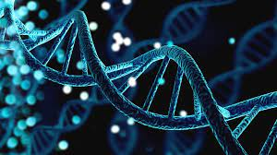
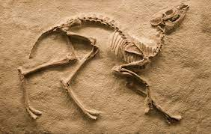
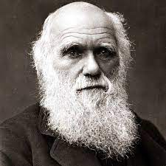
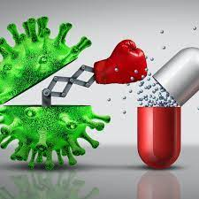
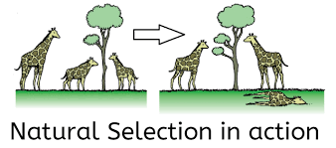
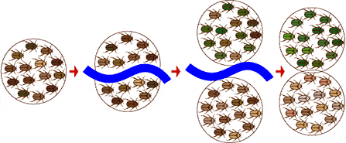
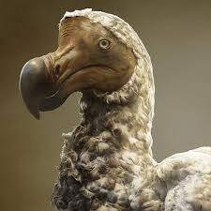
Natural selection
Supporting evidence for natural selection
Genetic evidence
Fossils
Antibiotic resistance
Charles Darwin
A geographical barrier like a river can divide a population
Each side undergoes natural selection with different environmental conditions
New species forms - speciation
If you get an exam question on “evolution” or “natural selection” write about this process
Takes a long time
6 mark answer
Mutation occurs causing variation
Competition occurs
Best adapted survive – “survival of the fittest” – best suited phenotypes
Best adapted reproduce and pass on favourable alleles to offspring
Beneficial characteristics become common
Less adapted die
Extinction – no living individuals of a species left
New predator
Environmental changes
Catastrophic event
New disease
competition

Slide 10
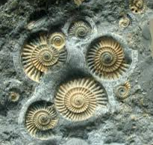
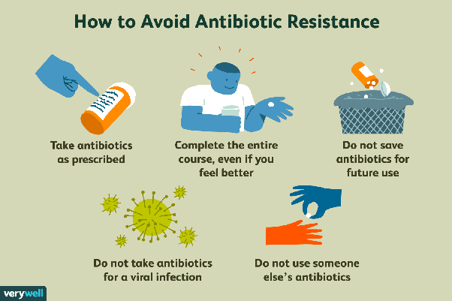
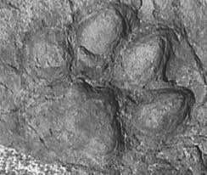
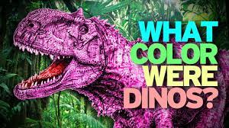
Fossils
Antibiotic resistance
V
Gradual Replacement
Hard body parts, such as bones and shells, which do not decay easily
are replaced by other materials as they decay.
Preservation
Dead animals and plants can be preserved in:
Amber (fossilised resin)
peat bogs (too acidic for decay microbes)
tar pits (no oxygen or moisture for decay microbes)
Ice (too cold
Casts or Impressions
Casts or impressions, such as footprints or burrows. These become covered by layers of sediment, which eventually become rock.
Bacteria become resistant due to mutation
Do not know for sure about prehistoric creatures
Soft body parts decayed
Fossils incomplete or destroyed
Antibiotics must only be given for bacterial infections

Slide 11
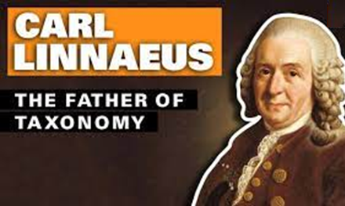
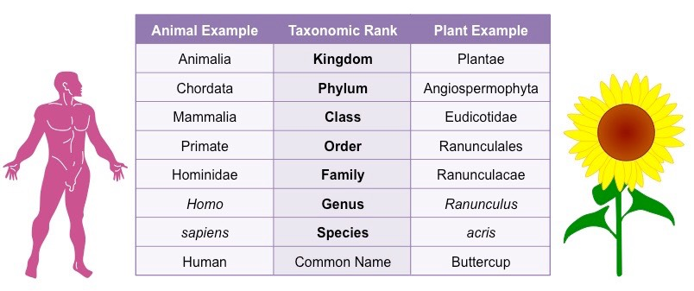
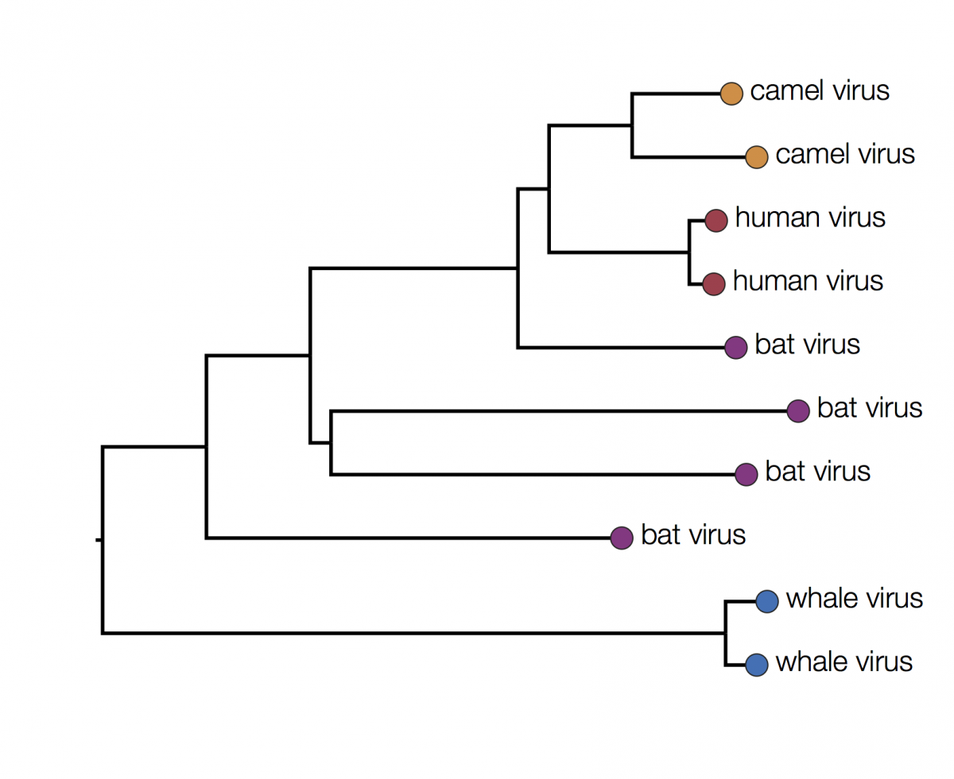
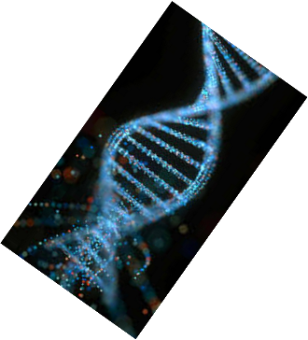
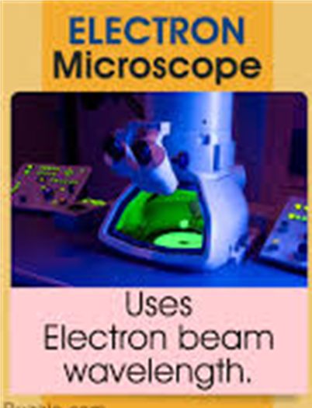
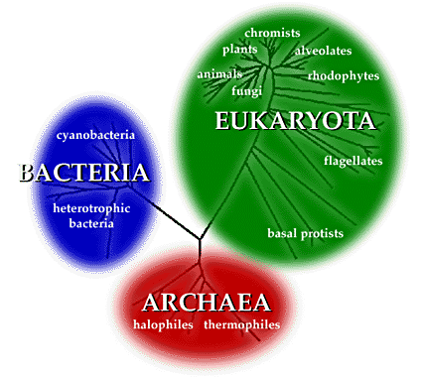
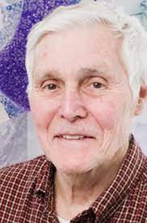
Grouped organisms by their structural similarities
Learn these groups and their order
Classification
Binomial name
Homo sapiens
Used across the world as a common language for naming organisms
Genus
species
Evolutionary trees show which species have a common ancestor and which are closely related
Changing ideas
New evidence!!!
Some organisms were not classified correctly
Eukaryotes
(contain a nucleus)
DNA analysis
Chemical analysis
Better microscopes electron microscopes
3 domain system
Carl Woese
Grouped organisms from chemical and DNA analysis, and from microscope work – produced the 3 domain system
Prokaryotes (no nucleus)
Primitive bacteria
extremophiles

