Slide 1
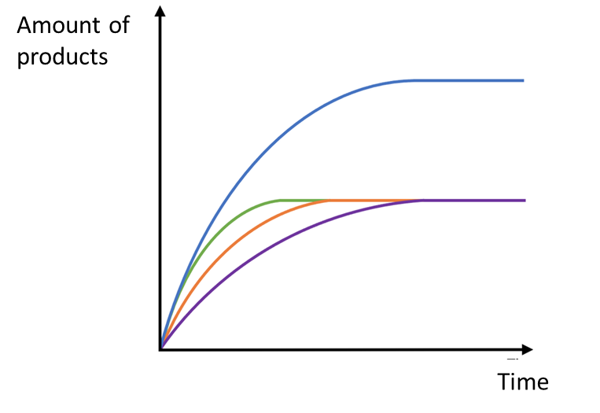
For a reaction to occur, particles need to collide successfully but…
Particles need to collide with enough energy to break the bonds in the reactants – activation energy
More frequent collisions increases the speed of a reaction
C6 Rate of Reaction
Higher
This line shows more products are made than the other lines, therefore more reactants at the start
Rate of any reaction decreases with time as reactants used up
Green, orange and purple shows same amount of products made, therefore same amount of reactants at the start
Blue line has the fastest rate because the line is steepest
Purple line has the slowest rate because the line is least steep
Unsuccessful collision
Particles do not collide with enough energy
Amount of products made
Time
Rate =
Successful collision
Particles had enough energy (activation energy) to form new products
Amount of reactants used
Time
Rate =

Slide 2
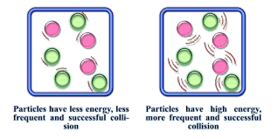
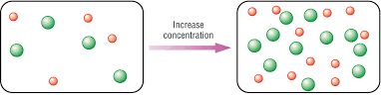
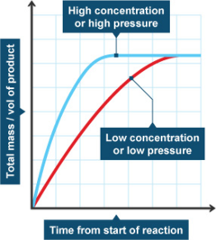
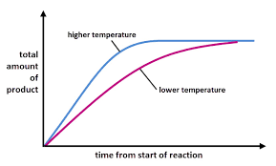
Temperature
Concentration
Concentration number of particles in a given volume
Few particles less collisions
Lots of particles, lots of frequent successful collisions
High temperature = faster rate of reaction
Particles have more kinetic energy and move more
More successful frequent collisions
High concentration = faster rate of reaction
More particles in a given volume
More successful frequent collisions
Higher concentration faster rate and steeper curve
Higher temperature faster rate and steeper curve

Slide 3
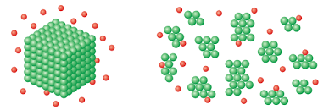
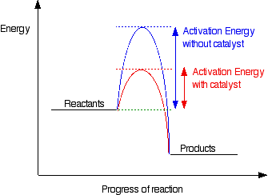
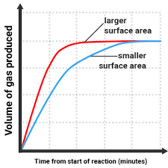
Surface area
Catalyst
Speeds up a reaction
Does not get used up in a reaction
Lowers the activation energy providing an alternative pathway
Lump has a low surface area – few surfaces exposed and few collisions
Powder has a large surface area – many surfaces exposed, many collisions
High surface area = faster rate of reaction
(powder)
More particles are exposed when a substance is broken up
More surfaces for successful frequent collisions
e.g. powder
Larger surface area faster rate and steeper curve
Units for rates
Solid: g/s
Volume of liquid or gas: cm³/s
Amount of product or reactant in moles: Mol/s
e.g. lumps

Slide 4
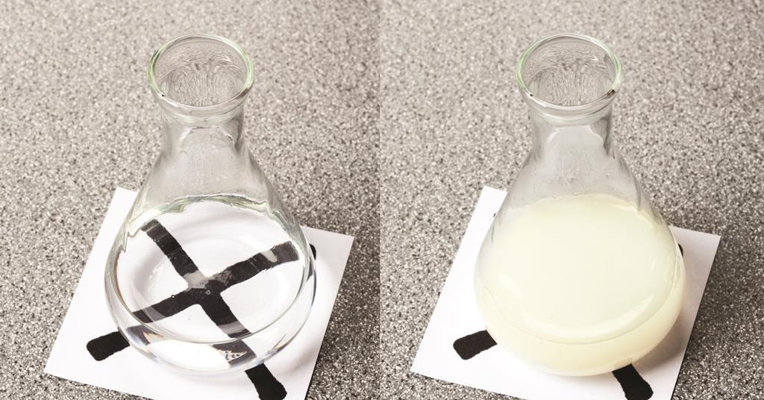
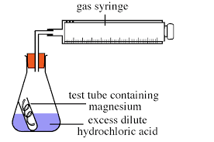
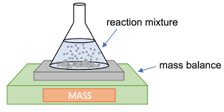
RP sodium thiosulphate and Hydrochloric acid
Magnesium and HCl
Sulphur is a solid- makes the solution cloudy and opaque
magnesium
Bubbles of hydrogen
acid
Independent:
Concentration of HCl
Dependent:
Volume of hydrogen produced (gas syringe) or change in mass (balance)
Controls:
mass of magnesium
Temperature of hydrochloric acid
Volume of acid
(aq) (aq) (aq) (l) (g) (s)
Independent:
Concentration of HCl
Dependent:
Time taken for cross to disappear
Controls:
Concentration sodium thiosulphate
Temperature of reactant solutions
Volume of acid
Volume of sodium thiosulphate
precipitate

Slide 5
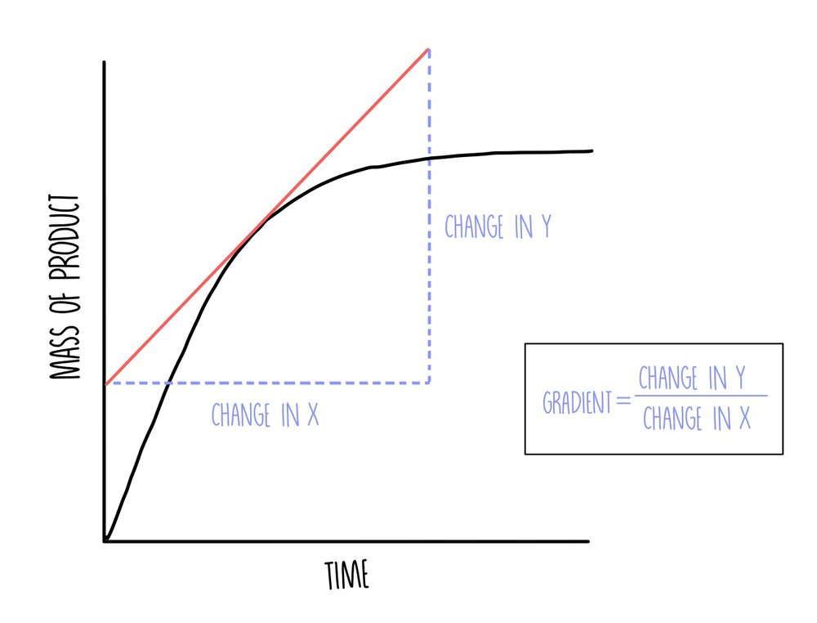
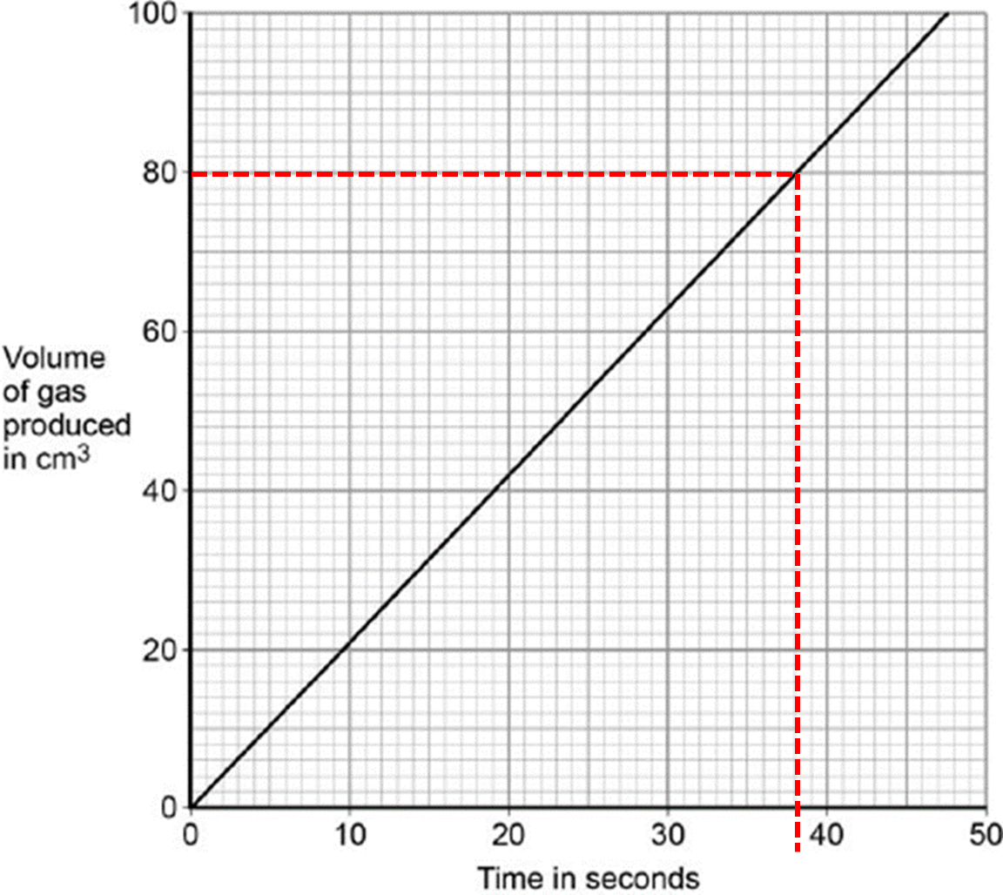
Calculating Rate
Tangent to a curve
Straight line
Y
X
This method is only for curved lines
Use a ruler to draw a straight line at where you want to measure rate
Draw a triangle around the tangent
Calculate the change in y and change in X
Gradient (rate) = change in Y
change in X
Straight Line
Rate = gradient of the line
Gradient = Y
X

Slide 6
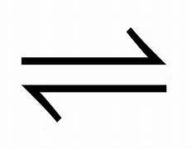
Reversible reaction and equilibrium
Symbol for reversible reaction
Equilibrium
Rate of forward reaction
=
rate of backwards reaction
Catalyst
Will increase the rate of both reactions
Does not effect the position of equilibrium
4 moles gas
2 moles gas
Le Chatelier Principle
Concentration
Increase reactants – equilibrium moves to the side to make more products
Decrease products – equilibrium moves to the side to make more reactants
Temperature
Increase temperature – favours the endothermic reaction (takes in energy)
Equilibrium moves to left and more N₂ and H₂ produced
Decrease temperature – favours the exothermic reaction (gives out energy)
Equilibrium moves to right and more NH₃ produced
Pressure (only affects gases)
Increase pressure – equilibrium moves to side with fewer gas particles e.g. moves to right (NH₃)
Decrease pressure – equilibrium moves to side with more gas particles e.g. moves to left (N₂ +H₂)

