Slide 1
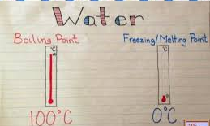
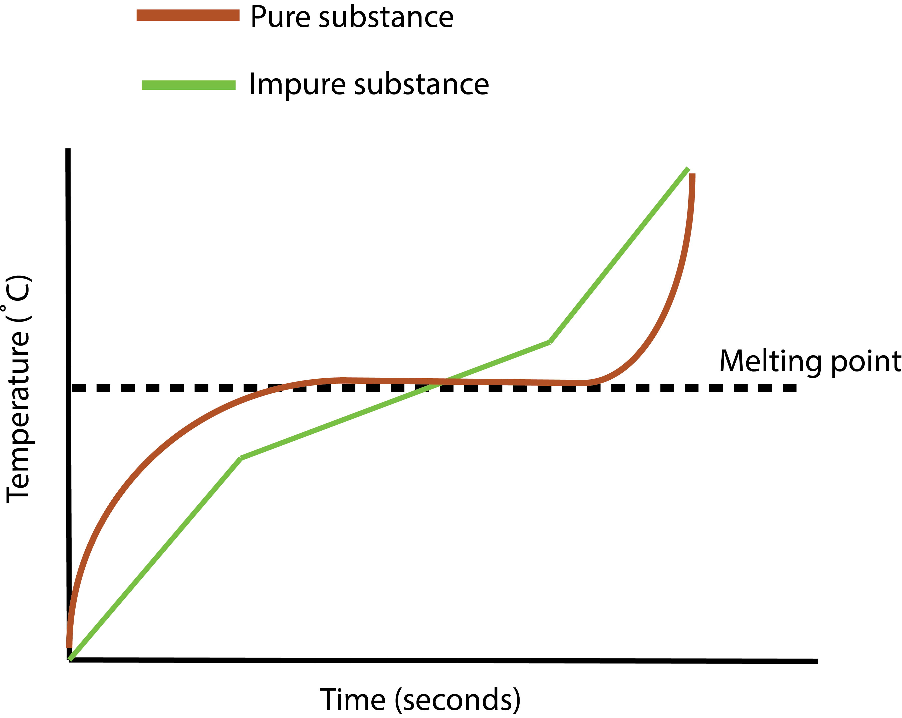
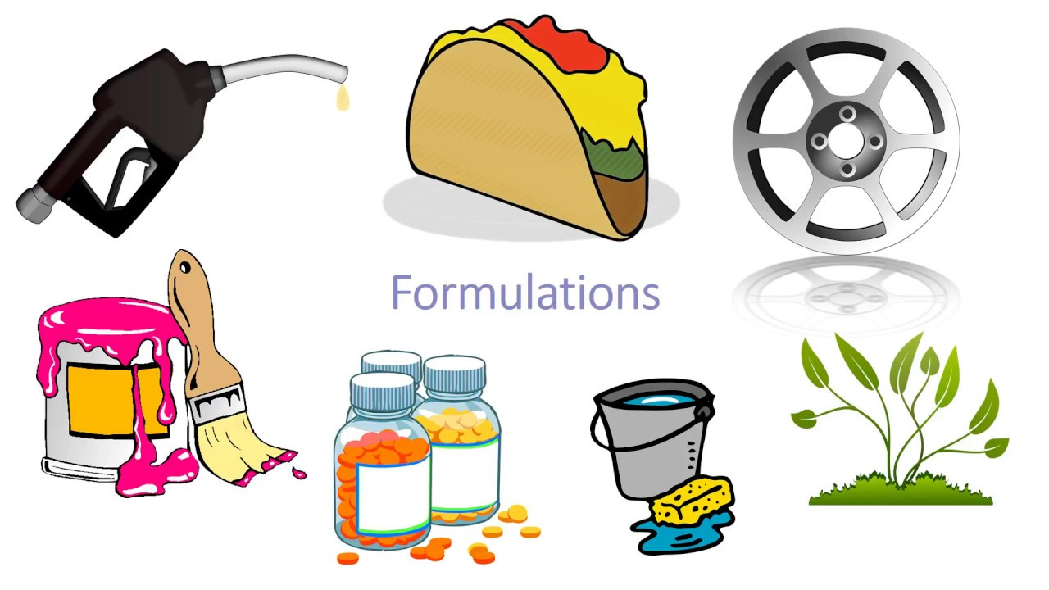
Chemical Analysis
Pure substance:
Contains only one compound or element
Boiling and melting point are specific
Pure substances
Know your definitions
Impure substance:
Is a mixture
Range of boiling and melting points
Formulation
mixtures with a specific purpose
e.g.
Pigments in paints
Additives in food
Used in drugs
Impure substance
Pure substance
Impure substance

Slide 2
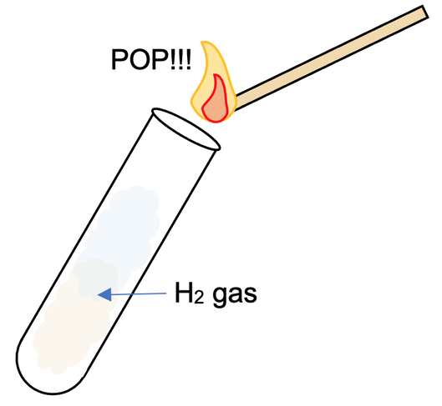
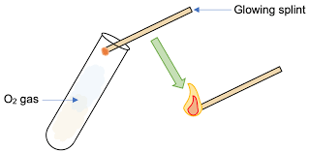
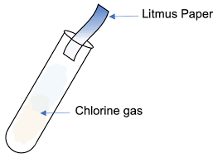
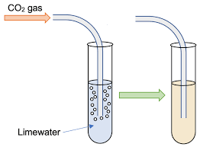
Gas tests
Oxygen
Relights a glowing splint
Hydrogen
Lit split will burn with a squeaky pop
Carbon dioxide
Limewater turns cloudy
Chlorine
Damp litmus paper bleaches white

Slide 3
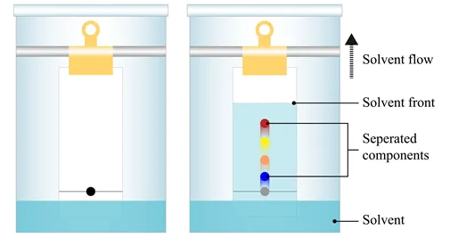
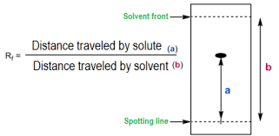
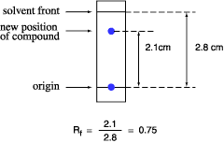
Chromatography RP
Draw a pencil line 2cm from the bottom of the paper – pencil will not run
Add dye / unknown substance as a small dot on the line – stationary phase
Place the paper into a solvent – ensure solvent below the line
Let the solvent run up the paper – if substances in the mixture are soluble they will run up the paper – mobile phase
When the solvent is 1cm from the top of the paper remove and draw a pencil line – solvent front
Rf must be less than 1
Example

Slide 4
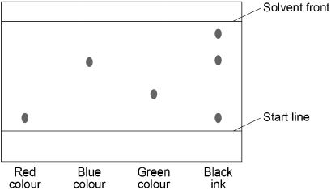
Chromatography exam question
Conclusions
Black is a mixture – more than 1 colour dot in a column
Black contains red and blue as dots correspond with same distance of known blue and red
Black also contains an unknown - if no other knows match must state it is an unknown
Chromatography separates substances in a mixture by their different solubilities
To identify what is in a sample, run known samples against the unknown, on the same chromatogram

