Slide 1
Atmosphere
Possible 6 mark question
Early Earth | Reason for change | Earth today
Molten rock, covered with volcanoes | Earth cooled | Rock became solid forming crust as plate tectonics
Little or no oxygen | Plants and algae evolve and photosynthesise | 21% oxygen in the atmosphere
High amounts of carbon dioxide due to volcanoes | Plants and algae evolve and photosynthesise Dissolved in oceans Taken in by shell creatures and form limestone | 0.04% carbon dioxide in the atmosphere
Water vapour from volcanoes | Earth cooled and water vapour condensed | Water fell as rain to form oceans
Lots of ammonia from volcanoes (little nitrogen) | Ammonia reacts with oxygen NH₃ + O₂ → N₂ + H₂O | 78% nitrogen in the atmosphere
Lots of methane from volcanoes | Methane reacts with oxygen to form carbon dioxide | Added to carbon dioxide in the atmosphere

Slide 2
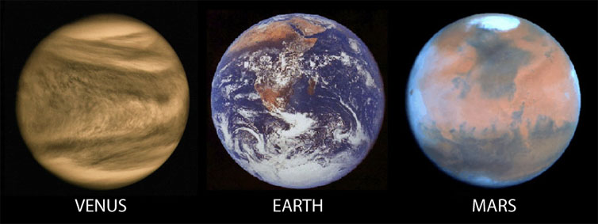
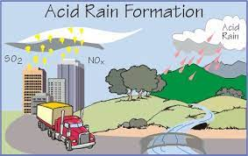
There is no recorded evidence of the early earth so we do not know exactly what it is like
Scientists have made predictions
Early atmosphere is very much like Venus, high carbon dioxide levels
Early Earth contains a lot of iron compounds like the rocks of Mars
Acid Rain
Causes:
Burning fossil fuels containing sulfur impurities to produce sulfur dioxide
Reacting oxygen and nitrogen in car engines to form nitrogen oxides
These gasses dissolve in rain water to form acid rain
Effects
Kills plants and fish
Weathers limestone statues

Slide 3
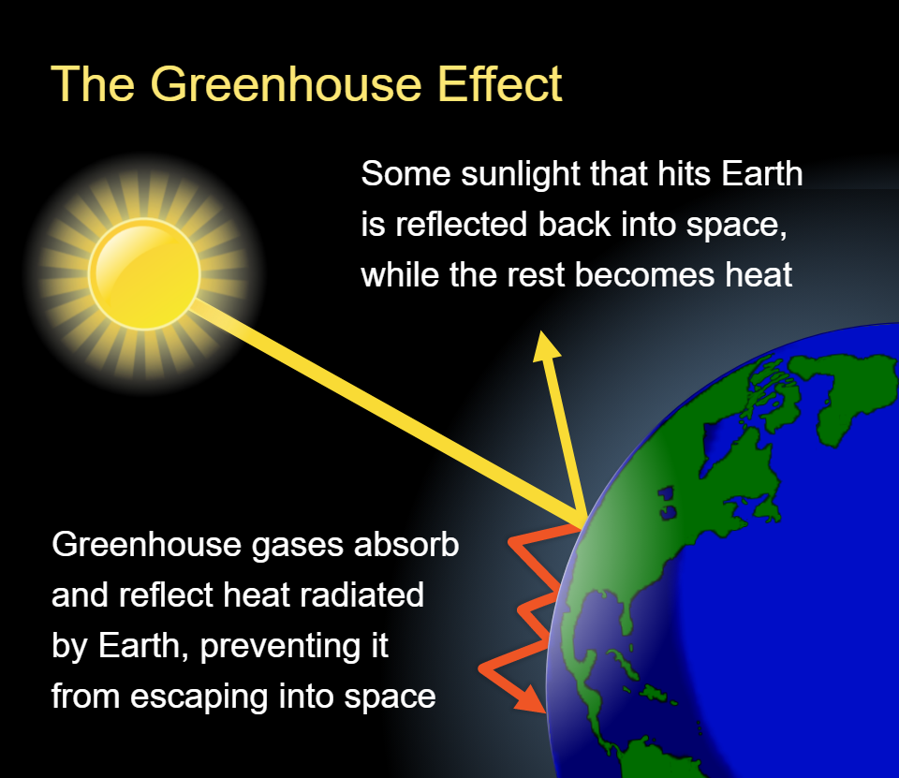
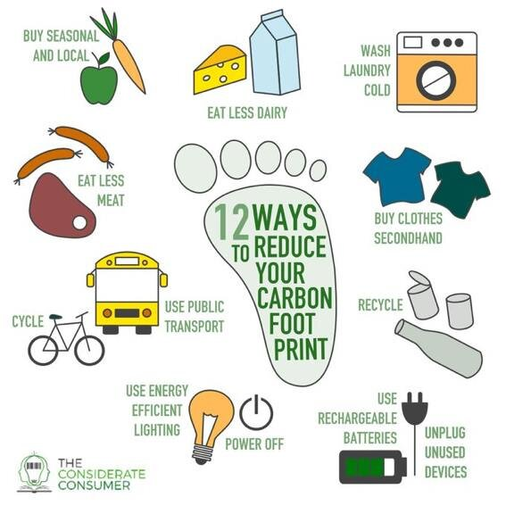
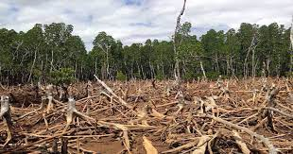
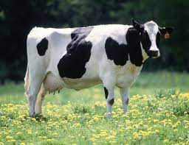
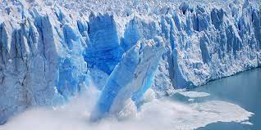
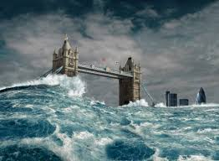
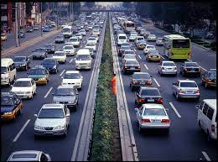
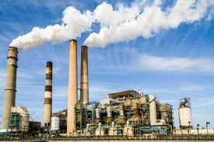
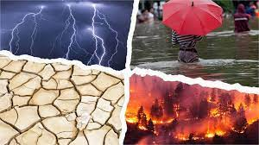
Traps heat that would have radiated from the Earth
Greenhouse gases
Carbon dioxide
Methane
Water vapour
Causes:
Effects
sea levels rise
Deforestation
Methane from cows
Polar ice caps melt
Adverse weather conditions
Burning fossil fuels

Slide 4
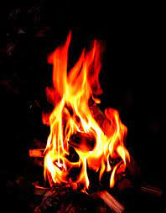
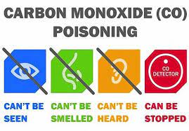
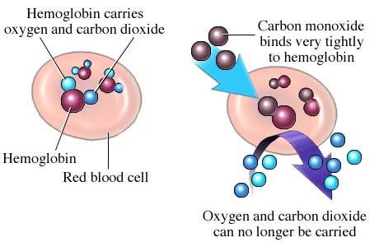
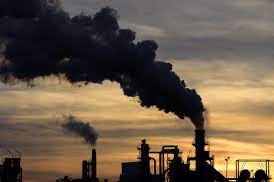
Problems with Combustion
Complete combustion
Plenty of oxygen
All the fuel is burned
Fuel + oxygen → water + carbon dioxide
Combustion means to burn
Causes global warming
Incomplete combustion
Limited oxygen
Only some of the fuel is burned
Fuel + limited oxygen → water + carbon dioxide + soot + carbon monoxide
Soot:
Unburnt carbon particles
Carbon monoxide is a toxic, odourless and colourless gas
Effect:
Causes respiratory problems
Carbon monoxide binds to haemoglobin preventing oxygen from binding

