Slide 1
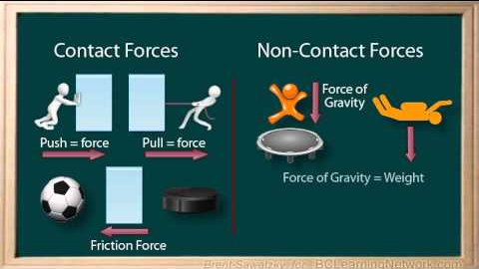
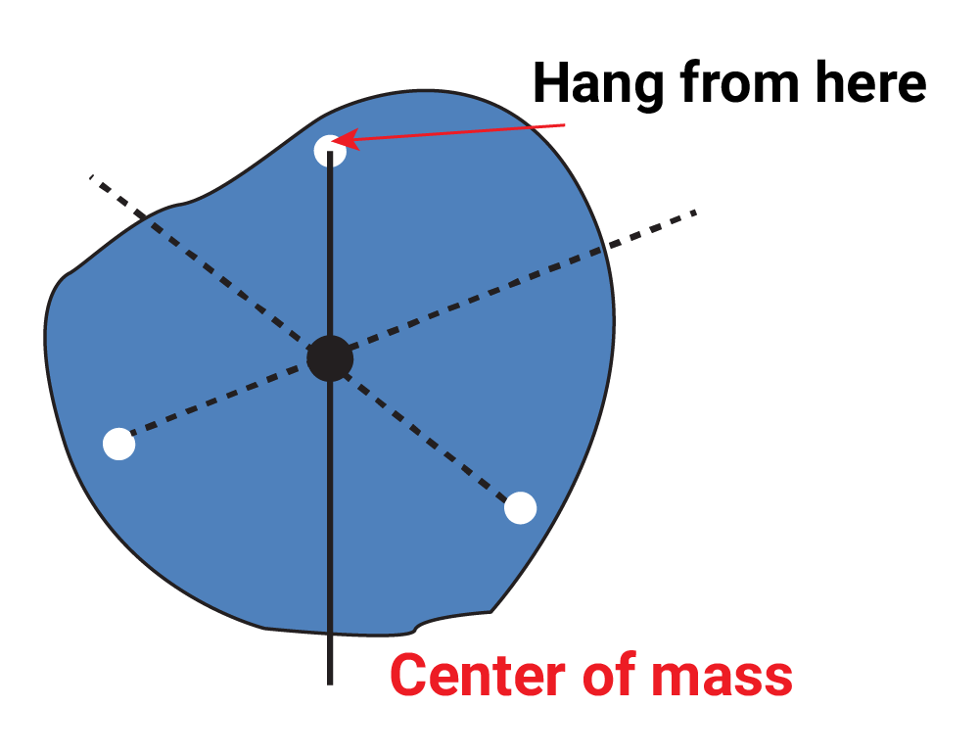
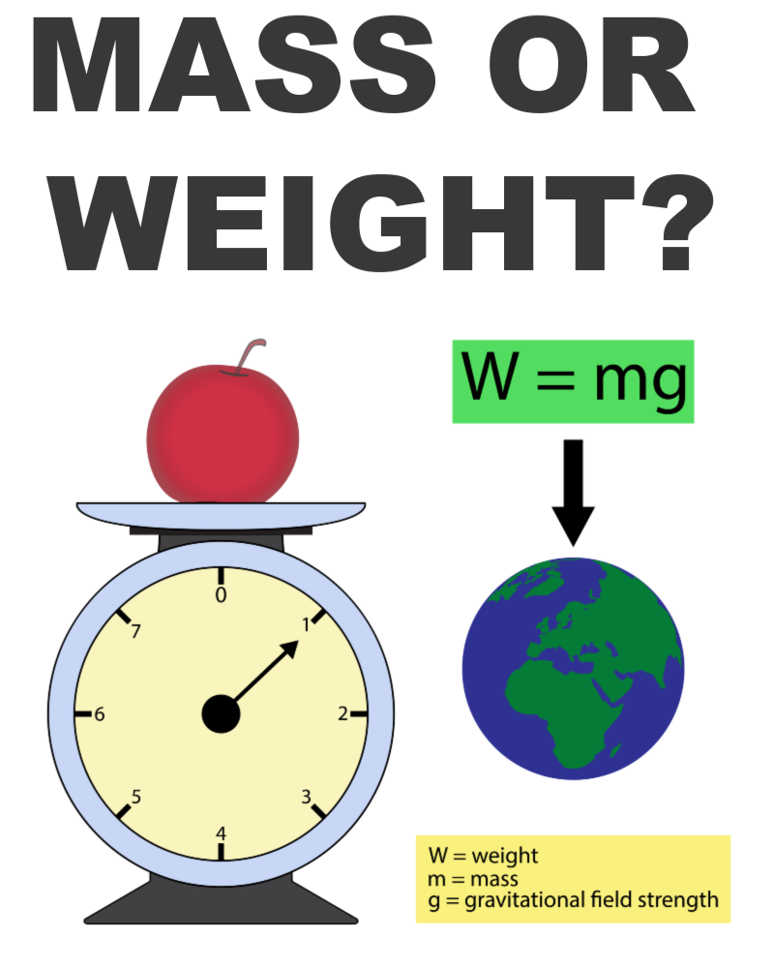
P5 Forces
 | Vector quantity | Scalar quantity
Properties | Magnitude (size) Direction (straight line) | Magnitude No direction
Examples | Velocity Acceleration Momentum Displacement Force e.g. weight | Speed Temperature Time Distance Mass
Two objects need to be touching
Two objects must not be touching
Force acting on a single point on an object is centre of mass (point where whole mass is concentrated
Mass is the amount of stuff
Weight is the force of gravity on the mass
Earth has a greater gravitational field strength than on the moon – weight is greater on Earth
Weight (N)
Mass (kg)
Gravitational field strength (N/kg)

Slide 2
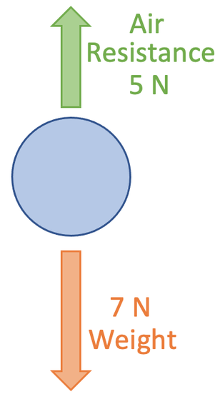
Free body diagram
Arrow size – show magnitude of force
Arrow direction – direction of force
Resultant force is the overall force.
If in a straight line
Add forces if in the straight direction
Subtract opposing forces
Friction 15N
Resultant force
= 7-5 = 2N (down)
Thrust 5N
Always state the direction of the resultant force as it is a vector quantity
Resultant force = 15-5 = 10N (left)
Resultant force = 0N
Object stationary
Or
Object moving at a constant speed
Force is used to move an object a distance
Work is done (transfer of energy)

Slide 3
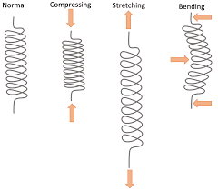
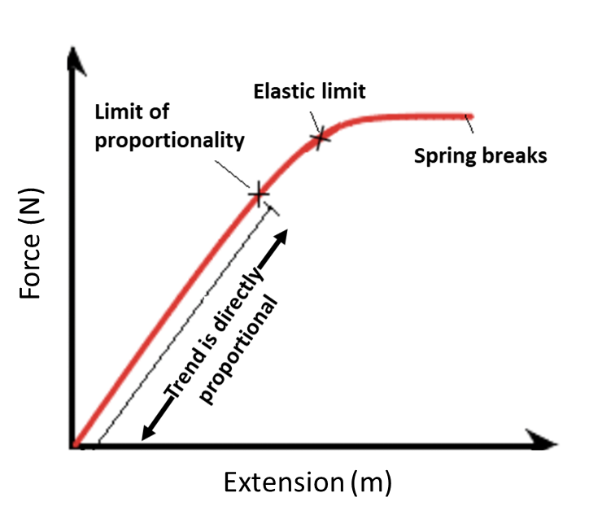
Elastically deformed
Can return to original shape and length
Forces can make an object
Stretch
Compress
bend
Inelastically deformed
Cannot return to original shape and length
Work is done to stretched or compressed is transferred to elastic potential energy store
Gradient is spring constant
Be able use both equations in a question
Directly proportional – straight line through (0,0)
Limit of proportionality – the trend is not directly proportional
Large spring constant means stiffer the spring

Slide 4
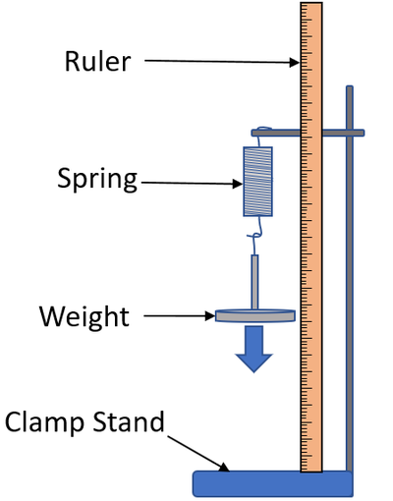
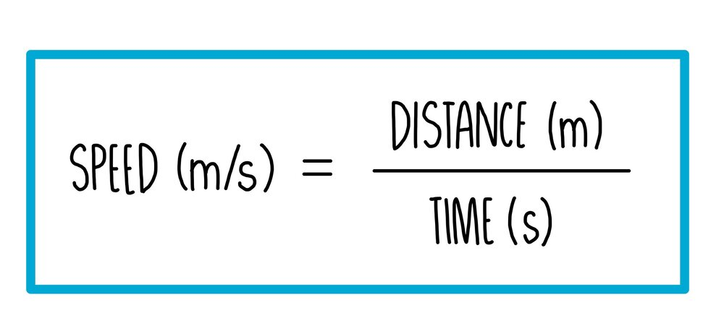
RP – Extension of a spring
Speed - how fast an object moves – scalar
Velocity – how fast you move in a straight line - vector
Measure the spring length with no load and add a marker at the bottom of a spring
Add weight, record new length and calculate extension (change in length)
repeat
Independent variable:
Weight added to the spring
Dependent variable:
Extension length of the spring
Controls:
Same spring
Take the reading when the spring stops bobbing up and down
Take reading at eye level to reduce error
1.5m/s
3 m/s
6 m/s
Average speed
Acceleration
speeding up / slowing down
(m/s)
(m/s²)
(s)

Slide 5
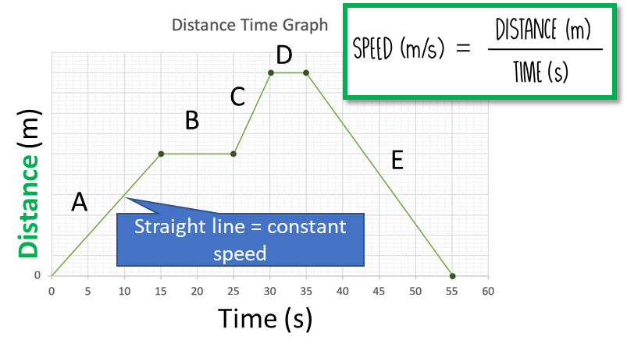
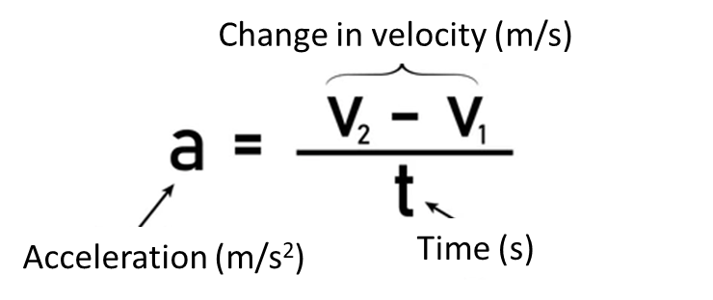
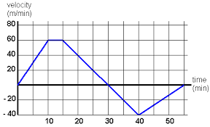
Distance – time graph
Gradient = speed
A,C and E have a constant speed
C is faster than A – steeper gradient
E moving back to starting position
B and D are stationary (distance stayed the same) – resultant force 0N
Velocity – time graph
Gradient = acceleration
A – constant acceleration forward
B – terminal velocity – resultant force 0N
C – constant decelerating forward
D - constant acceleration backwards
E – constant deceleration backwards
Number +ve (accelerating)
Number –ve (decelerating)
B
When the line reaches x axis the object is stationary
A
C
Velocity (m/s)
Calculating distance from a velocity time graph
Calculate the distance under A,B and C
D
E
Time (s)
Under A = ½ x 10 x 60 = 300m
Under B = 5 x 60 = 300m
Under C = ½ x 15 x 60 = 450m
Total distance = 300 + 300 + 450
= 1050m
Split the area into rectangles and triangles
Find the area of each rectangle and triangle
Rectangle = base x height
triangle = ½ base x height
B
A
C

Slide 6
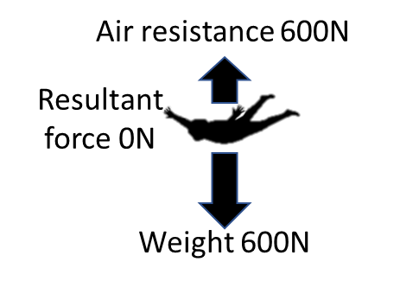
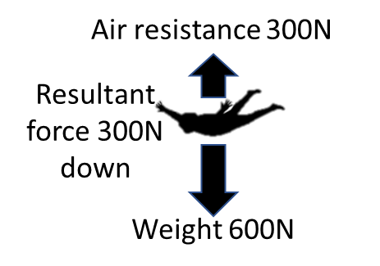
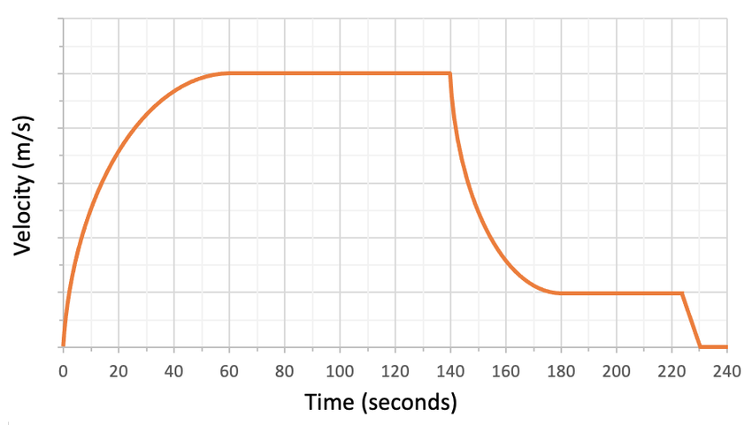
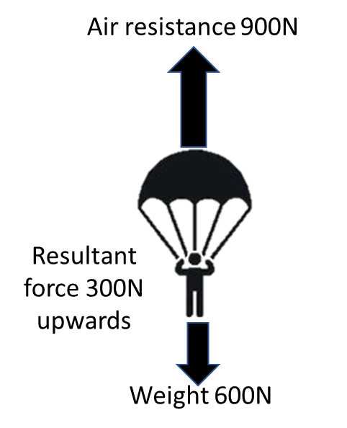
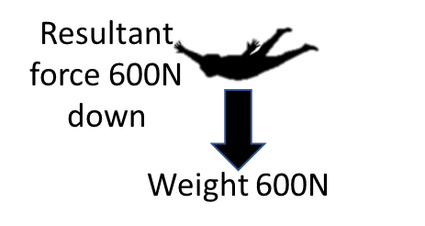
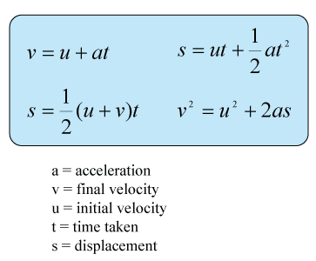
Air resistant increases, resultant force reduces
Sky diver accelerates but less
Terminal velocity
Air resistant = weight
Moving at terminal velocity
Air resistant greater than weight
decelerating
Greatest acceleration due to biggest resultant force downwards
Air resistant = weight
Moving at terminal velocity
Sky diver landed
Uniform acceleration
See the physics equation sheet

Slide 7
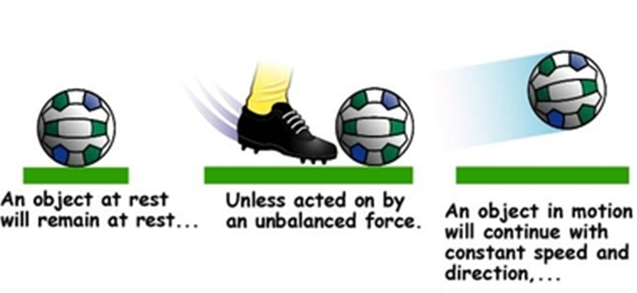
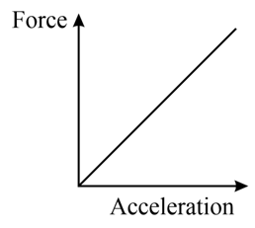
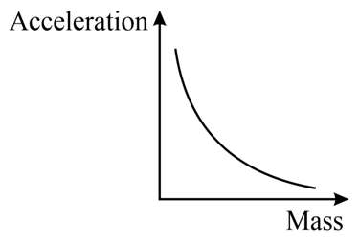
Newton’s Laws
First Law
Forces unbalanced
Resultant force greater than 0N
Object accelerates
Forces unbalanced
Resultant force greater than 0N
Object accelerates
Resultant force 0N
Resultant force 0N
Second Law
Larger the resultant force acting on an object, the greater the acceleration
An object with a larger mass will accelerate less than a smaller mass object with the same resultant force
F (Resultant Force) – N
m (mass) – kg
a (acceleration) – m/s²
Inversely proportional
Directly proportional
e.g. a lorry accelerates less than a fiesta
e.g. a bigger engine gives a bigger acceleration

Slide 8
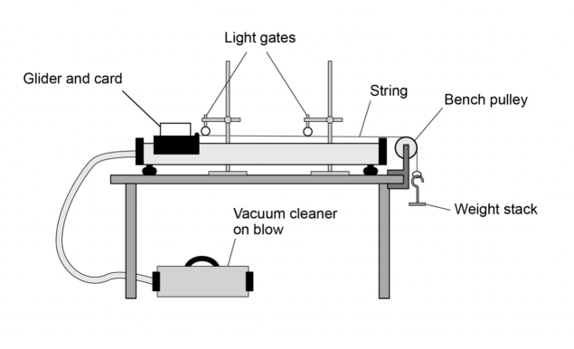
RP – F=ma Second Law
Light gates measure velocity and thus the acceleration can be calculated
F=ma
F (weight stack)
M mass of trolley / glider
You can make the trolley heavier by increasing the mass – to investigate the effects of mass
Effects of mass of glider / trolley
Independent variable:
Mass of glider / trolley
Dependent:
Acceleration
Control
Same starting point / line
Same distance
Same force applied – same weight stack
You can add more weights to investigate the effects of force
Air track to reduce friction
Effects of force added
Independent variable:
Force added to weigh stack
Dependent:
Acceleration
Control
Same starting point / line
Same distance
Same mass of trolley / glider

Slide 9
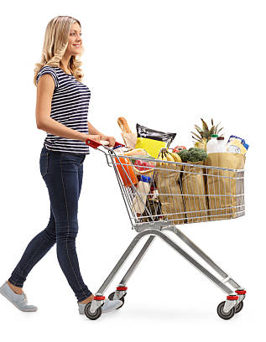
Newton 3rd Law
reaction force equal and opposite, push on the paddle and kayak
When 2 objects interact, the forces they exert on each other are equal and opposite
Action force push on the trolley
Action force push on the water
Reaction force push back on the woman
Reaction force – force exerted from water to boat
Action force – force exerted from boat onto water
If you push the shopping trolley by 300N, the trolley pushes back on you with a 300N force
When you stop pushing, the trolley stops
Action force - The propeller pushes back on the water
Reaction force – the water exerts and equal but opposite force on the boat in the forward direction

Slide 10
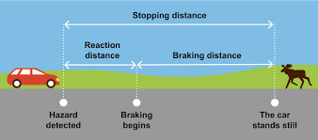
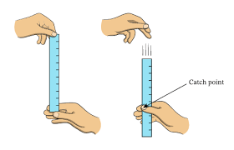
Stopping distance
Stopping distance
Thinking distance
Braking distance
Look at B5 homeostasis reaction time required practical
Stopping distance = thinking distance + braking distance
Thinking distance – distance the vehicle travels during the driver is thinking about pressing the break
Braking distance – distance the vehicle travels while the breaks are working
Factors affect thinking distance | Factors affect braking distance
Speed Drugs Alcohol tiredness | Speed Road conditions e.g. ice Brake conditions Tyre conditions

