Slide 1
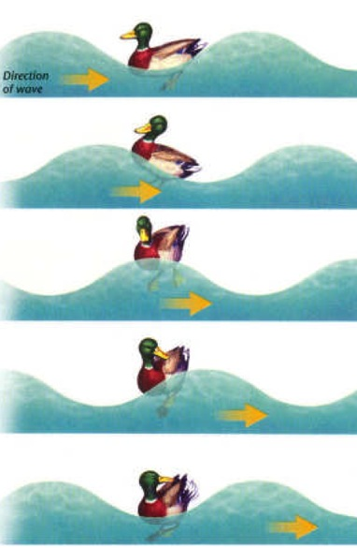
Transverse wave
P7 Waves
Waves carry energy not matter (particles stay at the same place)
Transverse wave definition
Oscillations perpendicular to the direction of energy
e.g. all electromagnetic waves
Longitudinal wave
e.g. sound
When a wave travels through a solid, liquid or gas, the particles vibrate (oscillate) and transfer energy
compression
rarefaction
Longitudinal wave definition
Oscillations parallel to the direction of energy
Has rarefactions

Slide 2
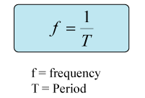
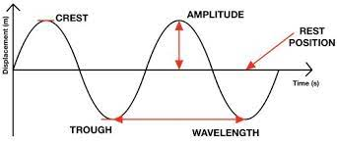
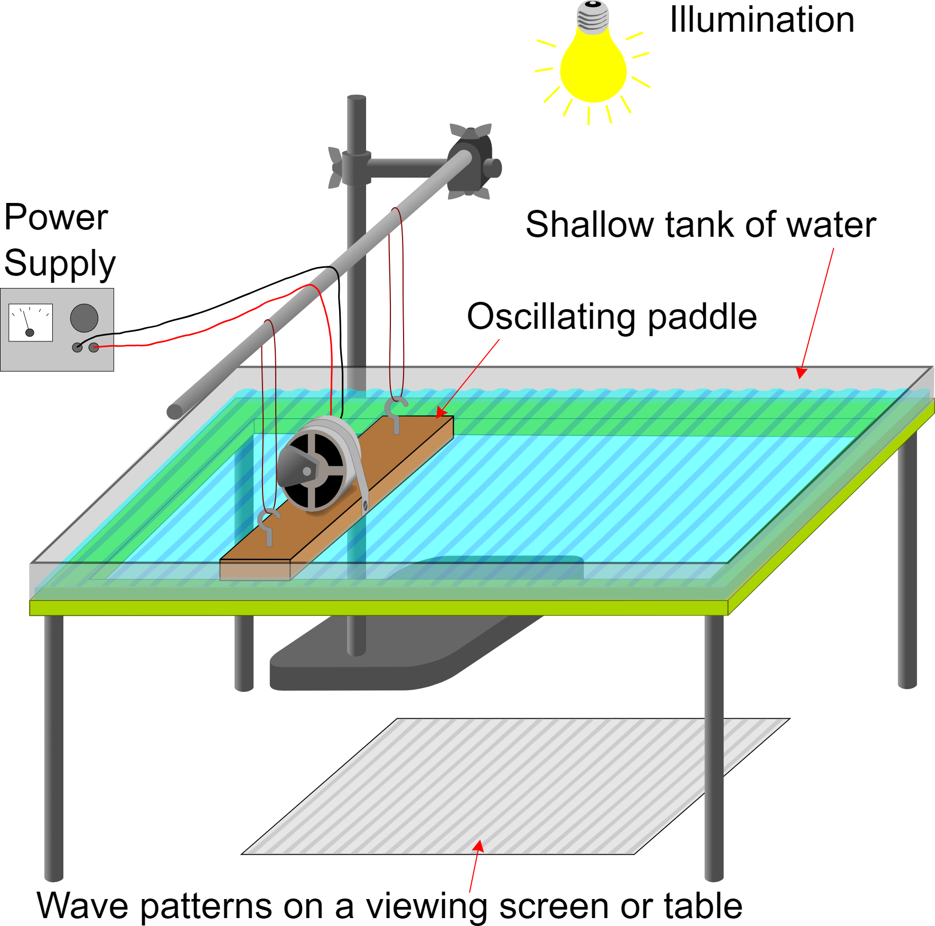
Amplitude (m)– maximum displacement from resting point
Wavelength (m) – distance between same point on 2 adjacent waves
Frequency (Hz) – number of waves passing a point in 1 second
Period (s) – amount of time for a full wave
RP Ripple Tank
Switch on the power supply - causes the dipper to create water waves at a set frequency
Measure wavelength:
Take a still photo – place a ruler next to the wave shadows, measure the distance of 10 waves and divide by 10
3. Measure frequency:
Take a motion video – place a timer next to the wave shadows, count the number of waves in 10 s and divide by 10
4. Use wave speed = wavelength x frequency to calculate speed

Slide 3
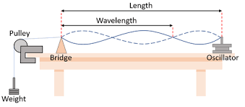
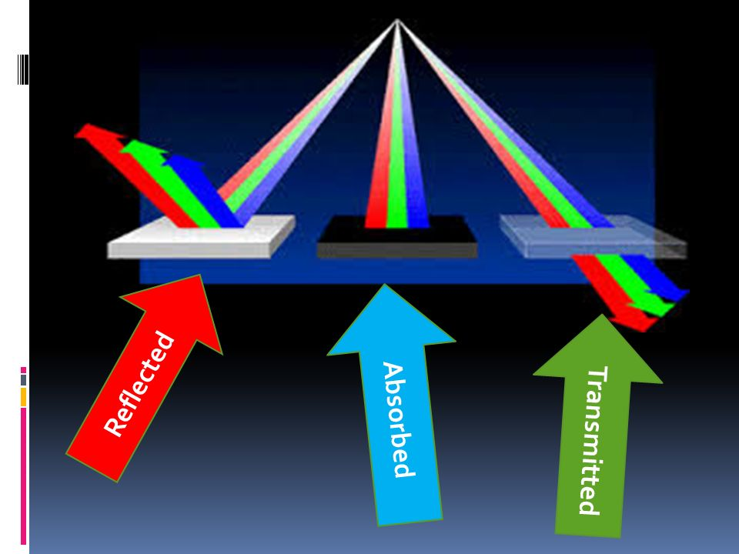
RP Waves on a string
The signal generator is set at a specific frequency
This causes The oscillator to vibrate the string
Adjust the frequency of the signal generator until a clear wave is seen
Measure the wave length of a wave on the string (each oval ½ wave)
Moving the bridge will change the wavelength
Masses ensure the string is taught
Signal generator
Frequency on signal generator
Frequency on signal generator
When waves meet at a boundary they can be…
absorbed
reflected
transmitted
Example
White object reflects all colours of white light
Black object absorbs all colours of white light
All colours of white light are transmitted through glass

Slide 4
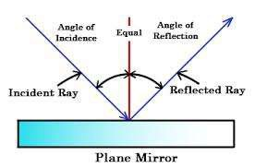
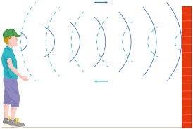
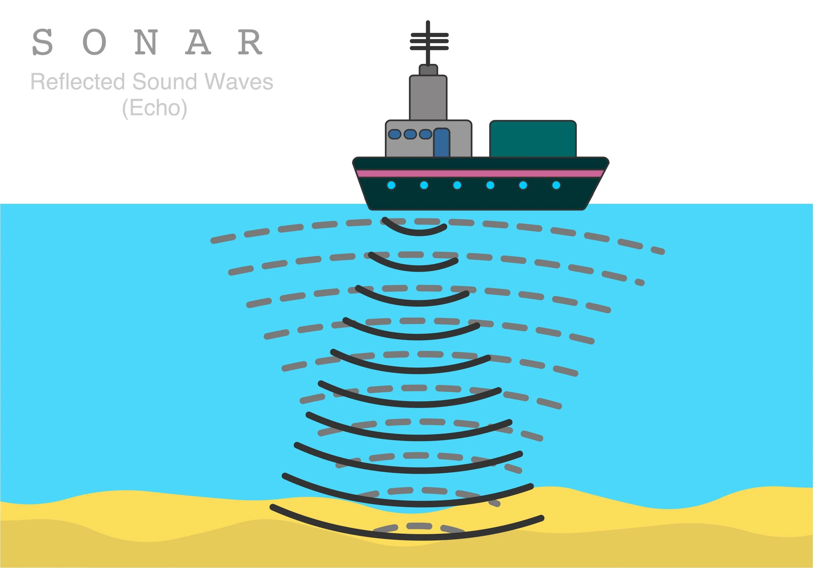
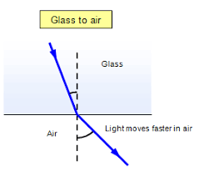
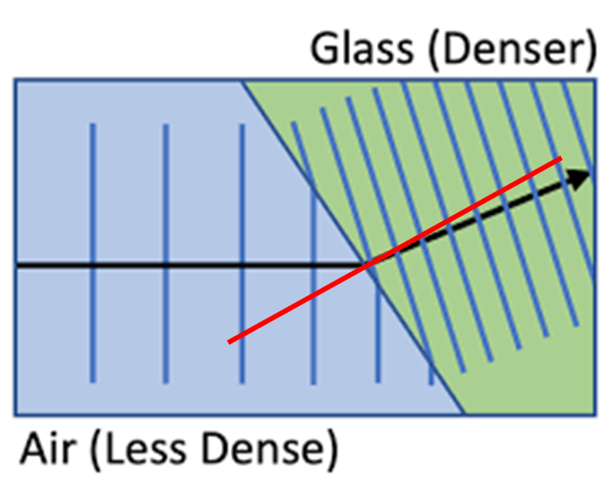
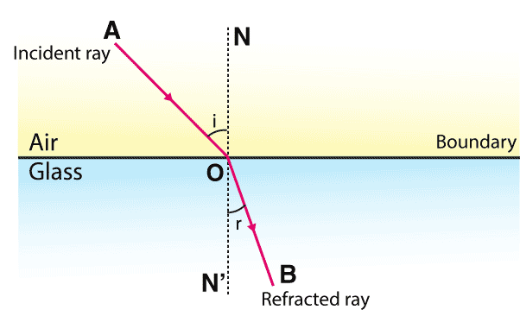
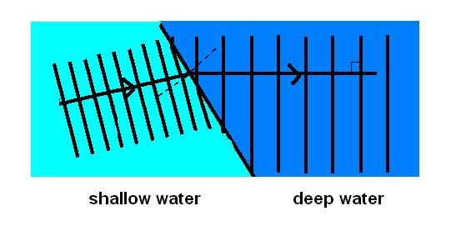
The normal line is perpendicular to the boundary
Reflection
sonar
echo
Wave front – wavelength decreases as moves slowly and moves towards normal
Refraction
A ray travels in straight line but…
If it enters a medium with a different density, the ray will change speed and direction
Air is less dense than glass
Glass is more dense
The wave speeds up at the boundary, as it enters air
The wave moves away from the normal
Shallow water
Deep water
The wave slows at the boundary, as it enters glass
The wave move towards the normal
Wave moves faster in deep water – wavelength increases and moves away from normal

Slide 5
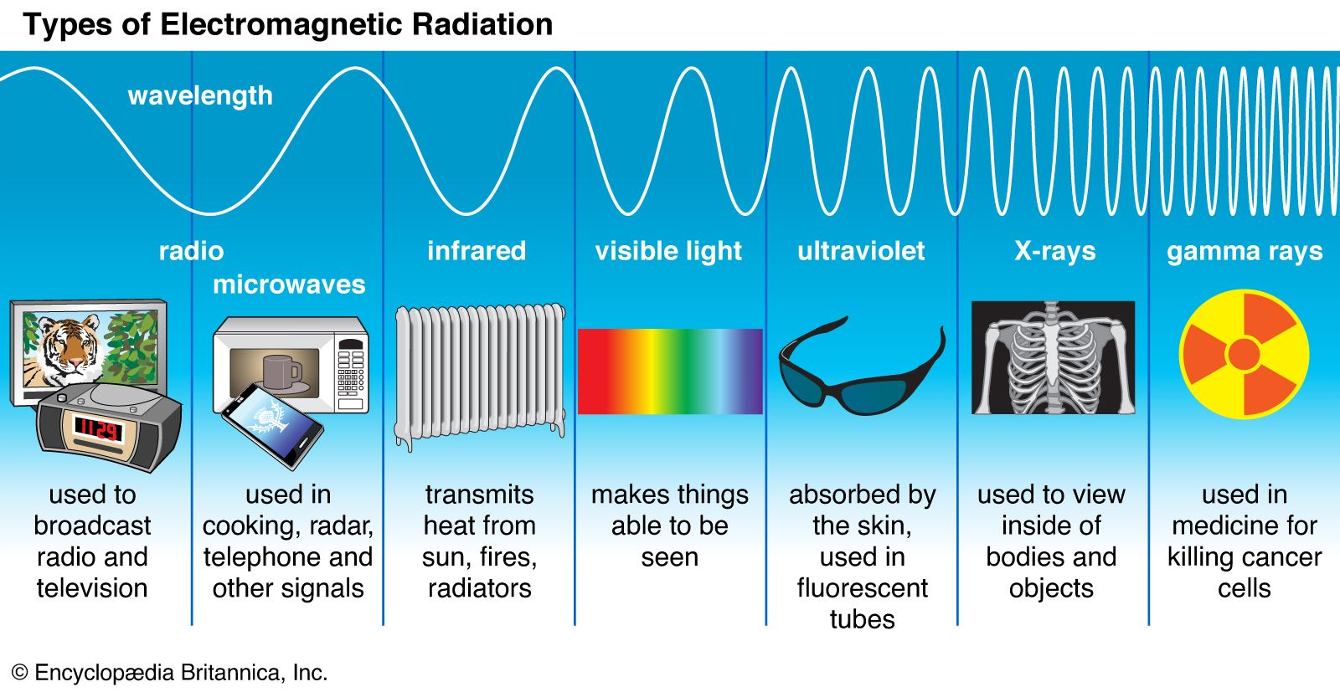
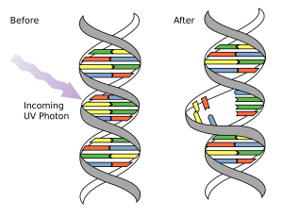
All electromagnetic waves are
Transverse
Travel at the same through a vacuum
Learn the order!
Radio wave
Microwave
Infrared - burns
Visible - blindness
Ultraviolet (UV)
skin cancer
X-ray
Gamma
Sieverts (Sv)– total amount of radiation absorbed and how harmful it is
Increase wavelength
Increase energy
Increase danger
Increase frequency
Ionising
Can cause cancer

Slide 6
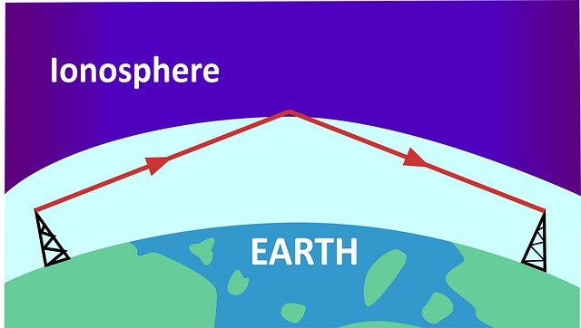
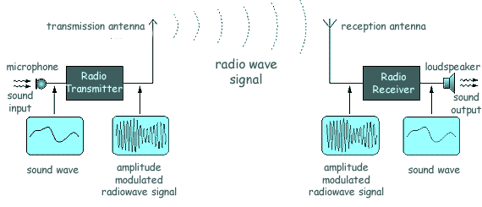
Radio waves
4 mark question!!!
3. Transmitter emits radio waves at the same frequency as sound wave
Have long waves
Long wave radio signals – diffracted (bend) long distances around Earth
Medium and short wave radio signals
reflected from ionosphere
travel long distances
1. Sound (longitudinal) has a frequency
2. Electrons in the amplifier vibrate at the same frequency
Alternating current has same frequency
4. Receiver absorbs radio waves
Electrons vibrate at the same frequency as radio wave and an alternating current produced
Bluetooth
FM radio

Slide 7
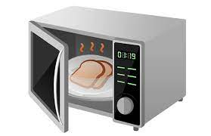
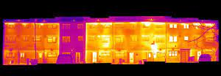
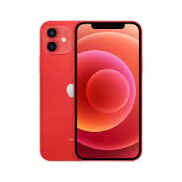
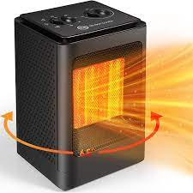
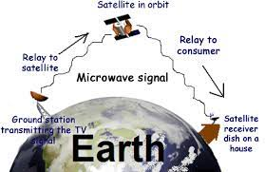
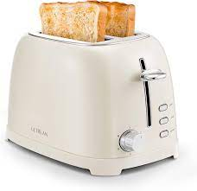
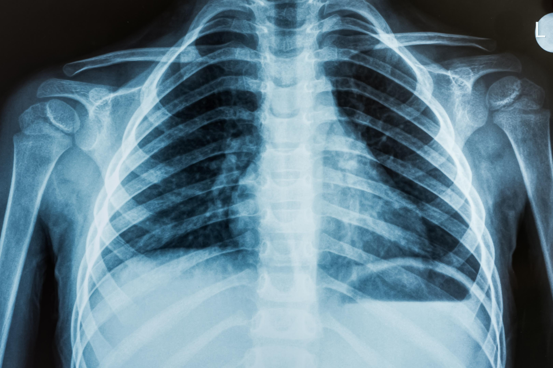
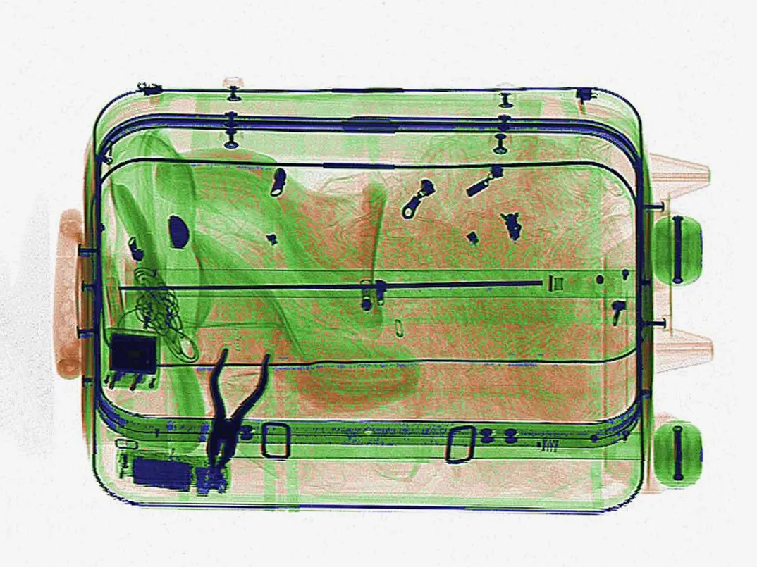
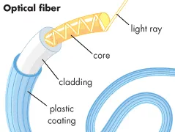
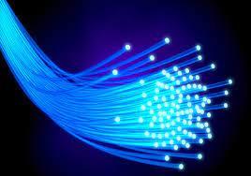
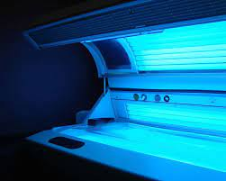
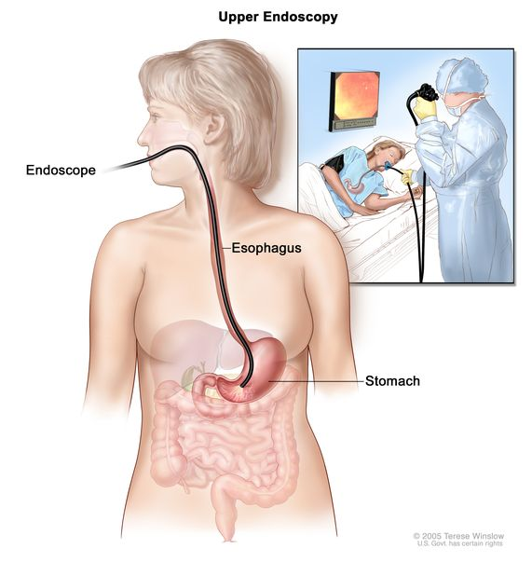
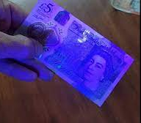
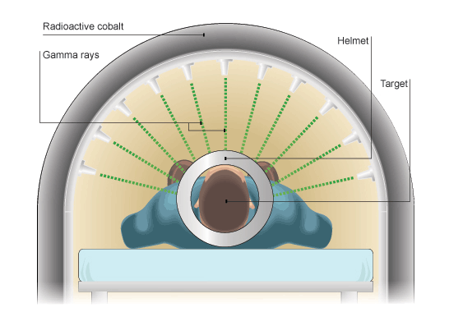
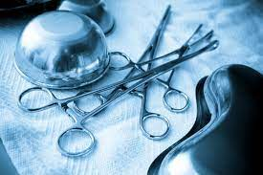
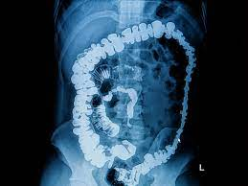
Microwaves
Infrared
Cooking
Heat water in food
Firemen use infrared cameras
Communication
Pass through Earth’s atmosphere e.g. satellite TV and mobile phones
Cook food e.g. grill toaster
Electrical heaters
X-ray
Visible
UV
Absorbed by denser material e.g. to see bones, luggage
Tan beds
Optical fibres
Glass or plastic
Visible light reflected down the length
Gamma
Treat cancer
Identify forged bank notes
Sterilise surgical equipment
Florescent lights emit UV radiation – absorbed by security pen ink and visible light emitted
Endoscope see inside the body
medical tracers

Slide 8
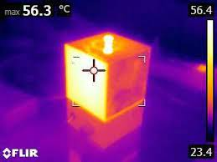
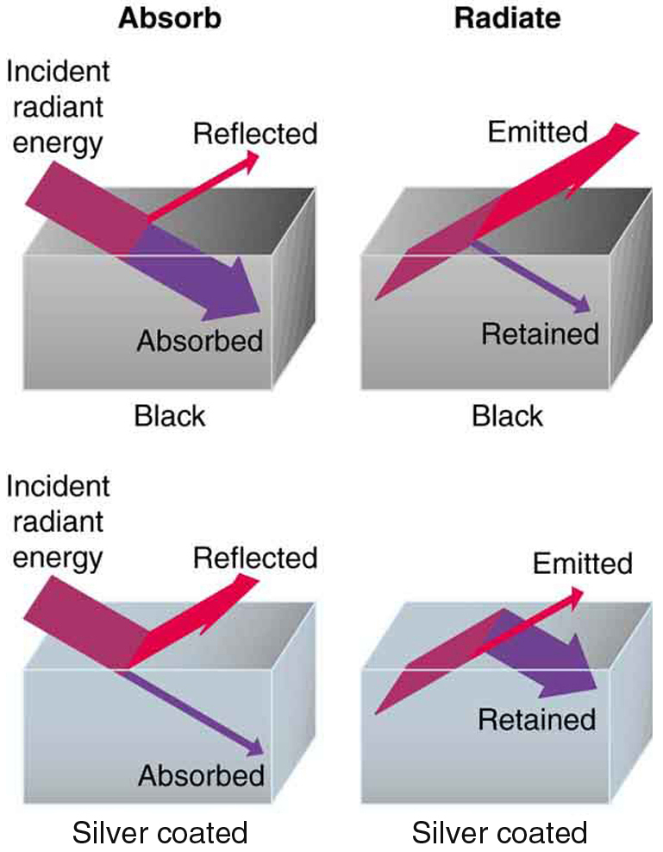
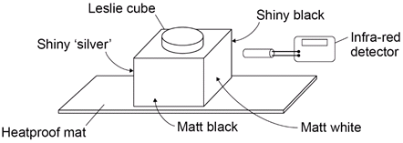
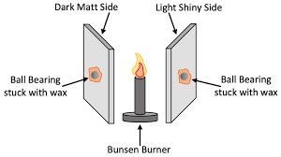
RP Infrared radiation
Black and matt surfaces are
Good absorbers
Good emitters
Repeat experiment
Fill will boiled water from kettle
White, silver, shiny
Poor absorbers and emitters
Good reflectors
Ball drops from the black first
Allow the cube to heat up
Independent variable
Surface of the Leslie cube
Dependent
Amount of infrared radiation – detected by IR sensor
Control
* Distance between detector and surface
The silver surface reflects light and is a poor absorber, wax melts more slowly
The black surface absorbs IR and emits it easily – wax melts quickest

