Slide 1
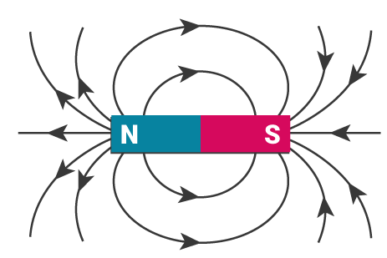
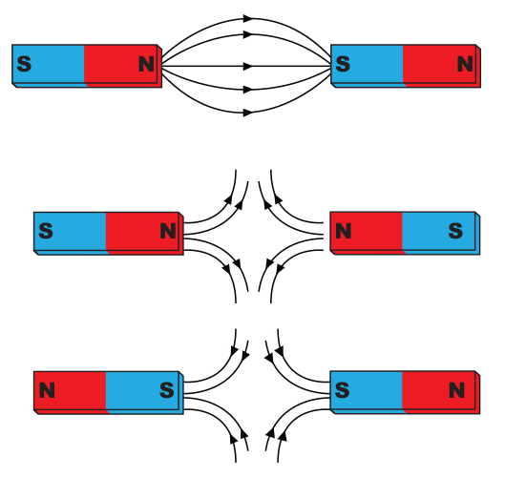
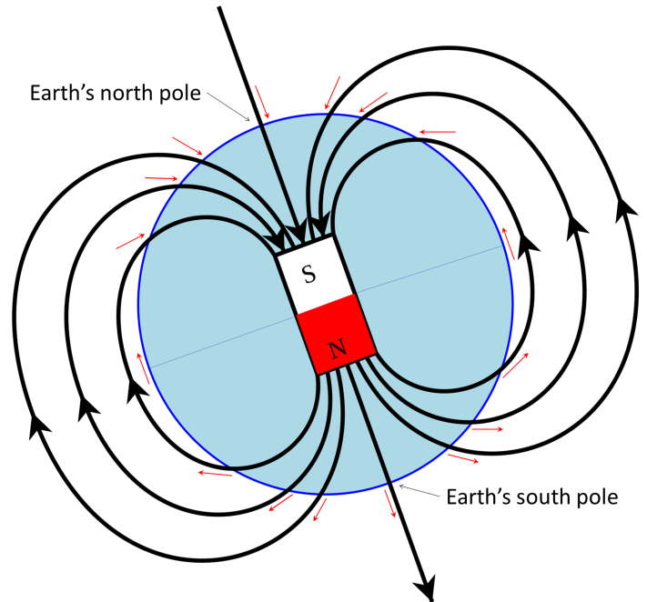
Magnetic field lines
Magnetism and Electromagnetism
Magnetic materials
Always attract to magnets
Do not repel
Permanent magnets have a north and south pole
Cobalt, iron, steel. Nickel – magnetic materials
Permanent magnets produce a magnetic field
Magnetic field is strongest at the poles
Closer together magnetic field lines –stronger the magnet
Magnetic material
Magnetic material not magnetised as no magnetic near
Magnetic material becomes induced because next to a magnetic field
Magnetic material no longer induced as no longer in a magnetic field
unlike poles attract
Like poles repel
Earth has it’s own magnetic field – this allows compasses to work
Be able to draw these diagrams

Slide 2
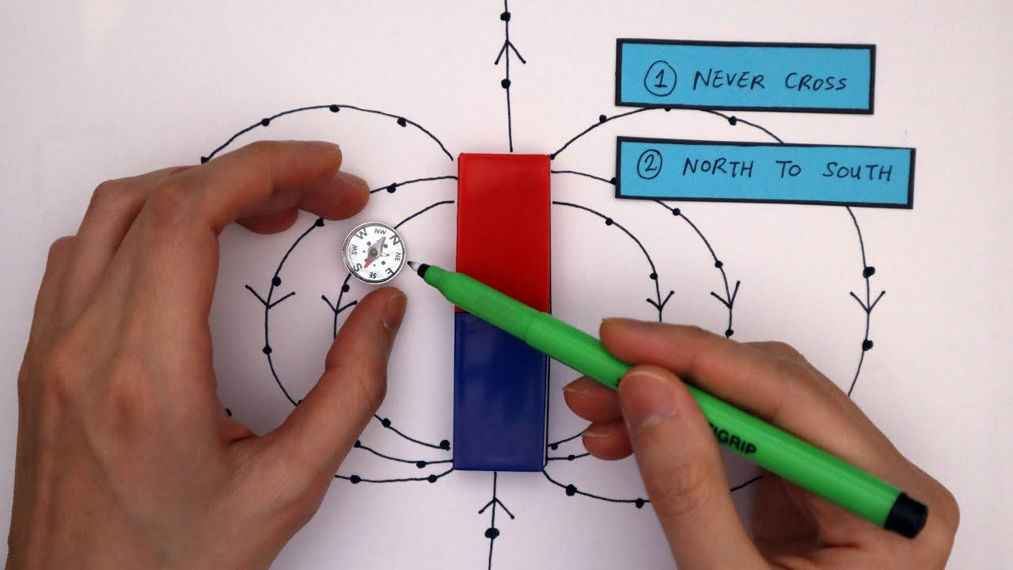
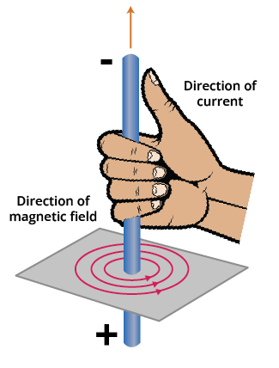
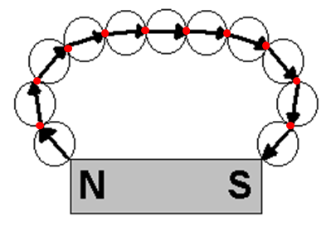
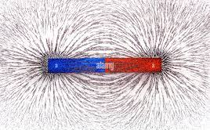
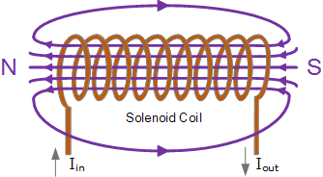
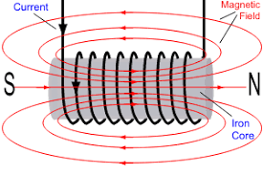
Magnetic field lines
Right hand rule
Electromagnetism
6 mark Q plotting compass
Magnetic field created if a current flows through an electrical wire
Reversing the current, reverses the magnetic field
Iron filings also show field
2
1
Solenoid is a coiled wire
Place the plotting compass next to the magnet (e.g. 1)
Where the arrow points – draw a dot (red dot)
Move the compass so that the end of the arrow is at the dot (e.g. 2) and draw a new dot at the end of the new arrow point – repeat until you reach the other pole.
Join the lines and place arrows on the lines to show direction of field
Electromagnet is a solenoid with an iron core
Increase magnetic field around electromagnet
Increase current
Use an iron core
Increase number of coils
Current on
Magnetic field around coils
Iron core becomes magnetised

Slide 3
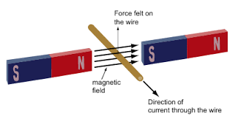
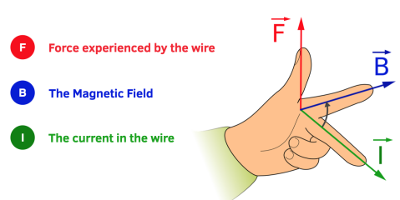
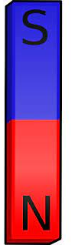
The motor effect
When a wire with a current is placed 90º in a magnetic field, a force is exerted which will move the wire
Flemings Left hand Rule
Force moves wire up
Magnetic field
Direction of current
Reverse the current, causes the wire to move in the opposite direction
Magnetic field
Direction of current
Force moves wire down
Reverse the magnetic field, causes the wire to move in the opposite direction
Magnetic field
Direction of current
Force moves wire down

Slide 4
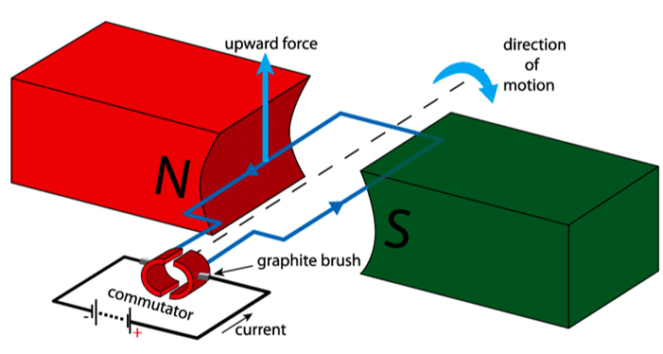
Current carrying coil rotates in a magnetic field
Because the coil wire is pushed up at one side and down at the other, it will continuously rotate
Increase motor
Increase current
More turns on coils
Increasing magnetic flux density
B
F
Wire side at the north pole is forced up
Wire side at the north pole is forced down
The current has been revered on the south side
Slip ring is used so that wires will not tangle
Force (N)
Magnetic flux density – strength of magnetic field (T, tesla)
Current (A)
Length (m)

