Slide 1
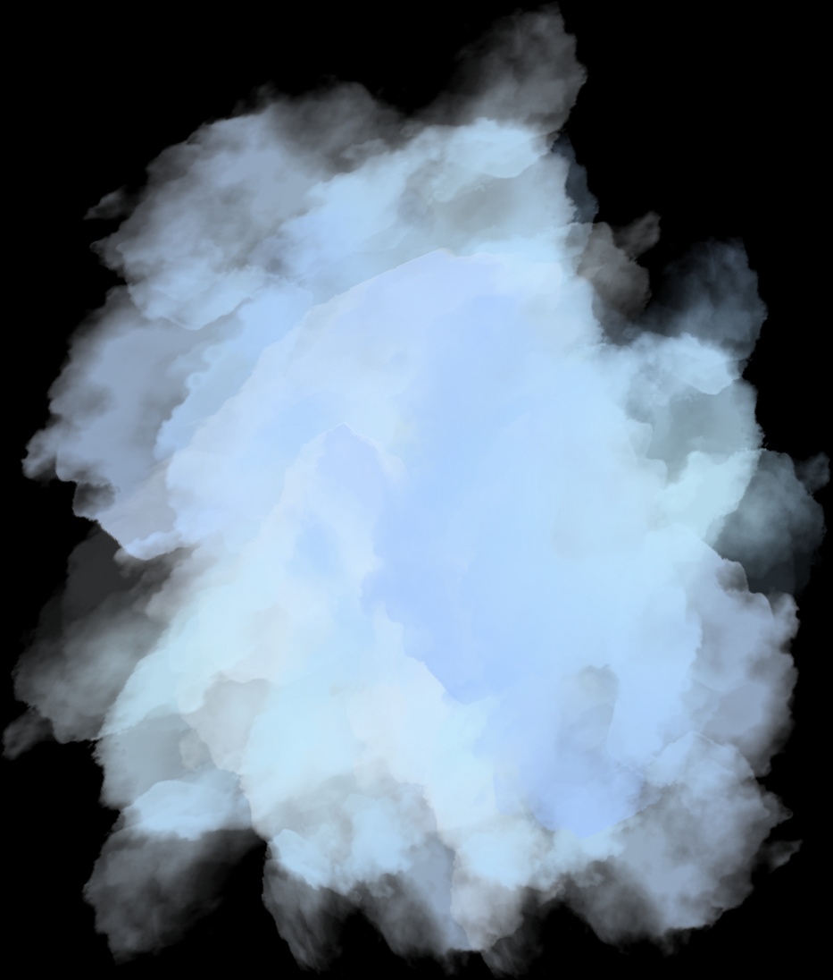



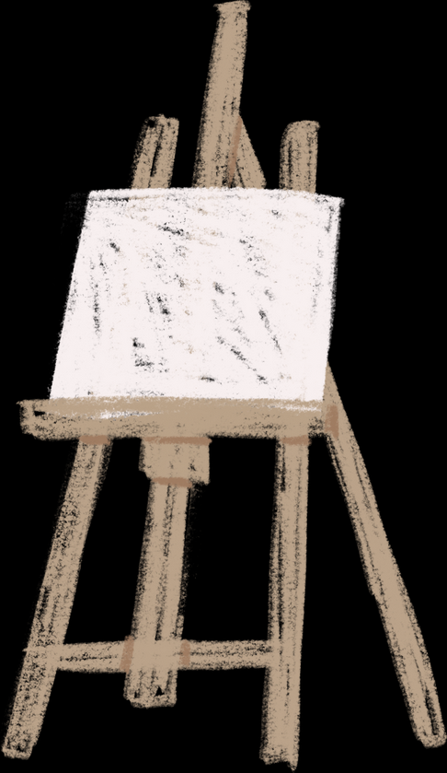
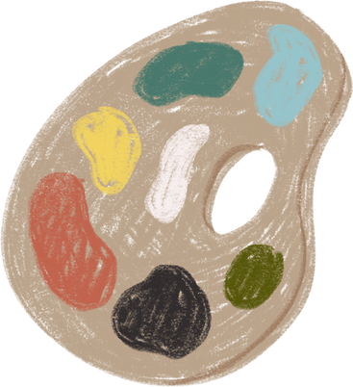
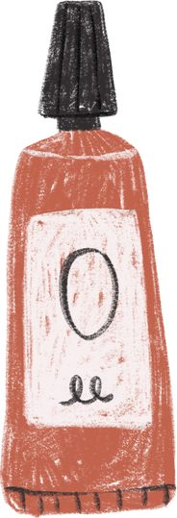

using colour in p1q5

Slide 2


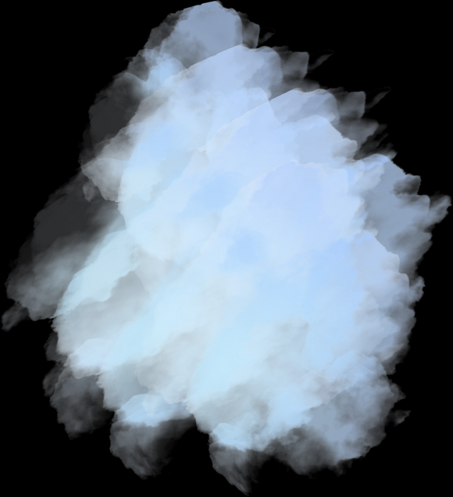
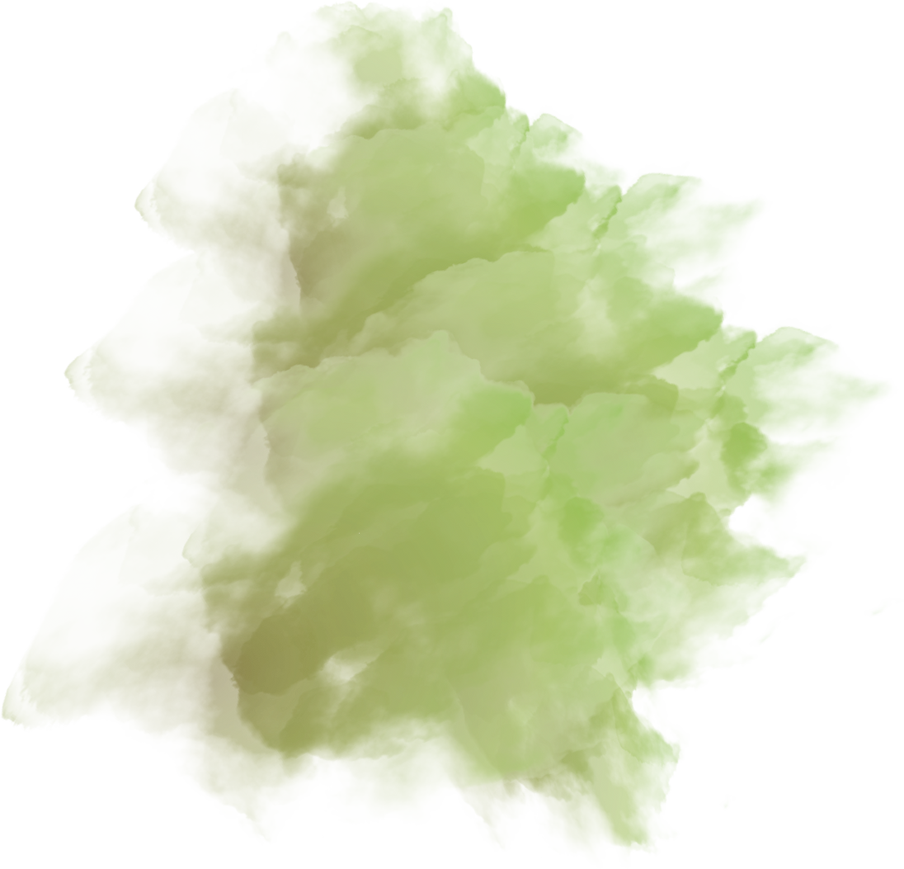
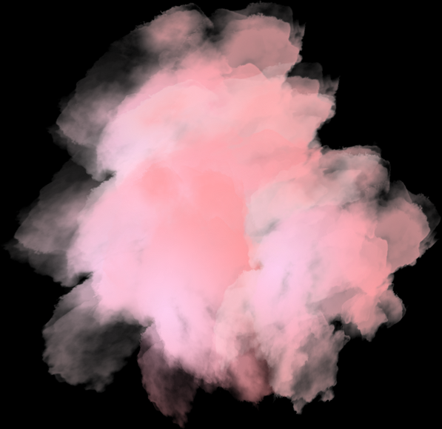
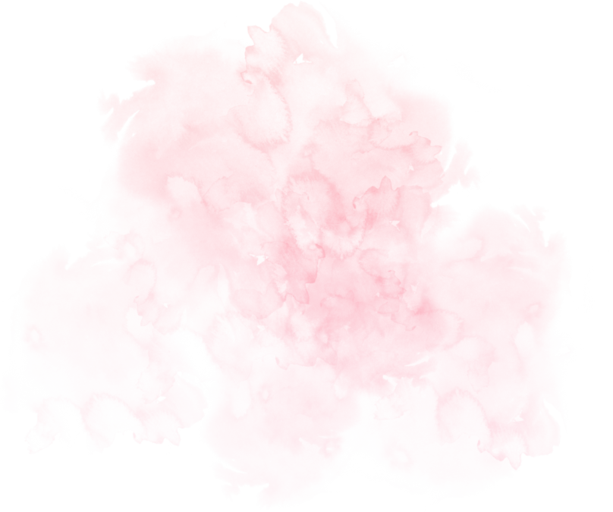

lesson focus
How to write about colour
how can we use colour?
consider vocabulary
01
02
Considering how colour impacts the tone or mood of our writing
Building up the vocabulary we need to describe colour effectively
exploring model answers
independent practice
03
04
Looking at strong examples of colour description
Spending time deliberately using tht vocabulary we have

Slide 3

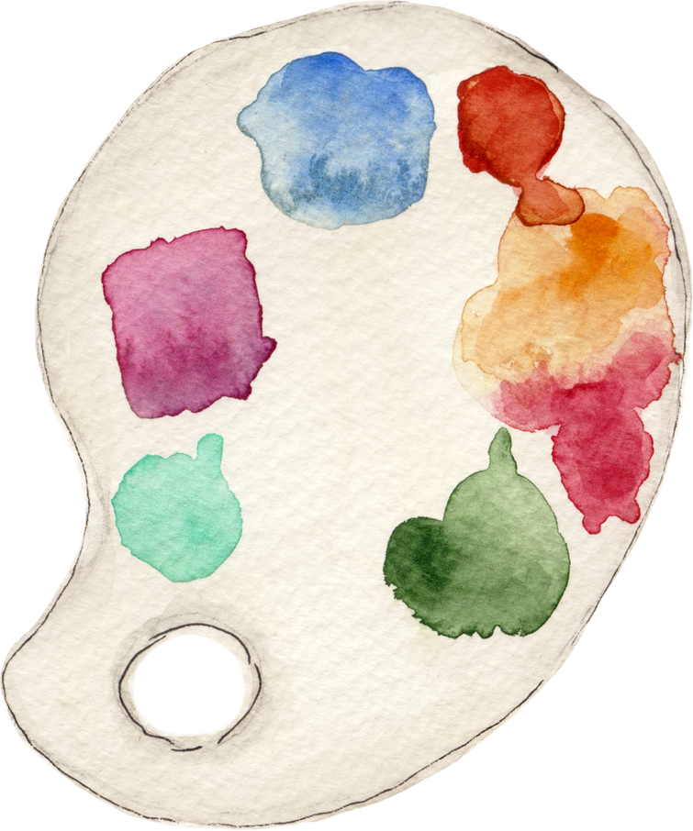
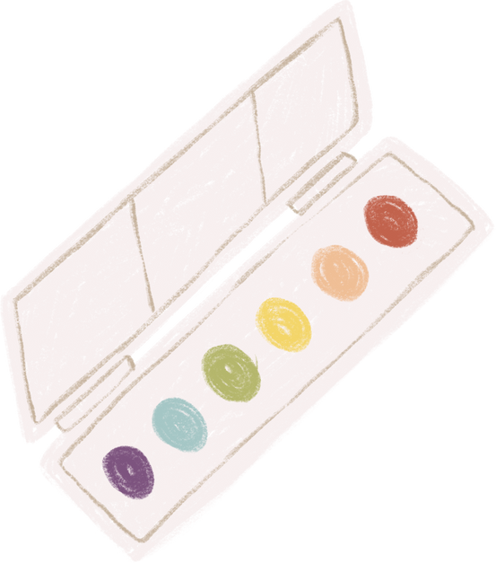

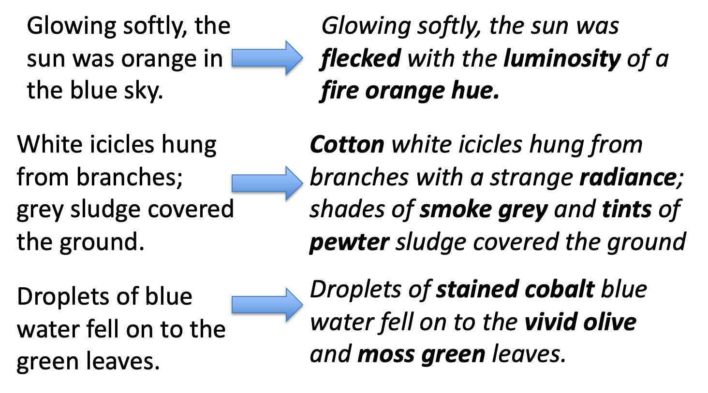

how can we use colour?

Slide 4
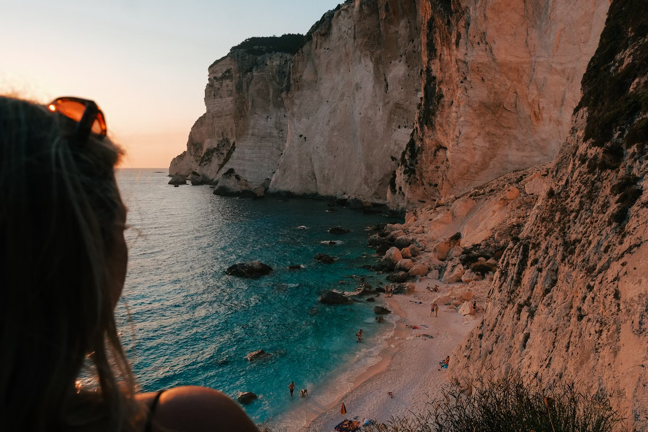
The sea shimmered with a soft turquoise flush, its waves folding gently against the ivory-stained sand. Golden sunlight glazed the cliff face, warming it with a mellow apricot hue that seemed to melt into the stillness of the evening. Peach light clung to the rocks like a memory, softening every edge. Down below, the scattered towels and figures looked like dabs of pastel brushed gently onto a canvas — untouched, unhurried, at peace.
WHAT MOOD IS CREATED?
The sun sagged behind the cliffs, smearing the sky with bruised peach and a heavy copper haze. Shadows bled into the folds of the rockface, turning amber into rust, warmth into weight. The sea, once vibrant, had dulled to a glassy teal — strangely still, as if holding its breath. From above, the figures on the sand looked brittle and distant, swallowed by the sheer scale of the stone. Darkness seeped into the corners. Something was shifting.

Slide 5

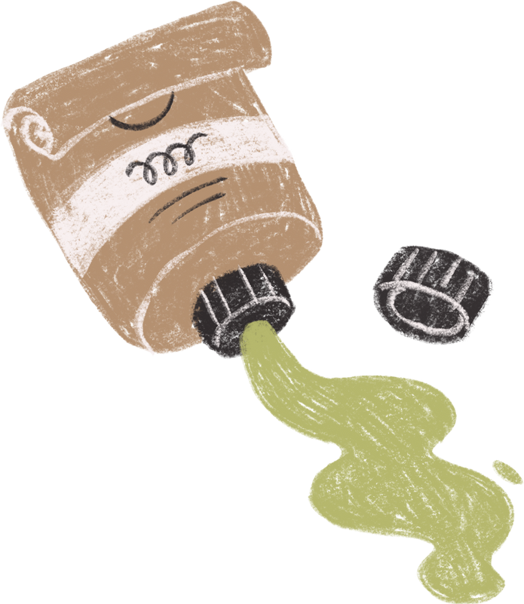
let’s be precise
colour
type
First decide the specific shade of colour of the thing you are describing.
Think about what the colour is made of or what it is doing
style
level
Now consider what kind of tone the colour has
Consider how strong or soft the colour is

Slide 6

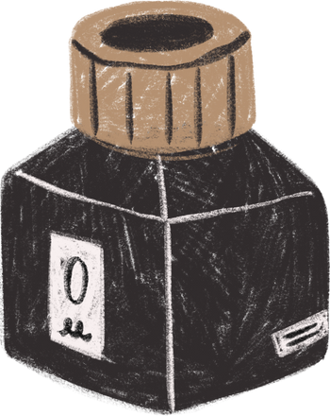
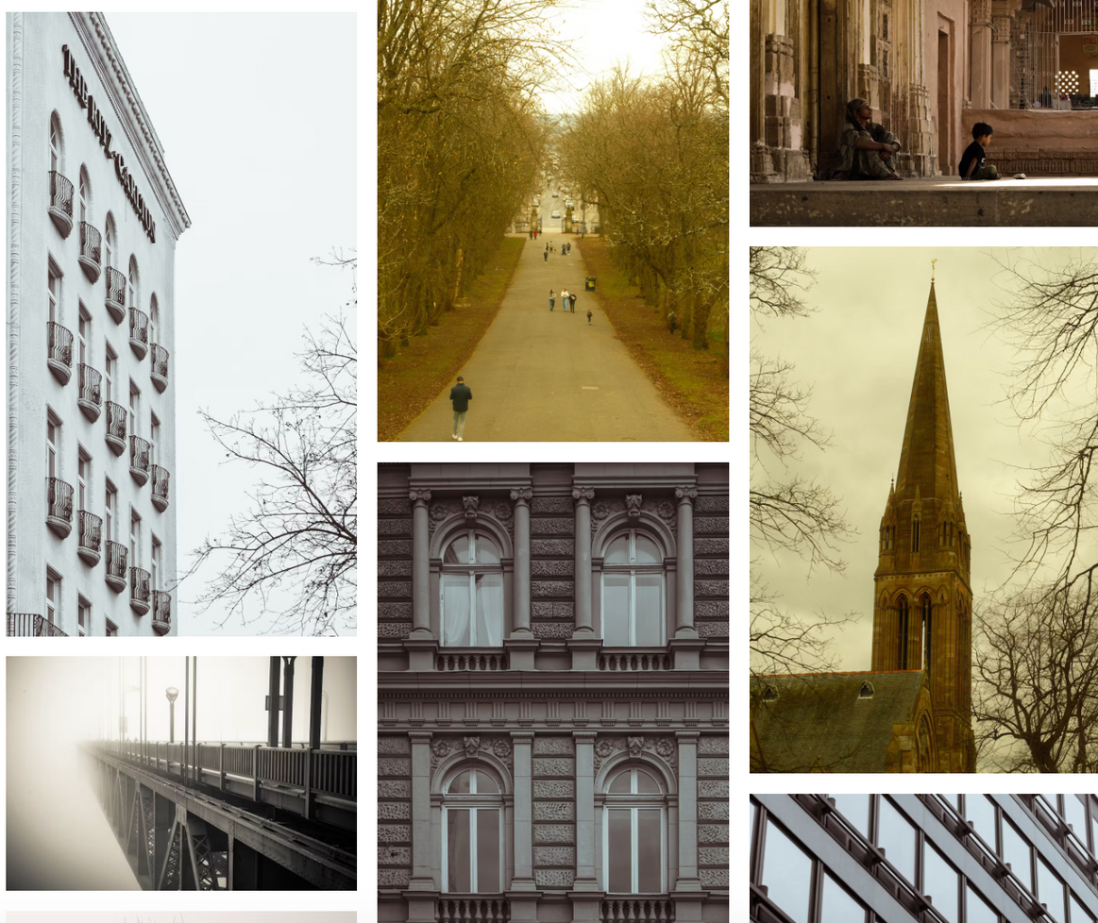
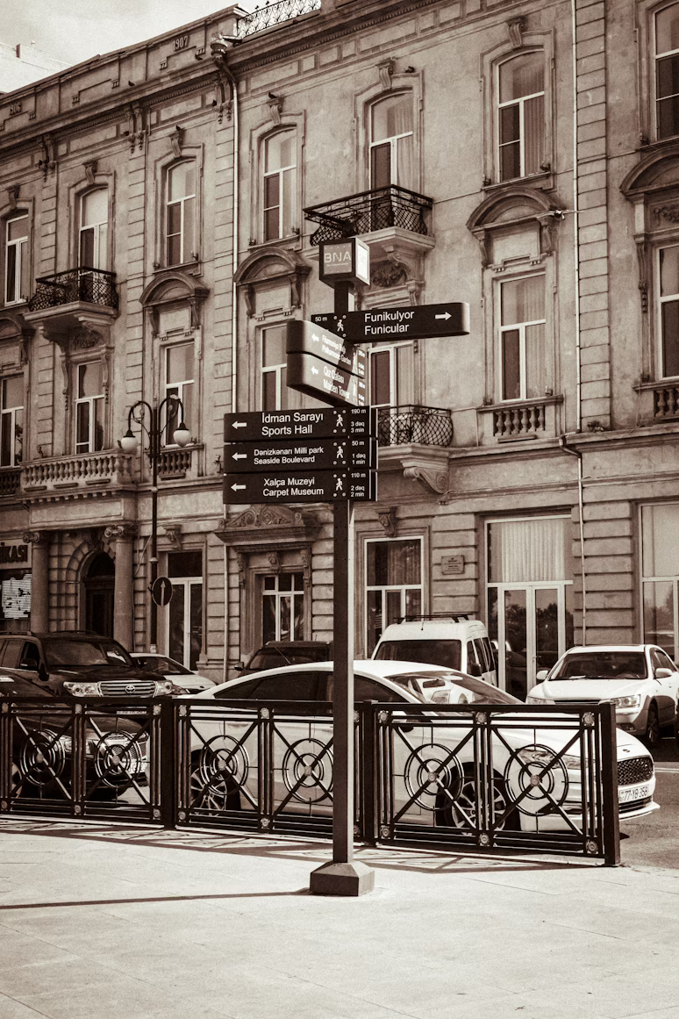
how would you describe this colour?

Slide 7
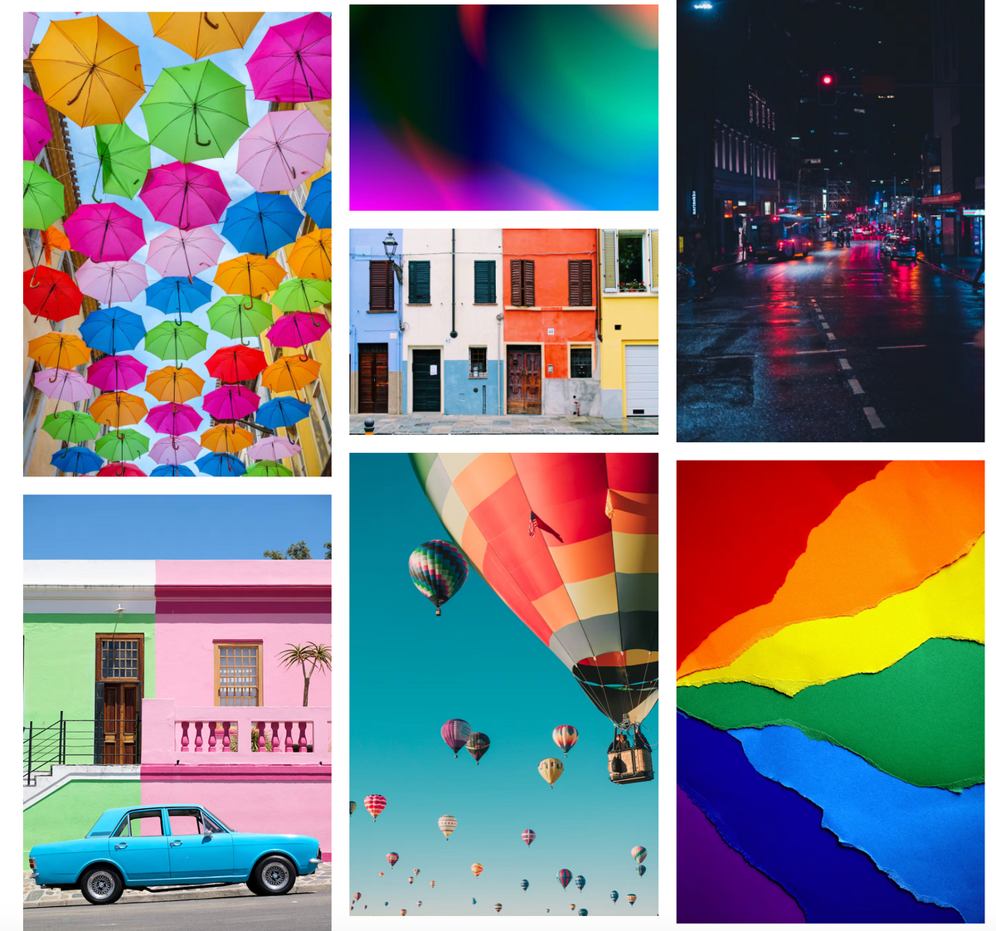
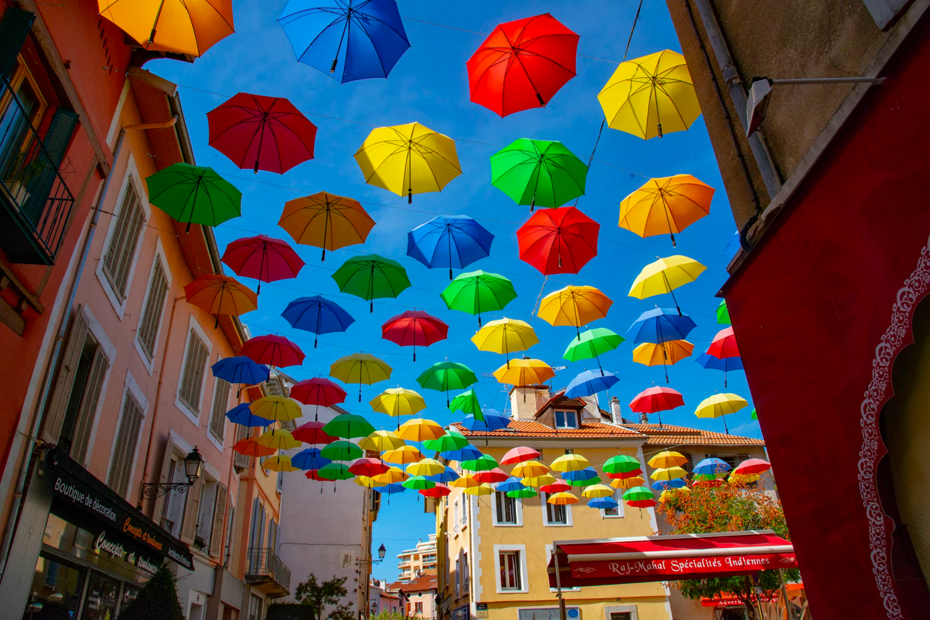
how would you describe this colour?

Slide 8
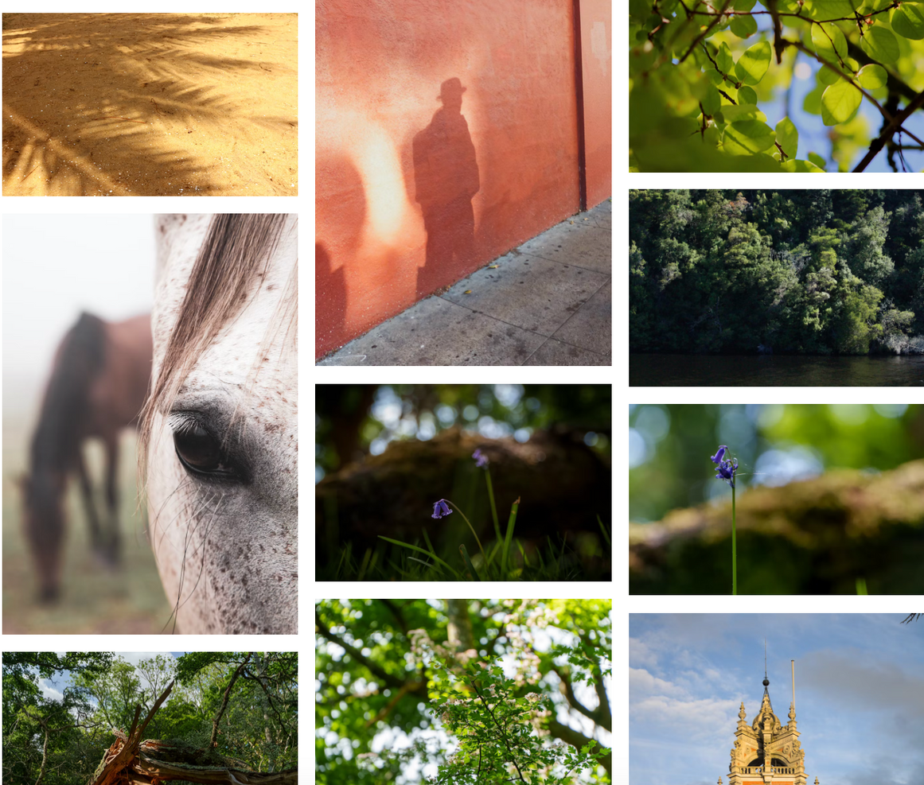
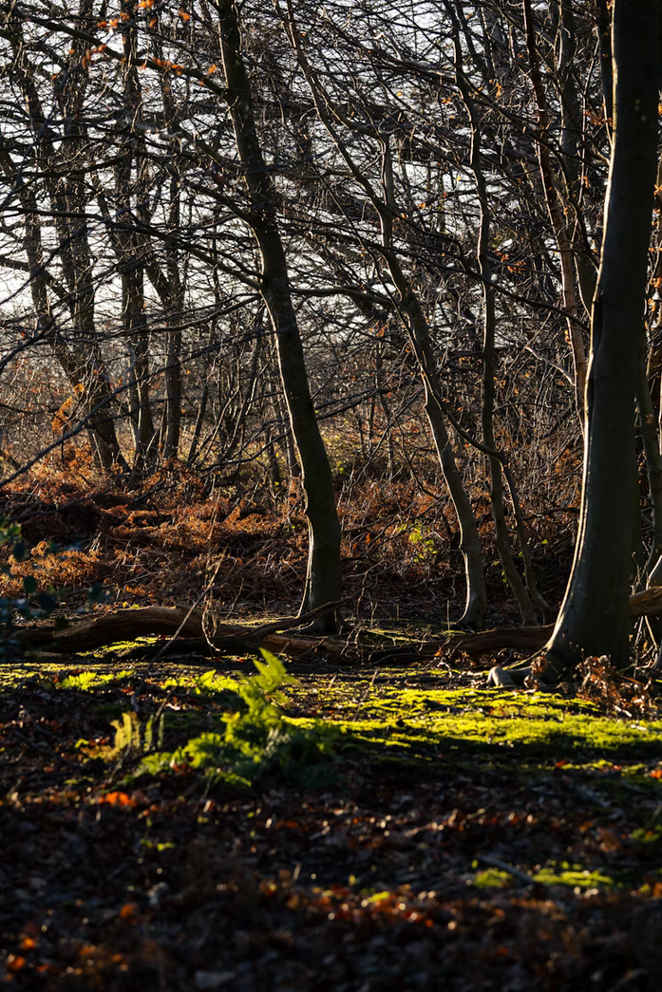
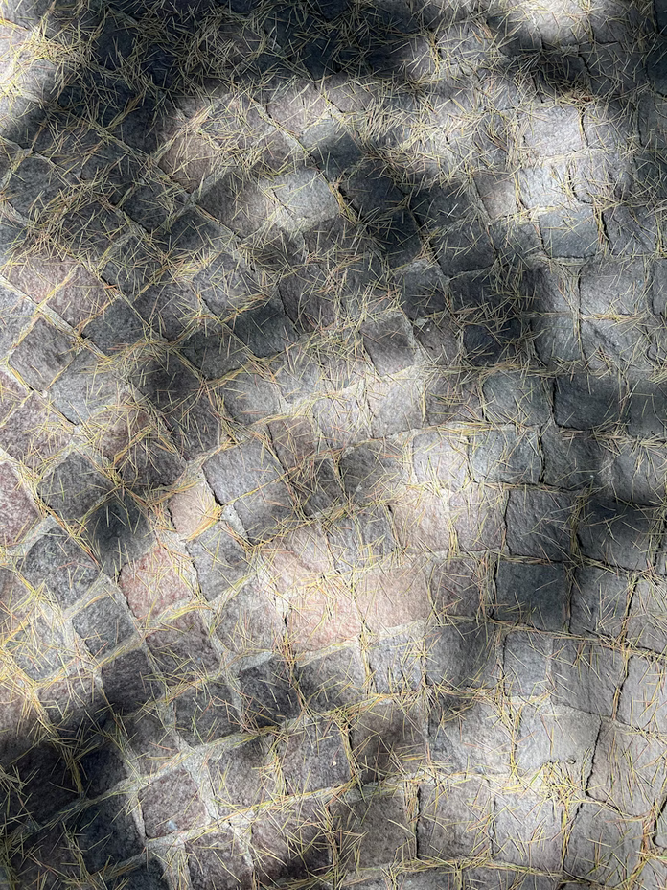
how would you describe this colour?

Slide 9
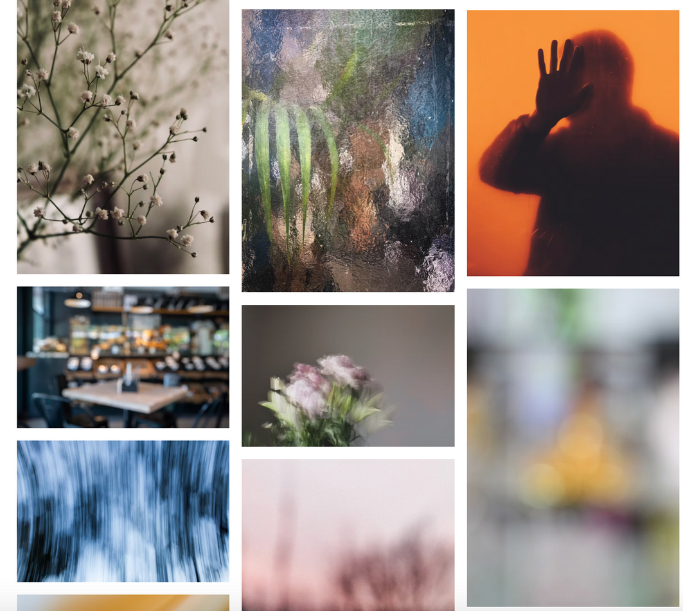
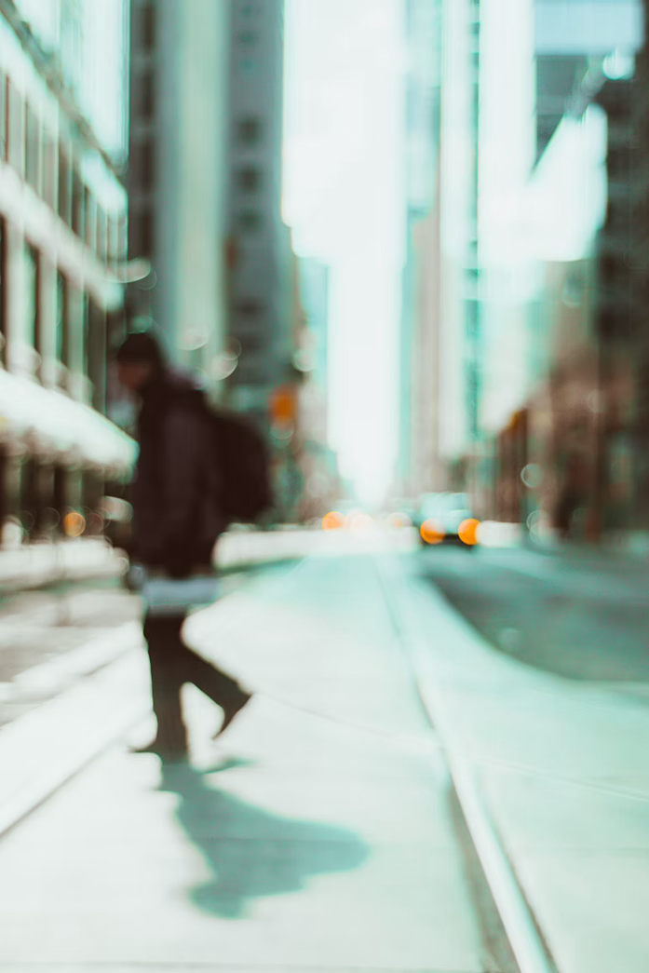
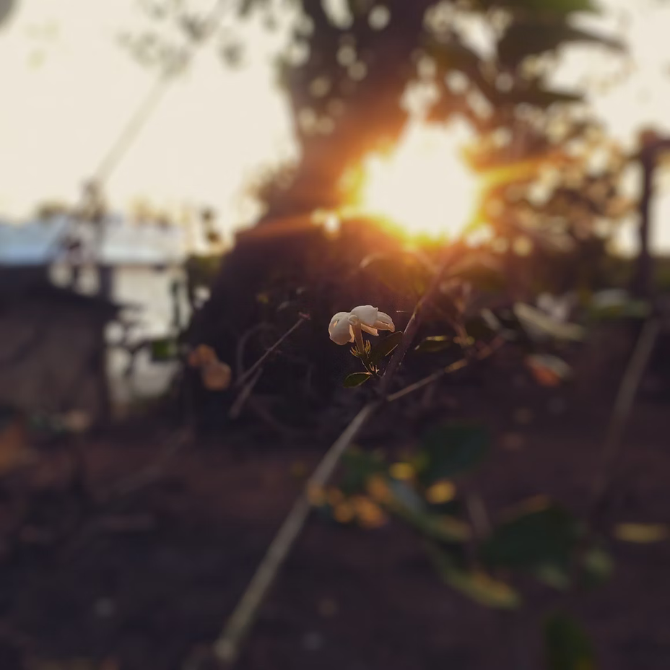
how would you describe this colour?

Slide 10
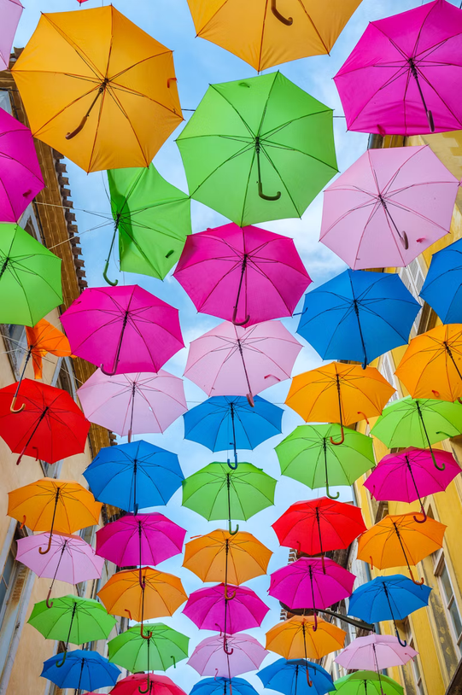
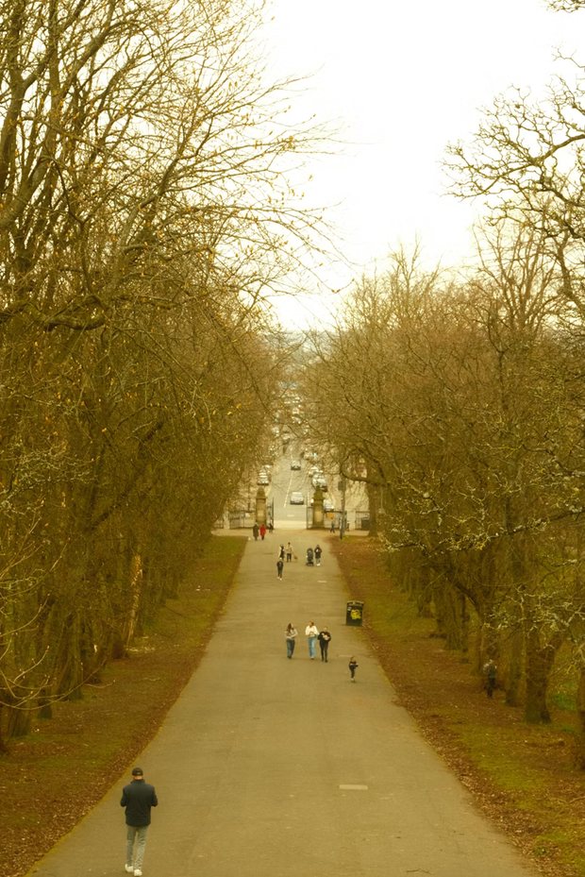
building vocabulary
dappled
SEPIA
vibrant
blurred

Slide 11
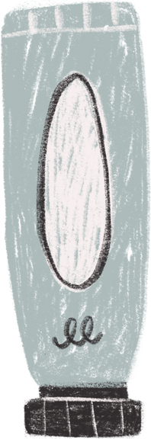

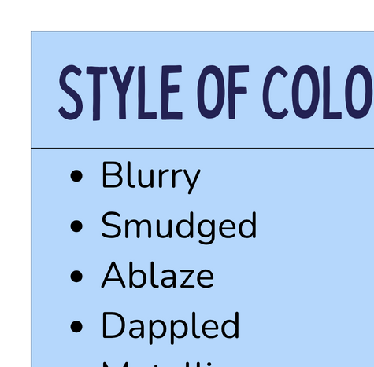
vocab bank

Slide 12
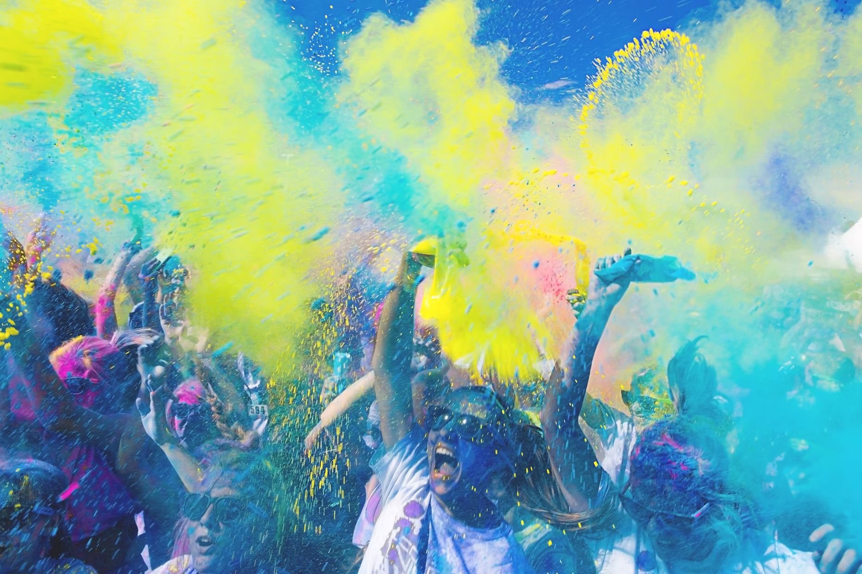

describe the colour

Slide 13
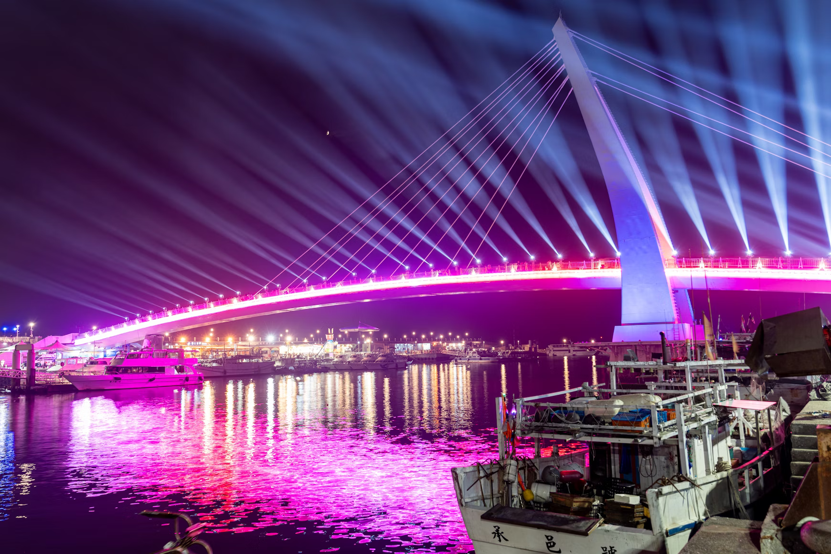
describe the colour

Slide 14
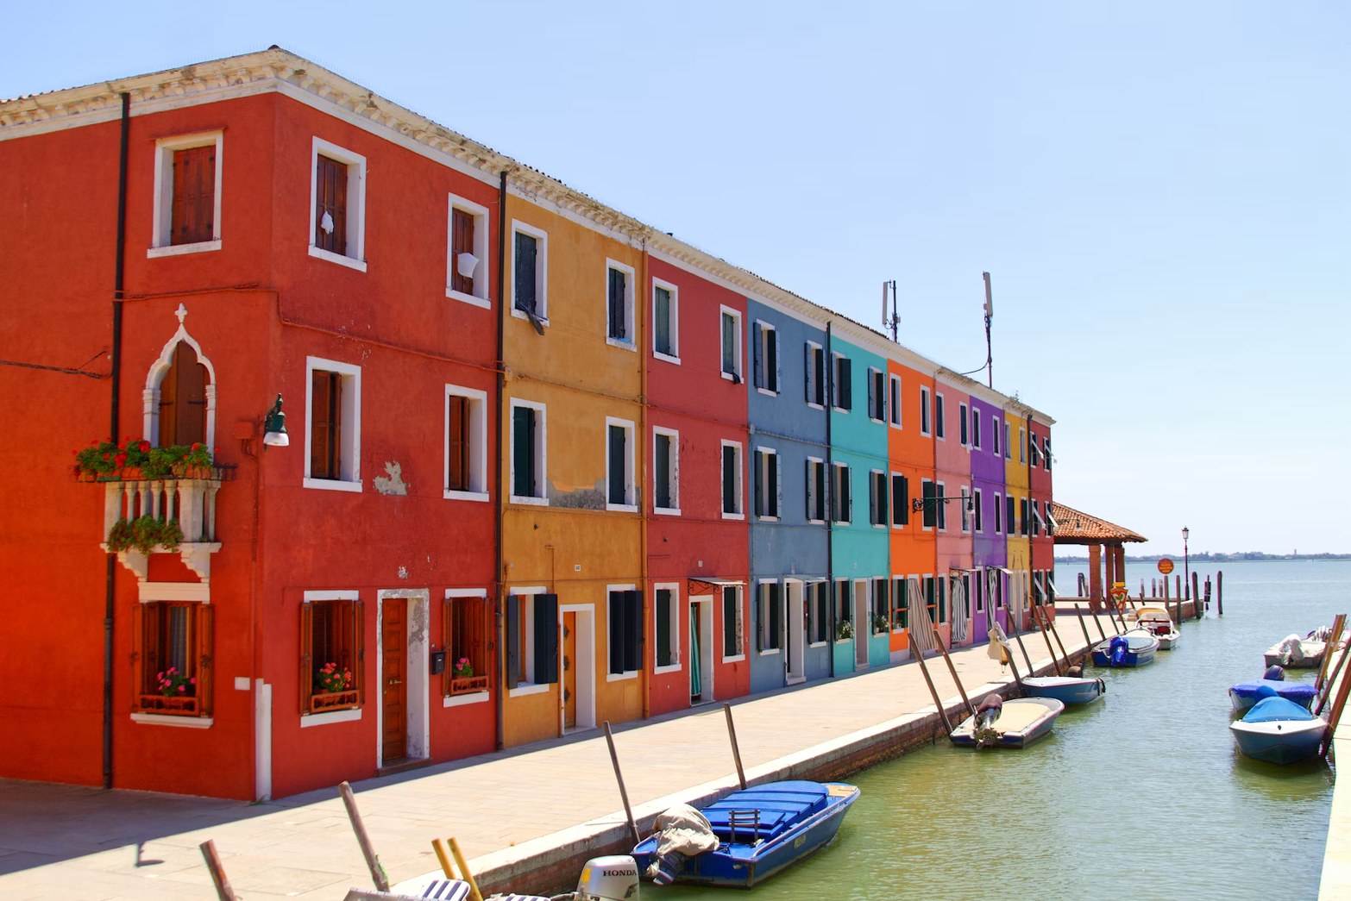
describe the colour

Slide 15
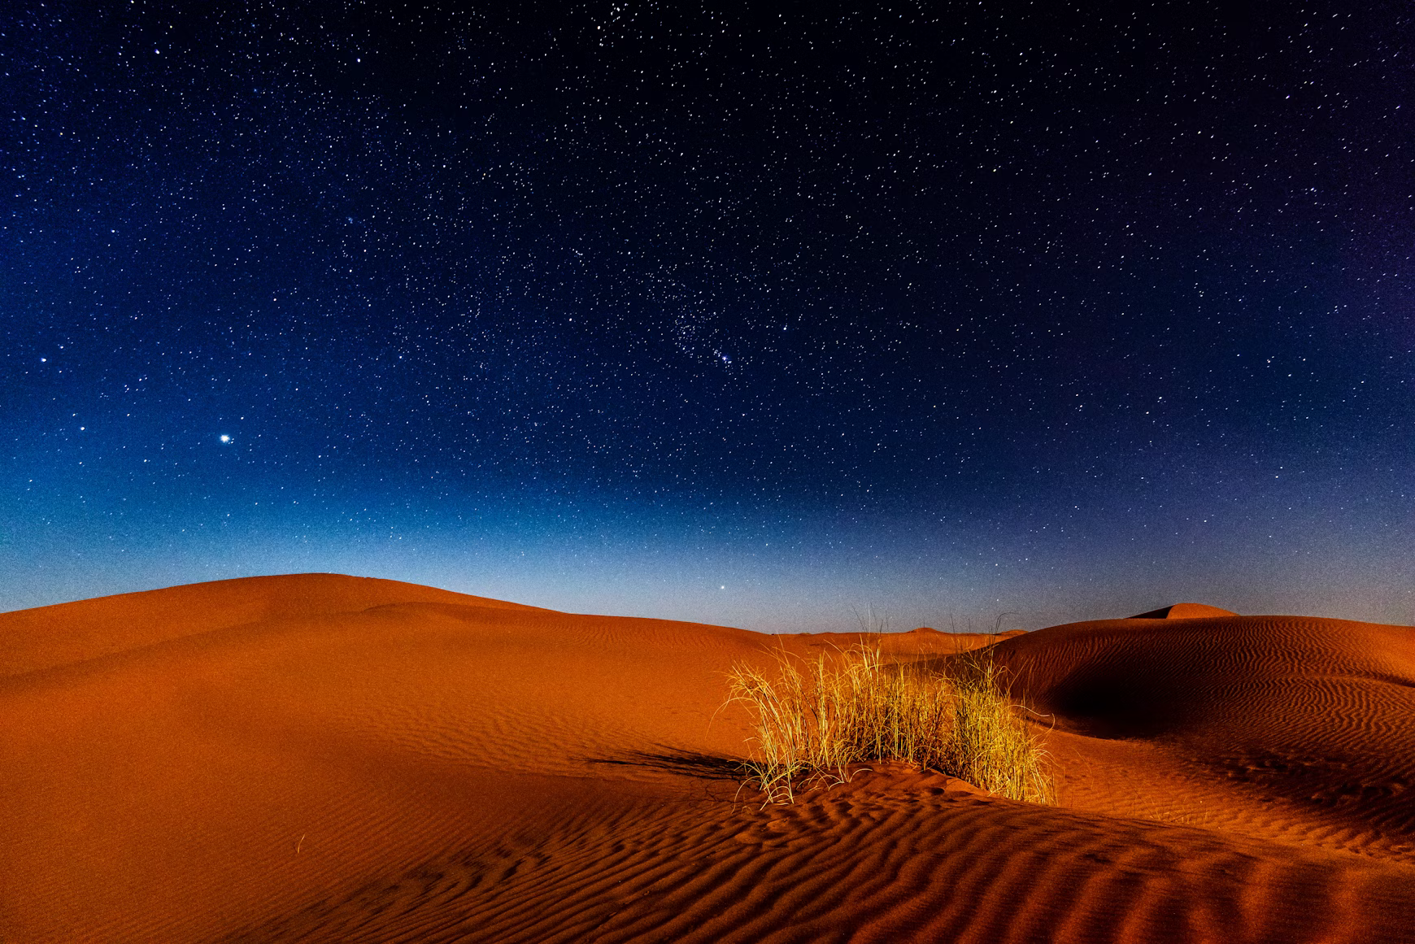
describe the colour

Slide 16
why is this a good example of colour imagery?
A burnt-orange haze stretched across the dunes, the sand steeped in rust and shadow. Above, the sky deepened from cobalt to velvet, each star pricking the darkness like a pin through silk. The last smear of twilight flickered low on the horizon, a faint afterglow caught between indigo and ink. Even the air seemed stained with quiet — dusted in ash-blue silence, lit only by the low pulse of cosmic light.

Slide 17
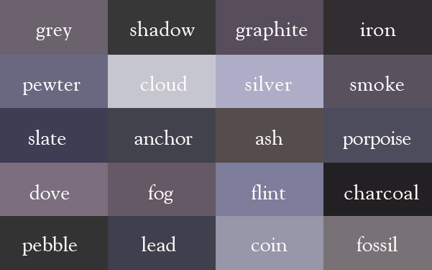
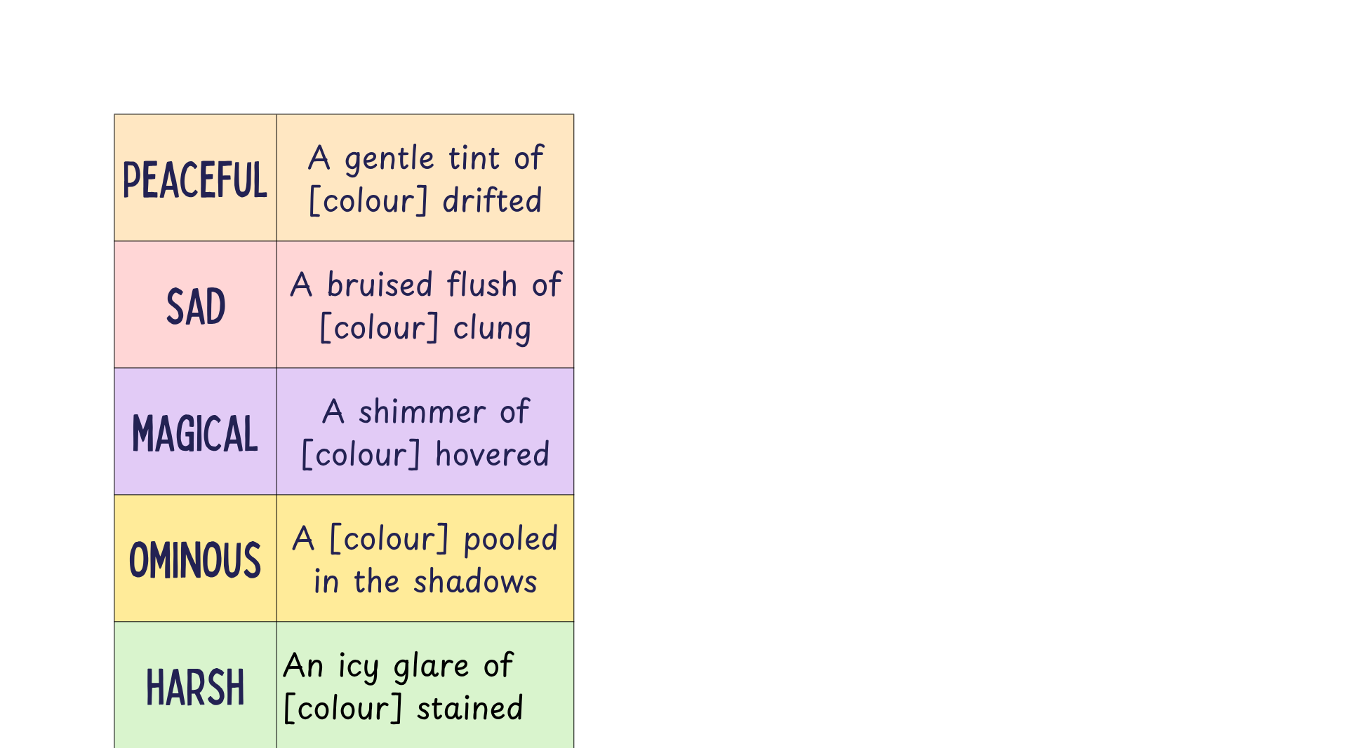
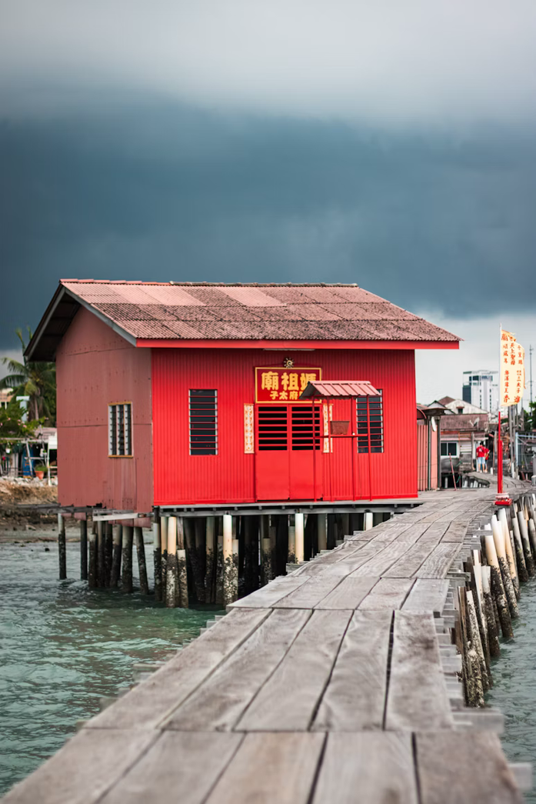
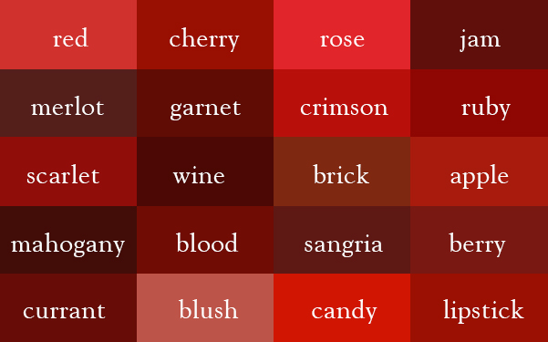
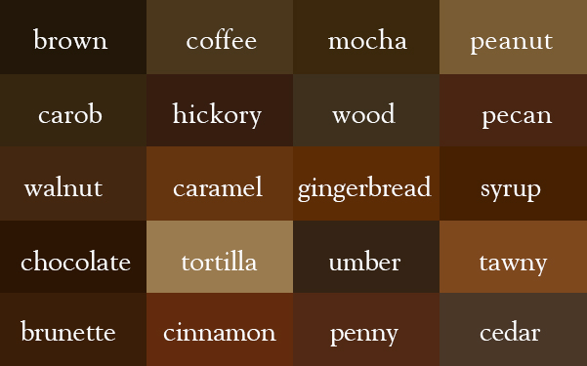
let’s create moods

Slide 18
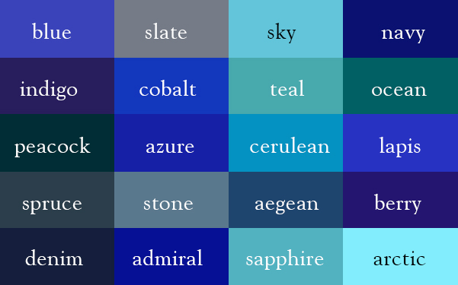
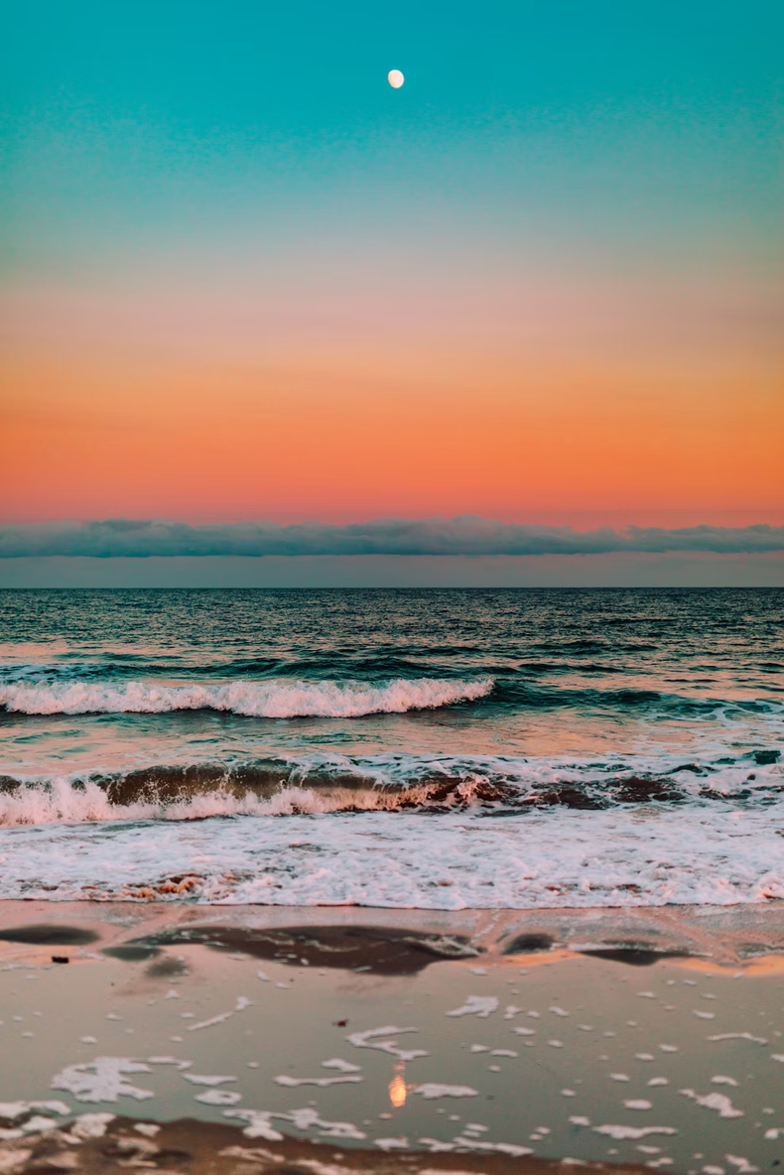
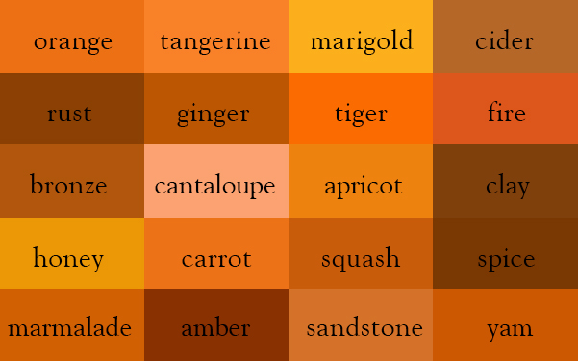
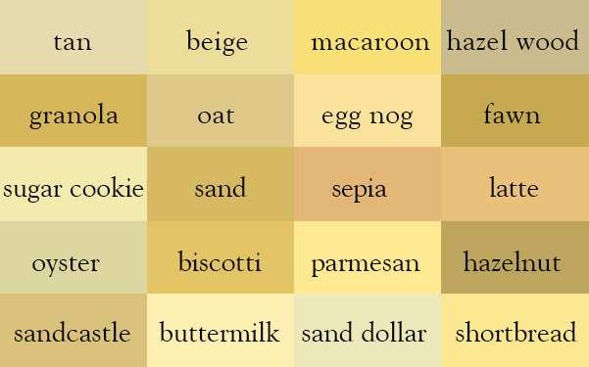
let’s create moods

Slide 19
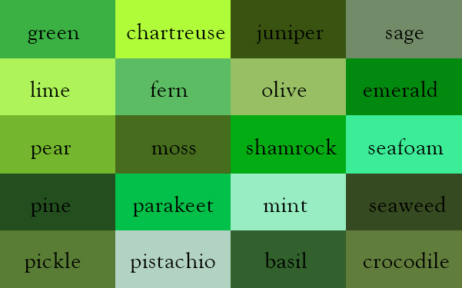
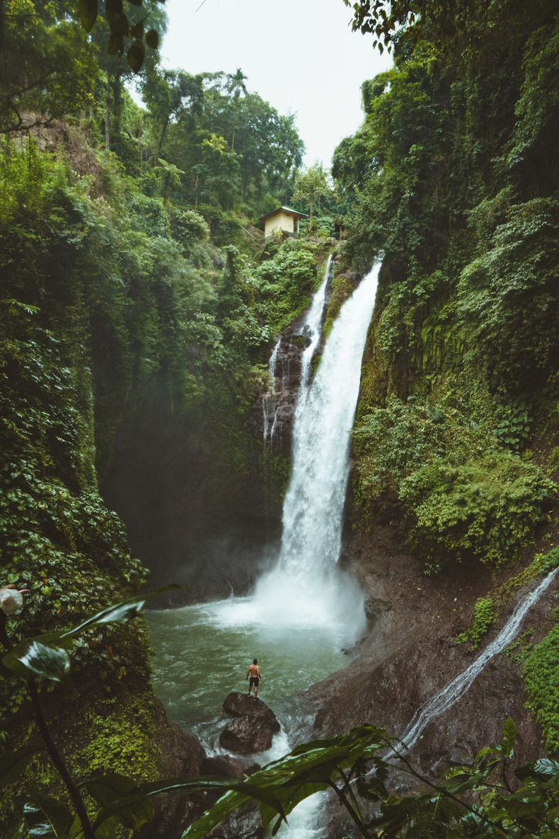
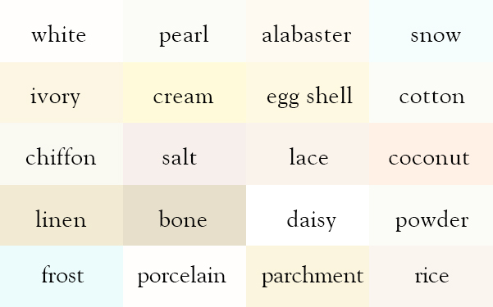
let’s create moods

Slide 20
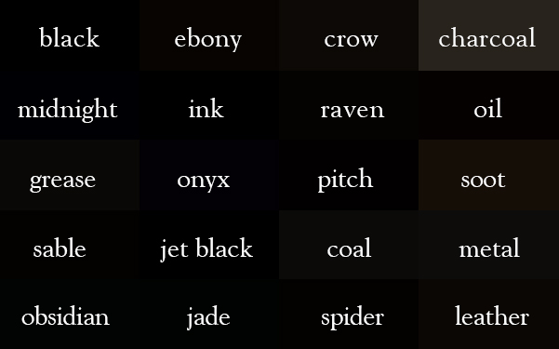
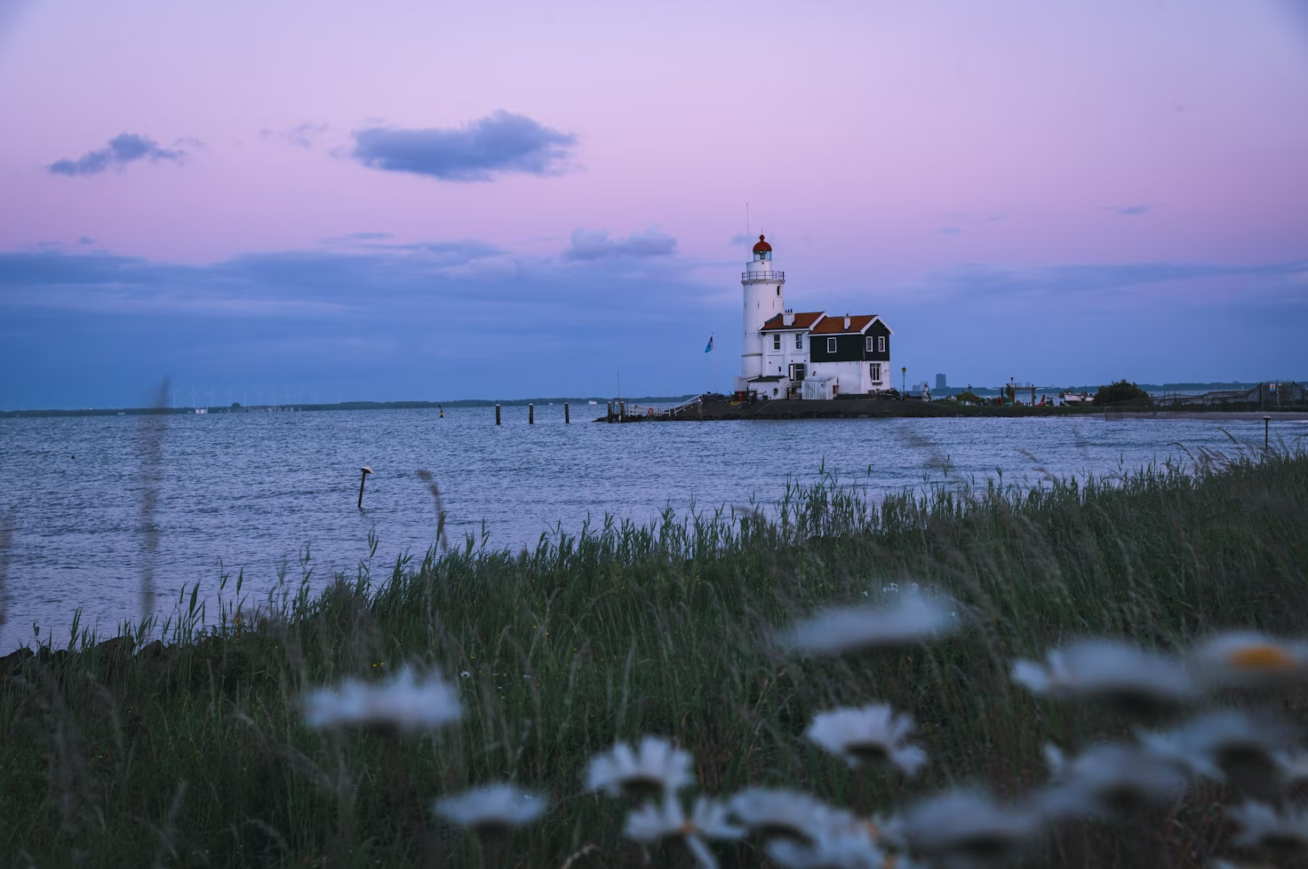
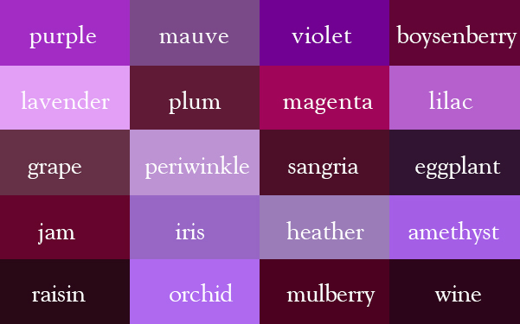
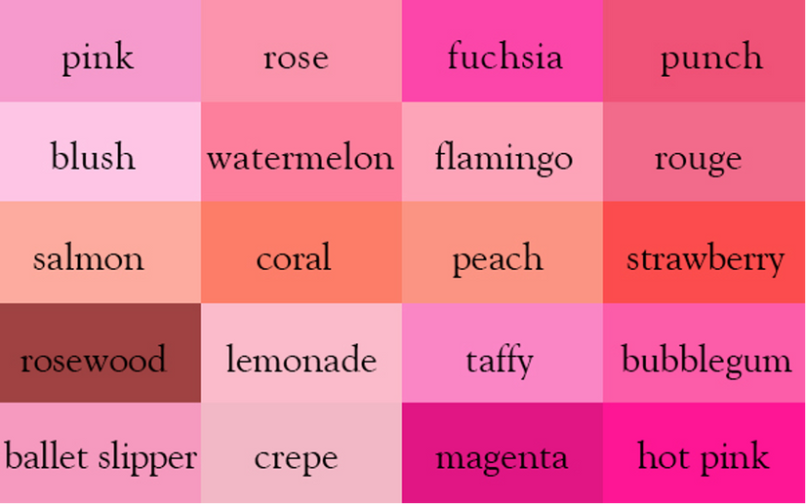
let’s create moods

Slide 21

verbs to bring colour to life
Consider the way the colour moves - does the colour...
bleed
flicker
creep
burst
a brief, wavering movement, perhaps fragile or fading
a slow, silent movement suggesting something stealthy or sinister
a sudden, explosive movement, suggesting power or intensity
a spreading movement which is permanent and stains
trickle
spill
drift
sink
a slow, leaking movement which enters through cracks or narrow spaces
an overflowing, soft movement which indicates a lack of control
a soft, floating motion, suggesting something calm or dreamlike
a downward, heavy movement - suggesting weight or finality

Slide 22
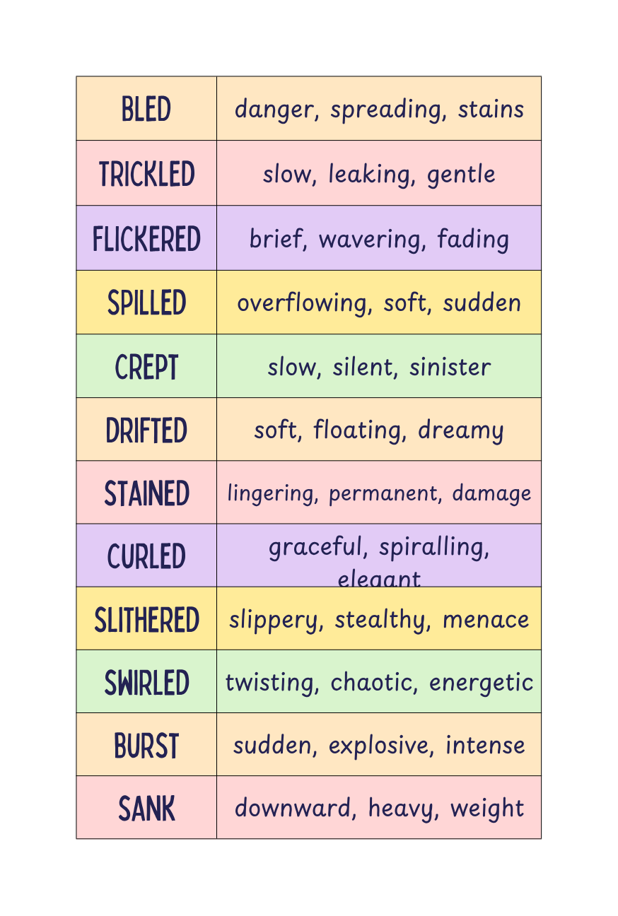
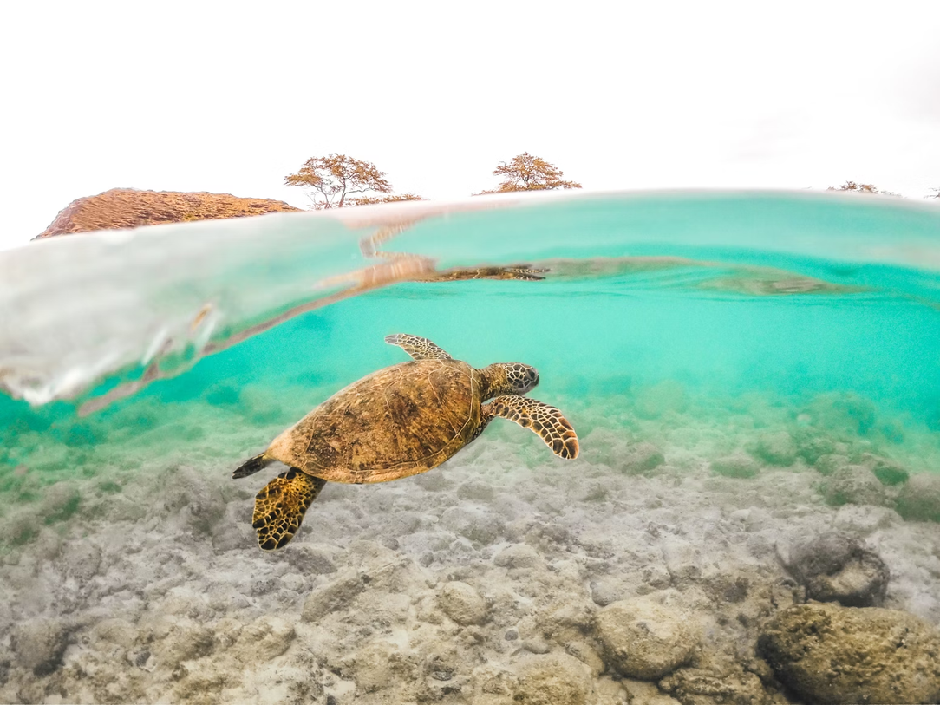
verbs for colour
  A blur of turquoise [VERB] across the seabed, soft as breath.
  Light [VERB] over the turtle’s shell in a dappled glaze of emerald and honeyed gold.
  Mint green [VERB] around its limbs, wrapping the turtle in a shimmer that moved like thought.

Slide 23


verbs for colour
  A jade flush [VERB] across the lake, the boats lined up like quiet stitches.
  Mist [VERB] into the mountain cracks, a dull ivory stain on the sky.
  Frosted green [VERB] around the boats, whispering through the ripples.

Slide 24

verbs for colour
  Lantern light [VERB] through the mist, an afterglow of amber trembling against the rain.
  A line of charcoal shadow [VERB] along the shopfronts, darkening the gaps between puddles.
  Ashen light [VERB] into the street, soaking the cobbles with a heavy, metallic sheen.

Slide 25



building a palette
Describe the blues of this image and create a joyful OR sinister atmosphere.

Slide 26


building a palette
Describe the greens of this image and create a joyful OR sinister atmosphere.

Slide 27


building a palette
Describe the oranges of this image and create a joyful OR sinister atmosphere.

Slide 28


building a palette
Describe the pinks of this image and create a joyful OR sinister atmosphere.

Slide 29


using colour to change time
  As the light shifted, the once-pure [colour] began to [verb]...
  By morning, the [colour] had drained from the street, leaving behind...
  Where [colour] had glowed the night before, only a faint [shade] now lingered.
  The city traded its [night-time palette] for [day-time palette], like...

Slide 30


using colour to change time
  As the light shifted, the once-pure [colour] began to [verb]...
  As the storm arrived, the [colour] had drained from the village, leaving behind...
  Where [colour] had glowed earlier that day, only a faint [shade] now lingered.
  The path traded its [day-time palette] for [storm-time palette], like...

Slide 31

let’s create a description

Slide 32


let’s create a description

Slide 33


let’s create a description

Slide 34

let’s create a description

Slide 35

let’s create a description

Slide 36

let’s create a description

Slide 37
let’s create a description

