Slide 1

Monday 22nd September
English Language Paper One: Question 5
Do Now: An Inspector Calls Retrieval
Copy and complete the following statements When the Inspector enters, the lighting shifts from ‘pink and ________’ to ‘_________ and harder’ to show how their comfortable capitalist life has been shattered. Priestley uses _________ _________ to make Mr Birling seem unlikeable and ignorant in Act One. In his final speech to the family, the Inspector warns that if they do not learn their lesson, they will learn it in ‘fire and ________ and __________.’

Slide 2
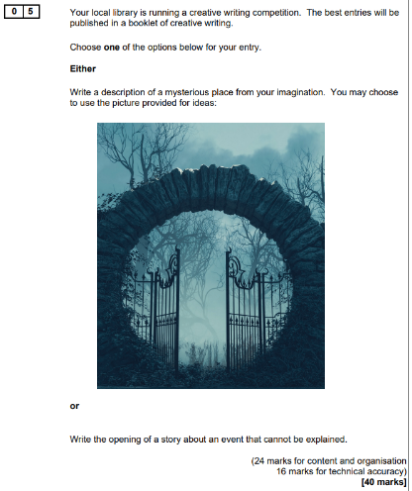

Slide 3
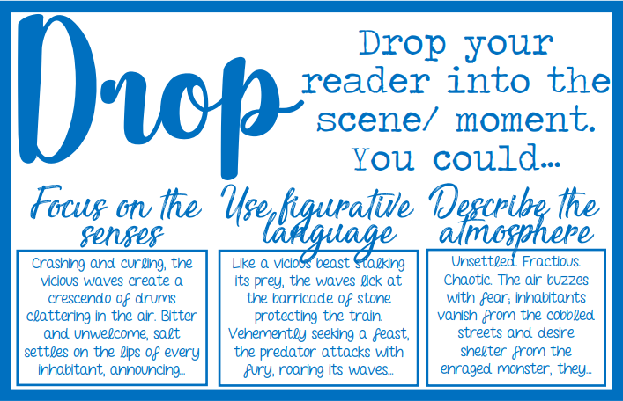
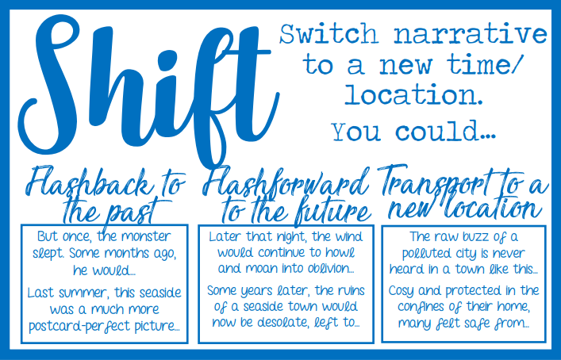
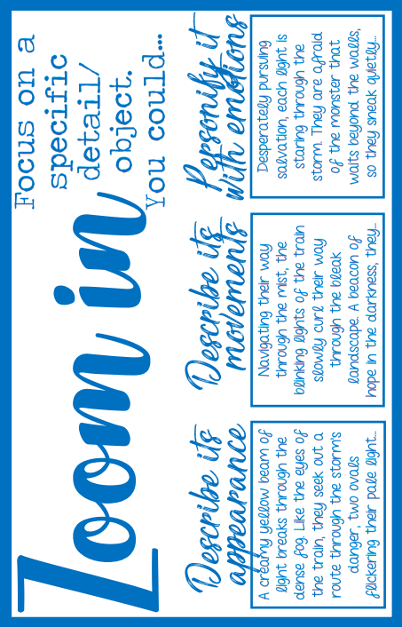
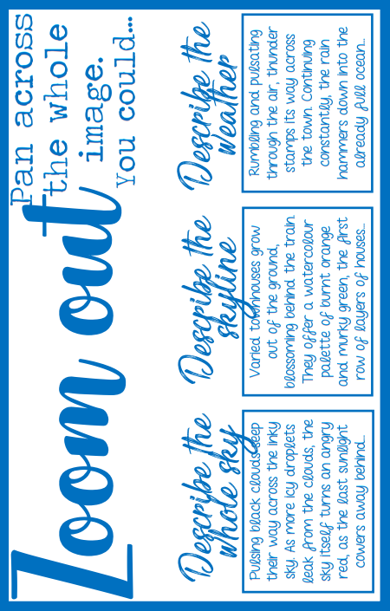

Slide 4
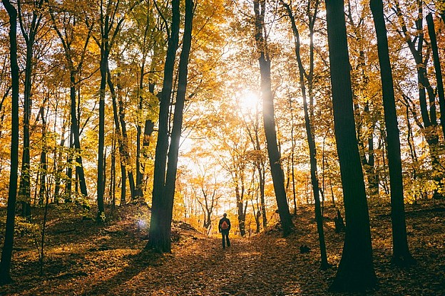
Zoom in
Drop
Zoom out
Drop
Drop the reader into the picture by describing the immediate surroundings. Provide detailed imagery and use figurative language
Shift
Notes:
This structure works for both descriptive and narrative writing
It gives students a clear focus to their piece, but also allows them opportunities to show off their skills
It can be used with 1st person or 3rd person narrator
It encourages the use of structural features
It restricts students from creating silly narratives
But also liberates them, in enabling them to show off all of their writing skills.

Slide 5
Zoom in
Drop
Zoom out
Shift
Shift to another time, place, perspective. This is where you show your manipulation of structure. Can you flashback or even forward?
Shift

Slide 6
Zoom in
Drop
Zoom out
Zoom in
Go back to the present and focus on one key detail from the image. The longer you spend describing it, the better your description will be.
Shift

Slide 7
Zoom in
Drop
Zoom out
Zoom out
Imagine you are a camera panning away from the image. Describe the big details – the weather, the light, the sky, the objects outside the image.
Shift

Slide 9
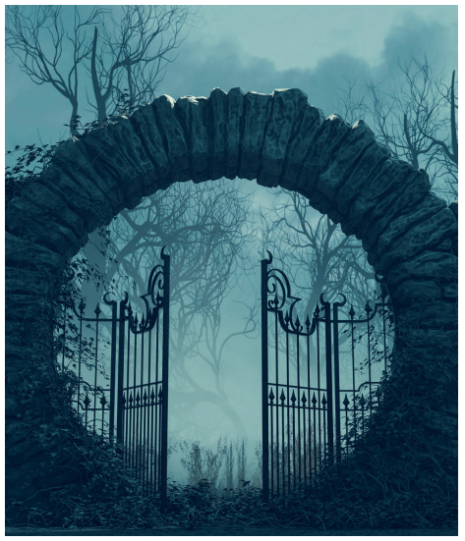

Slide 10
Sounds
Jot down what you can hear
Gathering Ideas

Slide 11
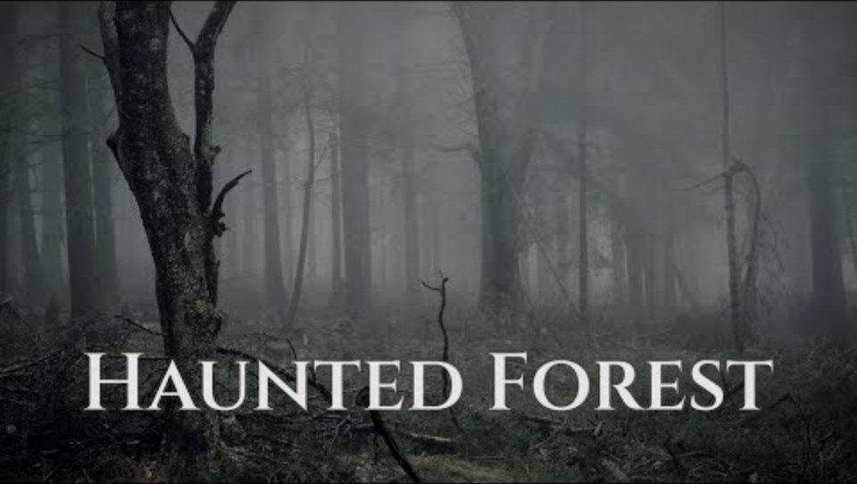
Gathering Ideas

Slide 12
Gather some vocabulary to create an extended metaphor
Words linked to the supernatural:
Haunt
Hover
Levitate
Ghostly
Ethereal
Gathering Ideas

Slide 13
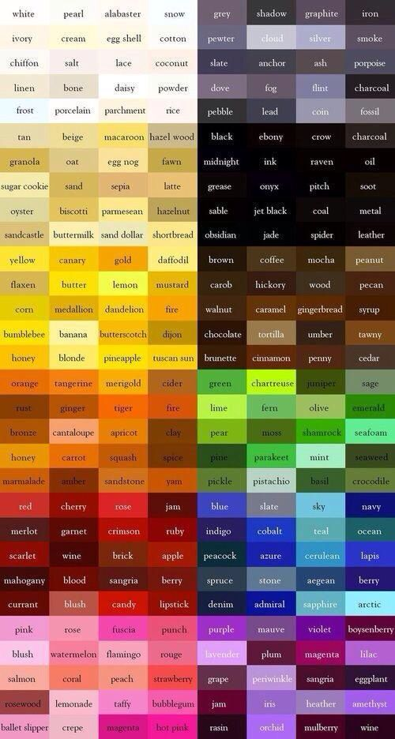
What colours could you describe?
Gathering Ideas

Slide 14
Setting description
Consider:
Weather
Sensory language
Gathering Ideas

Slide 15
What is beyond the image?
Gathering Ideas

Slide 16
DROP IN:
A damp chill clings to the air as you step closer to the ancient stone arch, its rough surface crawling with twisting ivy. The iron gates stand ajar, groaning faintly on their hinges as though disturbed by an unseen hand. Beyond, a ghostly mist weaves between the black, skeletal trees, their bare branches clawing at the pale, cloud-heavy sky. Every sound seems muffled, swallowed by the fog, until the sharp snap of a twig echoes like a warning. The world is drained of warmth, soaked in shades of grey-blue, as if time itself has slowed at the threshold of this forgotten place.

Slide 17
Tuesday 23rd September
Descriptive Writing
An Inspector Calls Retrieval
Which best describes Eric early on and why? awkward vulnerable unstable secretive
Which best describes Mr Birling and why? arrogant foolish insecure symbol of capitalism
Copy and complete the quotation said by Sheila, to Gerald: ‘You were the wonderful _____ Prince. You must have ______ it.’
Where does Eric steal money from to try and support Eva?
What year is the play set? What year was the play written?

Slide 18

A damp chill clings to the air as you step closer to the ancient stone arch, its rough surface crawling with twisting ivy. The iron gates stand ajar, groaning faintly on their hinges as though disturbed by an unseen hand. Beyond, a ghostly mist weaves between the black, skeletal trees, their bare branches clawing at the pale, cloud-heavy sky. Every sound seems muffled, swallowed by the fog, until the sharp snap of a twig echoes like a warning. The world is drained of warmth, soaked in shades of grey-blue, as if time itself has slowed at the threshold of this forgotten place.
Using your ideas from yesterday, write up the ‘DROP’ part of your descriptive Q5 in your exam booklet.
Write two paragraphs
Use personification
Vary your sentence starters
Ambitious vocabulary
Ambitious punctuation
Proofread – check grammar
Sensory language
Establish atmosphere

Slide 20
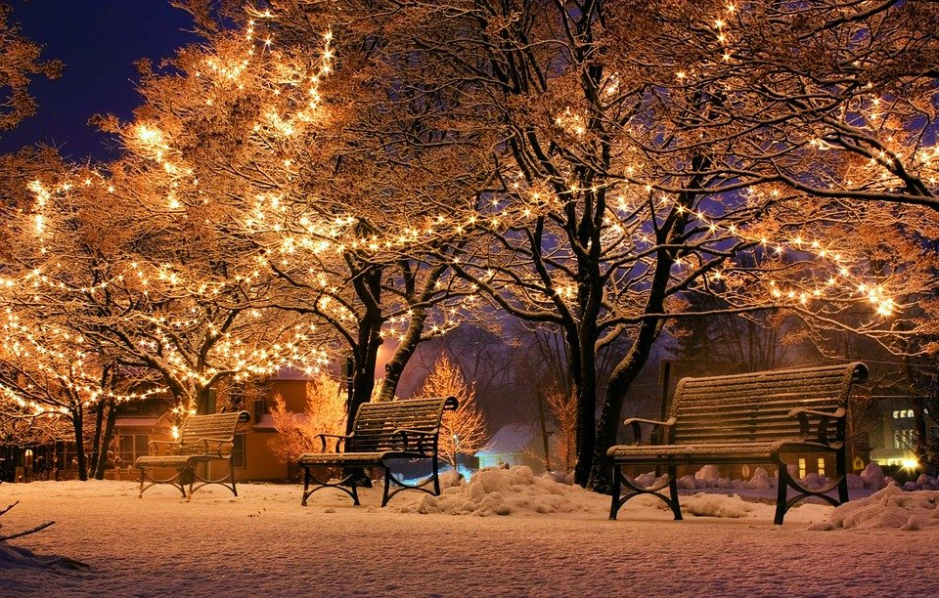
Five minutes earlier…
Five miles away…
Five years ago…
Creating a SHIFT
In a few hours time…
Just one week ago…

Slide 21
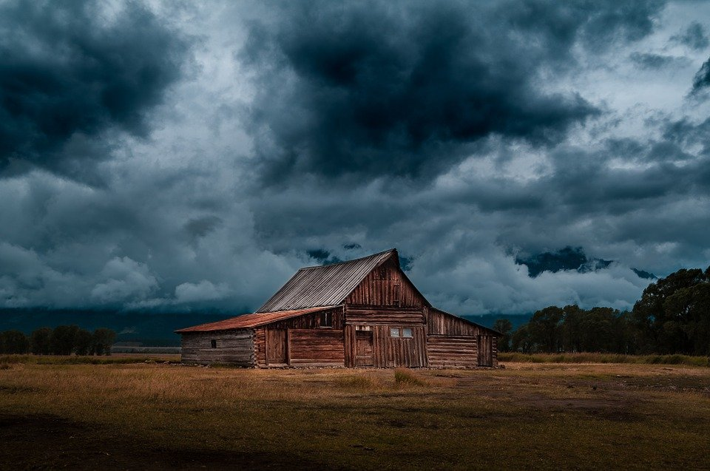
Five minutes earlier…
Five miles away…
Five years ago…
Creating a SHIFT
In a few hours time…
Just one week ago…

Slide 22
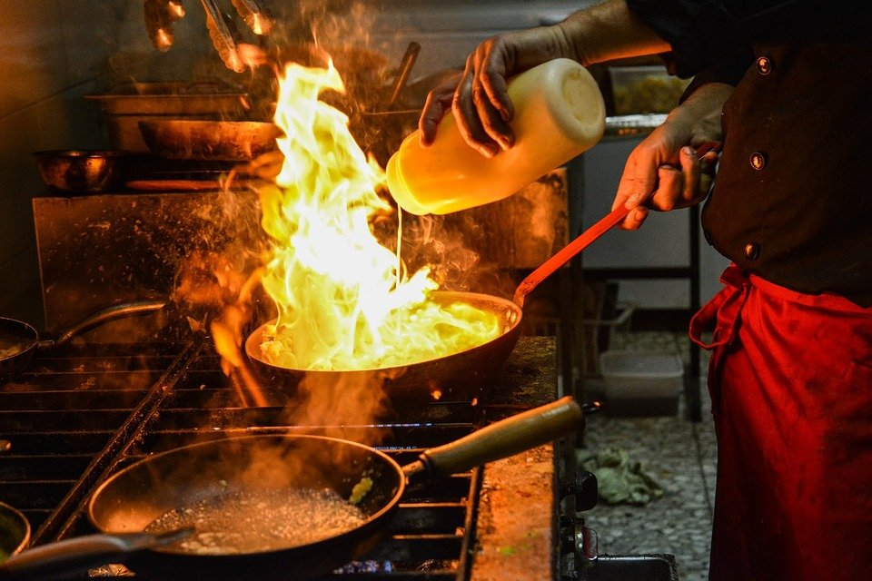
Five minutes earlier…
Five miles away…
Five years ago…
Creating a SHIFT
In a few hours time…
Just one week ago…

Slide 23
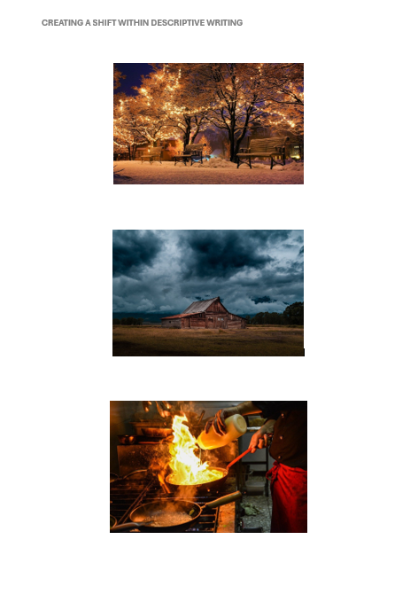
I do, You do
Annotate each image with some ‘shift’ ideas.

Slide 24

Wednesday 25th September
Descriptive Writing- Shift
Do Now: An Inspector Calls Retrieval
In what year is An Inspector Calls set, what year was it written? What object does Sheila return to Gerald, and what does this symbolise? How is Eva Smith connected to Mr Birling’s business? What does the Inspector say are the consequences if people ignore their social responsibility? Who telephones the Birlings at the very end of the play, and why is this moment dramatic?

Slide 25
Check and Correct!
An Inspector Calls is set in , written 1945. The engagement ring – it symbolises her rejection of Gerald’s behaviour and her refusal to blindly continue the engagement after learning of his affair. She was a factory worker at Birling’s works – Mr Birling sacked her for demanding higher wages. He warns of “fire and blood and anguish” – a clear reference to war and social upheaval if people do not learn responsibility. The police phone the Birlings – they announce a girl has just died and an inspector is on his way, creating a dramatic cliff hanger and reinforcing Priestley’s cyclical structure.
Do Now: An Inspector Calls Retrieval
In what year is An Inspector Calls set, what year was it written? What object does Sheila return to Gerald, and what does this symbolise? How is Eva Smith connected to Mr Birling’s business? What does the Inspector say are the consequences if people ignore their social responsibility? Who telephones the Birlings at the very end of the play, and why is this moment dramatic?

Slide 26
Shift
Shift to another time, place, perspective. This is where you show your manipulation of structure. Can you flashback or even forward?
Zoom in
Drop
Zoom out
Shift

Slide 27
Notes:
Model Paragraph

Slide 28
Five minutes earlier…
Five miles away…
Five years ago…
Creating a SHIFT
In a few hours time…
Just one week ago…

Slide 29
Five minutes earlier…
I was inside the abandoned mansion.
Five miles away…
A man sits by a fire, plotting his revenge.
Five years ago…
Beautiful, stately home full of love and warmth
Creating a SHIFT
In a few hours time…
It will be pitch black, not star in the sky.
Just one week ago…
The gates opened for the first time in one hundred years.

Slide 30
Exemplar Shift:
Five years ago, this imposing archway and its wrought-iron gates were not cloaked in shadows, but instead served as a glittering threshold to a magnificent stately home. Beyond the entrance stretched a sweeping driveway, bordered by rose bushes that blazed with colour, their perfume drifting like whispers of welcome through the summer air. The gates themselves, now rusted and overrun with ivy, once gleamed proudly in the sunlight: symbols of grandeur, elegance, and prosperity. From within the house, golden light spilled across the lawns; laughter, music, and conversation fluttered through the night like birdsong, filling every visitor with warmth and belonging. Inside, crackling fires painted the walls with flickering light, and oak tables groaned under the weight of feasts, drawing families together in harmony. How strange, that this place (once brimming with joy, love, and life) should now stand as little more than a hollow echo of its glorious past.

Slide 31
Exemplar Shift:
Five years ago, this imposing archway and its wrought-iron gates were not cloaked in shadows, but instead served as a glittering threshold to a magnificent stately home. Beyond the entrance stretched a sweeping driveway, bordered by rose bushes that blazed with colour, their perfume drifting like whispers of welcome through the summer air. The gates themselves, now rusted and overrun with ivy, once gleamed proudly in the sunlight: symbols of grandeur, elegance, and prosperity. From within the house, golden light spilled across the lawns; laughter, music, and conversation fluttered through the night like birdsong, filling every visitor with warmth and belonging. Inside, crackling fires painted the walls with flickering light, and oak tables groaned under the weight of feasts, drawing families together in harmony. How strange, that this place (once brimming with joy, love, and life) should now stand as little more than a hollow echo of its glorious past.
Using the exemplar, write up the ‘SHIFT’ part of your descriptive Q5 in your exam booklet.
Write one paragraph
Create a clear contrast
Vary your sentences
Ambitious vocabulary
Ambitious punctuation
Proofread – check grammar
Sensory language
Establish a juxtaposing atmosphere

Slide 32
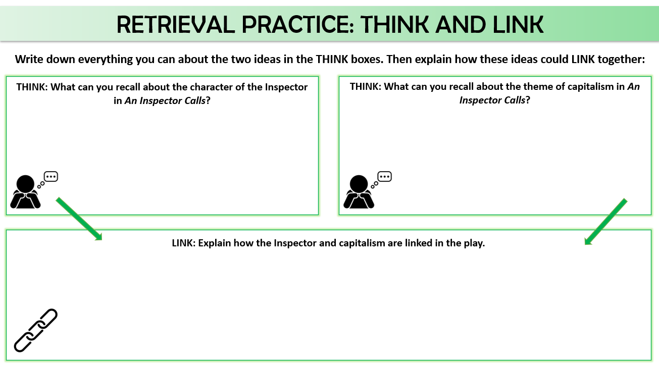
Friday 26th September
Descriptive Writing: Zoom In

Slide 34
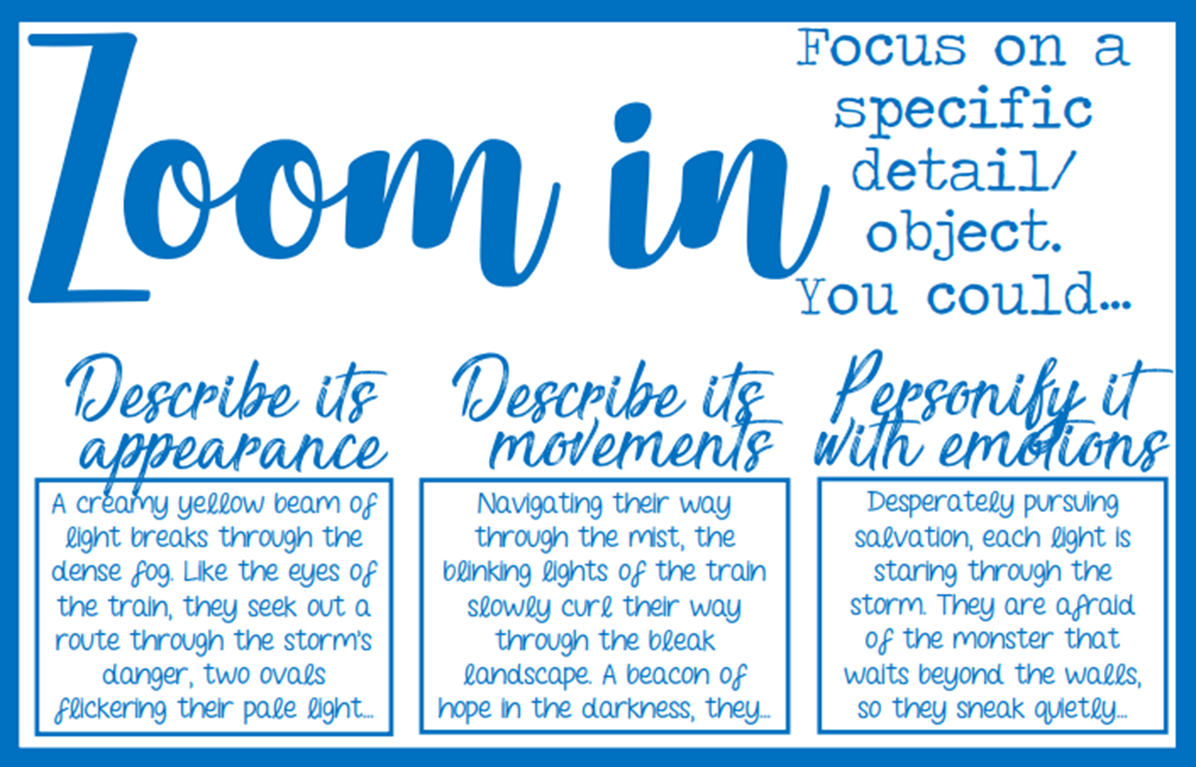
Notes:
Remind students that they can add things to an image to describe
They may want to focus on something that is moving/changing to allow more detail
This may, in a narrative, be a point to introduce more details about a character – ask students, what are key things you need to know about a new character?

Slide 35
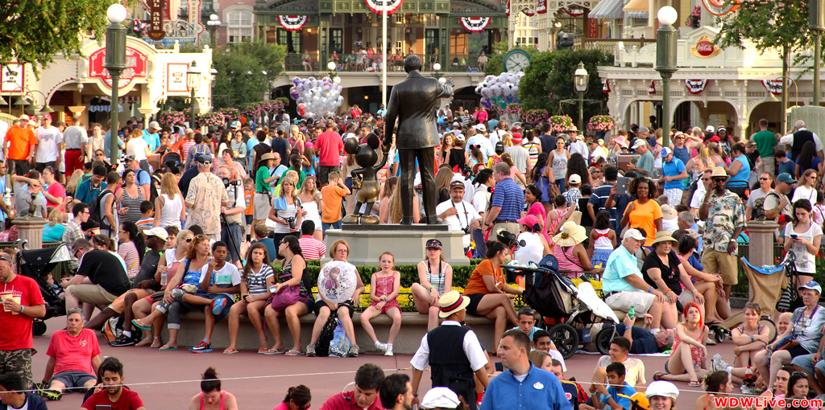
Choose a character to zoom in on…
What are they thinking?
Why are they there?
What are they feeling?
Who are they with?
What type of person are they?
Describe their movements/behaviour

Slide 36

Choose a character to zoom in on…
What are they thinking?
Why are they there?
What are they feeling?
What’s in their basket?
What type of person are they?
Describe their movements/behaviour

Slide 37
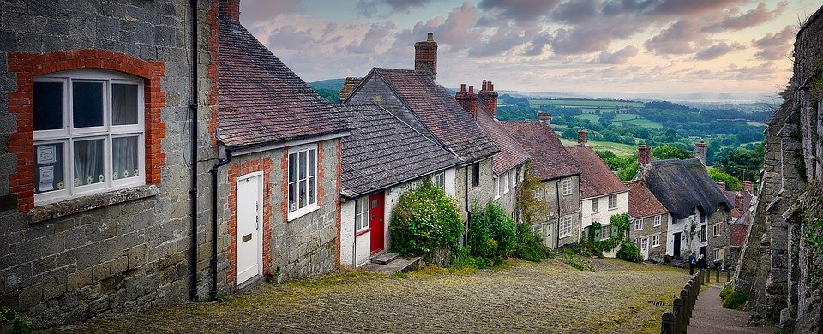
Create your own character for the image…

Slide 38
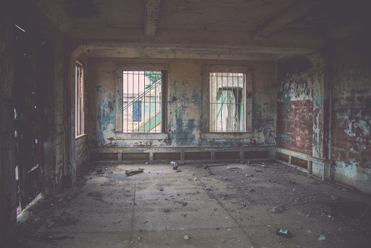
Choose an object to describe…

Slide 39
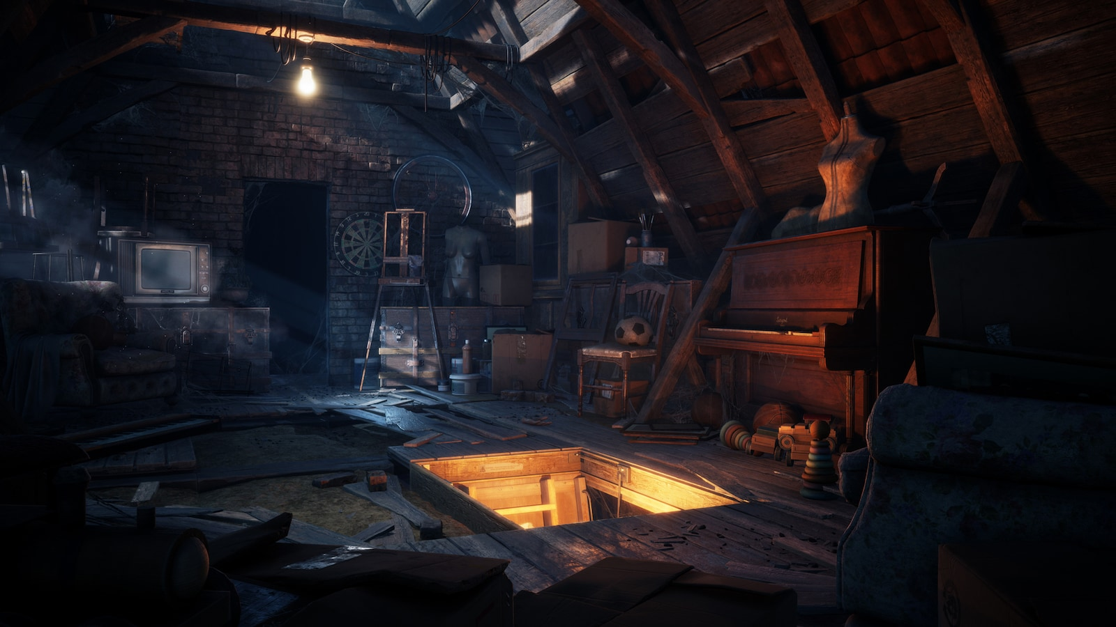
Choose an object to describe…

Slide 40
Choose an object to describe…
The old piano crouches in the shadowy corner of the attic. Its once-polished mahogany body now dulled to a weary, reddish-brown by years of dust and neglect. Cobwebs cling to its edges like lace. Its lid sits slightly open, as though caught mid-breath, and the faint glow of the single bulb above casts a weary shimmer across its carved frame. Dust lies thick across its keys like a blanket protecting a child. Sitting amid cluttered boxes and childhood relics, it waits for someone to lift the dust, strike a key, and breathe life back into its forgotten song.

Slide 41
Choose an object to describe…
The old piano crouches in the shadowy corner of the attic. Its once-polished mahogany body now dulled to a weary, reddish-brown by years of dust and neglect. Cobwebs cling to its edges like lace. Its lid sits slightly open, as though caught mid-breath, and the faint glow of the single bulb above casts a weary shimmer across its carved frame. Dust lies thick across its keys like a blanket protecting a child. Sitting amid cluttered boxes and childhood relics, it waits for someone to lift the dust, strike a key, and breathe life back into its forgotten song.

Slide 42
What can you zoom in on?

Slide 43

The old piano crouches in the shadowy corner of the attic. Its once-polished mahogany body now dulled to a weary, reddish-brown by years of dust and neglect. Cobwebs cling to its edges like lace. Its lid sits slightly open, as though caught mid-breath, and the faint glow of the single bulb above casts a weary shimmer across its carved frame. Dust lies thick across its keys like a blanket protecting a child. Sitting amid cluttered boxes and childhood relics, it waits for someone to lift the dust, strike a key, and breathe life back into its forgotten song.
Write your ‘Zoom In’ paragraph.
Write one paragraph
Describe in detail
Vary your sentences
Ambitious vocabulary
Ambitious punctuation
Proofread – check grammar
Sensory language
Use personification
Describe movements

Slide 44
Monday 29th September
Descriptive Writing: Zoom Out
Do Now: An Inspector Calls Retrieval
In what year is An Inspector Calls set, what year was it written? The Inspector is Priestley’s ‘mouthpiece’ – what does this mean? Recall one quotation from the Inspector’s final speech to the Birling’s in Act Three. Recall one quotation from Mr or Mrs Birling that shows their disdain (disregard and hatred) for the working classes. Copy and complete the quotation said by Sheila, to Gerald: ‘You were the wonderful _____ Prince. You must have ______ it.’

Slide 45
Do Now: An Inspector Calls Retrieval
In what year is An Inspector Calls set, what year was it written? The Inspector is Priestley’s ‘mouthpiece’ – what does this mean? Recall one quotation from the Inspector’s final speech to the Birling’s in Act Three. Recall one quotation from Mr or Mrs Birling that shows their disdain (disregard and hatred) for the working classes. Copy and complete the quotation said by Sheila, to Gerald: ‘You were the wonderful _____ Prince. You must have ______ it.’
CHECK AND CORRECT IN GREEN PEN
Set in 1912, written in 1945. This means that Priestley delivers his political message through the character of the Inspector. ‘fire and blood and anguish’, ‘millions and millions and millions of John Smiths and Eva Smiths.’ ‘Girls of that class’, ‘ a girl of that sort’, ‘soon be asking for the world’ ‘You were the wonderful fairy Prince. You must have adored it.’

Slide 46
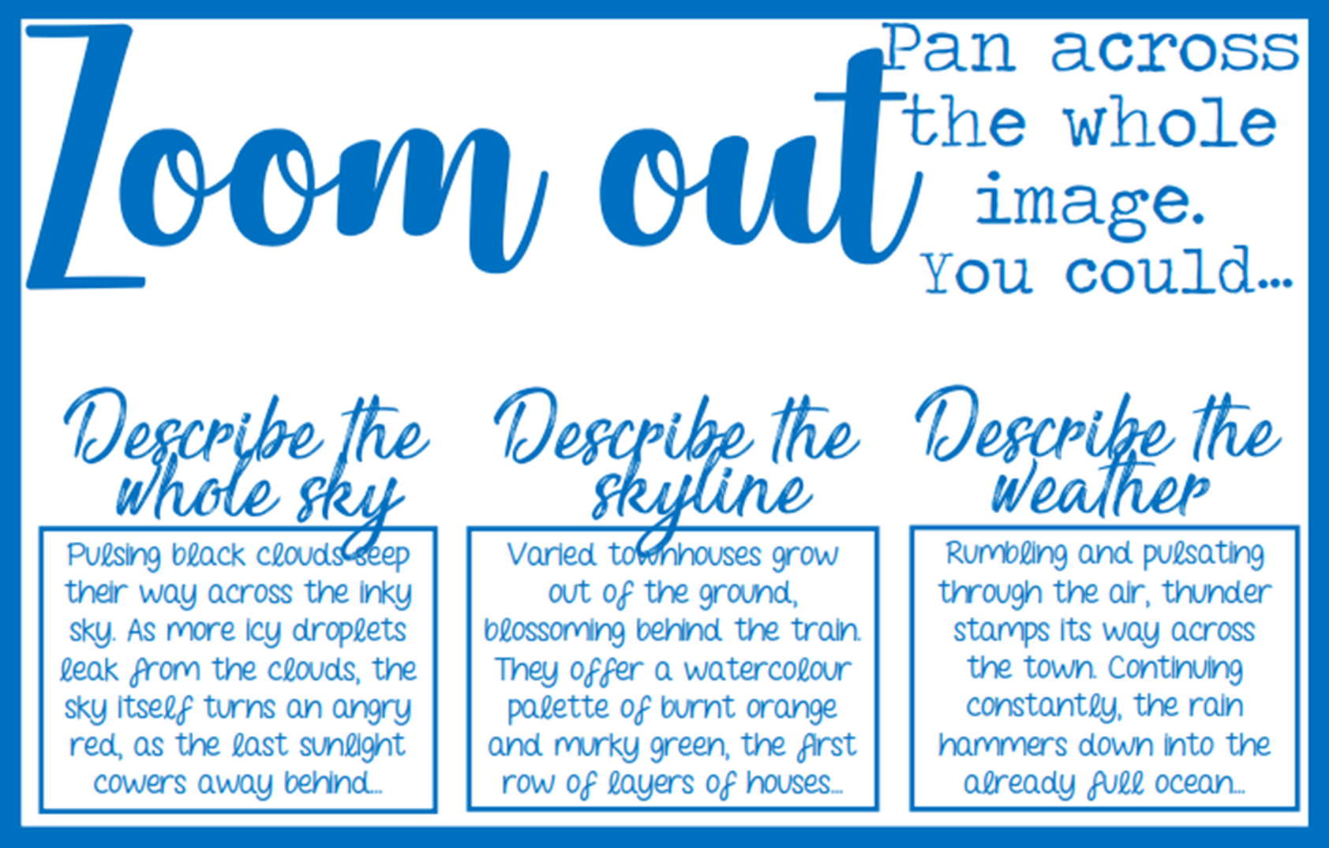
Notes:
Ask students to describe the mood in the scene by describing the weather.
Give them various images of weather in the same place to help build these descriptions.
Get students thinking beyond the picture – a good way to do this is show them drone footage.
Get students to describe different types of light! Give students images with the colour thesaurus resource and get them to build their colour vocabulary.
Build on this using their knowledge of art vocabular: shades, tones, textures.
Get students to use this to describe key “bigger images” – sunset/sunrise, city skylines, canopies of forests and horizons on beaches.

Slide 47
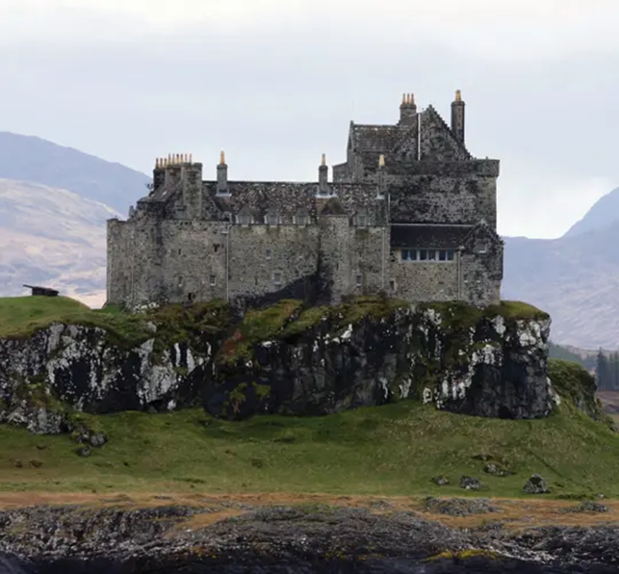
Q5: Write a description of an ancient building inspired by the image.
ZOOM OUT

Slide 48

Watch the drone footage and jot down a list of things you could ‘zoom out’ and describe
Zoom
Out
different types of light

Slide 49
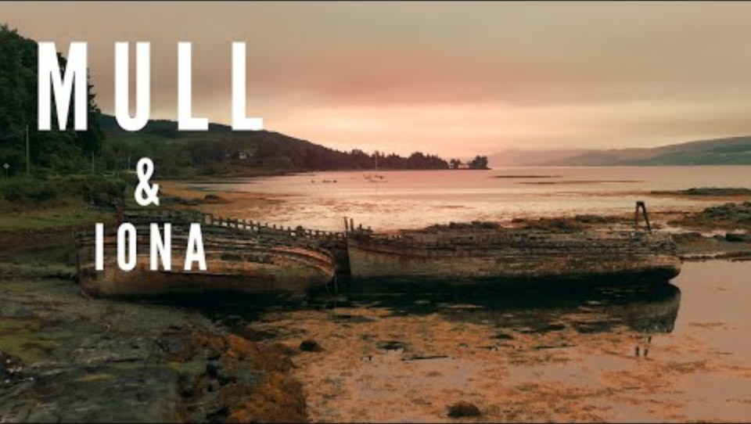

Slide 50

Q5: Write a description of an ancient building inspired by the image.
ZOOM OUT:
In the distance, the surrounding mountains rise above the castle, their slopes marked by shifting tones of plants, rock and mist. Like a blanket, the mist clings to the mountains in soft, trailing veils, wrapping the slopes in a shifting, ghostly shroud. It gathers thickly in the valleys and hollows, blurring the line between land and sky, while higher peaks loom faintly through the haze. Their outlines muted and uncertain. The sky - broad and often restless - is overcast, painted in pale shades of heather grey and pearlescent white. Soft, diffused light filters through the clouds, enhancing the castle’s austere silhouette. Cloud cover appears thick and tenacious in some areas but lighter in others; hinting hopefully at patches where the sky might briefly be broken by the stubborn sunlight.

Slide 51
What can you zoom out on?

Slide 52
Sombre
Lightless
Obscured
Depraved
Vicious
Sinister
Malevolent
Hellish
Apprehension
Macabre
Ominous
Haunting
Bleak
Skeletal
Gaunt
Howling
Crackling
Rotting
Starless
Devoid
Write your ‘zoom out’ paragraph.
Write one paragraph
Describe the weather, light and sky
Vary your sentences
Language devices
Ambitious vocabulary
Ambitious punctuation
Personify the unexpected
Proofread – check grammar

